Slide 1
Diffusion Model

Slide 2
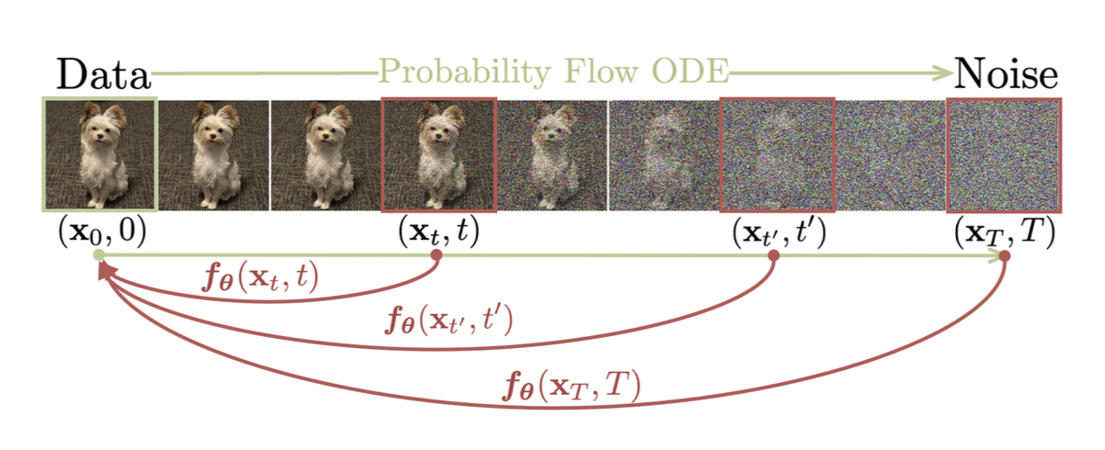
Song et al., 2023

Slide 3

Diffusion Model
Learn the noise $ε$ of process.
Expect a probability distribution through noise
$$ℒoss= 𝔼x0,ε , t \left\|ε_{θ}(x_{t},t)− ε\right\|2$$
Predicated Noise from model
Ground Truth noise

Slide 4




$$x_{t+1}= \sqrt{α_{t} } x_{t} +\sqrt{1 −α_{t}} ∗ε$$
def add_noise(x, t, alpha_hat):
alpha_t = alpha_hat[t]
alpha_t = alpha_t.view(-1, 1, 1, 1)
sqrt_alpha_t = torch.sqrt(alpha_t) sqrt_one_minus_alpha_t = torch.sqrt(1 - alpha_t)
noise = torch.randn_like(x)
noisy_x = sqrt_alpha_t * x + sqrt_one_minus_alpha_t * noise
return noisy_x, noise
$$\sqrt{α_{t}}$$
$$\sqrt{1−α_{t}}$$
$$ε$$

Slide 5

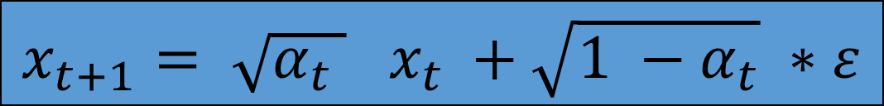
$$x_{t+1}= \sqrt{α_{t} } x_{t} +\sqrt{1 −α_{t}} ∗ε$$
If we select to decrease over time (t): $$α=\left[1:0\right]$$
Then the noise will increase over the time

Slide 6


for epoch in range(epochs):
model.train()
total_loss = 0
for imgs, _ in loader:
imgs = imgs.to(device)
t = torch.randint(0,timesteps, (imgs.size(0),),device=device)
noisy_imgs, noise = add_noise(imgs, t)
predicted_noise = model(noisy_imgs,t)
# loss
loss = criterion(predicted_noise,noise)
optimizer.zero_grad()
loss.backward()
optimizer.step()
total_loss += loss.item()
avg_loss = total_loss / len(loader)
random (t) for each image
$$ε$$
$$\hat{ε}$$

Slide 7
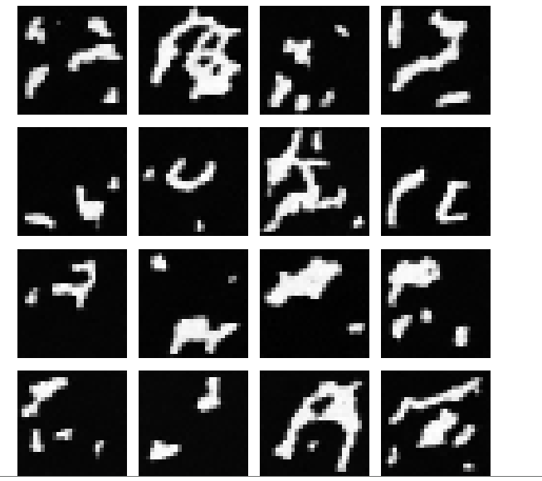
Model Results after 20 epochs ~ 64 minutes

Slide 8

Pre-trained Model
import torch
from diffusers import DDPMPipeline
model_id = "google/ddpm-cifar10-32"
pipe = DDPMPipeline.from_pretrained(model_id)
pipe = pipe.to("cuda" if torch.cuda.is_available() else "cpu")
# Set random seed (controls noise)
generator = torch.Generator(device=pipe.device).manual_seed(0)
# Generate image from pure noise
image = pipe( batch_size=1, generator=generator,
num_inference_steps=100
).images[0]
image.save("imge.png")
after ~ 1 minute

Slide 9
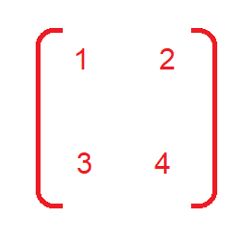
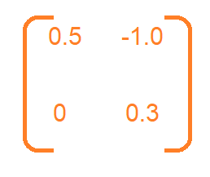
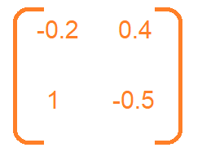
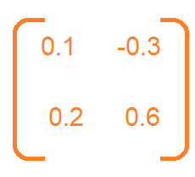



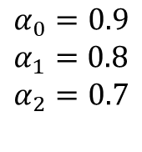

Example
$$x_{0}=$$
$$α_{0}=0.9$$
$$α_{1}=0.8$$
$$α_{2}=0.7$$
$$ε0$$
$$ε1$$
$$ε2$$

Slide 10
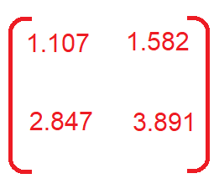
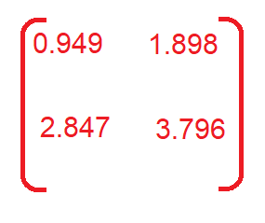
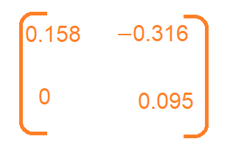


$$x_{1}= \sqrt{0.9 } x_{0} +\sqrt{0.1 } ∗ε_{0}$$
${x_{1} = 0.949 ∗ x}_{0} + 0.316∗$ $ε_{0}$

Slide 11
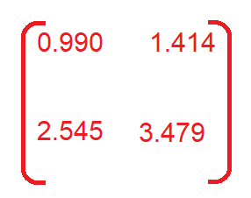
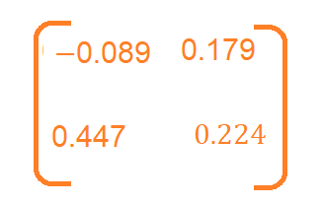
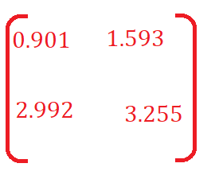
$$x_{2}= \sqrt{0.8 } x_{1} +\sqrt{0.2 } ∗ε_{1}$$
${x_{2} =\text{0.894}∗ x}_{1} +\text{0.447 }∗$ ${ ε}_{1}$

Slide 12
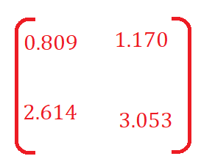
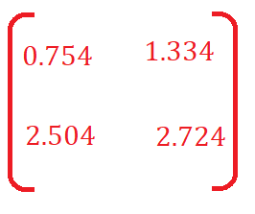
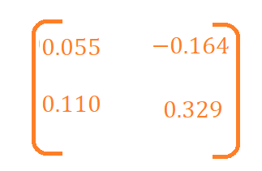
$$x_{3}= \sqrt{0.7 } x_{2} +\sqrt{0.3 } ∗ε_{2}$$
${x_{3} =\text{0.837}∗ x}_{2} +\text{0.548}∗$ ${ ε}_{2}$

