Slide 1

Documentation
Application for analyzing basketball players.
Made by:
Polishchuk Alexander 232-2
Ivanov Alexey 232-2

Slide 2
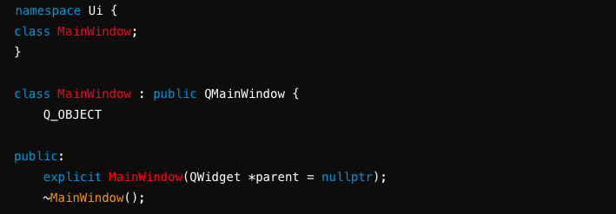
Problem statement.
The main idea of a project is to create an application for easy analyzing of players in basketball team. Application allows users add and delete players from table, also they can upload already existing dataset. And the main functionality is presented by data analysis of game metrics.
Implementation details.
Calss MainWindow is a class inheriting from QMainWindow

Slide 3
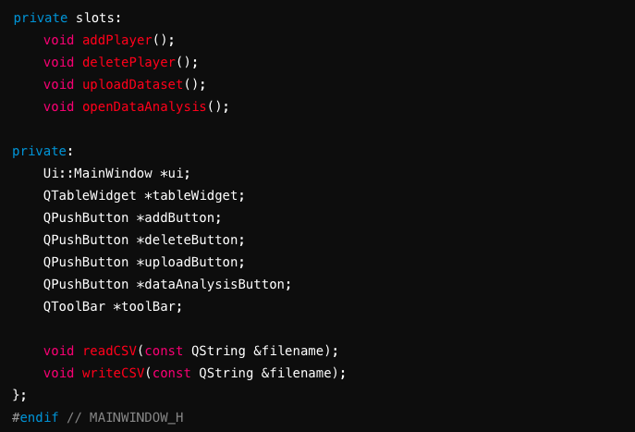
Private slots: Methods that will be connected to signals: addPlayer(), deletePlayer(), uploadDataset(), openDataAnalysis(). Private Members: Pointers to the UI components: tableWidget, addButton, deleteButton, uploadButton, dataAnalysisButton, toolBar. Functions to read from and write to a CSV file (readCSV, writeCSV).

Slide 4
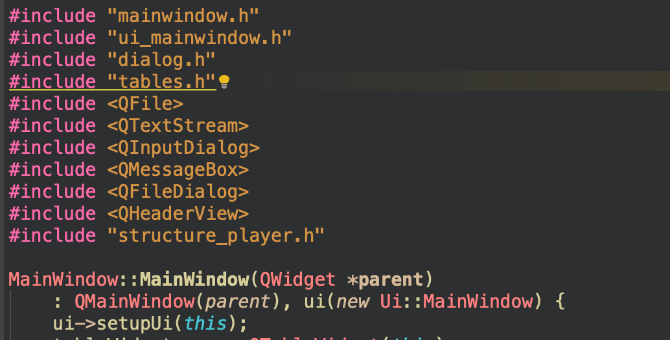
Includes of headers mainwindow and dialog. Also Qt modules was included Initialize the base QMainWindow class with parent, create the ui object, and set up the UI.

Slide 5
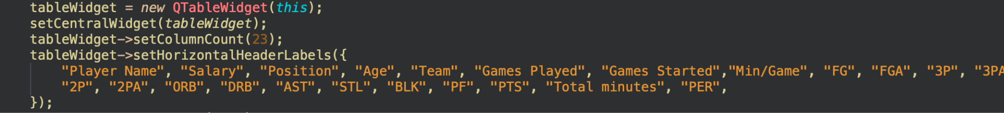
Initialization of a QTableWidget with some parameters.

Slide 6
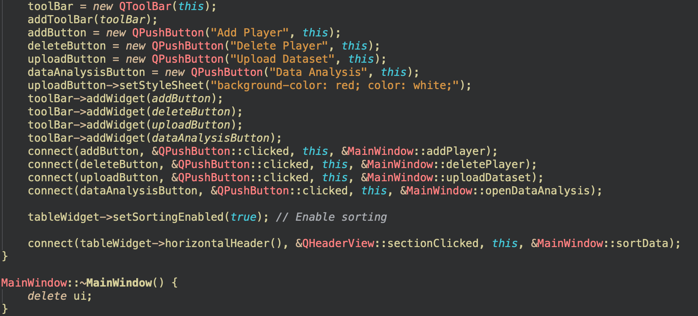
Creating new ToolBar in MainWindow. Then we need to create buttons: “addButton”, “deleteButton”, “uploadButton”, “dataAnalysisButton” and set their texts, also we need to add them to toolbar. Then we need to connect the clicked signal to button.

Slide 7
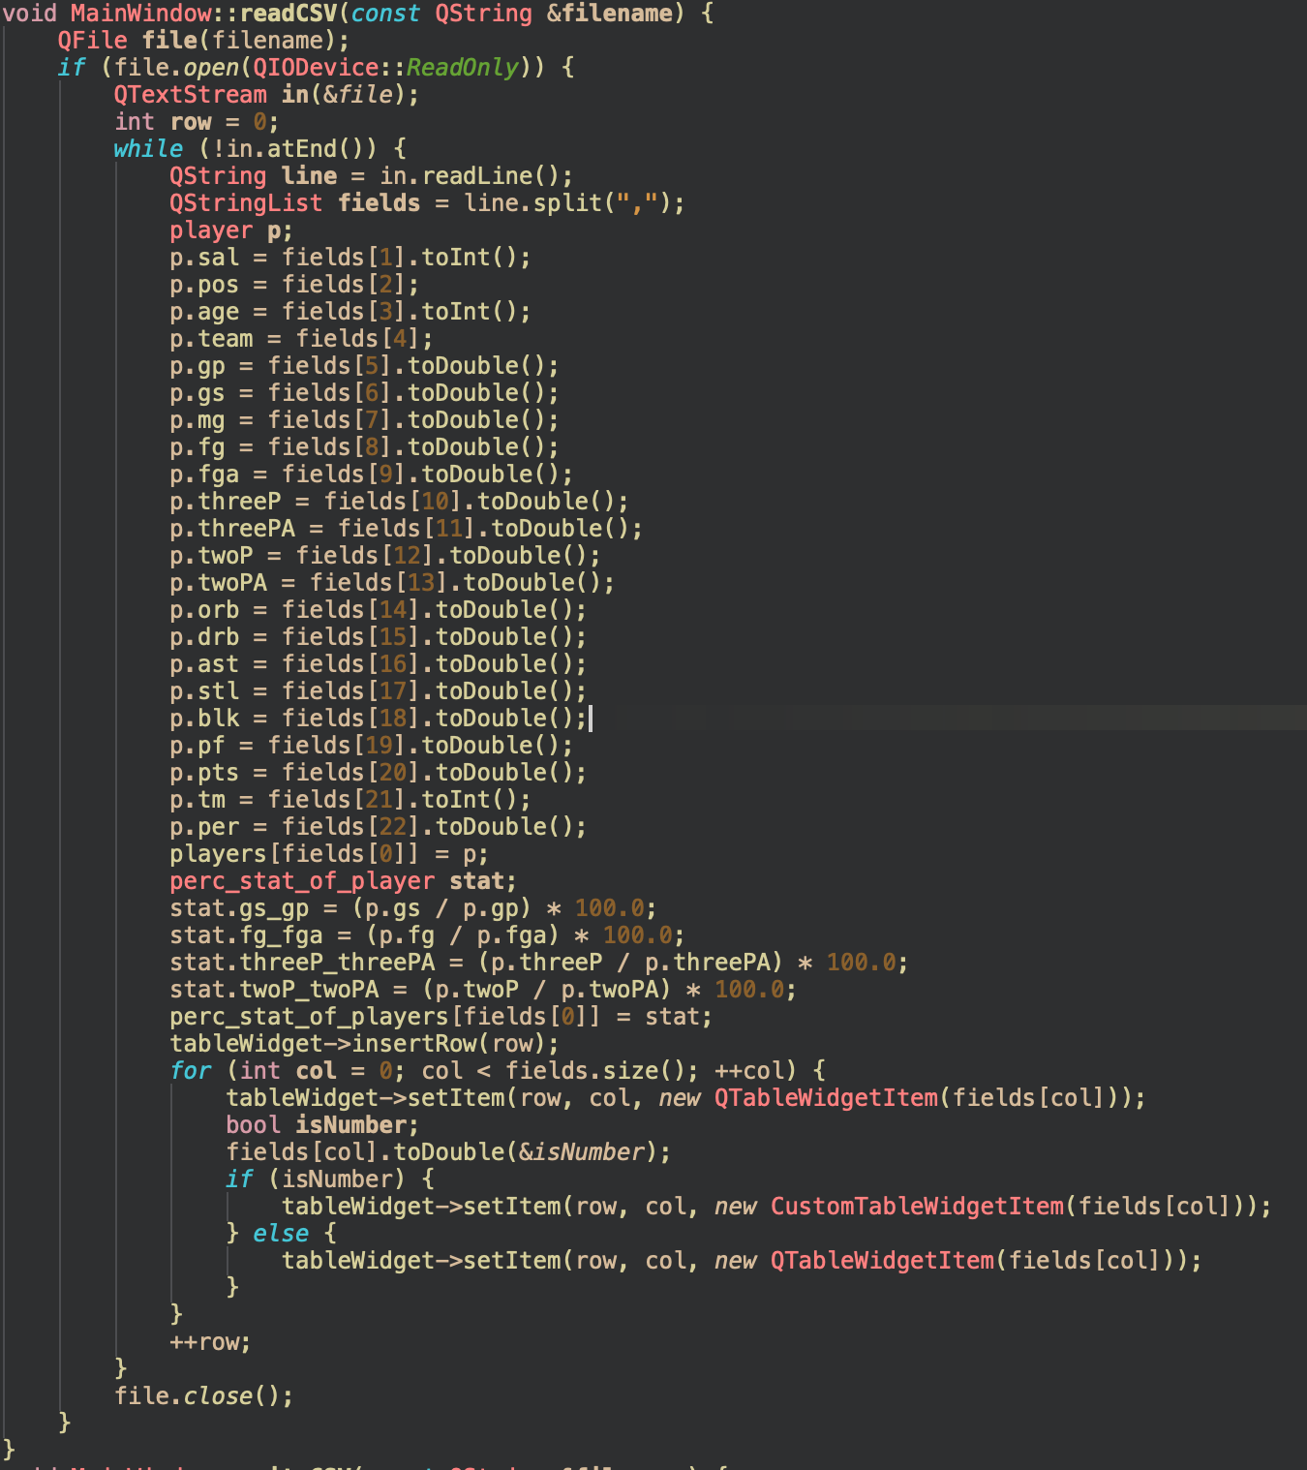
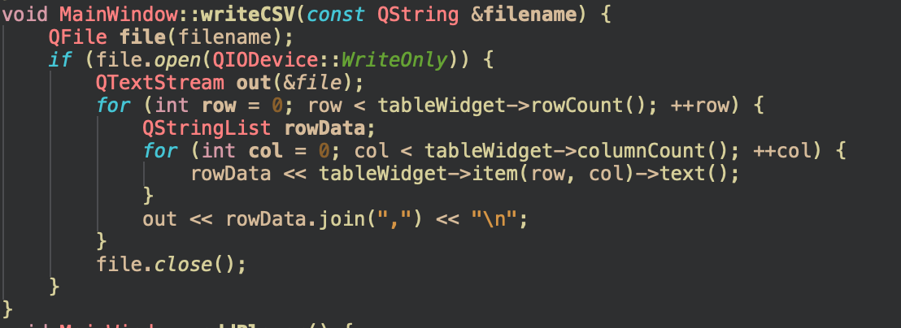
Then we are needed to read our file and write to TableWiget

Slide 8
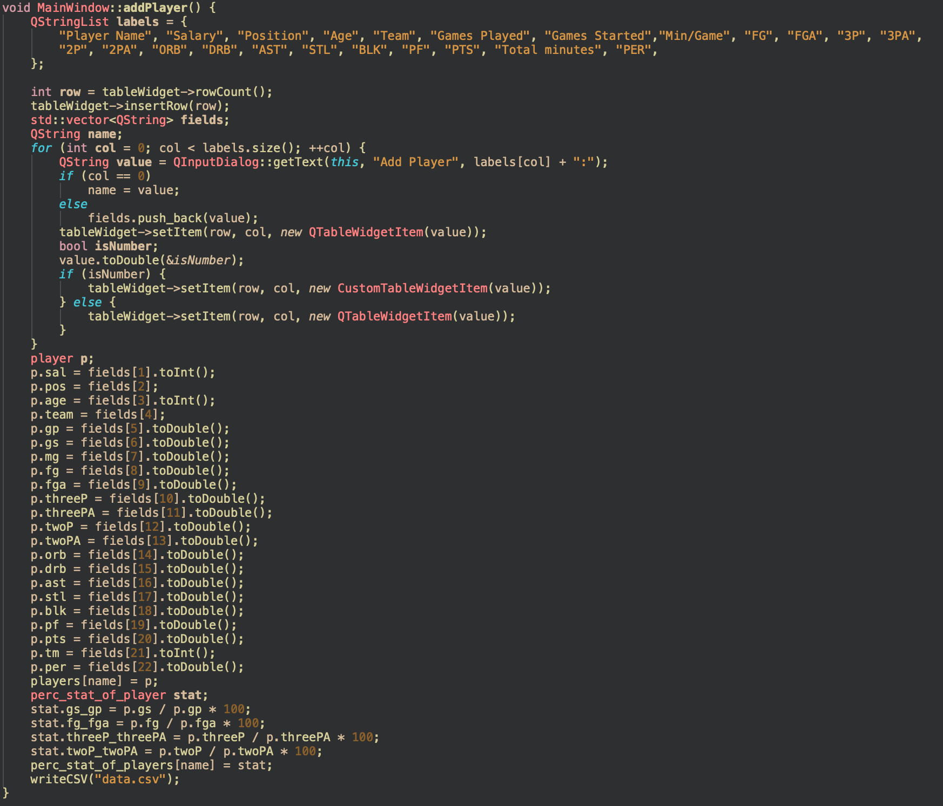
Function addPlayer which add player to table if user wants to add it manually

Slide 9
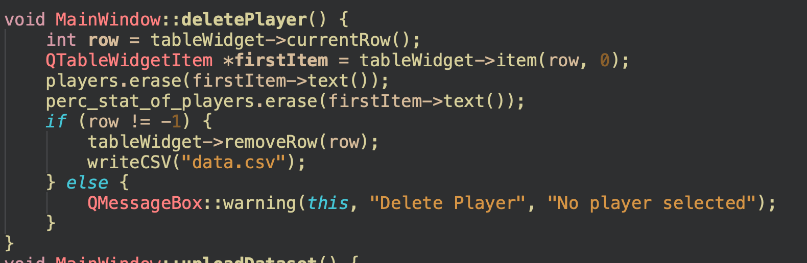
Function deletePlayer which removing selected player from dataset, and answers “No player selected” if user has not selected it.

Slide 10
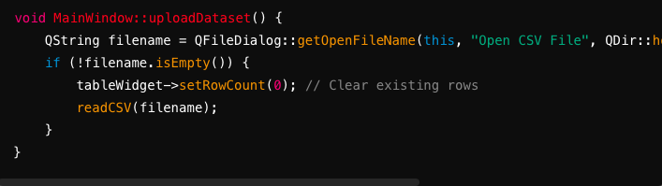
Function uploadDataset which takes file and add it to table

Slide 11
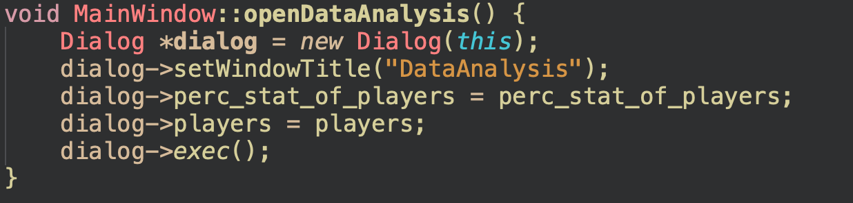
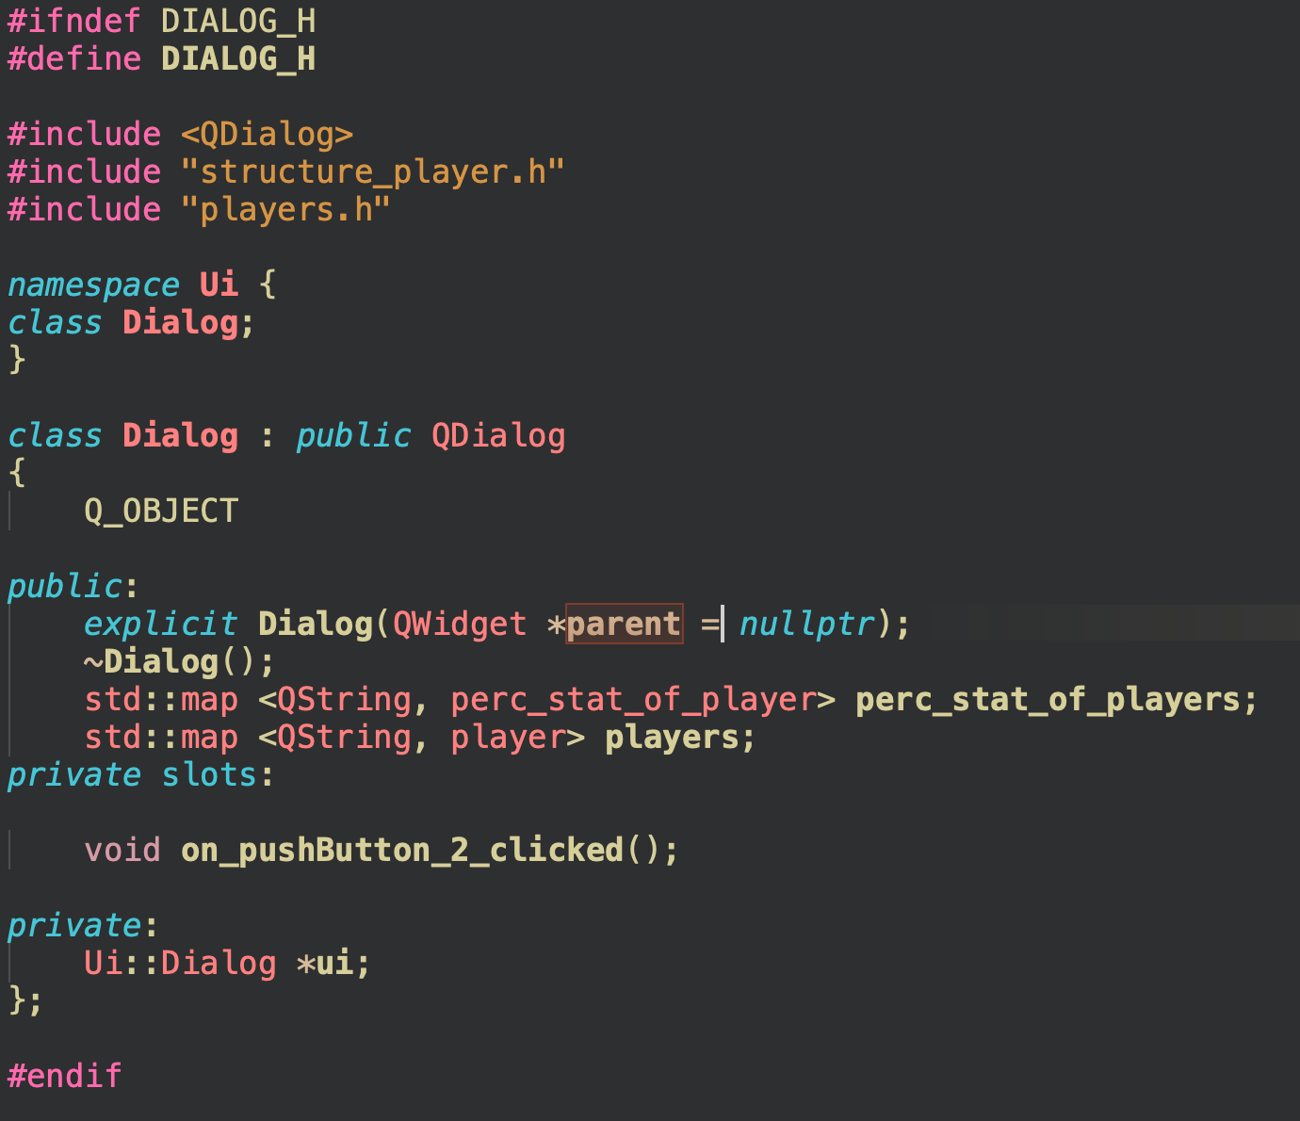
Function for opening dialog window with data analysis
Constructor/Destructor: Declares the constructor (explicit Dialog(QWidget *parent = nullptr)) and destructor (~Dialog()) for the Dialog class.

Slide 12
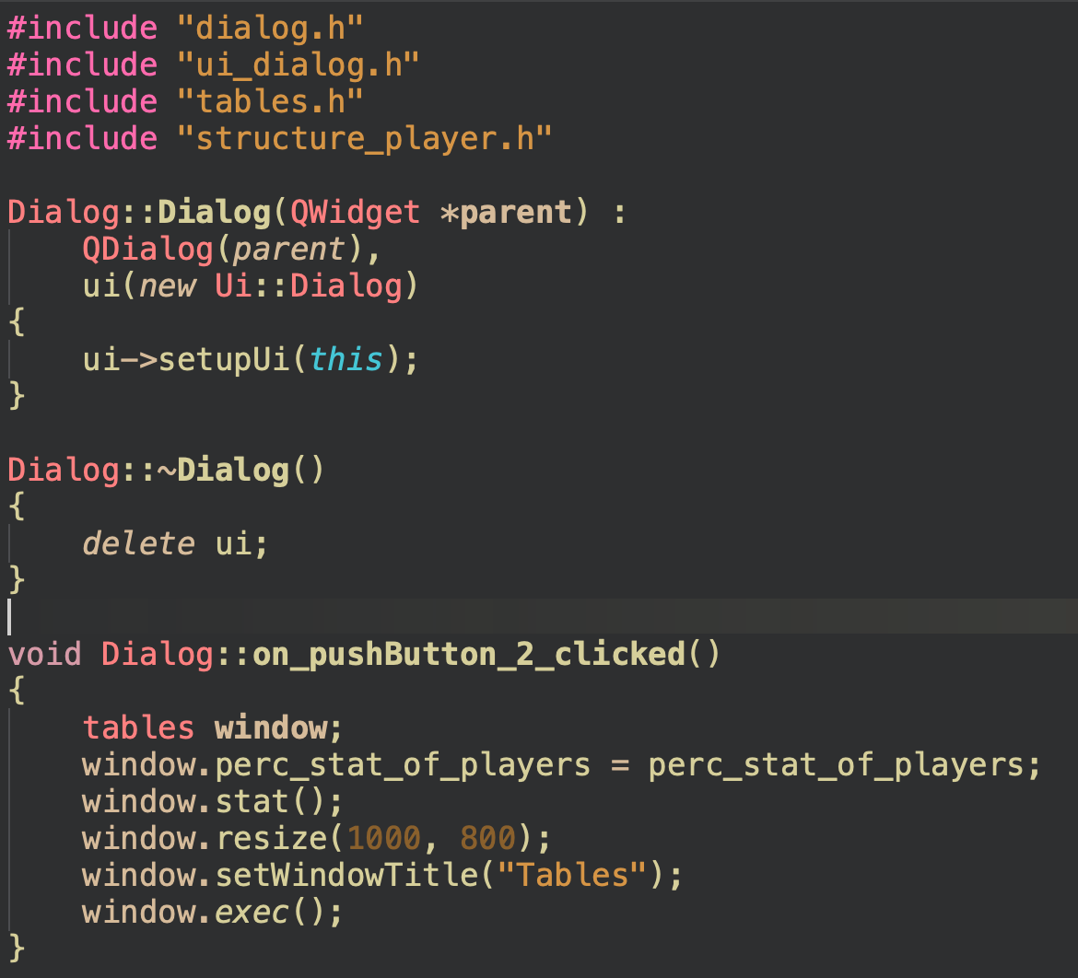
Initialize the base Qdialog class with parent, create the ui object, and set up the UI.

Slide 13
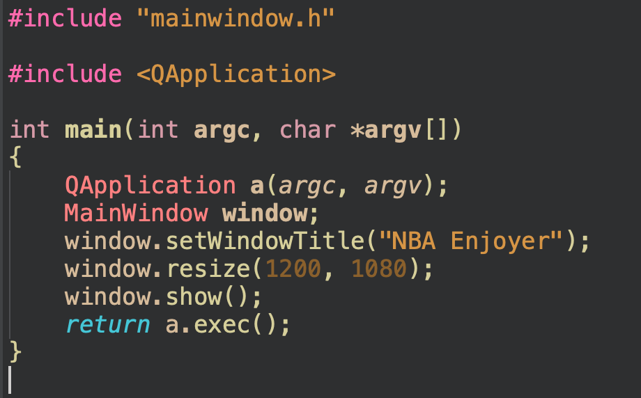
mainwindow.h: Header for the MainWindow class. QApplication: Provides the application object.

Slide 14
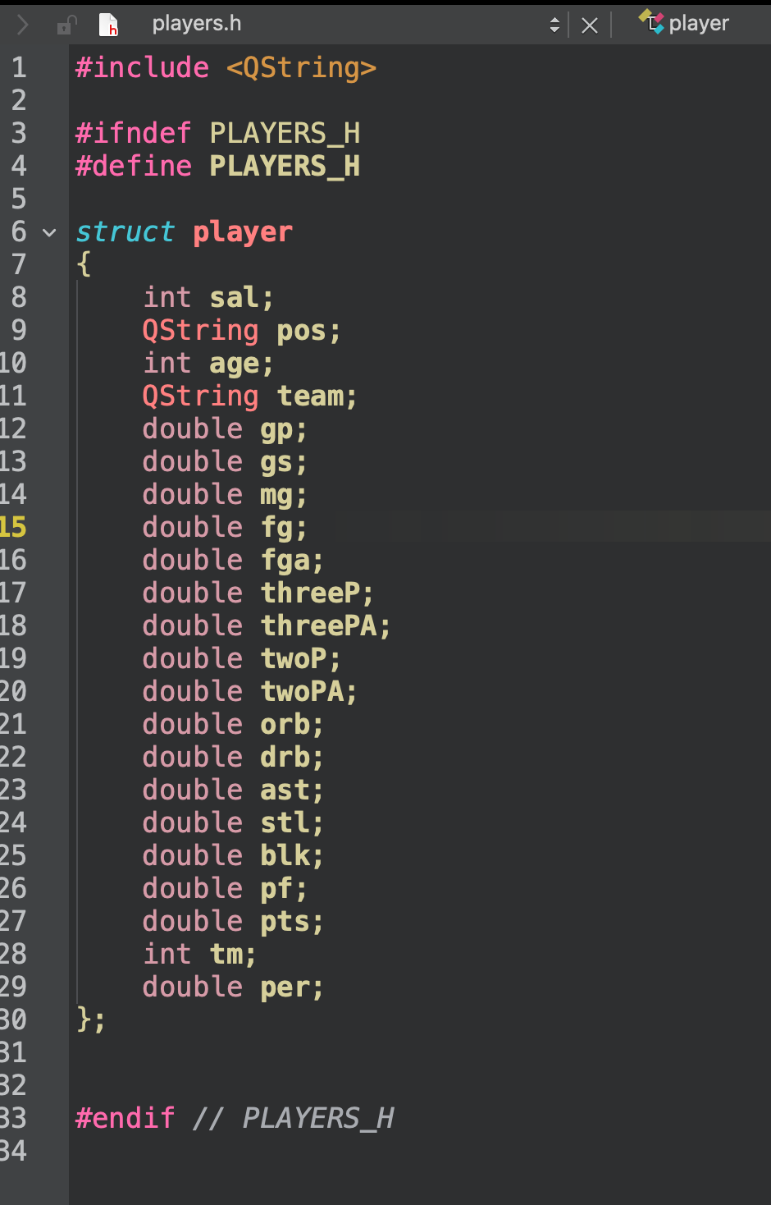
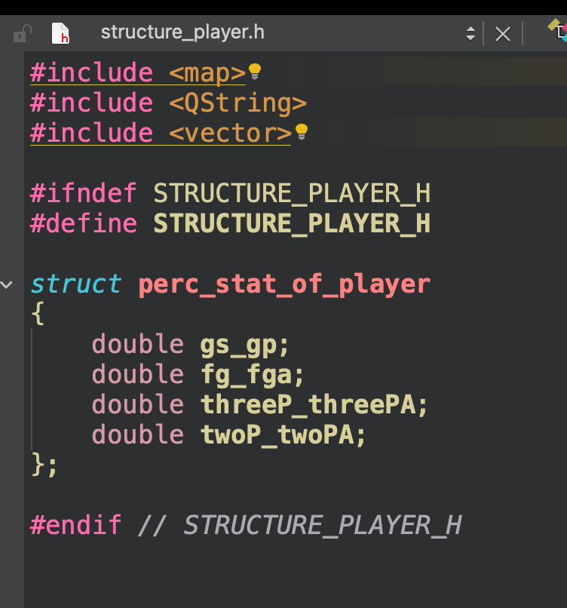
Added structure player and perc_stat_of_player, which used for additional tables and graphics, also easy to add players or delete them

Slide 15
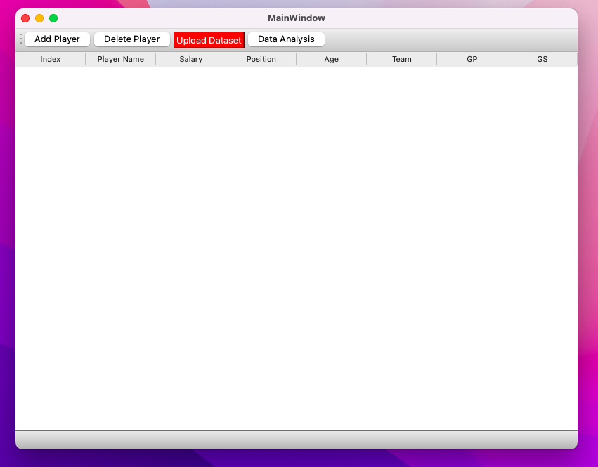
Main window

Slide 16
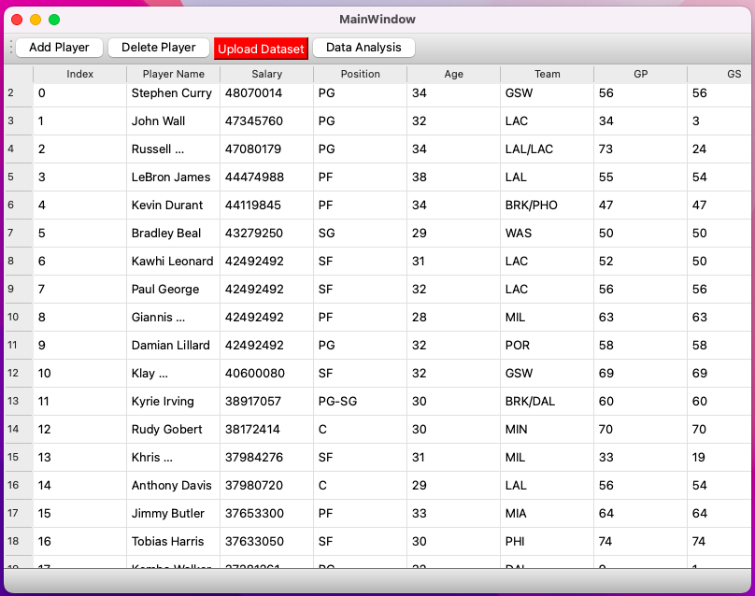
Uploading dataset

Slide 17
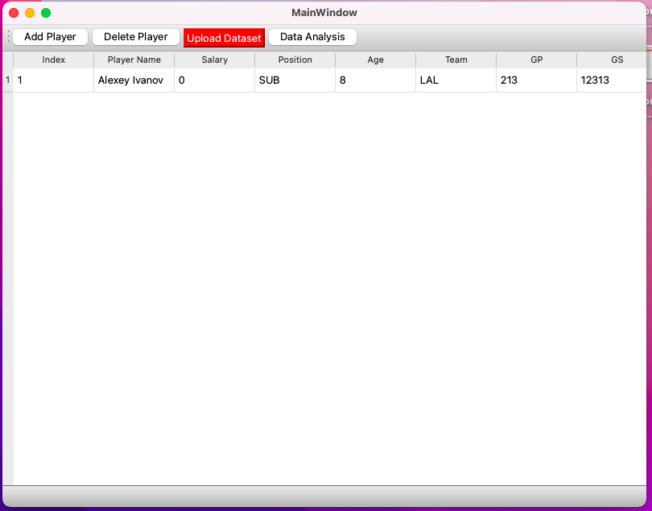
Adding a player

Slide 18
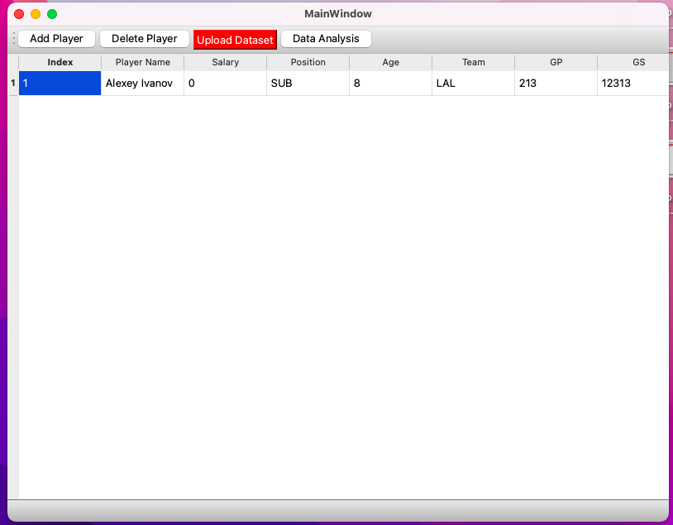
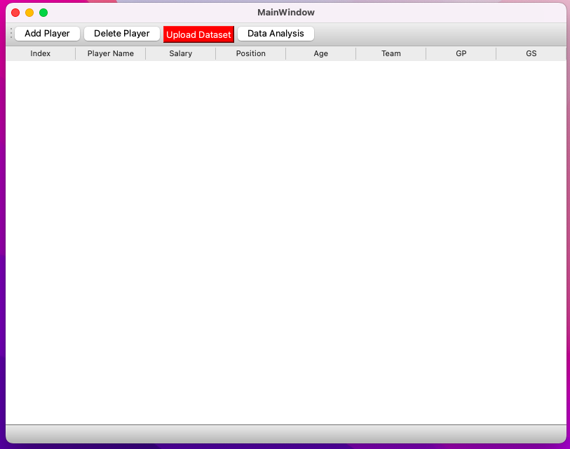
Deleting players

Slide 19
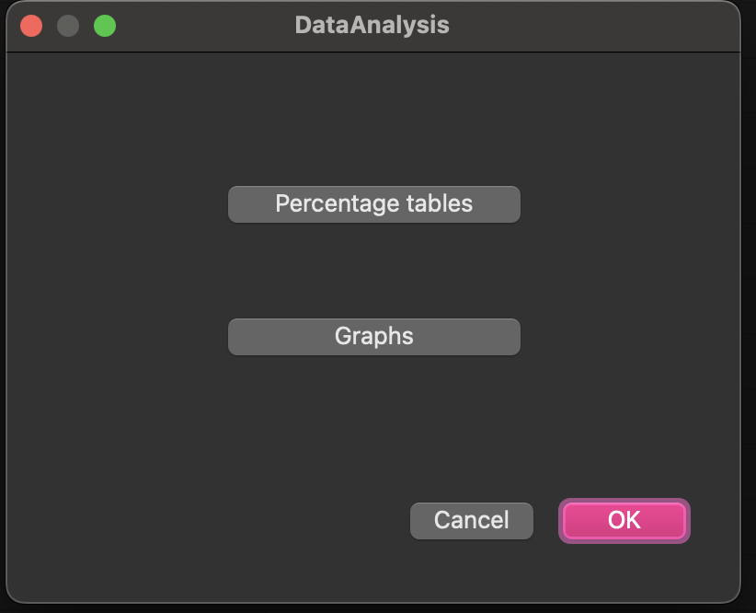
Dialog window

Slide 20
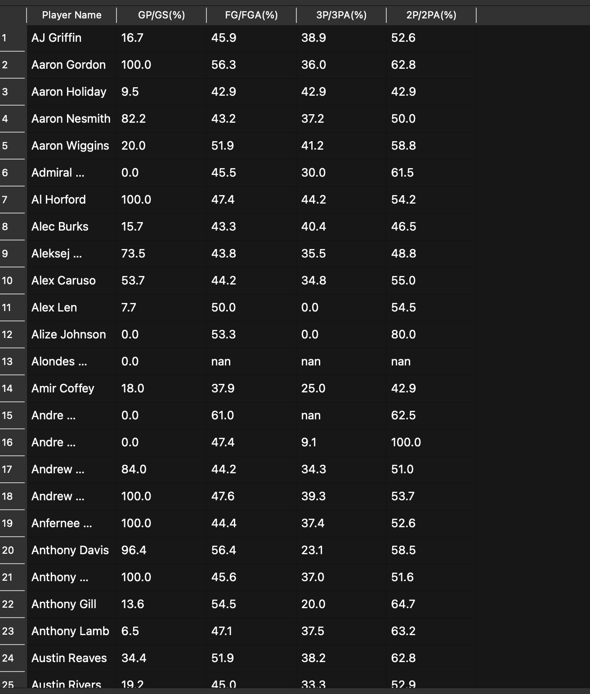
Additional table

Slide 21
Results
The application includes functionalities for viewing, adding, deleting, uploading, and analyzing player data through an interactive user interface.

