Slide 1
Variables
Where Data Goes To Hang Out

Slide 2
Outline
What a variable is not?
Variable analogy
What a variable is.
How do we use them?
Notes:
It is important to have a good and accurate understanding of what a variable is and how they work, particularly when you are just starting your programming journey. Variables are a simple concept but easy to misunderstand, so first we will talk about what a variable is not. Then we will talk about what a variable is and how we use them in programs.

Slide 3
What a Variable is not!
A value that can change? …Nope
Some data? …Nope
A name associated with data? …Not really
Notes:
So let’s talk about what a variable is not. It is not a value. Its not data. Is it a name associated with data? Well that’s only half the story.

Slide 4
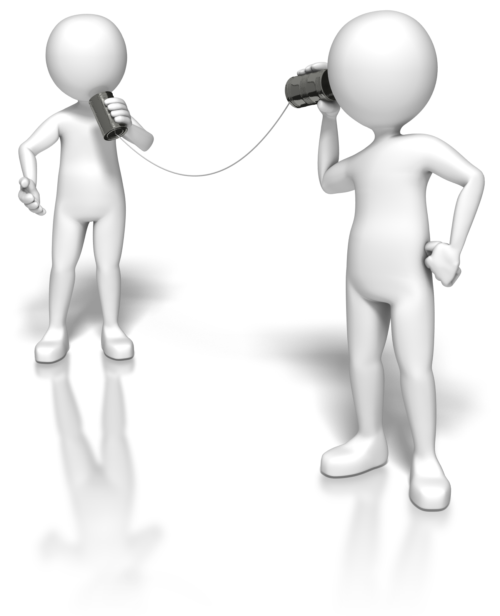
Consider this
What name should I make the reservation under?
Be ready to answer questions!
Smith
I’d like to make a reservation for two
TableForTwo
smith
Notes:
Watch the following and be prepared to ask answer questions about what you see

Slide 5
Riddle me this!
Which two people will be eating dinner?
How big is the reserved table?
How will the diners claim their table?
Don’t know: A variable is not a value!
A table for two: A variable needs to know the size of the data!
smith: A variable needs a label or identifier so you can reference it!
Notes:
So lets think about what we know about this reservation.
QUESTION 1: Which two people will be eating dinner? ---elicit responses from students. One answer to anticipate: “the Smiths” If a student gives this answer. You should respond: “Good! That’s a fair assumption, does that get us any closer to identifying who these people are?”--- -CLICK FOR NEXT ANIMATION- The answer is we don’t know, because a variable is not a value. This is important… In programming terms, a variable is not a value! We only know that they are people and they share a very common name with many other people, so we can’t identify who these people are. But we do know the last name they use, we might call this a datatype!
QUESTION 2: How big is the reserved table? ---elicit responses from students--- A table capable of seating two people. Depending on what language you are using the translator or compiler needs to determine how much space in memory to reserve for the various values it might receive.
QUESTION 3: How will the diners claim their table? ---elicit response from students--- The name “Smith” is attached to the reservation so the the diners can identify which table is the one they reserved. In the machine the program will store a reference or memory address of the variable, but programmers need a better way to reference the variables they want to use, so we assign common name for like “myInt” for convenience.

Slide 6
So What Is A Variable
A Variable is a space in memory reserved to hold values of a certain type, with a name so it can be referred to later in programming.
We can assign a value to a variable using an assignment operator.
We may re-assign a different value any time we want, but the variable stays in the same place with the same name.
Notes:
Now we are ready to discuss what a variable is. A variable is a space in memory reserved to hold values a of certain type. This space in memory has a name so we can refer to it later in the code. We can assign a value to a variable using an assignment operator. We can assign a different value to that space in memory any time we want; however the variable name stays in the same place and has the same name.

Slide 7

A Non-Typed Variable (Python)
Python is a scripted, non-typed language
Datatype is determined when the translator reads it
Variable Name
Assignment Operator
Value
Notes:
A non-typed variable does not require the programmer to state the type of data that the variable stores. Scripted languages like Python use translators to read one line of code at a time while running the program. This translator can determine what type of data is being assigned to the variable and requisition the necessary space in memory to store the values assigned to the variable. It is important here to note the terminology programmers use here. The two horizontal lines used here is refer to as an assignment operator. We can also use an equivalency operator --some time called a comparator– to test whether two variables have the same value. Often the equivalency operator is denoted by two equal signs: ==.

Slide 8
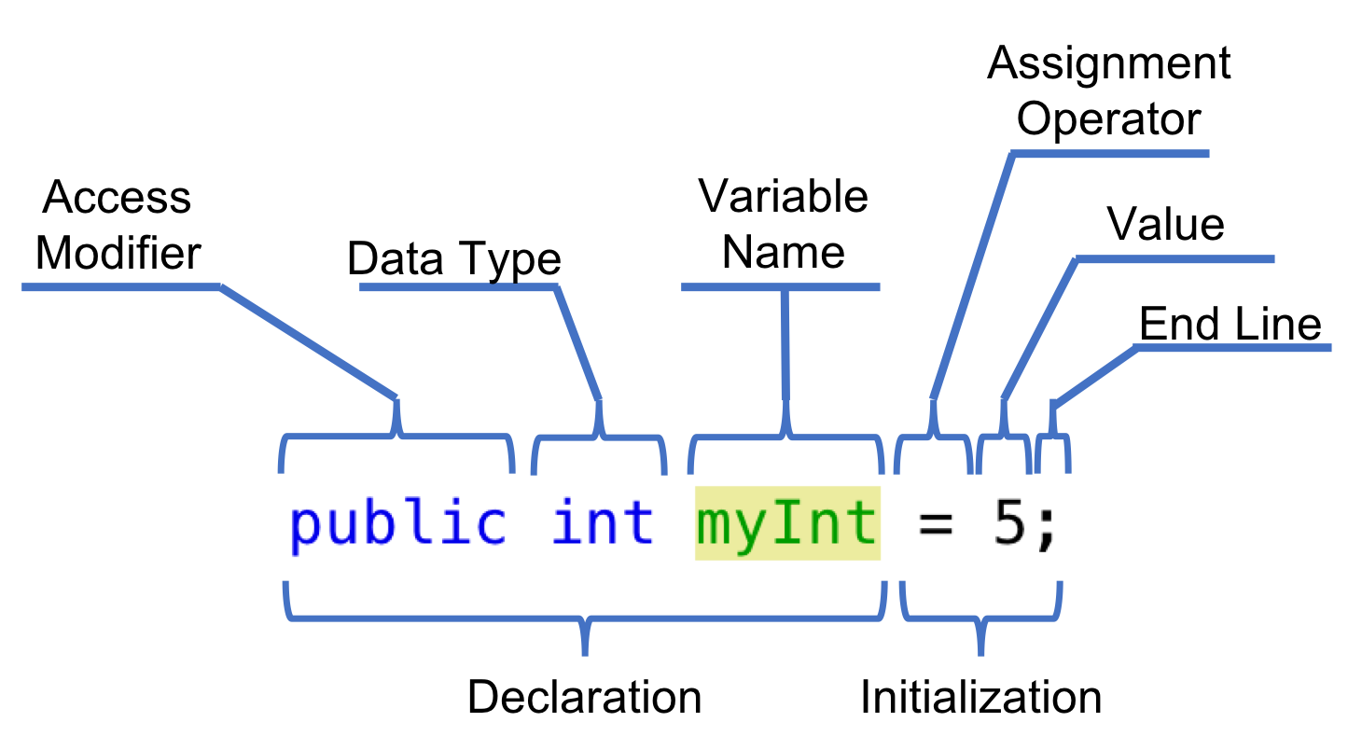
A Typed Variable (Java)
Java is a Compiled, Type Language
Datatype must be declared explicitly
Notes:
A scripted language uses a translator to read English-based code line by line and convert it into machine code in real time while running the program. So if we can think of a scripted language reading a book line by line following the instructions while running the code, a compiled language has already read and memorized the entire book before the program even starts. A complied language converts the English-based code into a bytecode which can then be executed. Since a compiled language must convert the code into bytecode before running the program, the compiler needs to know how much memory to allocate for each variable. Therefore, the programmer must explicitly state the type of data each variable will hold, because datatypes require different amount of memory.

Slide 9
Variable Datatypes
Declaration | Common Name | Example | Data Size
int | Integer | 5 | 4 Bytes
char | Character | ‘a’ | 2 Bytes
String | String of Characters | “abcdef” | Uses Dynamic Memory
boolean | True or False | true | 1 Byte
Notes:
Variables can be used to store and refer to many different types of data and/or data objects. Some of the most common datatypes are listed here.

Slide 10
Check Progress
What is a variable?
What’s the difference between a scripted language and compiled language?
What are the parts of a variable?

Slide 11
Let’s try some variables
Open the VariableExercise.py program in Thonny on your STEMBot
Scroll down and locate four variables named leg_1, turn_degrees, turn_direction, and leg_2
Flip a coin out in front the STEMBot
Determine a path to reach the coin.
move forward a certain length
set the direction of the turn
turn a number of degrees
move forward to the coin

