Slide 1
Loops
When Computers Have Deja Vu

Slide 2
Outline
Programming structures
Why Loops?
Iteration
Repetition
Types of Loops
How to write them in Python
Examples in other programming languages
Notes:
Loops are one of the most common programming structures. Loops perform an repetitive operations that can be run a specified number of time or until a condition is false. In this presentation we will why and how to use loops in programs, different types of loops and how to write them.

Slide 3
Program Structures
Perform logical tasks
Shift control between program objects
Perform repetitive tasks
Respond to user interaction
Provide data organization for storage and retrieval.
Much, much, more

Slide 4
Why do we use Loops?
Iteration
Move through an ordered collection of data.
Mapping, moving through a digital representation of a physical environment.
Repetition
Performing some action multiple times.
Continually check sensor data.

Slide 5
Loops
Start
false
END
condition
true
doSomething()

Slide 6
How do we accomplish this.
for loops
foreach loops
while loops

Slide 7
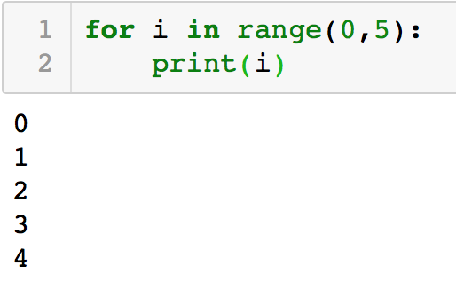
for loop
Index
range function
Min value
-Indexed!!!-
Max value

Slide 8
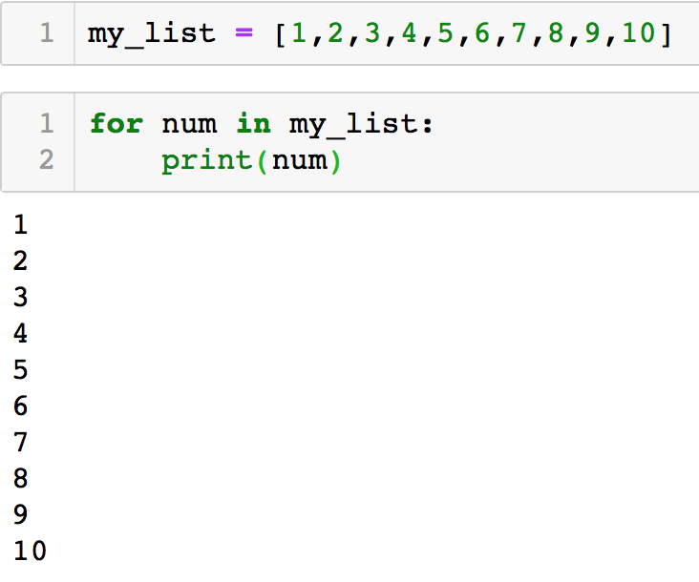
foreach loop
-Not Indexed!-
for each thing in this group of things… dosomething!
Variable
in???
Data
collection

Slide 9
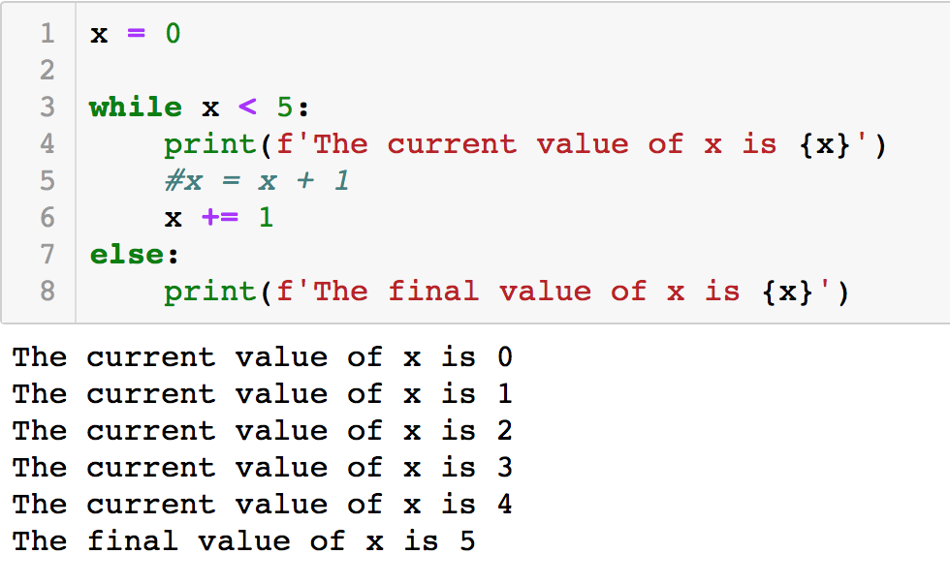
while loop
-Not Indexed!-
repeats an action until a condition is false
can used else for final action
condition

Slide 10
Some loop commands
break
breaks out of (terminates) the current closest enclosing loop
pass
goes to the top of the closest enclosing loop
continue
does nothing at all.

Slide 11
Questions

