Slide 1

Capstone Project
Dilyan Kovachev
AAA Northeast

Slide 2
Background
AAA Northeast is one of the regional clubs comprising the American Automobile Association. It covers Rhode Island, Connecticut, Massachusetts and portions of New York and New Jersey. The American Automobile Association has 58 million members in the US and Canada. They offer services such as roadside assistance, maps and various discounts as part of their services. Roadside assistance is a costly benefit, particularly towing. Members who frequently use roadside assistance are less desirable.
AAA also offers other paid services at highly competitive prices. They also offer insurance, travel and banking/loan products. AAA would like to increase the penetration of these services.
A member may have a standard membership or a premium membership covering themselves and optionally additional household members. Many of AAA members typically have a long tenure with the club.

Slide 3
Objectives
Provide a market segmentation of AAA members (or member households) that will allow AAA Northeast to optimize marketing campaigns and strategies and better serve their members overall. Train ML Regression models to predict the Total Cost that might be associated with acquiring new or existing users in the future.
Use data provided to train “look-alike” (classification) models and use model predictive scores to determine the probability of users for purchasing different FSV products and services.
Use findings from Data Analysis and Model metrics to provide recommendations and help the AAA Northeast team:
Better anticipate the needs of members and promote AAA services and products that are aligned with their profiles
Customize communications and offering to various strategic segments to drive business value for AAA
Expend more effort driving acquisition and renewal of desirable members
Methodology - below are some of the major metrics that we plan to use for EDA and ML to achieve our objectives:
Revenue:
Likelihood to Purchase FSV Products
Length of Tenure / Renewal Rate
Number of members in the household
Level of membership
Total Cost:
Use of roadside service
Frequency of use
Cost to service
Type of Vehicles Owned

Slide 4
Overview of General Approach & Methods Used
Regressors used to predict Total Cost
Linear Regression
Ridge and Lasso Regression (L1 & L2)
DecisionTreeRegressor
2. Classification models for Likelihood to buy FSV Services
Logistic Regression
RandomForest
KNN
3. Clustering Models used for Segmentation
KMeans
Clusters were also used for data exploration and to verify validity of predictive features
Identified Profiles of users likely to become very costly to AAA as Customers
Identified Profiles of users are likely to Purchase FSV Products
4. EDA, Feature Engineering & Preprocessing
Pair-plots and Correlation Matrices
Recursive Feature Elimination (RFE)
Turning Categorical Features into Dummies
Turning Features that were strings in original data to numerical (ex. Income, Credit Ranges)
Cross-Validation (KFolds 5 & 10)
Minmax and Standard Scalers
SMOTE & Down-sampling of Class Imbalances

Slide 5
Part 1
Focus on EDA and ML approaches to predict the Total Cost to AAA for a Specific Household
Use findings to recommend marketing strategies and pricing optimizations to AAA Northeast

Slide 6
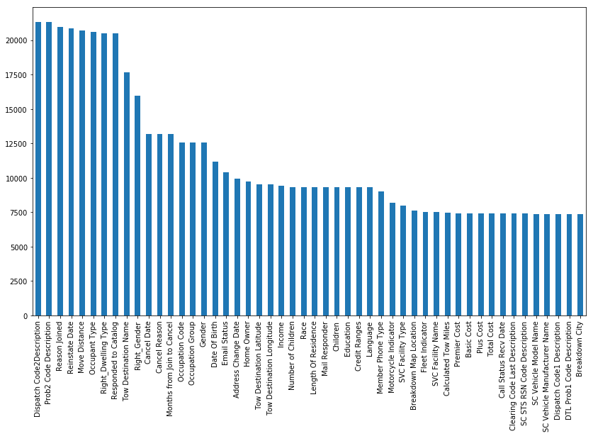
EDA & Feature Engineering
This was one of the most important parts of this project where I was able to uncover data correlations and insights that guided the rest of my process
Features with most missing values
First important observation was that there are a lot of metrics in the data with missing values
EDA was necessary to filter out the noise in the data and decide which features we want to keep for final predictive modeling
Used a combination of Clustering, Correlation Pairplots, Correlation Matrices, and Running Basic Regression Models with Recursive Feature Elimination and looking at the coefficients of the predictive features to uncover the data that might be most valuable to our future analysis

Slide 7
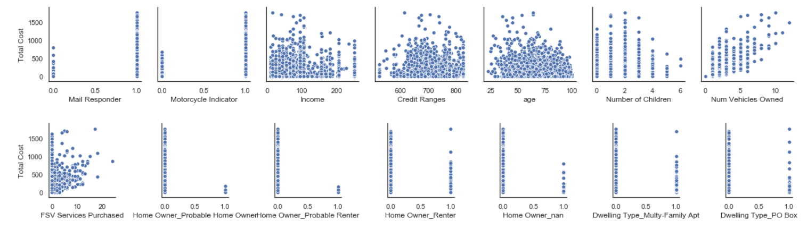
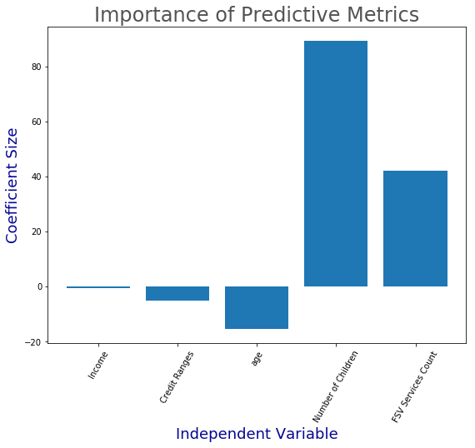
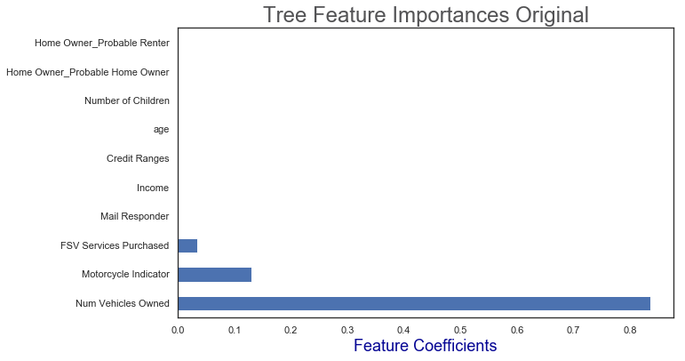
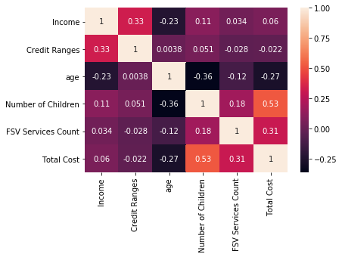
Pair-plots showing relationship between some of the top predictive features and Total Cost
Lasso Regression Top Features
Decision Trees Top Predictive Features
Correlation Matrix of Top Features
Using Regression Models, Correlations and RFE for EDA
Findings
The most important Predictive Features in the Dataset, correlated with Total Cost, were extracted by running a number of Regression Models and Decision Trees and collecting the top predictive features from the best performing models
Top Features Related to Total Cost: Motorcycle Indicator, Number of Vehicles in Household, Number of Children, FSV Product Count, Age, Credit Ranges, Income, Mail Responder, Home Owner, Renter etc.

Slide 8
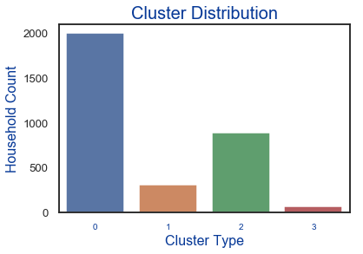
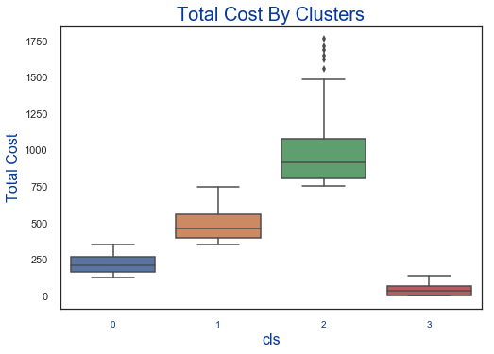
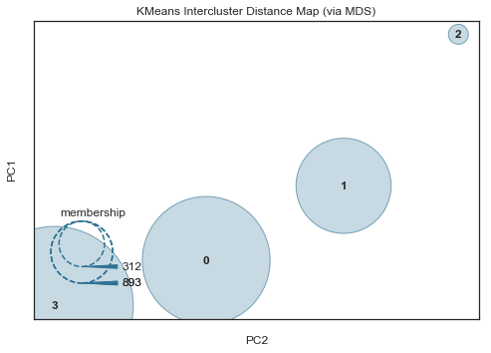
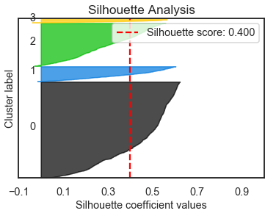
Fig. 2
Using KMeans Clustering for EDA and Insights
Findings
Metrics such as Elbow Method, Silhouette Analysis and Plotting Inter-cluster Distances were used to optimize the model to 4 distinct clusters
Clusters 1 and Cluster 2 contained the majority of households with higher than average Total Cost as seen in Figure 2
The Next Step was to zoom in on Cluster 1 and Cluster 2 and find features associated with those households that were distinctively different in terms of AVG magnitude, compared to the the rest of the AAA customers in the dataset
Doing a deeper dive into the features correlated with Total Cost per household, identified in our prior analysis such as Number of Children, Age, Number of Vehicles, FSV Services Purchased etc. can further confirm the predictive power of those metrics when trying to estimate the lifetime Total Cost of an AAA Customer / Household.

Slide 9
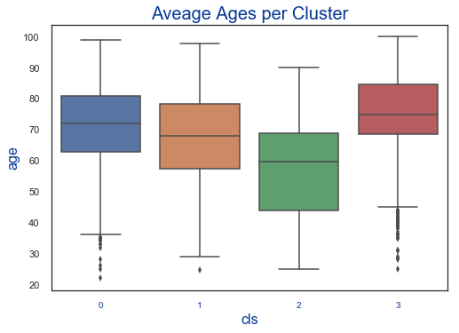
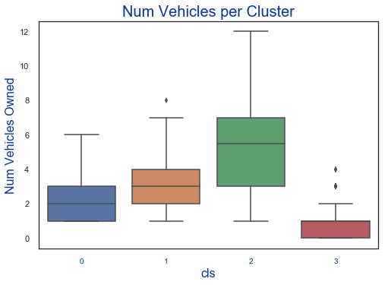
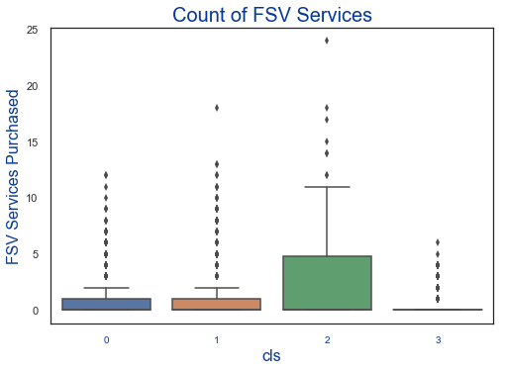
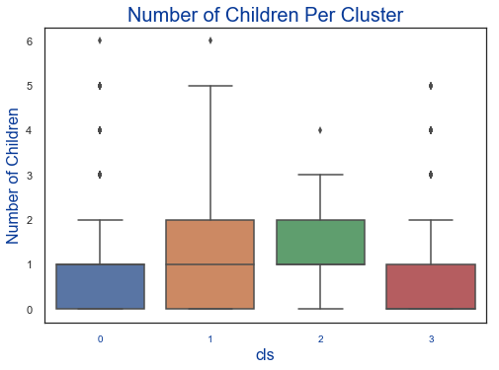
Using KMeans Clustering for EDA and Insights
Findings
Before we look at the graphs to the left let’s remember that Segment 1 and Segment 2 contain most user profiles associated with high Total Cost per Household
The more vehicles in a household, the higher the Total Cost to AAA for servicing that customer
The more children in a household, the higher the Total Cost to AAA for servicing that customer
The lower the average age in the household, the higher the Total Cost to AAA
The more FSV Products that a household is signed up for, the higher the Total Cost to AAA

Slide 10
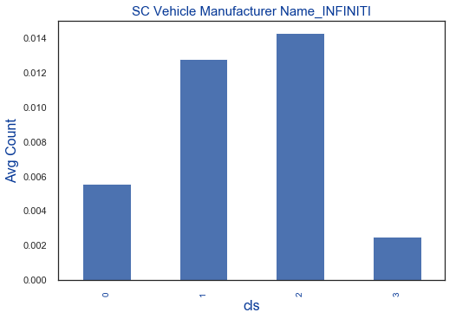
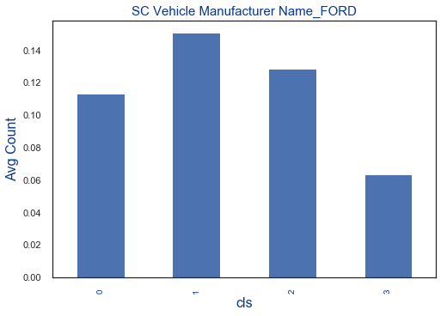
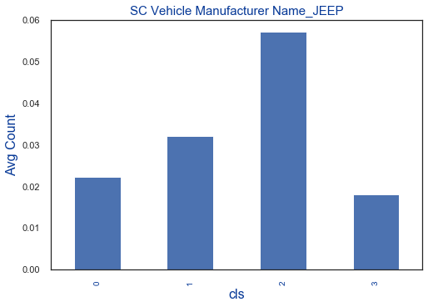
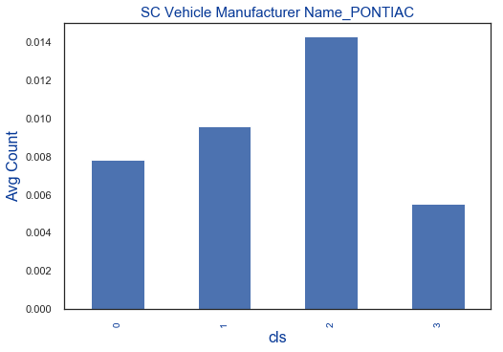
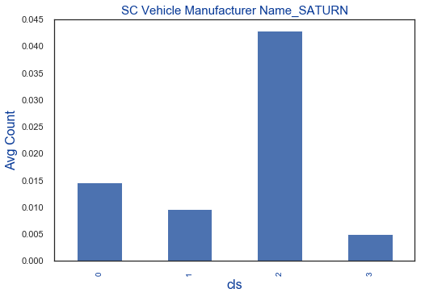
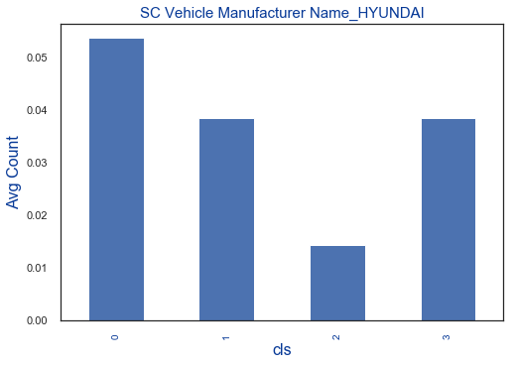
Cheaper car makes such as Hyundai are more prevalent in Customer Segments associated with Lower Cost
Explore Car Makes Owned by Clusters with High Total Cost
Findings
Looking at what types of cars (*excluding motorcycles*) are more prevalent in households associated with higher Total Costs we can start to observe some patterns such as:
Luxury Cars
Sports Cars
Jeeps & 4x4
Older Cars that break more often such as Ford & Saturn
The last example shows cheaper car makes such as Hyundai that are more prevalent in Cluster 0 and 3, associated with Low Cost
***Note: There were a lot more plots made and car makes related to Total Cost explored to confirm this conclusion but top 5-6 graphs were chosen for simplicity of presentation.

Slide 11
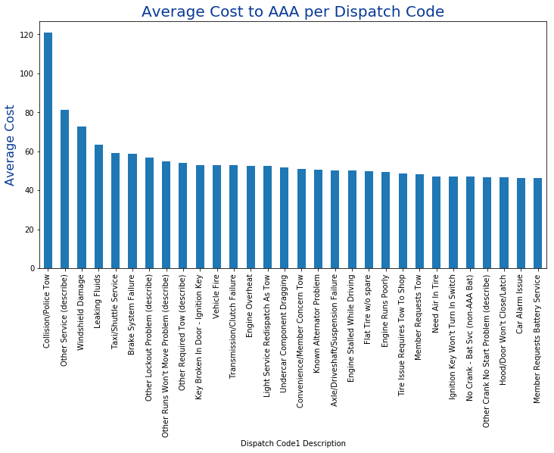
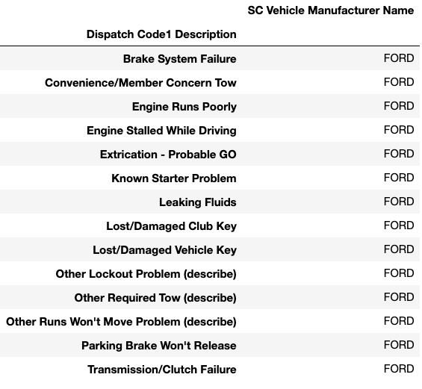
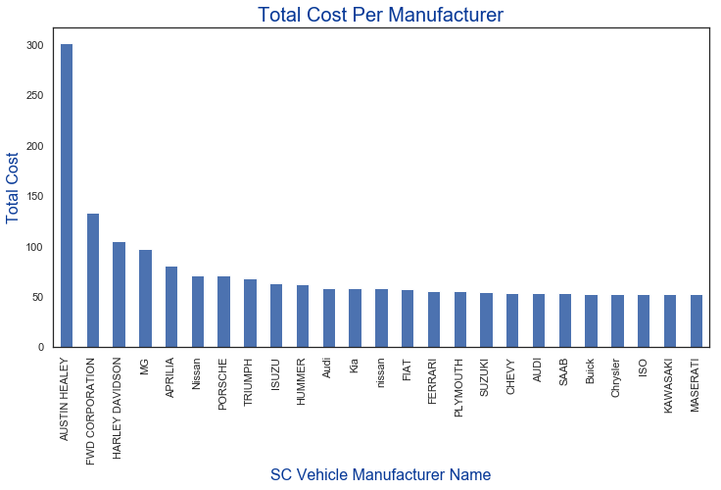
Customer Cluster 1 & 2 associated with high Total Cost own more “FORD”s per household
Explore Total Cost by Service Call and Car Make
Findings
In terms of vehicle models, Motorcycles , Sports Cars, and Luxury Cars are associated with higher Total Cost to AAA
In terms of Dispatch Code, anything involving serious accidents or car damage such as Collision, Police Tow, Windshield Damage, Leaking Fluids, Brake System / Engine Failures and Lockout Problems results in higher Cost
Grouping Data by the more costly Dispatch Codes and the most frequent Car Makes associated with those incidents provide useful insights on which car makes/models break more often or have owners who get into more accidents
One example of a deeper investigation into Car Models showed that FORD is a make associated with lots of incidents associated with high service cost to AAA such as various engine malfunctions, break failures, lockouts, Tows etc.

Slide 12
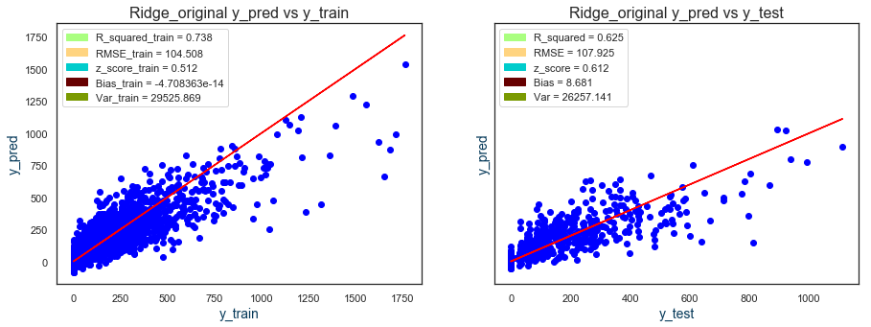
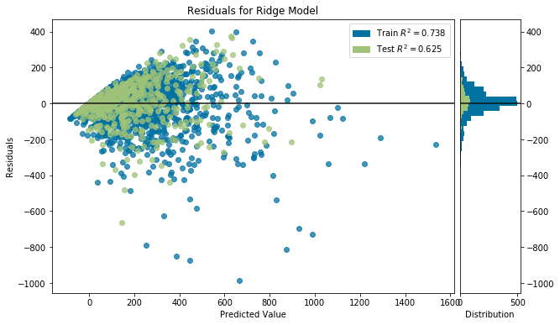
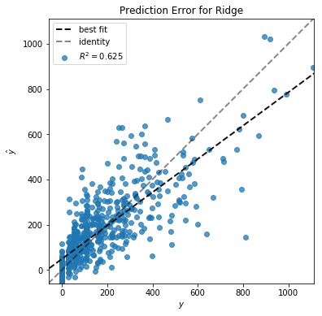
Summary of Regression Model Optimization Metrics and Scores
Findings
Several Regression models were tested and optimized of which Ridge and Lasso Regression with MinMax Scaled features performed best
RFE, Cross-Validation, and MinMaxScaler were used to reduce bias, overfitting and select the features with most predictive values
R2 scores of 0.74 for Training Data and 0.63 for Testing data give us confidence that our model predicts Total Cost 13-24% better than base model that always guesses mean value with R2 = 0.50
RMSE of 107 tells us that on average our model is off by $107 when predicting Total Cost
Z_score of 0.612 for error tells us that on average our model prediction is off by 0.612 standard deviations given the distribution of Total Cost
Model can be further optimized and used by AAA to predict whether new customers are likely to become costly to AAA over time which can guide subscription fee adjustments and renewal offers
Similar metrics for train and test data indicate that our model is not overfitting
Similar metrics for train and test data indicate that our model is not overfitting

Slide 13
Final Recommendations to AAA (Part 1)
Introduce a New Membership Tier with higher yearly subscription and higher service fees for households with Motorcycles, Sports Cars, Luxury Cars, Jeeps and other models associated with higher Total Cost
Adjust Marketing budgets and strategies (special promotions & discounts) to attract customers associated with Lower Lifetime Total Costs to AAA such as:
Households of older average age :: Households with lower number of children / young dependant drivers :: Households of higher average Income :: Households with lower number of Vehicles Owned :: Households with cheaper car makes & models (ex. Hyundai, Toyota, KIA etc.)
Avoid sending special offers and consider only offering Basic Membership to customers such as:
Families with kids & young adults :: customers with lots of vehicles :: customers with motorcycles and sports / luxury cars :: customers of lower income :: customers with lower Credit Scores
Regression model can be used to predict future Total Cost of new customers, once AAA collects some data, which can guide subscription fee adjustment over time and subscription renewal offers and rates

Slide 14
Part 2
Use Classification Models to build “look-alike” segments of customers likely to buy various FSV Products & Services
Use findings to recommend optimal marketing strategies and improve customer communication towards getting existing customers to buy more AAA products and services

Slide 15
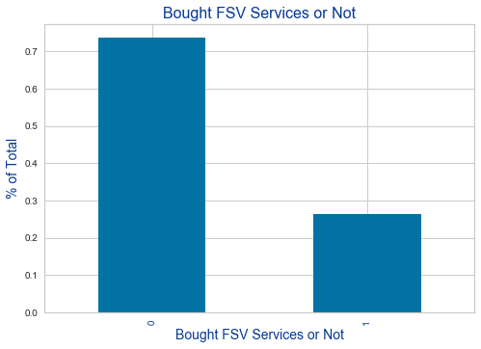
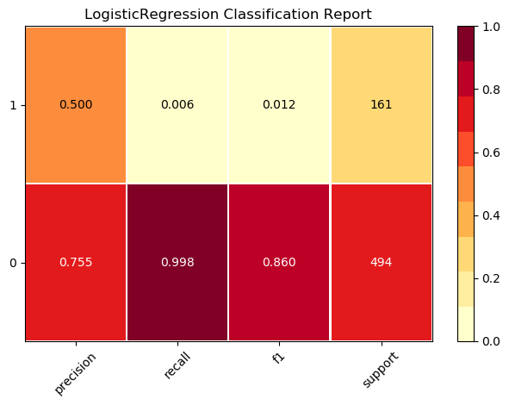
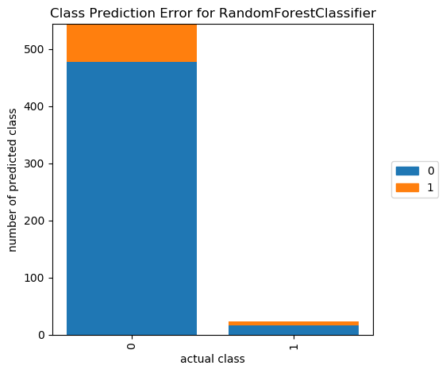
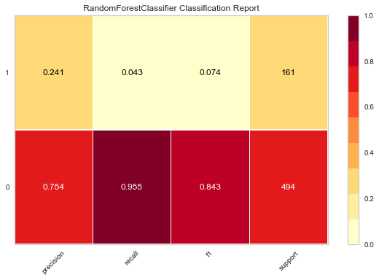
*Class Imbalance causing basic classifiers to predict Class 0 mostly
Using Classification to Estimate Likelihood to buy FSV Products
Findings
Households who have purchased at least one FSV Product were labeled as Positive Class = 1. The goal is to train models that can accurately predict which households are likely to fall in the Positive Class.
The first major observation was that there is a heavy class imbalance in the data because a lot fewer households have purchased FSV Products
Logistic Regression, RandomForest, and KNN models were tested first without any optimization to gauge base level performance
Precision and accuracy seemed relatively high at first sight at about 76%. Plotting the actual prediction Labels and the Confusion Matrices showed that base models were mainly predicting the majority Class = 0, which would not serve our use case, since we care more about predicting Class 1
Next steps would be to optimize models for less bias towards Class 0 and better accuracy and overall f1-score on getting Class 1 correct more often
74%
Class imbalance
26%

Slide 16
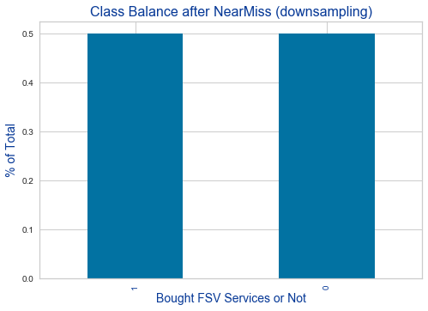
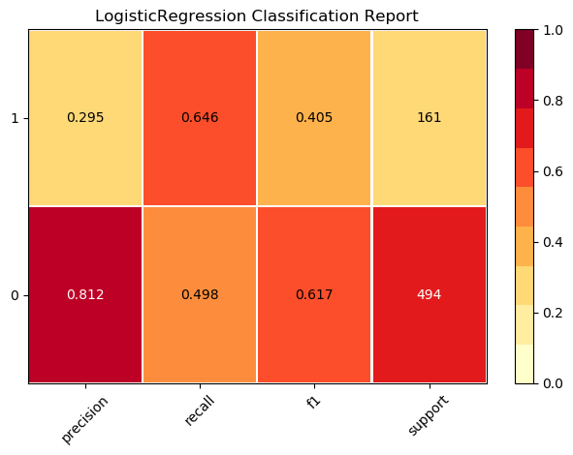
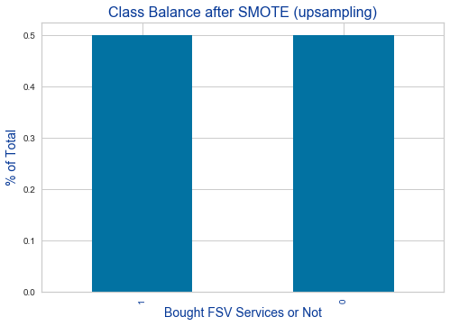
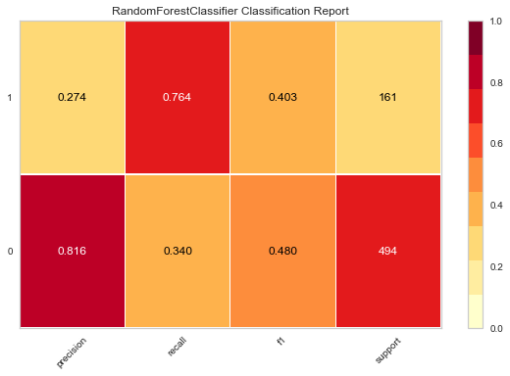
Using SMOTE and NearMiss to Fix Class Imbalance
Findings
Used SMOTE for upsampling and NearMiss for downsampling as well as scaling features and testing out different hyperparameters to optimize overall model accuracy and f-1 score balance
Logistic Regression with a downsampled training dataset with features scaled with MinMaxScaler was the best performer followed by RandomForest with SMOTE up-sampling
Optimizing f1-score (harmonic mean between precision and recall) and overall accuracy for Class 1 ensures that we get more of our prediction right when trying to predict which customers are likely to buy FSV Products in the future
Next Step is to draw insights from model feature importances and Lift/Gain Curves and use those as recommendations to AAA
704
704
*Class Imbalance fixed by SMOTE and NearMiss methods
1914
1914

Slide 17
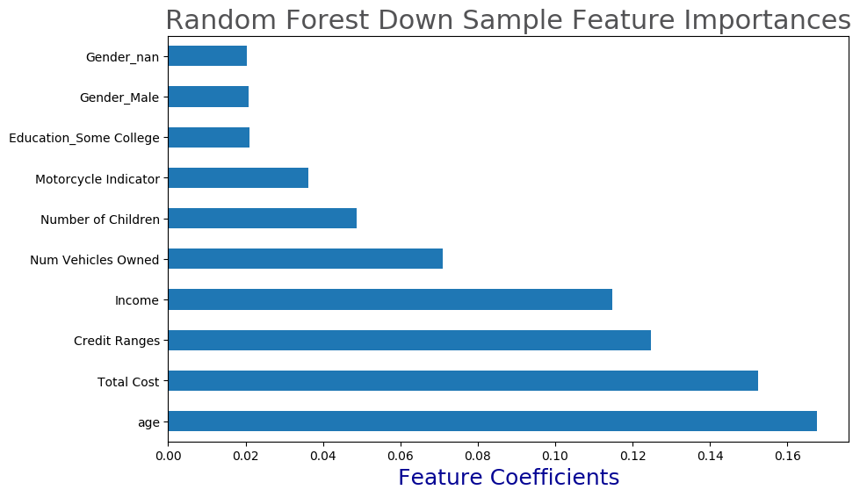
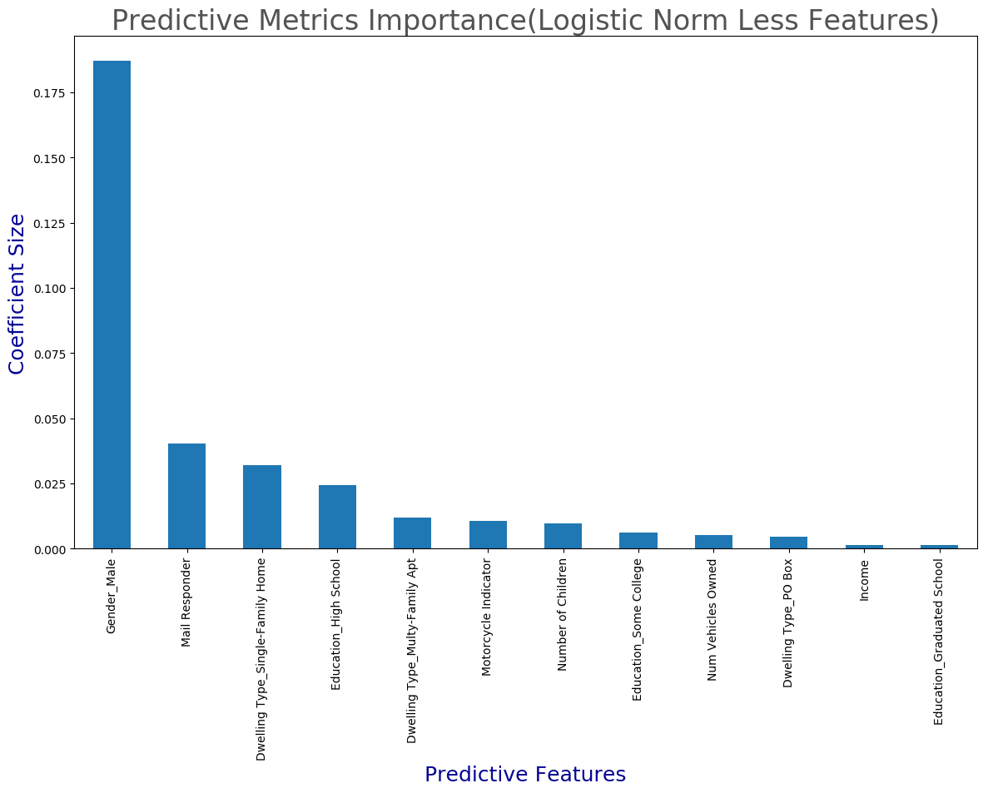
Gaining Insights From Feature Importances and Coefficients
Findings
Selecting the Top Performing models with interpretable outputs such as predictive coefficients from Logistic Regression and feature importances from Random Forest generated the combined list below, which according to the models makes customers more likely to purchase FSV Products
Top Features that make people more likely to buy FSV Products:
Age :: Total Cost :: Credit Ranges :: Income :: Number of Vehicles ::
Number of Children :: Motorcycle Indicator :: Education College ::
Gender Male :: Mail Responder :: Education High School ::
Dwelling - Single Family Home :: Dwelling - Multi-Family Apt ::

Slide 18
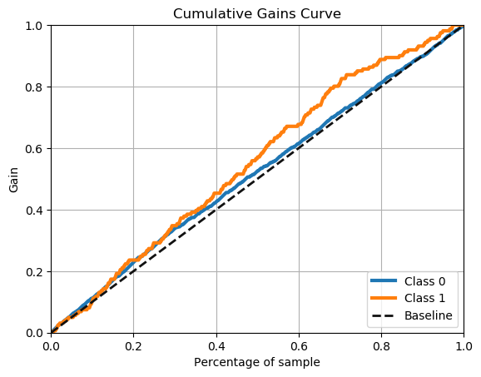
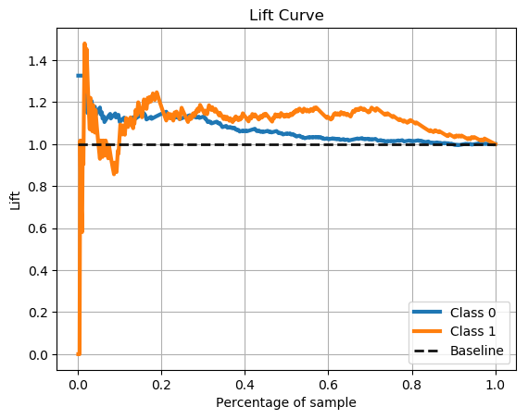
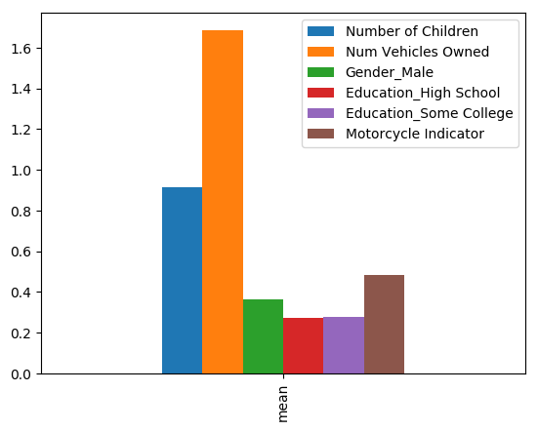
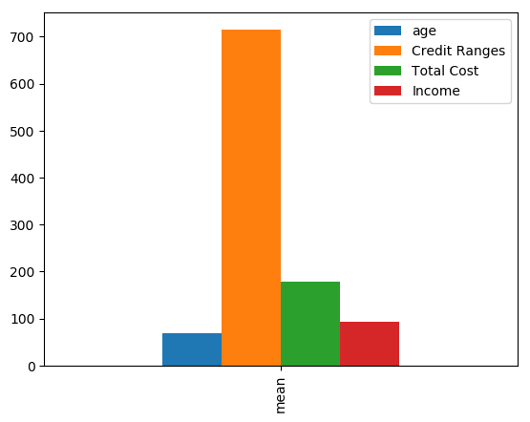

Use Insights to Inform Marketing and Anticipate Customer Needs
Findings
Cumulative gains and lift curves are a simple and useful approach to understanding what returns we are likely to get from running a marketing campaign and how many customers we should contact to maximize the reach of our most valuable customers who are likely to covert (Buy FSV Products)
The diagonal dashed line represents the results of random guessing, and is the baseline against which to evaluate the lift that our model generates. The orange line shows the actual lift we get from adding more users to the sample. By looking at the Gains and Lift charts we can see that the ideal curves peak at around 70% of Sample after which we start observing diminishing returns by adding more users to sample. This means that we can reach 100% of our targeted customers who are likely to buy FSV Products by sending marketing campaigns to only 70% of the total population
To identify the average profile of customers likely to buy FSV products, we isolated the customers in original positive sample (who bought FSV Products) and looked at the those customer features that both of our look-alike models deemed as most predictive. By using AVG values from Figure 3 & 4 we generated a profile of the Households we want to target first with ads and promotions for FSV Products & Services:
Fig. 3
1.7
Fig. 4
712
0.9
0.6
170
0.4
Gender: Male
Age: 68
Children : 1
Vehicles: 2
Motorcycles: 1
Mail Responder: Yes
0.35
0.35
68
90
Income: $90K
Credit Ranges: 712
Total AAA Cost: $170
Education: High School or Higher

Slide 19
Part 2: Recommendations to AAA
Getting more existing customers to purchase FSV Products can offset some of the higher Total Cost associated with those users since there are some common characteristics found in both segments
Adjust marketing budgets, efforts and strategies (special promotions & discounts) to target customers who are more likely to sign up for FSV Products as identified by our look-alike models such as:
Older male customer (avg age 68) with one or more children, annual income of $90K or more, Credit Score of 712+, who are “ Mail Responders”, have some level of College Education, living in a single-family home or multi-family unit in a household with at least 2 cars and 1 motorcycle.
Avoid sending special offers and wasting marketing $$$ on user profiles that are significantly different in their demographic and social characteristics, compared to the most desired profile described above
Low income households comprised of younger women with no children, less than 2 cars, credit scores lower than 700, who are not “Mail Responders”, and have lower education levels and lower average incomes.
Save Marketing $$$ and increase ROI by using model predictions to only target 70% of households, which will guarantee that you will reach 100% of the desired users who are more likely to buy FSV Products

Slide 20
*Appendix
Lots of different models were tested and many popular model optimization and data preprocessing techniques and approaches were used for both the Regression and the Classification predictions. Some of the models with lower performance scores were not discussed in detail in this presentation
Lots of additional findings of less importance and significance as measured by lower model performance and lower predictive coefficients and feature importances were also uncovered and graphed in Jupyter Notebook during the EDA and model testing and optimization stages of this project
Those findings and graphs were not shared in this presentation for the sake of brevity and to keep the size of the file smaller, but I would be happy to share additional findings and graphs if requested
*** Thank you for taking the time to read my presentation and thank you to all curriculum writers
and course instructors for the great lecture and all the help via email and office hours!!!

