Slide 1
Use Case Photovoltaic Can solar power replace conventional power plant output?
Nadja, Botan, Marc

Slide 2

Use Case Big Picture
Question:
Can solar power replace conventional power plant output?
Features:
Prediction
Dashboard
Scaling

Slide 3


Scaling
1
Household
2
Household per city
3
Household per subregion
4
Household per country

Slide 4
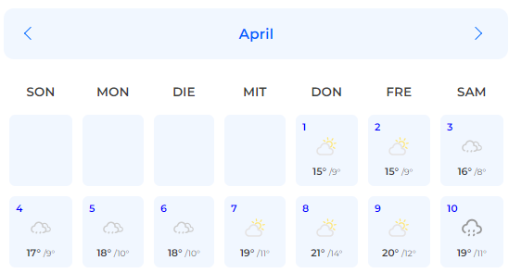
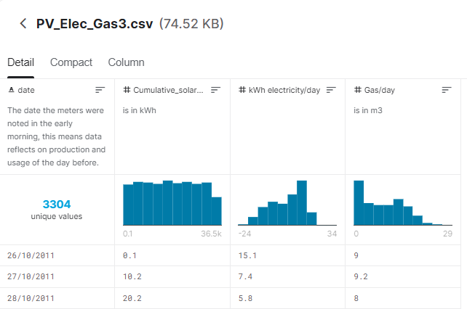
Conceptual design
Transformation
Daily Power production of solar panels and daily weather data
Storage
Scaling
Prediction
Dashboard
ELT
How much will the photovoltaic generate tomorrow or in the next days/months/years?
How much energy was generated in total?
Is it possible to supply an entire country with solar energy?

Slide 5
Data
date | Cumulative_solar_power | kWh electricity/day | Gas/day m³
26.10.2011 | 1 | 151 | 9
27.10.2011 | 102 | 74 | 92
28.10.2011 | 202 | 58 | 8
29.10.2011 | 296 | 49 | 66
30.10.2011 | 342 | 117 | 53
31.10.2011 | 38 | 11 | 57
01.11.2011 | 466 | 35 | 53
02.11.2011 | 516 | 105 | 54
03.11.2011 | 586 | 69 | 76
04.11.2011 | 605 | 103 | 55
05.11.2011 | 657 | 12 | 52
06.11.2011 | 718 | 119 | 48
07.11.2011 | 733 | 167 | 53
08.11.2011 | 738 | 111 | 73
09.11.2011 | 761 | 13 | 83
10.11.2011 | 825 | 76 | 72
11.11.2011 | 891 | 89 | 105
12.11.2011 | 955 | 129 | 102
13.11.2011 | 999 | 107 | 107
14.11.2011 | 1014 | 102 | 99
15.11.2011 | 1091 | 72 | 114
16.11.2011 | 116 | 94 | 136
date2 | Highest Temperature in degrees
26.10.2011 | 16
27.10.2011 | 20
28.10.2011 | 21
29.10.2011 | 15
30.10.2011 | 14
31.10.2011 | 15
01.11.2011 | 13
Range: 26.10.2011 -10.11.2020
Source: Kaggle Dataset

