Slide 1
Agenda
Quick Look of Analytical Tools
Traffic Source Performance Analysis
Internal Order Management System Analysis
What this report will cover

Slide 2
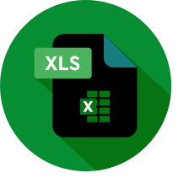

Analytical Tools
Excel
Programming Language
Excel functions, Excel Power Pivot, Dax, Excel Power Query
Python, Pandas, Seaborn

Slide 3
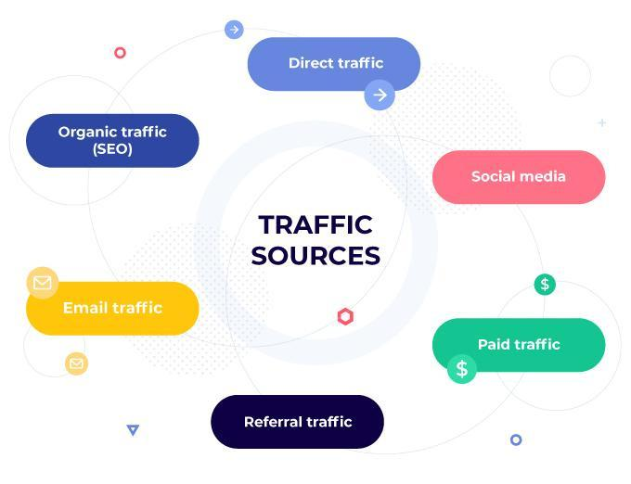
Traffic Source Performance Analysis

Slide 4

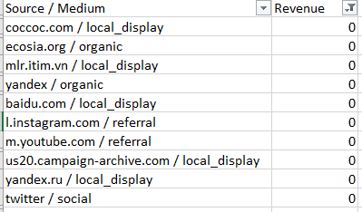
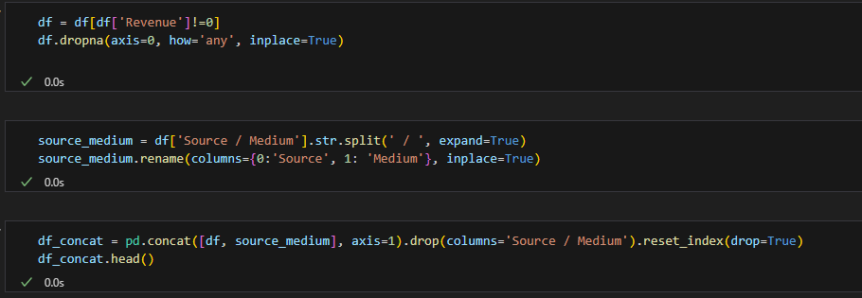

Data Cleansing With Python
There are sources that do not generate any revenue
Drop all records with sources that produce no revenue and a record with empty value for source / medium.
Split Source / Medium column into 2 columns: Source, Medium.
Data manipulation with python pandas

Slide 5
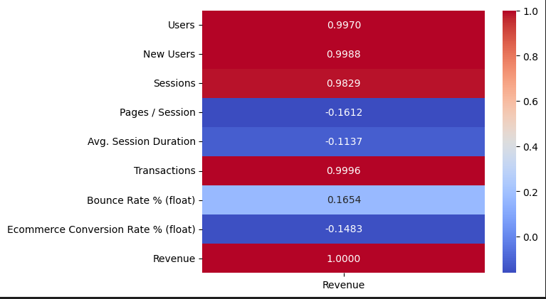
Feature Correlations
Result of df.corr()
Findings
01
Users, New Users, Sessions, Transactions exhibits strong positive correlation with revenue.
02
Pages / Session, Avg. Session Duration, and Eccomerce Conversion Rate is not as important to increasing revenue.
03
Further analysis will focus more on Users, New Users, Sessions, Transactions.

Slide 6
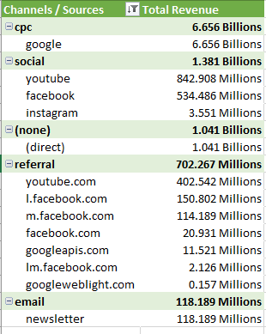
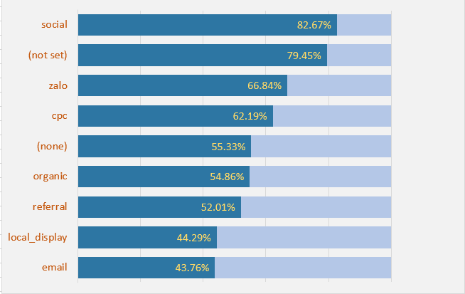
Sources / Channel Analysis
Top 5 Revenue channels
Bounce rate by Channel
Findings
01
The largest channel of revenue in comes from cpc
02
Social (mostly youtube, facebook) and (none)/direct have revenue over 1 billion
03
The channels that generate the most revenue still have high bounce rate
Social with 82.67%
Actions
How
Prioritize top 5 high-performing channels.
Reduce the bounce rate for high-performing channels especially social media channel.
Boost advertising expenditure on highest-performing channels and monitor the additional revenue generated to prevent diminishing returns.
Ensure there is no mismatch between what the ad promises and what the landing page delivers.

Slide 7
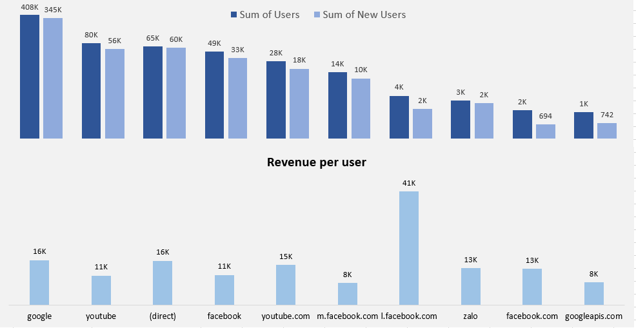
Sources / Channel Analysis
Top 10 sources with the most users and their revenue per user
Findings
01
Google is leading with the biggest number of users
02
Most other users come from all forms of Youtube, FaceBook, Zalo traffics
03
Number of users who arrive at the website directly ranks third
How
Improve brand awareness so more people know about out website and access it directly.
Better marketing campaign to get more high-paying customers from l.facebook.com.
Actions
Increase the number of users accessing website directly.
Attract more facebook users from l.facebook.com.

Slide 8
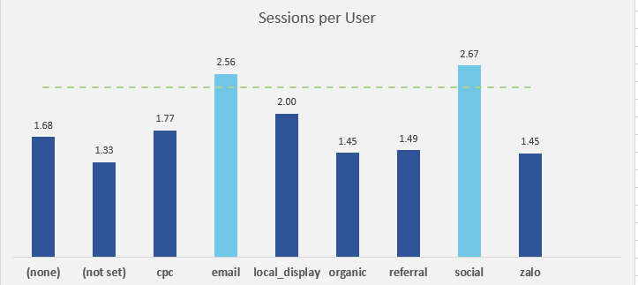
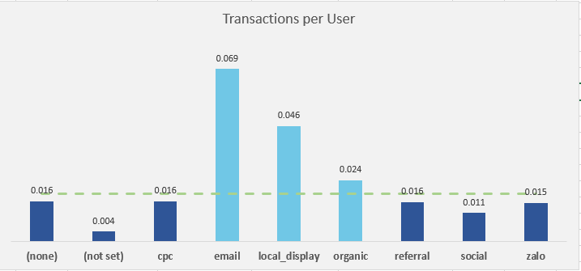
Sources / Channel Analysis
Avg Session per user
Avg Transactions per user
Findings
Actions
How
01
Social has the highest sessions per user.
importantly increase the sessions per users for cpc, (none), referral.
Urgently, there is a need to improve the transactions per user for cpc, social, (none), referral.
Introduce interactive elements on the website to enhance user engagement.
Ensure a seamless and intuitive checkout experience with minimal obstacles.
Tailor product suggestions and promotions according to customers’ preferences.
02
Important revenue channels like cpc, (none)/(direct), referral have below average sessions per user metrics.
03
Transactions per user for all highest revenue channels are below average, except for email with the highest metric.

Slide 9
Internal Order Management System Analysis

Slide 10

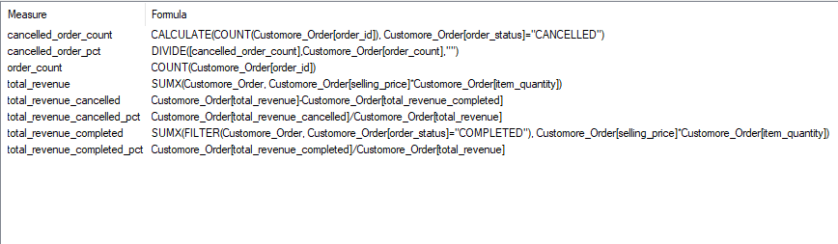
Data Cleansing and Preparation with Excel
Data manipulation
Create an Excel table from the data range
Dropping columns: voucher_platform and voucher_seller
Weekday_name using TEXT() functions
cleaned_payment_method using IF(), LEFT(), LEN()
ship_fee_category using IF()
Add table to power pivot data model and create DAX measures

Slide 11
61728
Total number of orders
Summary of Important KPIS
68626
Total number of items sold
10.066 billions
Total Revenue for all orders
Cancelled
Completed
19.81% of Total Revenue
81.19% of Total Revenue

Slide 12
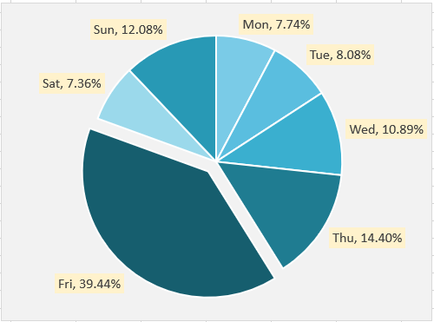
Internal Order Analysis
4.663 Billions
Revenue for orders with free shipping
15.54% of which is cancelled
5.402 Billions
Revenue for orders with shipping fee
23.49% of which is cancelled
Actions
How
Boost revenue on slower days of the week
Entice customers to purchase higher-priced items and related products.
Evaluate an appropriate shipping fee strategy.
Run flash sales or discounts specifically on Mondays, Tuesdays, and Saturdays.
Introduce bundled deals featuring popular items on Fridays, Thursdays, and Sundays.
Lower shipping fees or offer free shipping on select products to prevent order cancellations.

Slide 13
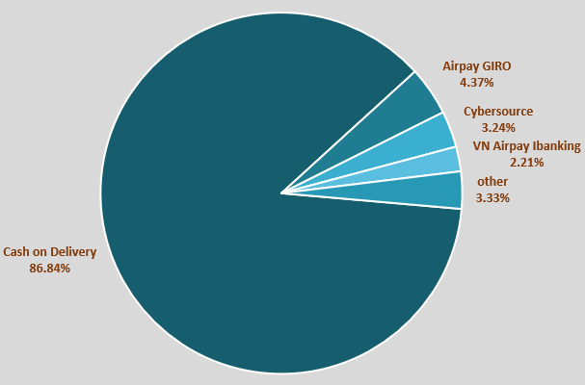
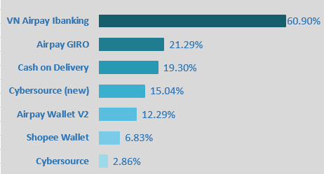
Internal Order Analysis
Revenue distribution by payment method
Findings
Actions
01
COD accounts for nearly 87% of revenue
Lower the order cancel rate for Airpay GIRO, COD and VN Airpay ibanking.
Encourage users to try out other payment methods with low cancel rate like Shopee Wallet, Cybersource.
02
60.90% of orders via VN Airpay ibanking are cancelled.
03
Order cancel rates for Airpay GIRO and COD are also high at 21.29% and 19.30% respectively.
Order cancelled % by payment method
How
Provide clear product descriptions, return policy and shipping information to avoid order cancellations.
Showcase positive reviews from users who have had a good experience using alternative payment methods.

Slide 14
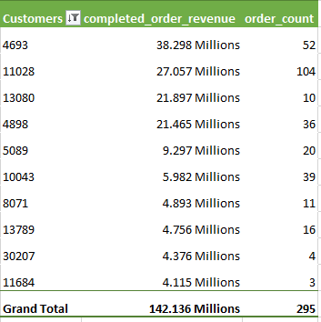
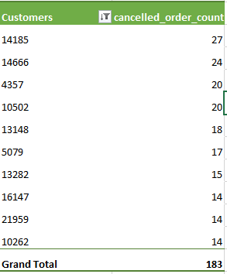
Internal Order Analysis
Top 10 customers that spend the most
Top 10 customers that cancel orders most frequently
Actions
How
Increase the order frequency and spending per order of top users.
Prioritize orders of customers with high spending and less likely to cancel .
Offer subscription or recurring purchase options for products top customers frequently purchase.
Develop a ML model to classify whether an order is likely to be completed or cancelled so that order can be handled accordingly.

Slide 15
THANK YOU FOR LISTENING

