Slide 1


Binary Matrix Rank Test
Nicu Neculache, Vlad-Andrei Petcu
Coordiantor: Prof. Simion Emil
Information Security - Academic Year 2021-2022
Cryptanalysis Techniques and Methods

Slide 2
Agenda
Introduction
Binary Matrix Rank Test - Mathematical fundamentals - Implementation
Evaluation & observations
Conclusions

Slide 3
Introduction
Statistical testing - mathematical technique for analysing an algorithm based on some input-output pairs (testing samples)
Run the algorithm (or the system) multiple times, obtain the results and analyze them in order to classify/validate the algorithm
Commonly used in the field of cryptography, specifically for the encryption, decryption and the keys or sub-keys generation

Slide 4
Binary Matrix Rank Test
Focus - the rank of disjoint sub-matrices of the entire sequence
Purpose - check for linear dependence among fixed length sub-strings of the original sequence
Main idea - construct matrices of successive zeroes and ones from the sequence - check for linear dependence among the rows or columns of the constructed matrices
The statistic of interest - the deviation of the rank from the expected value

Slide 5
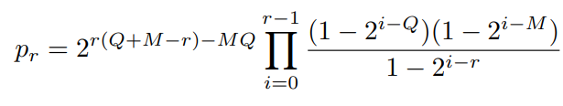
Mathematical fundamentals
The rank R of the M × Q random binary matrix takes values r = 0, 1, 2, . . . , m where m ≡ min(M, Q) with probabilities:
For M = Q = 32:

Slide 6

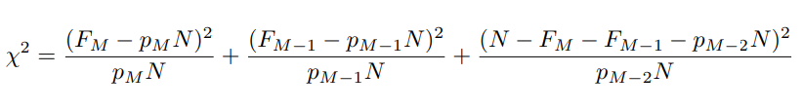

Rank frequencies:
Reference distribution (chi):
P-value =
Output: P-value < 0.01

Slide 7
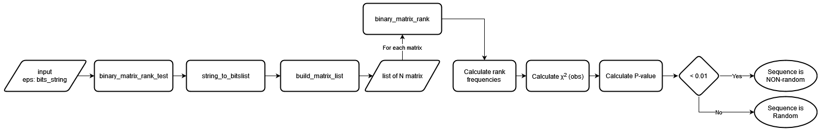
Implementation

Slide 8
Evaluation & observations
The variation of P-value from density of bits
Python random library, input length = 100000
Python random library - density iterations, input length = 50000
Random/Non-random count from density percentage

Slide 9
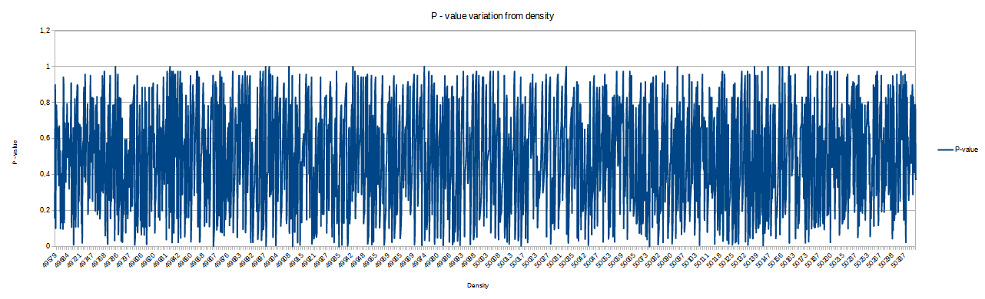
Python random library, input length = 100000

Slide 10
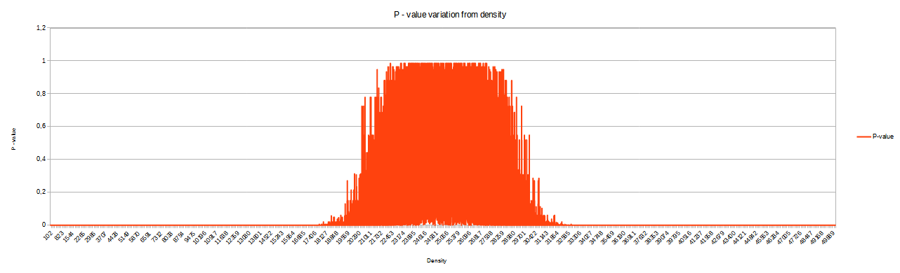
Python random library - density iterations, input length = 50000

Slide 11
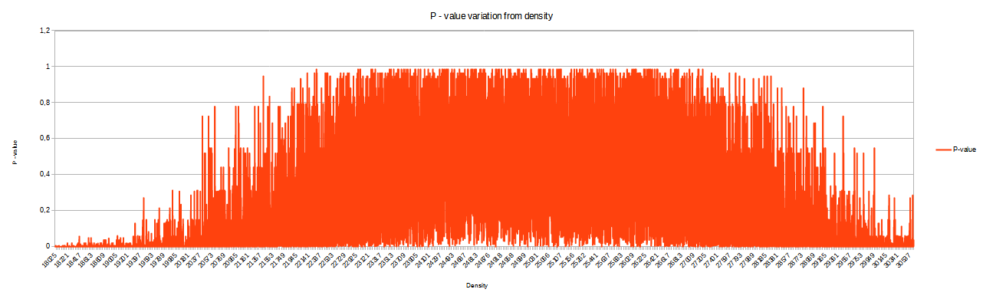
Python random library - density iterations 40-60%, input length = 50000

Slide 12
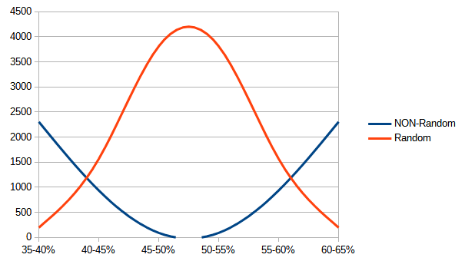
Random/Non-random count from density percentage

Slide 13
Conclusions
Bits density target: ≅ 50%

