Slide 1
Economic Drivers for Nuclear Flexible Operations
Phase 2 Preliminary Results
EPRI Team:
Sherry Bernhoft, Francisco de la Chesnaye, Erik Ela, Robin Broder Hytowitz, Chris Kerr, John Taber, Aidan Tuohy, David Ziebell
Via WebEx
September 21
Preliminary Draft Results: Please do not copy or cite

Slide 2

Agenda for July 9, 2020 WebEx
Overview Sherry Bernhoft
Preliminary Results John Taber
Preliminary Draft Results: Please do not copy or cite

Slide 3
Scenario Design

Slide 4
Current Scenario Matrix
Name | Short Name | Nuclear Costs | Renewable Costs | Policy
Default | Default | Reference | Reference | Current
Low Nuclear + High Renewable Costs | Default.LNHR | Lower | Higher | Current
100% RPS | RPS | Reference | Reference | 100% RPS by 2050 (Allowing Nuclear)
100% RPS + HN & LR | RPS.LNHR | Lower | Higher | 100% RPS by 2050
Carbon Tax | CTax. | Reference | Reference | Carbon Tax ($50 in 2025)
Carbon Tax + HN & LR | Ctax.LNHR | Lower | Higher | Carbon Tax ($50 in 2025)
Preliminary Draft Results: Please do not copy or cite

Slide 5
Preliminary Results

Slide 6
Load and Generator Supply Stack
Load completed
Total Load
Light Duty Electric Vehicles
Medium/Heavy Duty Electric Vehicles
Non-Seasonal Load
Residential/Commercial Air Conditioning
Residential/Commercial Space Heating
Generator Supply Stack
In progress

Slide 7
High-Level Insights from Static 5-Year Results
Some form of low-carbon policy, combined with favorable price evolution, may be necessary to see investment in nuclear generation capacity in Ohio
Similar conditions may be necessary to see increases in nuclear generation capacity in Illinois

Slide 8
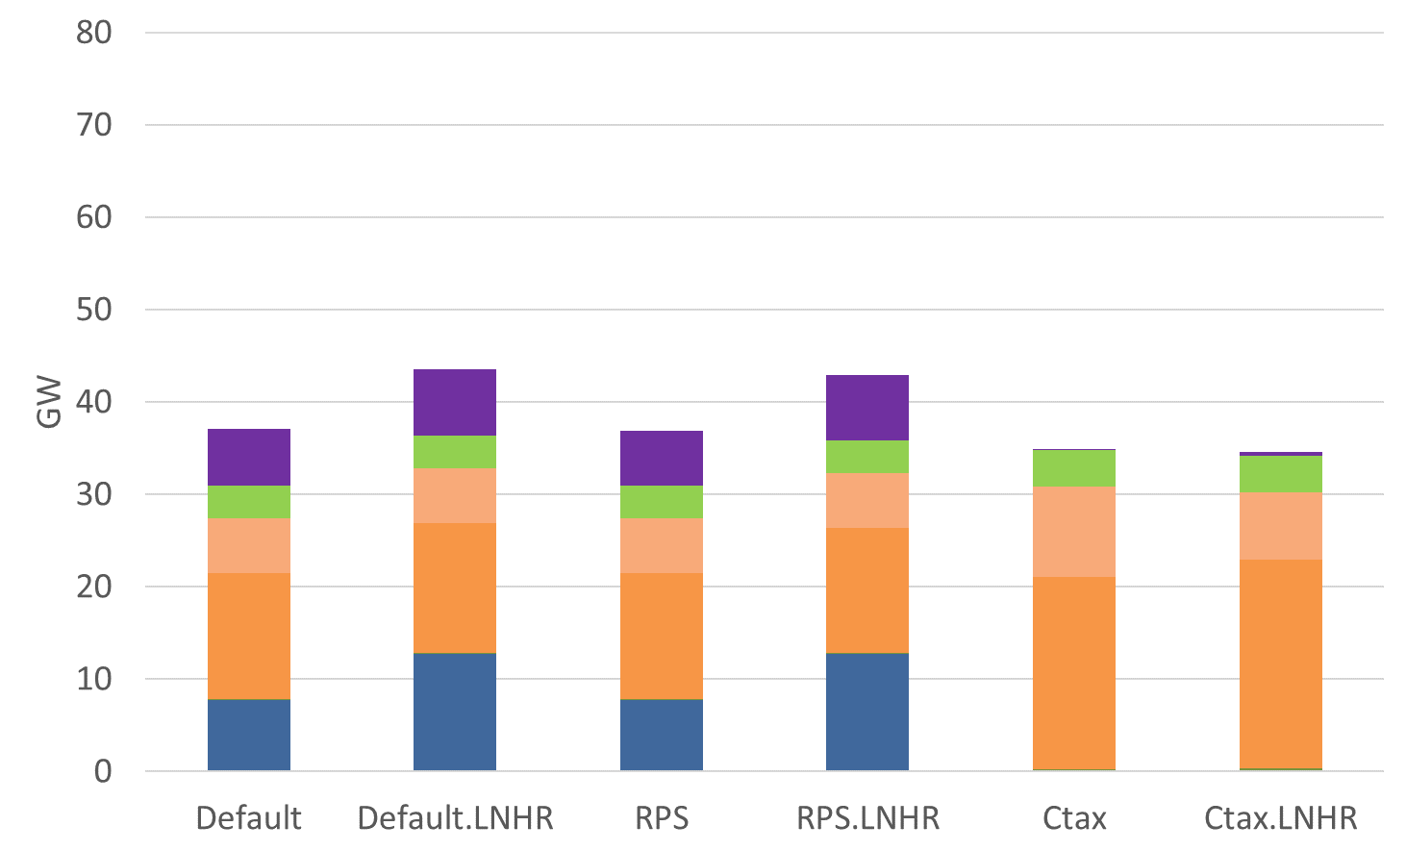
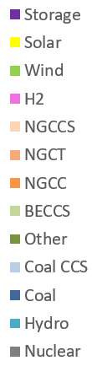
Ohio Capacity: 2025

Slide 9
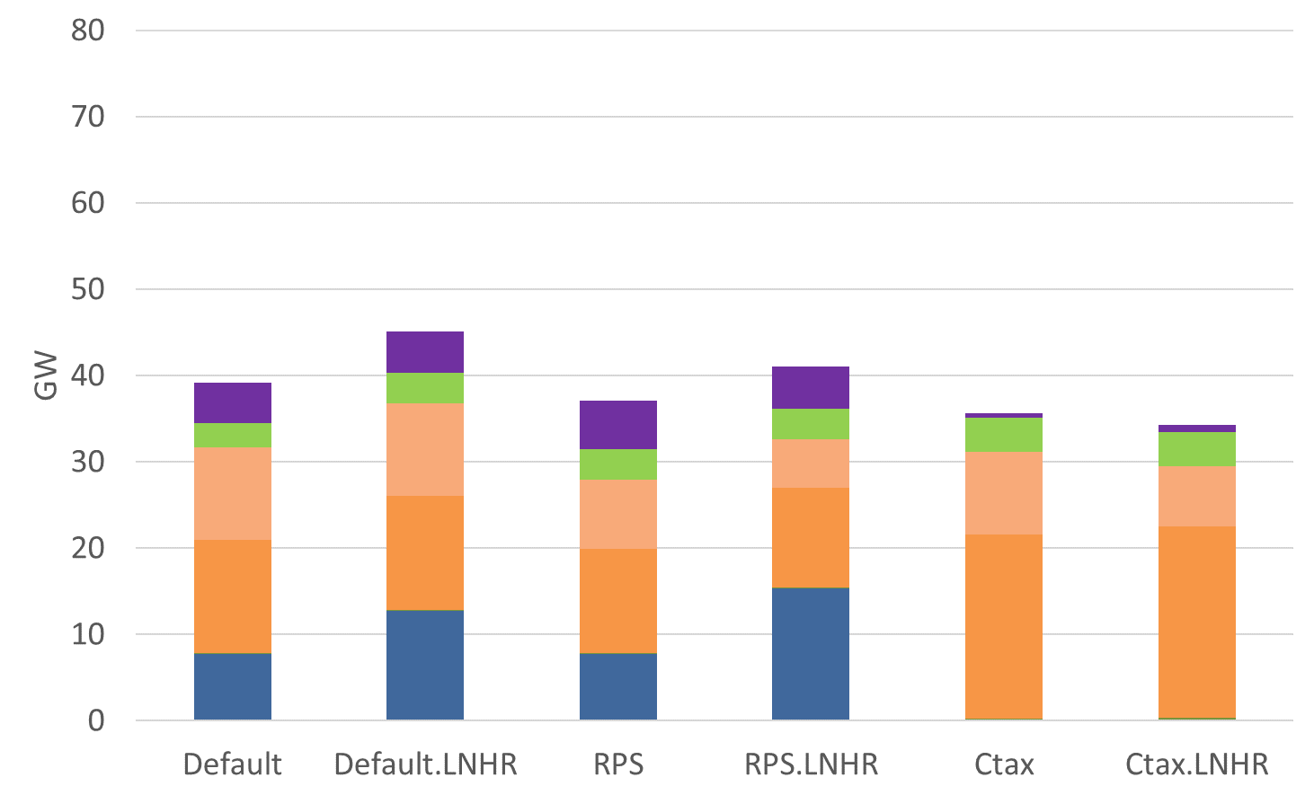
Ohio Capacity: 2030

Slide 10
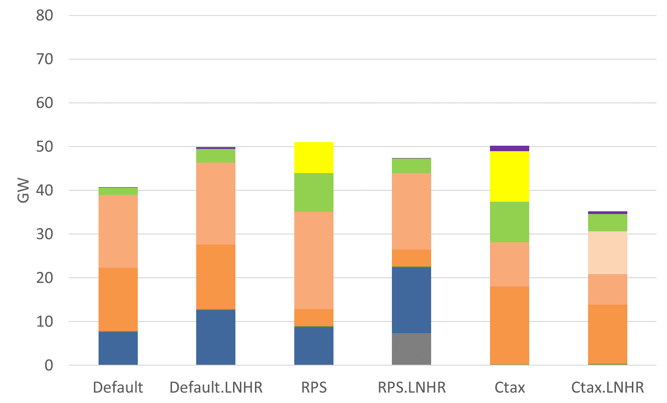
Ohio Capacity: 2035

Slide 11
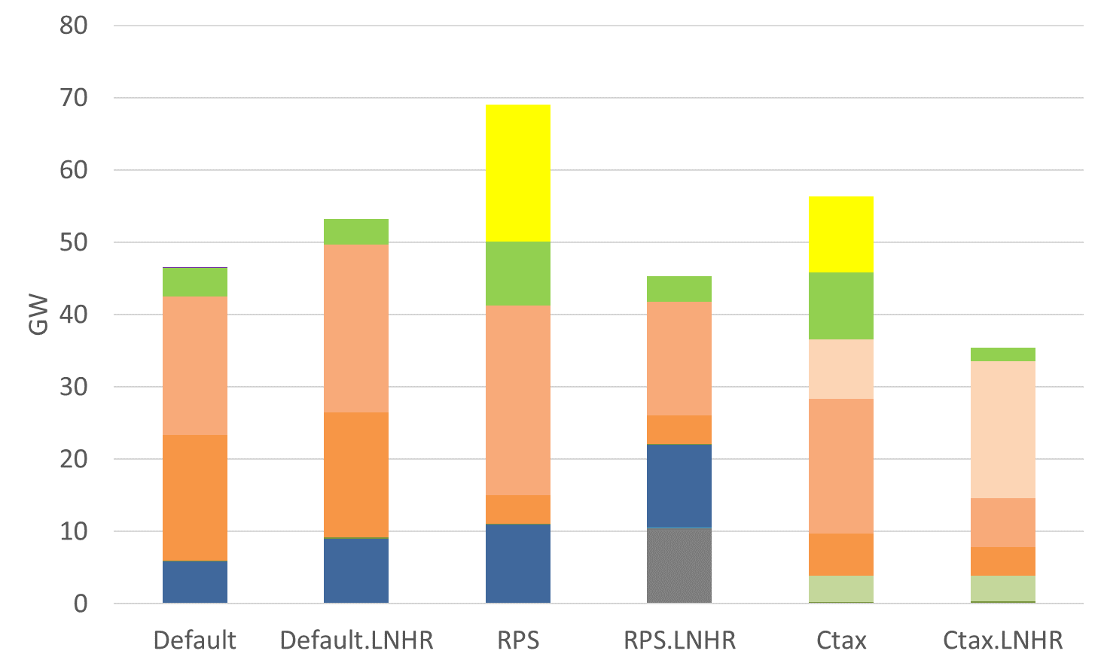
Ohio Capacity: 2040

Slide 12
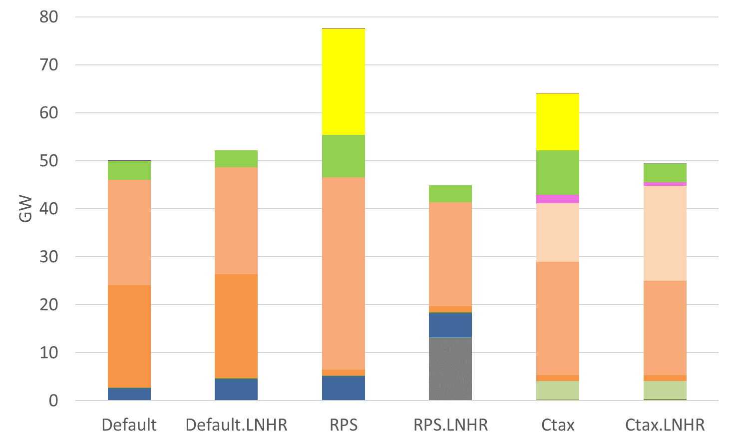
Ohio Capacity: 2045

Slide 13
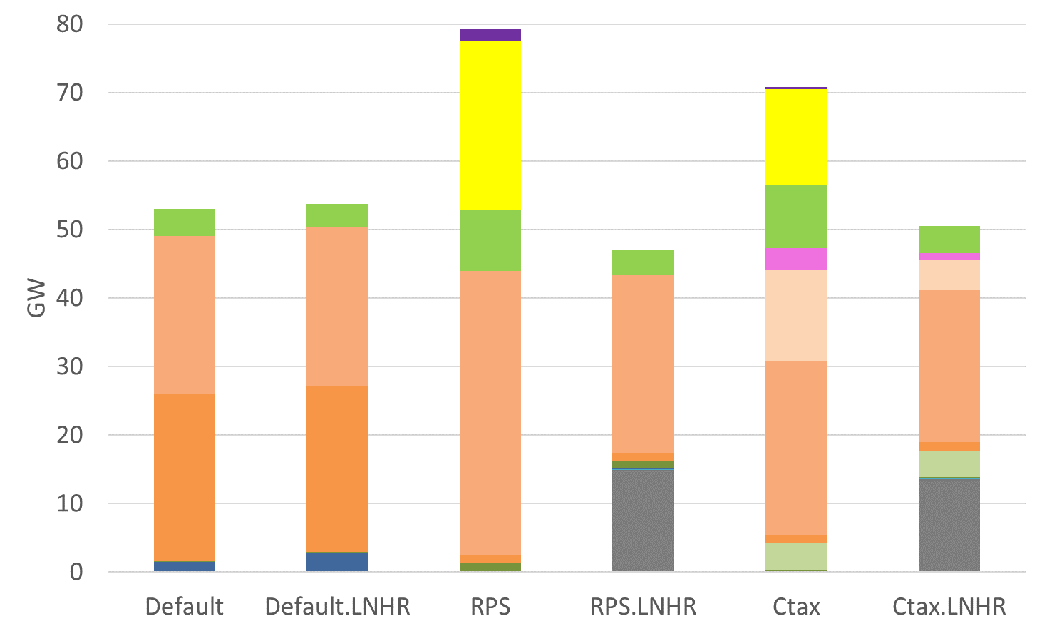
Ohio Capacity: 2050

Slide 14
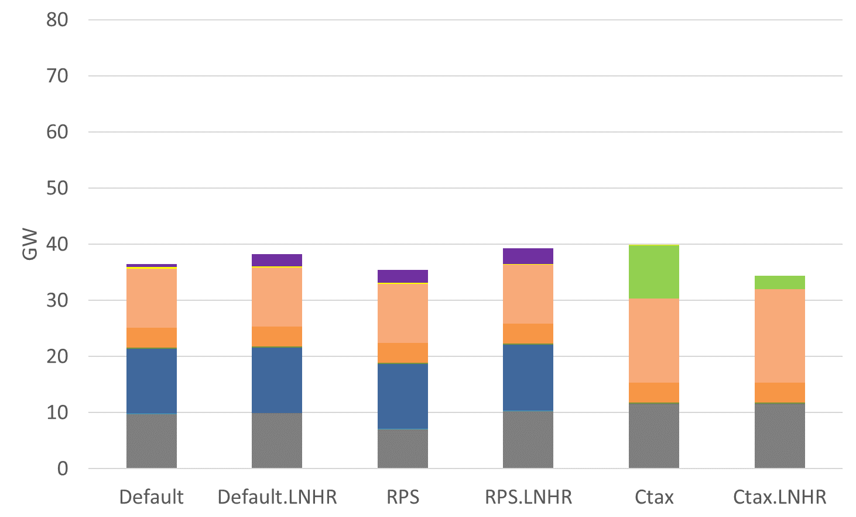
Illinois Capacity: 2025

Slide 15
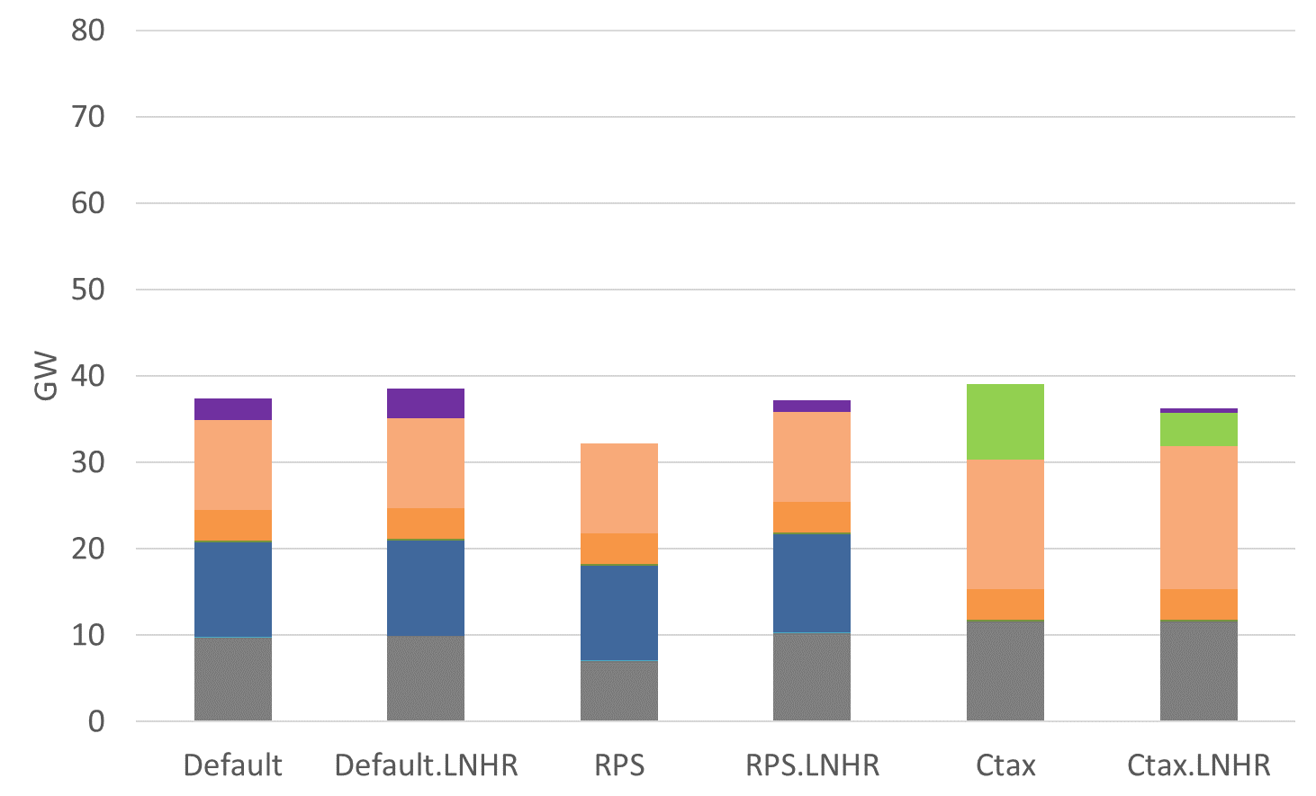
Illinois Capacity: 2030

Slide 16
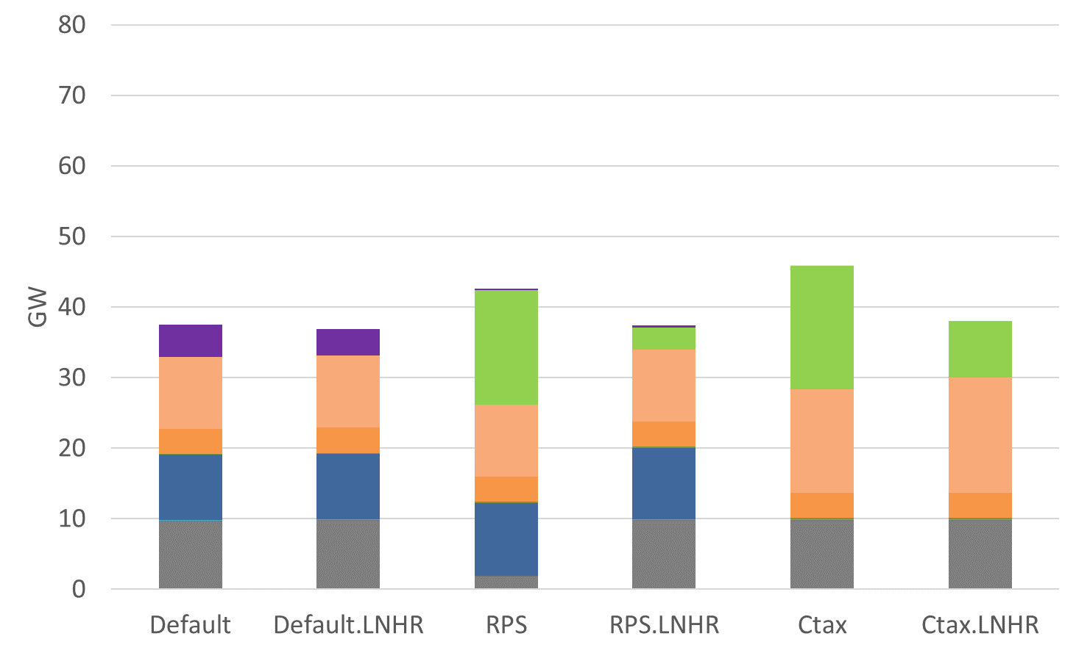
Illinois Capacity: 2035

Slide 17
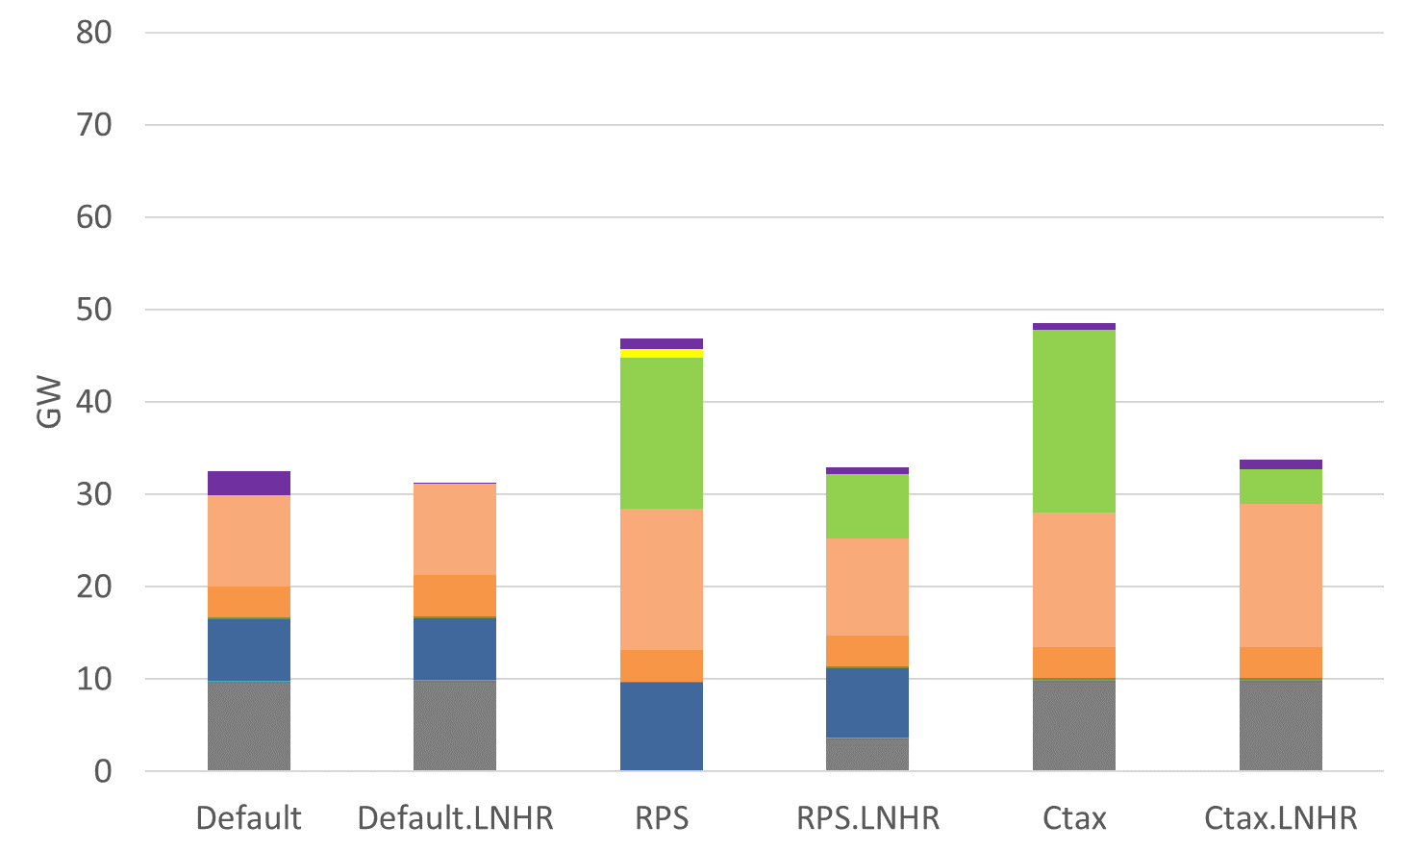
Illinois Capacity: 2040

Slide 18
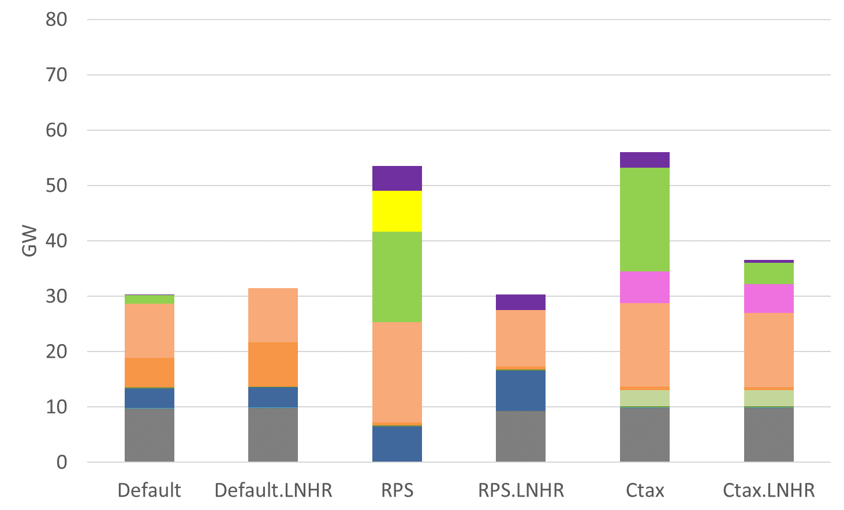
Illinois Capacity: 2045

Slide 19
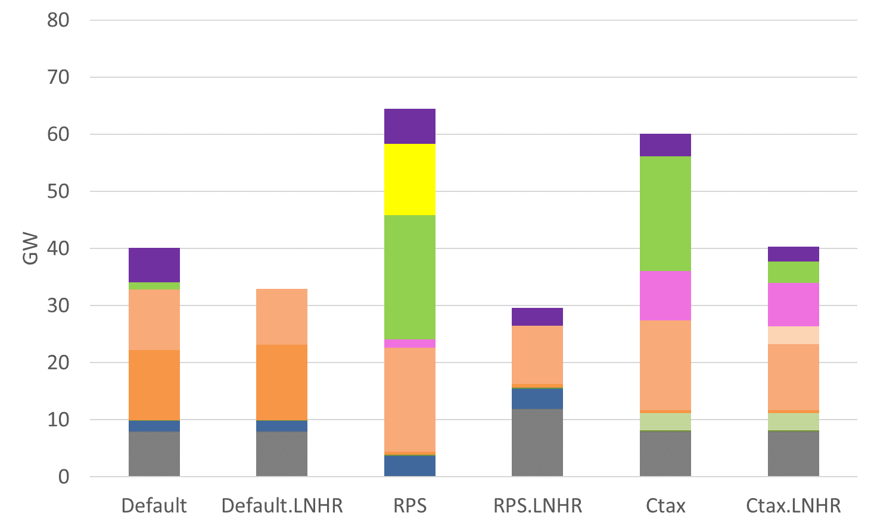
Illinois Capacity: 2050

Slide 21
US-REGEN Model

Slide 22
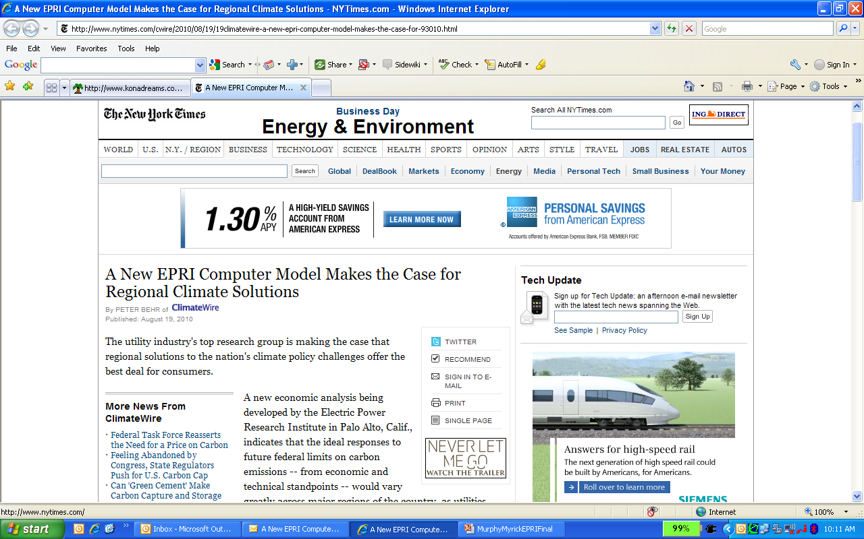
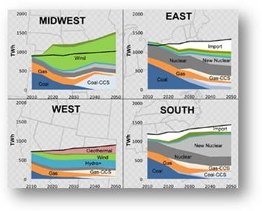
The EPRI US-REGEN Model
State-of-the-art simulation model of the U.S. electric sector combined with an integrated economy model, and state level detail
Determines “best” (i.e., economically optimal) mix of resources to power the economy
Sub-national granularity (16 regions / 48 state breakdown) makes it possible to capture variability in generation mix, resources, energy demand and other key variables
Powerful tool to support scenario planning
Incorporates proprietary EPRI data on the expected costs and performance of generation technologies and environmental controls
Developed and maintained by EPRI staff

Slide 23
US-REGEN Model Description
Pacific
General Equilibrium Economy Model
Aggregate Economic Representation
Energy Markets for Oil, Natural Gas, Coal, & Bioenergy
Foreign Exchange
NE
Mountain-N
NE-Central-C
NY
NW-Central
M-Atlantic
Energy Demand (Electric & Non-Electric)
Detailed model of residential, commercial, and light-duty vehicle technologies
High level representation of industrial & other transportation sectors
California
NE-Central-R
S-Atlantic
Mountain-S
Electric Sector Model
SE-Central
SW-Central
Endogenously Builds/Retrofits/Retires Capacity
Simultaneously Capacity Planning and Dispatch
Co-Optimizes Transmission
Texas
Florida

Slide 24
REGEN Strength: Detailed End-Use Modeling
Energy Use
Electric Sector
SYNCHRONIZED
Hourly Load, Renewables, & Prices
Pacific
Model Outputs:
Generation Capacity
Wholesale Prices
End-Use Mix
Emissions, Air Quality, and water
Demand Profiles
Climate zones
Building types
Household characteristics
Industrial mix
End-use technology detail
Investment and dispatch
Transmission
Renewable integration
Energy and capacity requirements
State-level policies and constraints
EPRI’s state-of-the-art modeling system synchronizes energy end-use and electric sector scenarios

Slide 25
Uses and Limitations of Economic Models
Models like US-REGEN necessarily are numerical abstractions of the complex economic and energy systems they represent. As such, they may contain:
Approximation errors
Incomplete system dynamics
Quality of data issues
When viewing model results, it is important to keep in mind:
Analyses are not intended to be viewed as a prediction of a particular outcome or cluster of outcomes.
Insights come by running a variety of cases, comparing the results, and asking “what if” questions.
Actual deployment of a model outcome is dependent on many additional factors, such as policy, permitting and siting.
“Essentially, all models are wrong, but some are useful”. -- George Edward Pelham Box

Slide 26
Present Project Results
Recurring webcasts/conference calls to discuss preliminary findings
Final project results
Powerpoint Slide deck to support final webcast/conference call
White Paper

