Slide 1
Improving Energy Storage Modeling in Long-Term Capacity Expansion Modeling
Final Results
John Taber Technical Leader Energy Systems and Climate Analysis
via Webcast October 7, 2021

Slide 2
Table of Contents
Review of US-REGEN
INL Scenarios
Electric Sector Results

Slide 3
Overview of US-REGEN

Slide 4

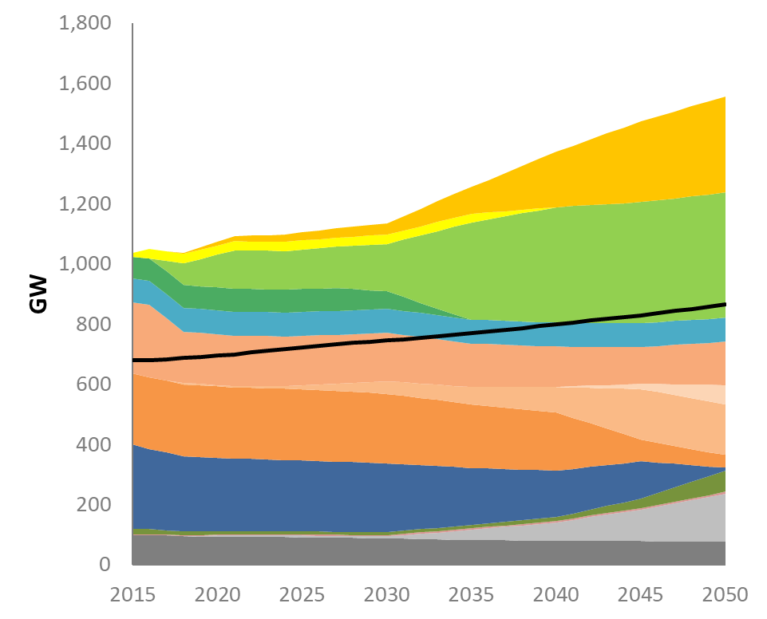
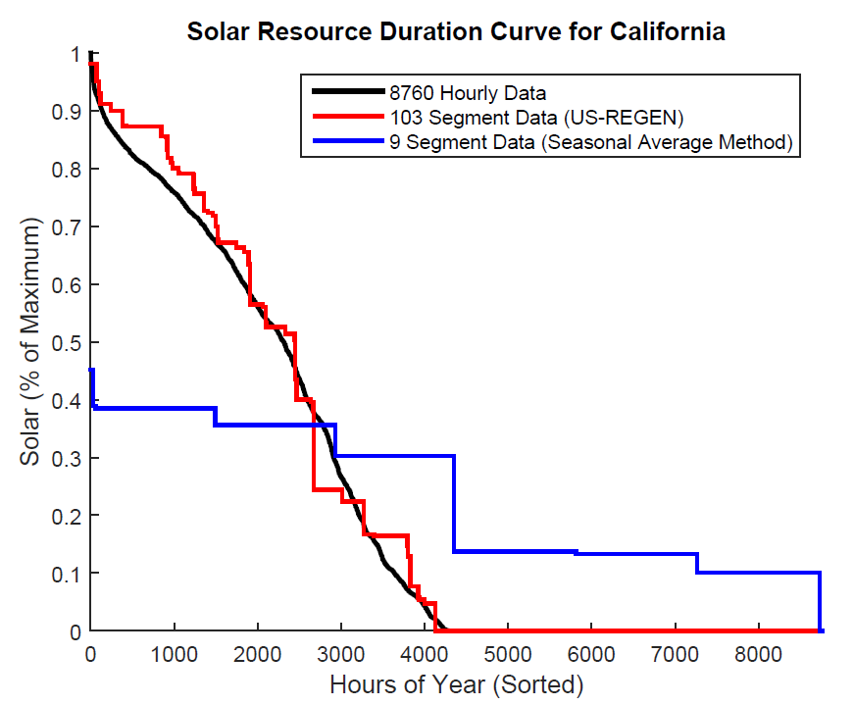
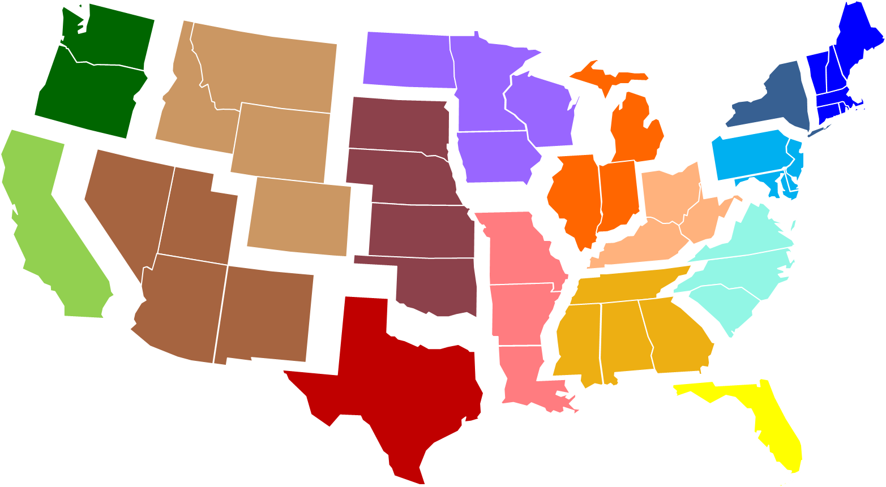
U.S. Regional Economy, GHG, and Energy (US-REGEN)
EPRI’s In-House Energy-Economic Model
Capacity Expansion Economic Model, Long Horizon to 2050
State-Level Resolution for Policy and Regulation Analysis
Innovative Algorithm to Capture Wind, Solar, and Load Correlations in a Long-Horizon Model
Documentation, articles, and reports available at https://esca.epri.com

Slide 5




US-REGEN: Current Model Structure
Electric Generation
Energy Use
Synchronized
Hourly Load, Renewables, and Prices
Model Outputs:
Economic equilibrium for generation, capacity, and end-use mix
Emissions, air quality, and water
Detailed representation of:
Energy and capacity requirements
Renewable integration, transmission, storage
State-level policies and constraints
Detailed representation of:
Customer heterogeneity across end-use sectors
End-use technology trade-offs
Electrification and efficiency opportunities
- Framework for understanding drivers of change in the electric sector and energy system
- Supported by EPRI engineering expertise and technology projections

Slide 6
Multiple “Flavors” of REGEN to Address Specific Questions
 | Integrated | Electric Only
 | Dynamic | Dynamic | Static | Unit Commitment
Optimization Horizon | Multi-decadal (35 years) | Multi-decadal (35 years) | Annual | Annual
Temporal Granularity | ~100 segments per year | ~100 segments per year | 8,760 hours | 8,760 hours
Capacity Mix | Endogenous | Endogenous | Endogenous | Exogenous (from dynamic model run)
Unit Aggregation | 100+ capacity blocks per region (dispatched together) | 100+ capacity blocks per region (dispatched together) | 100+ capacity blocks per region (dispatched together) | Individual units
Storage | N/A | N/A | Endogenous | Exogenous
Geographical Detail | User-specified regions, less than 20 | User-specified regions | All user-specified regions | All user-specified regions
Dispatch Constraints | Load balancing | Load balancing | Load balancing | Balancing, min. load limits, ramp rates, start costs, etc.
Optimization Type | Linear program | Linear program | Linear program | Mixed-integer program
Sectors | Entire economy | Electric Sector | Electric sector | Electric sector
Energy Demand | Endogenous; detailed end-use model | Fixed, may use supply curves for some inputs | Fixed | Fixed
Fuel Prices | Fixed | Fixed, may use supply curves for some inputs | Fixed | Fixed

Slide 7
Caveats: Uses and Limitations of Economic Models
Models are necessarily numerical abstractions of the complex economic and energy systems they represent. As such, they may contain:
Approximation errors
Incomplete system dynamics
Data quality issues
When viewing model results, it is important to keep in mind:
Analyses are not intended to be viewed as predictions or forecasts
Insights come by running a variety of cases/sensitivities, comparing the results, and asking “what if” questions
Actual dispatch and other model outcomes are dependent on many additional factors, such as policy, uncertainty, and unmodeled factors
“Essentially, all models are wrong, but some are useful.” –George Edward Pelham Box

Slide 8
INL Scenarios

Slide 9
Scenario Design
 | State Policy | US Policy | Nuclear Cost Assumptions | Renewable Cost Assumptions | Other Assumptions
Reference | Current (70% RPS in NYS by 2030) | Current | Default | Reference | No Li-Ion Storage
Reference + Storage | Current | Current | Default | Reference | Li-Ion Storage
CES | Current | 100% CES in 2035 | Lower Nuclear Costs | Small Declines in Wind and Solar PV | No Li-Ion Storage
CES + Storage | Current | 100% CES in 2035 | Lower Nuclear Costs | Smaller Declines in Wind and Solar PV | Li-Ion Storage

Slide 10
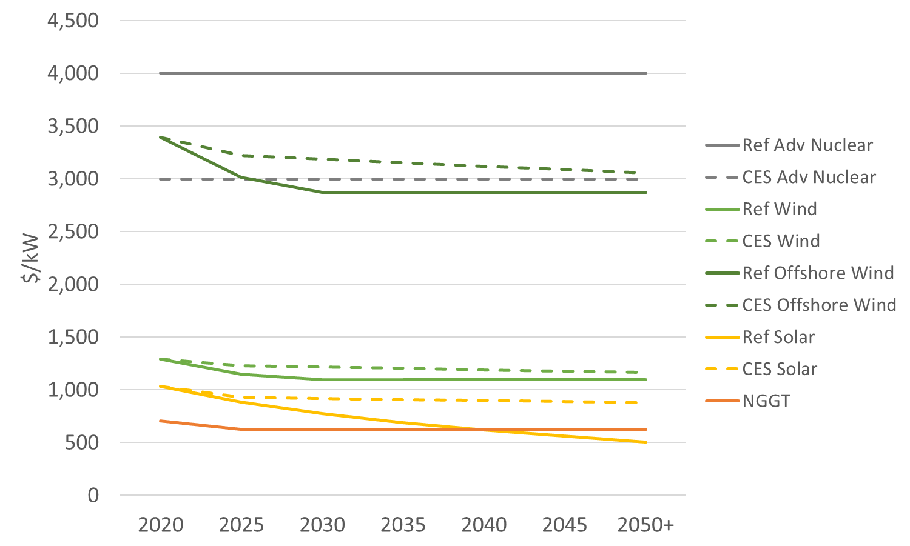
Cost Details
Note this is raw capacity costs (ie, not adjusted for capacity factor)
Wind capacity factors in NYS average 47-48%
Solar capacity factors average 14-20%
LCOE measurements downplay the importance of baseload power during low renewable/high load hours

Slide 11
Electric Sector Results

Slide 12
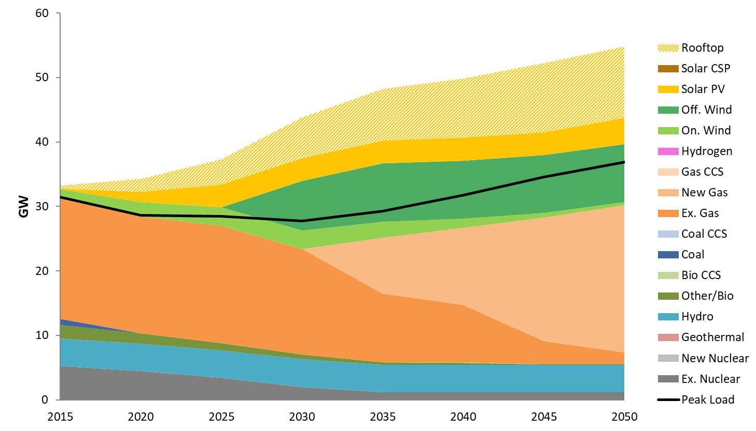
Dynamic Results: New York Capacity, Reference Scenario
New York State has a 70% RPS by 2030 in the Reference
No restriction on capacity for fossil-fired assets

Slide 13
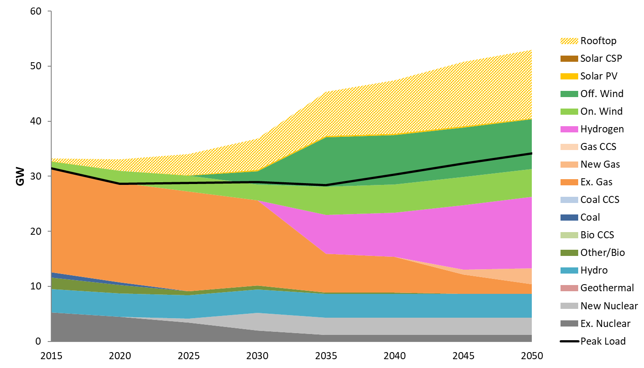
Dynamic Results: New York Capacity, CES Scenario
Policy is 100% nationwide CES starting in 2040, atop New York’s 70% RPS
Fossil capacity used to meet reserve requirement, but never dispatched
In Dynamic model, Hydrogen is used as storage

Slide 14
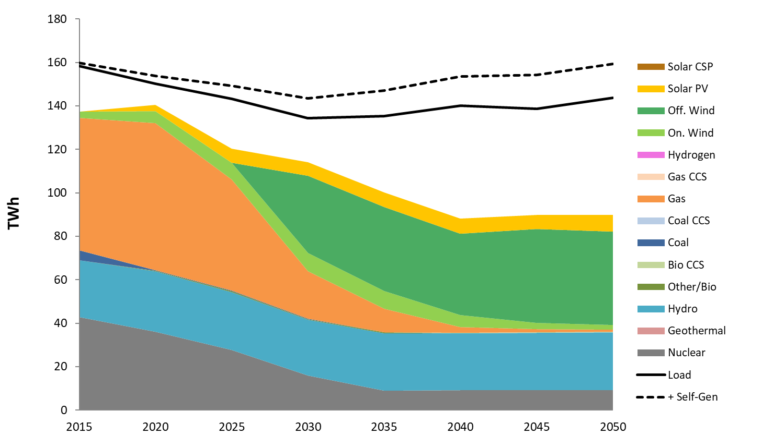
Dynamic Results: New York Generation, Reference Scenario
Surrounding regions have lower RPS/CES than New York
New England: 43% by 2035, 57% by 2050
Mid-Atlantic: 34% by 2030
Net Imports increase over 150% from 2015 to 2050

Slide 15
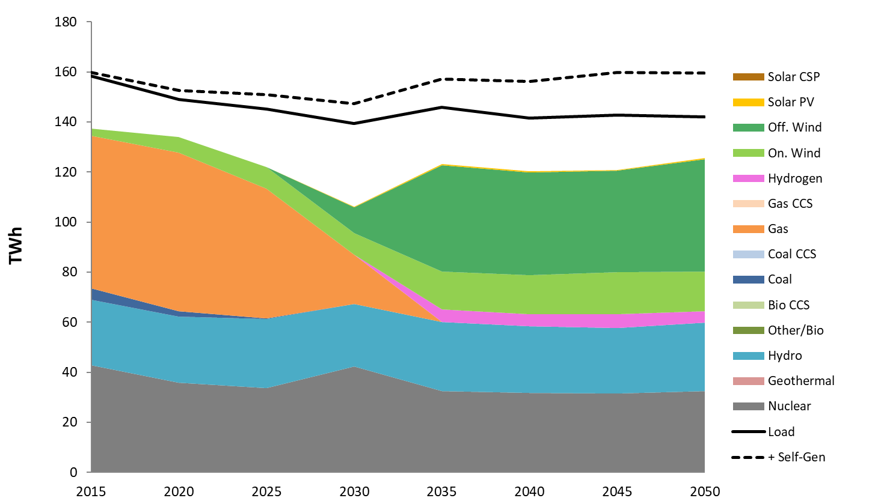
Dynamic Results: New York Generation, CES Scenario
When the entire US has a 100% CES, net imports in New York decrease roughly 50%
Quality and availability of renewable (especially wind) in NY greater than Mid-Atlantic

Slide 16
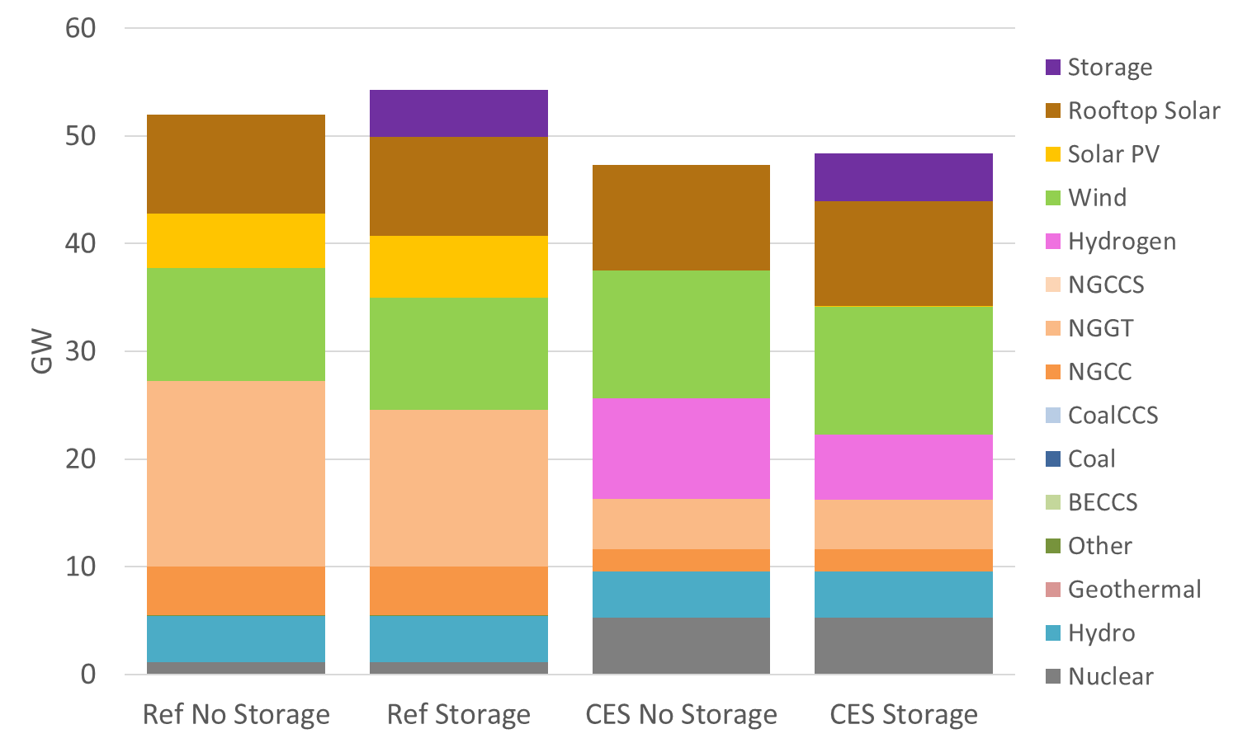
Static Model Results: New York Capacity
In Reference scenario, addition of storage allows for less NGCT capacity and slightly more Solar PV
In CES scenario, addition of storage mostly replaces Hydrogen (Which is used as long-duration storage)
In no case does storage affect nuclear capacity

Slide 17
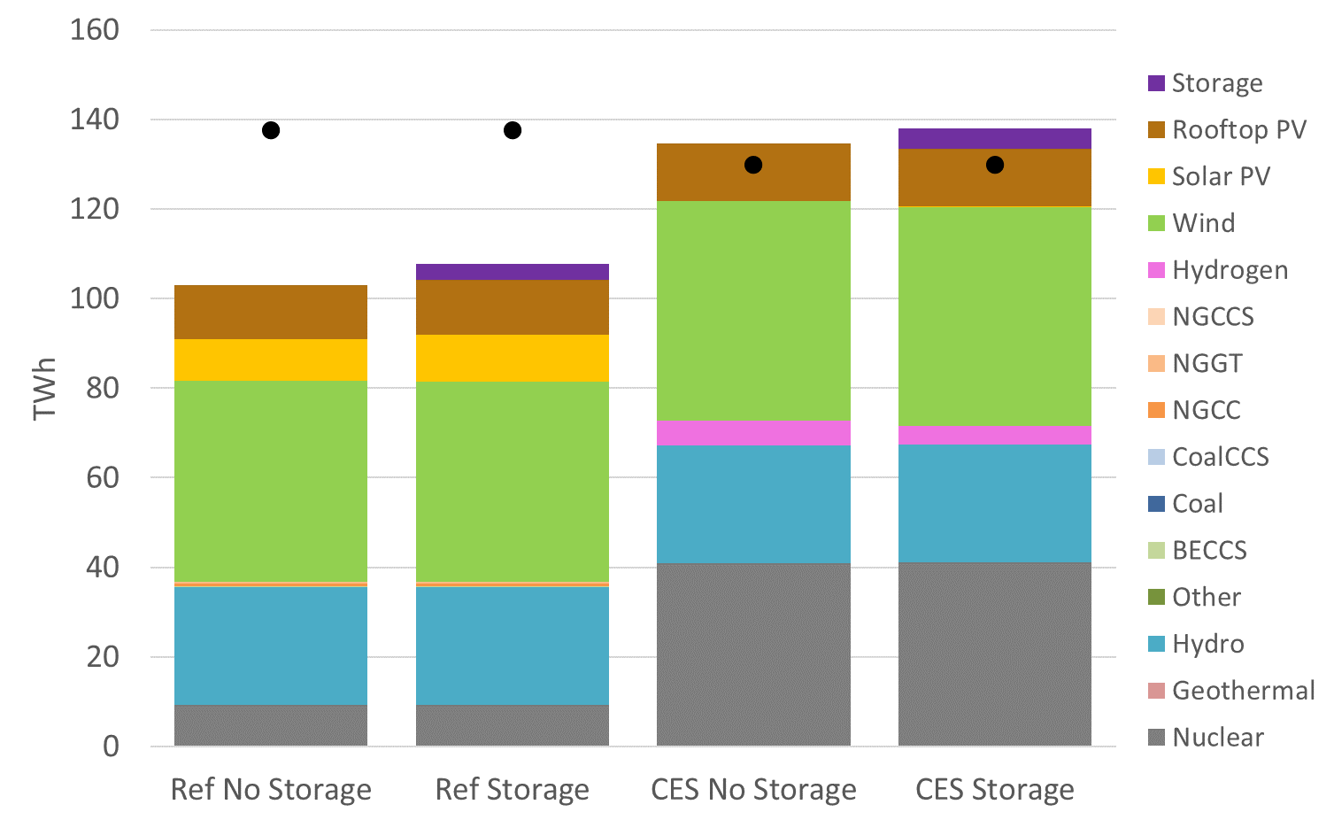
Static Model Results: New York Generation
Storage generation is net generation impact – ignoring charging (otherwise total storage contribution would be <0 due to losses)
Storage allows for slightly greater generation and lower curtailments from renewable energy
CES Scenario has more in-state generation and less imports (due to higher quality/lower cost of

