Slide 1
Exploring Information and Communication Technologies (TIC) and Key Tools
Author : {HAMMOUDI MANEL}
{SAAD SONIA}
{BOUASRIA CHAIMA}
{ALLEG ASMA}
{BELANOUAR DOUAA MERIEM}
Date of Submission : [03/01/2024]

Slide 2

In the rapidly evolving landscape of the digital era TIC has radically changed the way individuals , businesses and communities communicate.
This representation delves into the multifaceted realm of TIC, with a specific focus on key technologies such as Google services, Microsoft tools, Git, and GitHub.and we aim to understand the impact of these technologies on our interconnected world.

Slide 3
THE PLAN
Information and Communication Technologies (TIC)
Google Services
Microsoft Tools
Git and GitHub
Integration of TIC Tools
Challenges and Future Trends
Conclusion

Slide 4
Information and Communication Technologies (TIC) :
Definition :
TIC can be defined as abroad subject and concepts are evolving , It convers any product that stores, retrieves, processes, transmits or receives information electronically in digital form.
Evolution of TIC :
The development of information and communications technology (TIC) is characterized by rapid technical progress, as it has passed milestones and transformative innovation, namely :
Early Foundation: Birth of Telecommunication,
Emergence of Computing: The Birth of the Digital Era,
Rise of Networking: Connecting Computers,
Personal Computing: Bringing Technology to Individuals,

Slide 5
Internet Revolution: Connecting the Globe,
Mobile and Wireless Technologies: Anytime, Anywhere Connectivity,
Cloud Computing and Beyond: Scalability and Flexibility,
Integration of Emerging Technologies: AI, IoT, and Beyond.
Importance of TIC in Various Sectors
Information and Communication Technologies (TIC) have become indispensable in numerous sectors, driving efficiency, innovation, and connectivity. Here, we delve into the significance of TIC in key sectors.
1\ Healthcare: In the healthcare sector, TIC plays a crucial role in enhancing patient care, streamlining operations, and fostering medical research.
2\ Education: TIC has revolutionized education by introducing online learning platforms, virtual classrooms, and collaborative tools.

Slide 6
3\
Business and Commerce:
In the business realm, TIC tools drive operational efficiency, collaboration, and innovation.
4\
Finance:
The finance sector relies on TIC for secure and efficient transactions, risk management, and data analytics.
5\ Manufacturi-ng:
Smart factories leverage TIC to optimize production processes, monitor equipment health and enable predictive maintenance
6\ Transportation and Logistics:
TIC has revolutioni-zed the transportat-ion and logistics sector through innovations such as GPS tracking, real-time route optimization, and inventory management systems.
7\ Government and Public Services:
Governments leverage TIC to enhance- citizen services, streamline administrativ processes, and improve public engagement.
8\ Agriculture:
In agriculture TIC solutions contribute to precision farming, monitoring crop health, and optimizing resource use.
9\ Research and Developme-nt:
TIC accelerates research and development across various disciplines.
10\ Social Impact:
Beyond sectors, TIC has a profound social impact, fostering connectivity, information access, and civic engagement

Slide 7





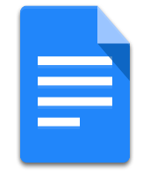




Google Services
1- Overview
Google, a global technology giant, provides a diverse range of services that have become integral to the digital experiences of individuals and businesses worldwide.
2- Key Services
Google Search
Google Meet
Google Photos
Google Drive
Google Calendar
Google Docs, Sheets, and Slides
Gmail
Google Maps

Slide 8
3- Integration and Collaboration Features
One of the distinctive strengths of Google Services lies in their seamless integration and collaboration features. Users can work collaboratively in real-time on documents, share files effortlessly, and synchronize data across multiple devices.
4- Table: Google Services Comparison
Service | Main Features | Integration with TIC Tools
Google Drive | Cloud storage, file sharing | Integrates with Microsoft Tools for collaborative document editing.
Gmail | Email, chat, and video calling | Connects seamlessly with Git for email notifications on repository activities.
Google Docs | Online document editing | Compatible with GitHub for sharing and collaborating on code documentation.

Slide 9
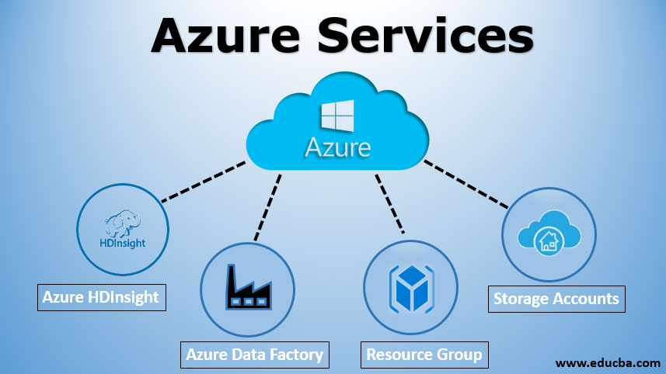
Microsoft Tools
1- Azure Services:
Microsoft Azure is a cloud computing platform that provides a wide array of services. Key features of Azure Services include:
Compute Services
Storage Services
Database Services
AI and Machine Learning
Networking Services

Slide 10




2- Collaboration Tools:
Microsoft Teams: Key features of Microsoft Teams include :
Chat and Messaging
File Sharing
Video Conferencing
Integration with TIC Tools
3- Table: Microsoft Tools Overview:
Tool | Main Features | Integration with TIC Tools
Word | Document processing and editing | Compatible with Git for version control and collaboration.
Excel | Spreadsheet and data analysis | Integrates with Google Drive for collaborative data sharing.
Power Point | Presentation creation | Connects with GitHub for collaborative development presentations.
Microsoft Teams | Team collaboration and chat | Seamless integration with Git for code repository discussions.

Slide 11


Git and GitHub
1- Introduction to Version Control:
Version control is a crucial aspect of modern software development.
Git is a distributed version control system that has become the industry standard for source code management.
2- Git Basics and Versioning:
Git: Among the features of Git we mention :
Repository (Repo),
Branching,
Commits,
Merging
Versioning:
Tags:
Git tags mark specific points in the history, usually releases, providing a snapshot of the codebase at that moment.
Semantic Versioning:
Developers use a versioning scheme to indicate the nature of changes (major, minor, or patch).

Slide 12
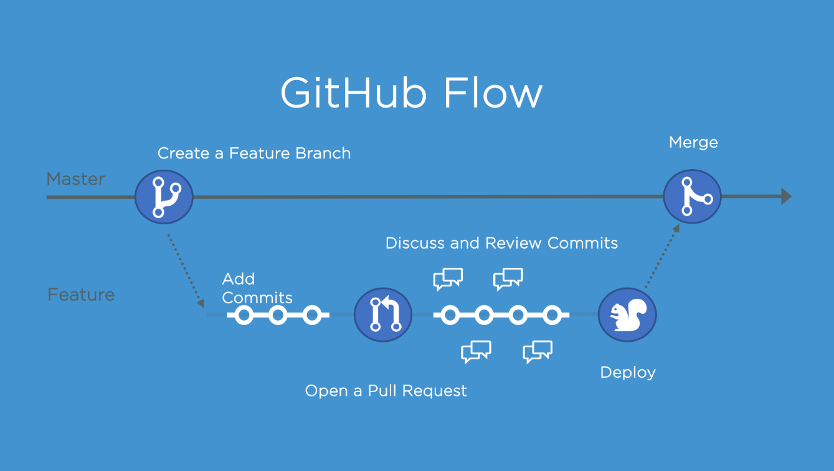
3- GitHub:
Code Repository: GitHub is a web-based platform that hosts Git repositories, making it easy for teams to collaborate.
Pull Requests: Developers propose changes to the main codebase through pull requests. This facilitates code review and discussion.
Issues and Project Management: GitHub includes tools for issue tracking and project management, streamlining development workflows.
Collaboration Features: GitHub enhances collaboration with features like wikis, discussions, and actions.

Slide 13
Integration of TIC Tools
1- Interoperability of Google, Microsoft, Git, and GitHub:
Integrating TIC tools like Google Services, Microsoft Tools, Git, and GitHub can streamline processes and enhance collaboration.
2- Case Studies of Successful Integrations:
Successful Integrations: There is :
Google Drive + GitHub,
Microsoft Teams + Git.

Slide 14
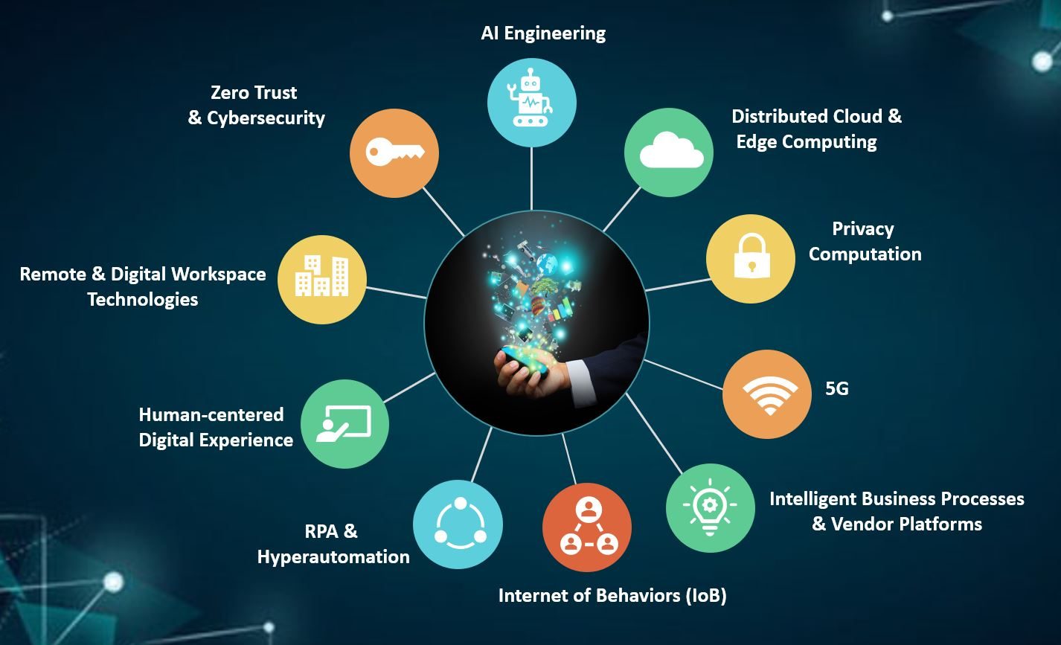
Challenges and Future Trends
1- Common Challenges in TIC Adoption
Security Concerns: Organizations face threats such as data breaches and cyber attacks.
Integration Complexity: : Integrating diverse TIC tools often comes with complexities.
Resistance to Change: Employees may resist adopting new technologies, leading to challenges in training, user adoption, and overall organizational transformation.
2- Emerging Trends in TIC:
AI and Automation,
Edge Computing,
Extended Reality (XR).

Slide 15
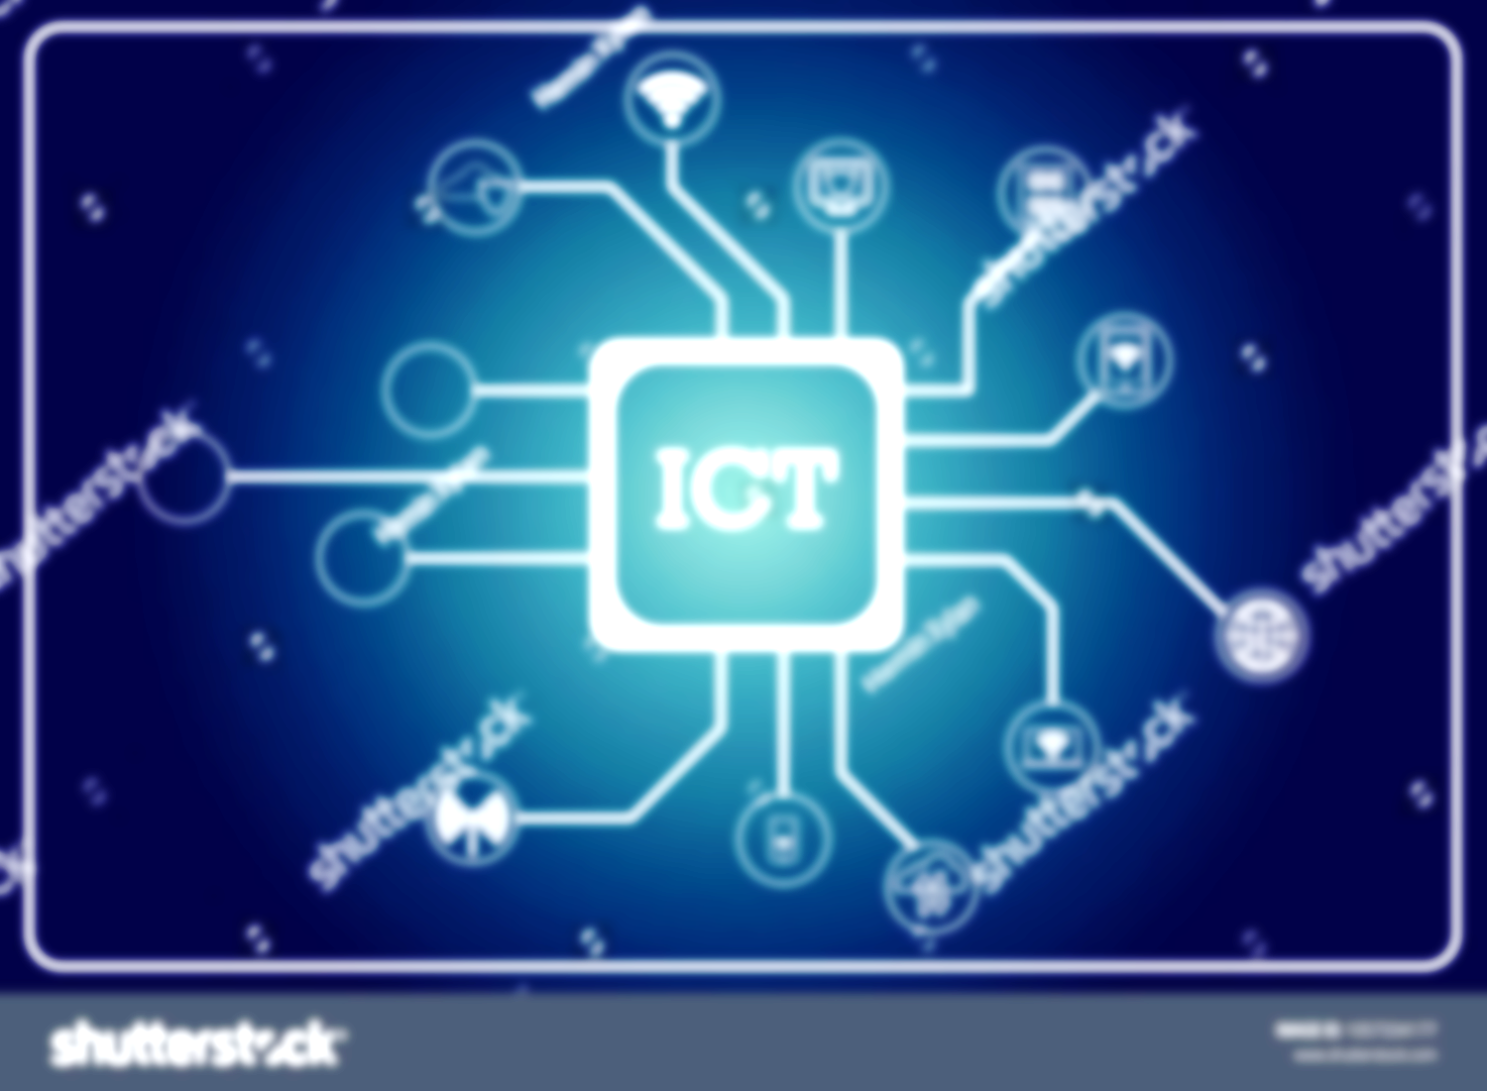
Conclusion
The representation highlights key findings in the exploration of Information and Communication Technologies (TIC) and associated tools, emphasizing the strengths of Google Services, Microsoft Tools, Git, and GitHub. Successful integration across these platforms is observed in case studies, while acknowledging challenges like security concerns. The representation ends with recommendations for efficient TIC implementation, emphasizing prioritizing security, investing in employee training, and staying informed on emerging trends, including AI and extended reality technologies.

