Slide 1
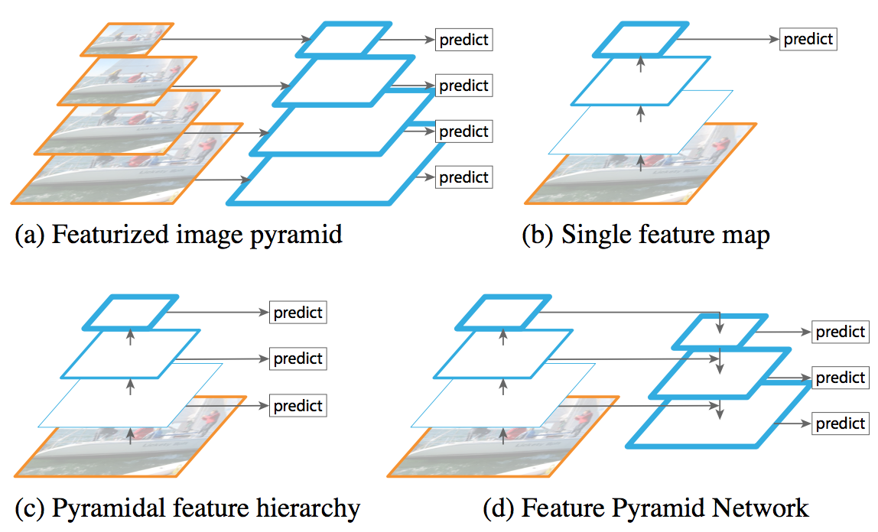
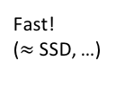
Backbone Enhancement: Improving Scale Invariance
SLOW!
(Viola & Jones, HOG, DPM, multiscale Fast R-CNN, …)
Do nothing; give up; Fast
(Fast R-CNN, YOLO, …)
Fast!
($≈$SSD, …)

Slide 2
Improving Scale Invariance
SLOW!
(Viola & Jones, HOG, DPM, multiscale Fast R-CNN, …)
Do nothing; give up; Fast
(Fast R-CNN, YOLO, …)
Fast!
($≈$SSD, …)

Slide 3
Improving Scale Invariance
SLOW!
(Viola & Jones, HOG, DPM, multiscale Fast R-CNN, …)
Do nothing; give up; Fast
(Fast R-CNN, YOLO, …)
Fast!
($≈$SSD, …)

Slide 4
Improving Scale Invariance
SOW!!
(Viola & Jones, HOG, DPM, multiscale Fast R-CNN, …)
Do nothing; give up; Fast!
(Fast R-CNN, YOLO, …)
Let’s examine this one
Fast!
($≈$SSD, …)

Slide 5
Compromise Feature Quality, but Fast (“Free”)
Low resolution,
Strong features
conv5
conv4
High resolution,
Weak features
conv3
The “native” in-network feature pyramid
poses an inherent tradeoff

Slide 6
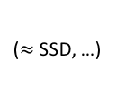
Backbone + Feature Pyramid Network (FPN)
[Optional, but recommended]
(Viola & Jones, HOG, DPM, multiscale Fast R-CNN, …)
Do nothing; give up
(Fast R-CNN, YOLO, …)
($≈$SSD, …)
(Fast/er R-CNN with FPN, …)
Lin et al. Feature Pyramid Networks for Object Detection. CVPR 2017.

Slide 7
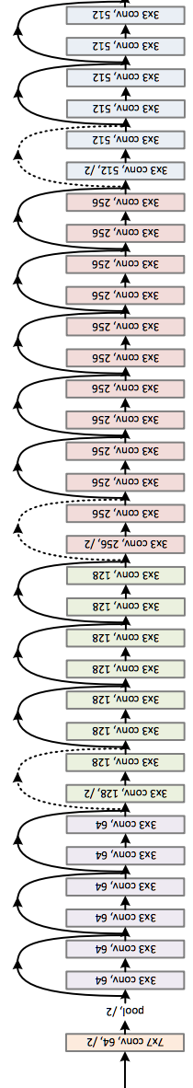
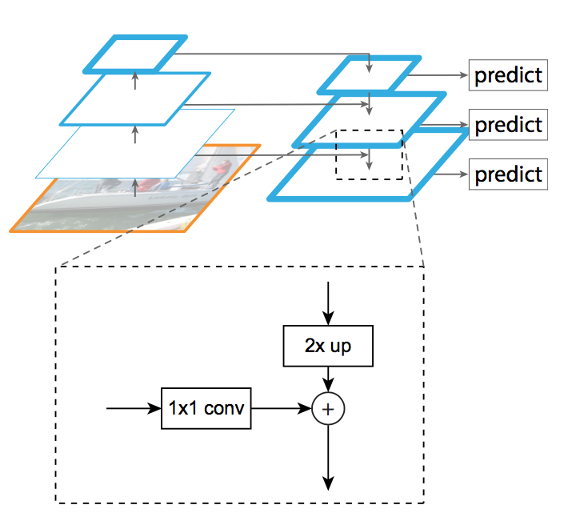
FPN
1/16 image resolution
Res4 stage output
1/8 image resolution
Res3 stage output
(Illustrated with
3 levels for simplicity;
typically use 5 or 6)
Backbone ConvNet
1/4 image resolution
Res2 stage output
FPN weights
use random
initialization
Input
Lin et al. Feature Pyramid Networks for Object Detection. CVPR 2017.

Slide 8
No Compromise on Feature Quality, still Fast
Low resolution,
Strong features
FPN pyramid
High resolution,
Strong features
Lin et al. Feature Pyramid Networks for Object Detection. CVPR 2017. See also: Shrivastava’s TDM.

