Slide 1
Preparing for Grad school and Winning Scholarships
Ms. Winfred Gatua
Wellcome Trust Fellow
1st July 2022

Slide 2
Preparing for Graduate school
Lack of publications should not deter you from applying for the MSc, PhD positions and job vacancies.
99.99% of the opportunities do not require a list of publications.

Slide 3
Do I know what I want to study?
Have a clear sense of the field of interest
You must be confident that you are capable to study the field without boredom
More specific interests, stronger applications
Not sure about your interest take time to meditate on topic of interest

Slide 4
What are my prospects after grad school?
You may not want to think about it now, however, it is very crucial in deciding on grad school
Research what you will be able to do with your degree after graduation
Academia or industry?

Slide 5
Am I financially prepared?
Most PhD programmes are fully funded
Master’s programmes offer less financial assistance
May require you to obtain student loans to cover tuition and or cost of living
Many schools offer, financial aid, merit scholarships, teaching assistantships and student loans with manageable interest rates
You may consider a part-time while holding a job to cover expenses

Slide 6
How much time do I need to apply?
PhD deadlines, December - January
Masters' deadlines, January, - March (Varies depending on location)
NB: You need couple of months to get your applications in order
Tasks:
Taking GRE and other required standardized tests
Asking professors for recommendations
Writing your statement of purpose
Researching grad schools
Deciding where you apply
NB: Start preparations in July/September

Slide 7
Should I panic if I've been out of school for several years?
No way
Many programs take candidates who have taken some time to put their careers in perspective
If you are really nervous, you can ease your transition by taking a class or two as a non-matriculated student in your field of study before heading back to the classroom fulltime

Slide 8
How to Choose a Grad School
List down the prospective graduate schools in order of priority
Keep career in mind
The quality of the faculty is key for masters and PhD programmes find a specific professor you would like to work with 1-6 years
Network with faculty members with whom you are interested working with
Make a connection with those faculty professors, it will be a boost to your application

Slide 9
Continue
Consult actual graduate students
Get to know the department, quality of education, their advisors, are they happy being in that institution?
Consider program resources and facilities
Does the institution have adequate facilities?
How are the labs and other resources like the library, grants, teaching assistantships and summer fellowships
For PhD students, you may want to know are the classes offered relevant to your interests and will they compliment your research?

Slide 10
Scholarship application tips

Slide 11
What is scholarship, grant and student loan?
Scholarship is “an amount of money given by a school, college, university, or other organisation to pay for the studies of a person with great ability but little money.”
Scholarships and grants are gift aid, which means students do not need to pay the money back. However, grants are usually need-based, and often go to young people who cannot afford the costs of their studies.
In contrast, most scholarships are awarded based on academic, athletic, or artistic abilities.
Unlike scholarships, student loans are a form of financial aid that needs to be paid back, sometimes with interest.

Slide 12
Types of Scholarships
Scholarships for excellent academic results (also called merit scholarships)
Scholarships for research, artistic, or athletic achievements
Scholarships for students from low income countries
Scholarships for under-represented groups (e.g. women, Hispanic and African-American students, citizens from developing countries)
Scholarships for all international students (e.g. the Studyportals Scholarship: International Distinction Awards)

Slide 13
Who can apply?
Anyone who meets the application requirements can apply
NB: Different scholarships may target different students
May be open to domestic and or international student

Slide 14
Common requirements
Registration or application form
Letter of motivation or personal essay
Letter(s) of recommendation
Letter of acceptance from an academic institution
Proof of low income, official financial statements
Proof of extraordinary academic or athletic achievement and Curriculum Vitae

Slide 15
1. Apply as early as possible
Remember the funding is limited
Gives you ample time to review your application
Beat the odds of deadline

Slide 16
2. Check university websites for opportunities
If you know which universities you want to study at, then the institution websites are a good place to start your scholarship search
In addition, find financial aid and funding from other institutions

Slide 17
3. Search for other scholarship providers
Looking beyond universities to find alternative scholarship providers
E.g., QS scholarship scheme
Talk to people and search using various resources, such as libraries, internet or books, for available funding opportunities

Slide 18
4. Pay close attention to the application essay topic
Ensure each scholarship application you write is well-targeted for the opportunity in question
Take you time to understand the topic in question
Identify all the key words, take time to understand them and strictly stick to the question when you answer

Slide 19
5. Get someone else to read your application
Helping you identify typos or other errors; constructive feedback can also help you become more aware of your own relevant strengths and achievements
Personal experience:
My applications have been greatly improved after sharing with someone and getting feedback

Slide 20
6. Manage your time well
Time management is especially critical if you’re juggling multiple scholarship applications
Make a calendar of all the deadlines and give yourself plenty of time to work on each application, and ensuring you submit all the required documents
Be patient, keep applying, and make sure you manage your time well, so you meet all the deadlines

Slide 21
7. Apply, apply, apply!
Stop doubting yourself and start applying!
They are competitive yes
However, putting in the effort was one of the best decisions I ever made
Received plenty of rejection letters before meeting with success, proving that it’s important – and worthwhile – to keep on applying. You never know which scholarship application will be the one that succeeds
Do not give up on your dreams

Slide 22
Mistakes to avoid
Not following directions
Not paying attention to the deadline and missing it
Not typing your application or sending in a sloppy application
Forgetting to spell check and to proofread
Not including information such as a transcript or recommendation
Not answering the essay question or another question asked

Slide 23
Shortlisted for opportunities. What next?
Interview preparation tips
Prepare well, failure to prepare is a preparation to fail
Prepare common interview questions
Prepare domain specific questions
Be punctual
EMBRACE GOOGLE

Slide 24
Websites
Scholarshipportal.com
Scholarships for Development – website providing financial aid programmes especially focused on students from developing countries
Official EU scholarship page – list of scholarships available for studies in Europe
Scholarships.com – database with over 3.5 million scholarships and grants
https://www.findamasters.com (Masters)

Slide 25
Continue
https://www.findaphd.com (PhDs)
Study abroad by individual countries
official info about scholarships in Austria
official info about scholarships in Denmark
official info about scholarships in France
official info about scholarships in Germany
official info about scholarships in Sweden
official info about scholarships in the Netherlands
official info about scholarships in the UK

Slide 26
Continue
New Life Research Foundation (NELIREF) – Scholarships (Facebook, twitter)
Be found where communications happen (LinkedIn, twitter, Facebook)
NB: Consider local scholarships (In country or regional)
Examples:
PAUSTI, EANBIT, WACCBIP, BECA, The Deltas, AAS, SACCAB,DELGEME, CAFGEN, MAWAZO, MOEST-Kenya etc
Never ignore local scholarships, they can set you on high (IDeAL and EANBiT) for scholarships abroad

Slide 27
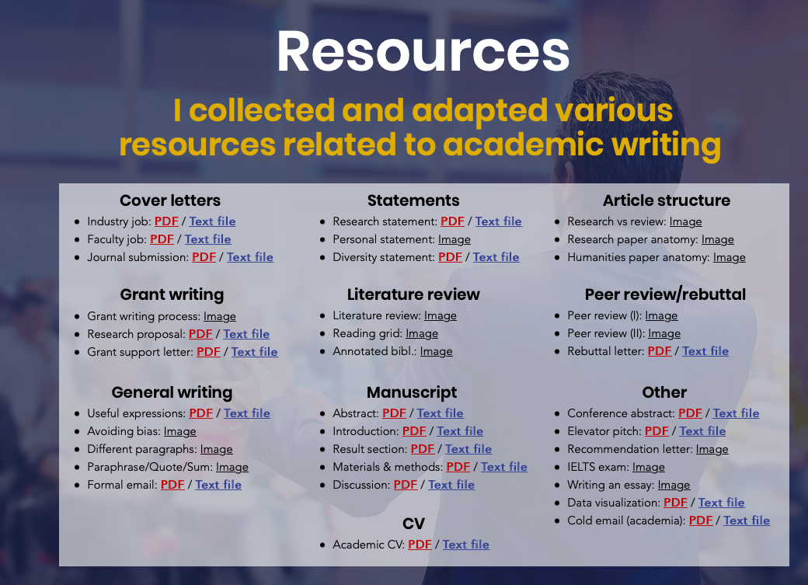
Must visit site

Slide 28












Acknowledgement
Advisors and mentors
Prof. Tom Gaunt
Prof. Deborah Lawlor
Prof. James Nokes
Prof. Santie deVilliers
Dr Charles Agoti
Dr Caleb Kibet
Dr Jie Zheng
Dr Yi Liu
Dr Atunga Nyachieo
Dr Emily Ng’etich
Dr Veronica Ngure
Tobias Ambundo
Evans Mudibo
Mom, Family and Colleagues

Slide 29
LinkedIn:
https://www.linkedin.com/in/winfred-gatua-0b2317101/
Twitter:
@gatuaprof
Thank you

Slide 30
Open Opportunities
https://www.rhodeshouse.ox.ac.uk/scholarships/apply/
Wellcome International Master’s Fellowships

Slide 31
Excelling in Graduate School
Get organized way before the semester starts rolling
Know what time you are active and get to know the leaders in your field
Read the materials (text books) way before
Get the syllabus/ curriculum way before

Slide 32
Continue
Establish a self-care routine
Take time to write down your goals
The above keeps you motivated like, why are you in grad school
Set goals for your semester to ensure that you accomplish each on at a time and on time

