Slide 1
Machine learning rfid project
VINCENT BOUREL 2021

Slide 2
objectives
As a reminder, the idea of this project was to propose machine learning solutions allowing the identification of tags in RFID tubes via two antennas IN and OUTI
I worked with the GridSearch and optimization of hyperparameters approach first. Thus, I put empirically different parameters in the hyperparameters set for SVC, Logistic Regression, Random Forest and Kneighbors classifier to get a better result. I was able to show you my results in class, but I was not able to retrieve my results since, so I turned to neural networks. I will briefly present you the results obtained

Slide 3
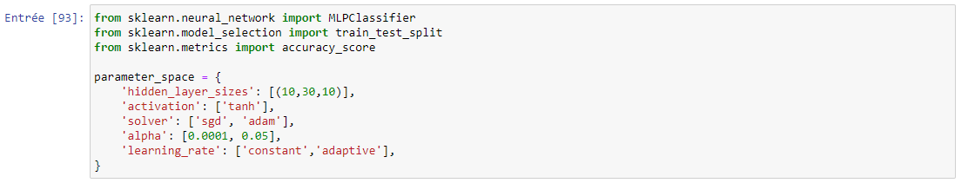
Import of libraries and definition of parameters for GridSearchRemark : To limit the computation time I limited myself to the default parameters

Slide 4
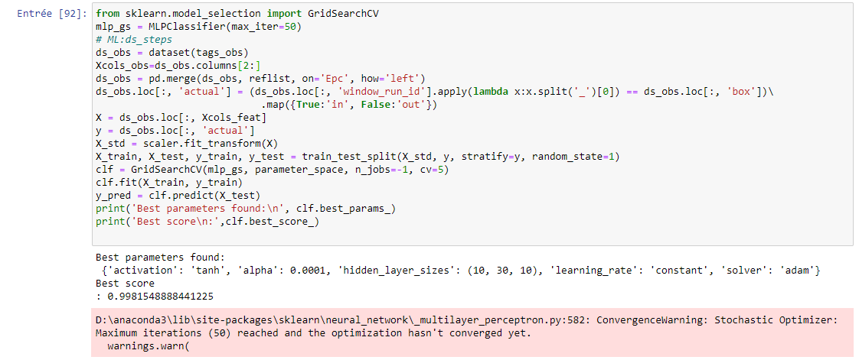
Algorithm and first results with 50 iterations.Remark : The number of parameters is not enough but we already obtain a satisfactory result.

Slide 5
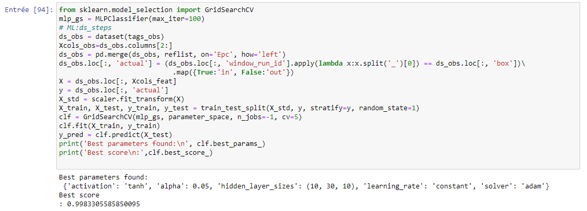
The Best parameters are the same but the score is now 0.9983. The 100 iteration instead of 50 didn’t change a lot the final score but the time of computing doubled

Slide 6
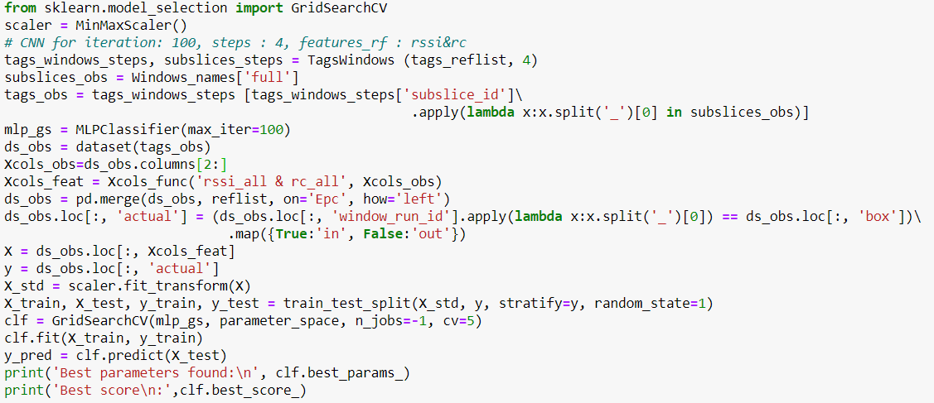
Same code but i used the extra and full dataset in order to get better results
Better result so fare

Slide 7
CONCLUSION
The CNN (Convutional Neural Network) seems to give good scores for RFID tag identification while I only tried to classify it. It would be interesting to improve the training of the network with other sets of data or by improving the existing sets. We can also improve the results by adding new parameters with better solvers for example or by increasing the number of layers. On the other hand I don't think that increasing the number of iterations is sufficiently interesting. For the rest, it will be necessary to consider adapted computing power for large neural networks for example.

