Slide 1
Representation Learning with Contrastive Predictive Coding

Slide 2
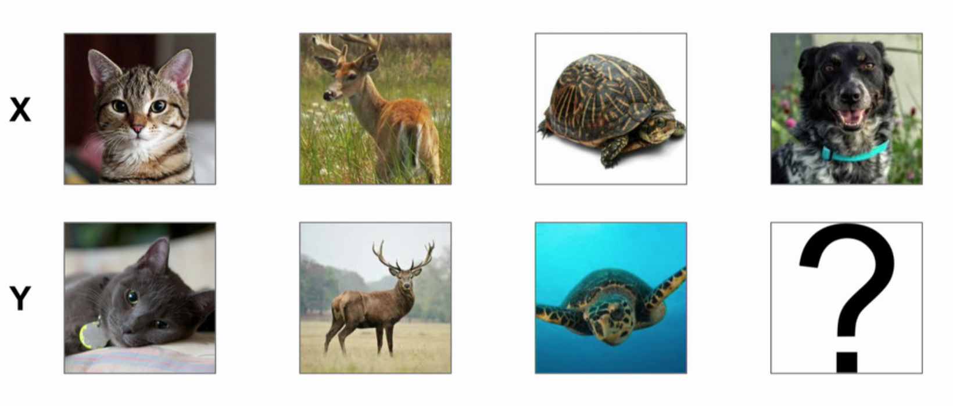
Mutual Information

Slide 3
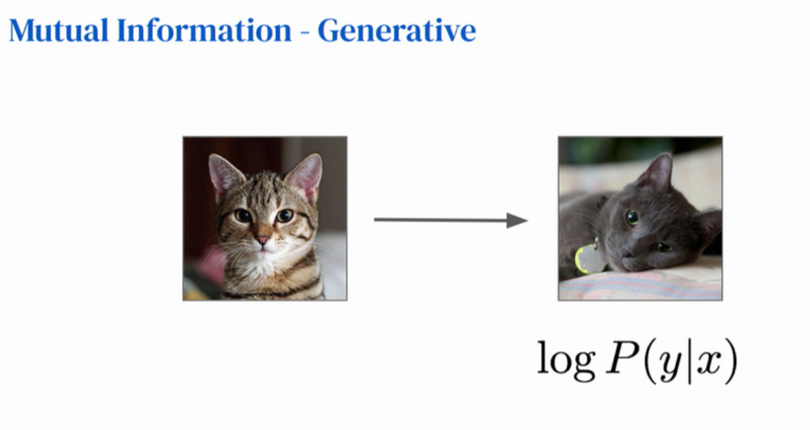

Slide 4
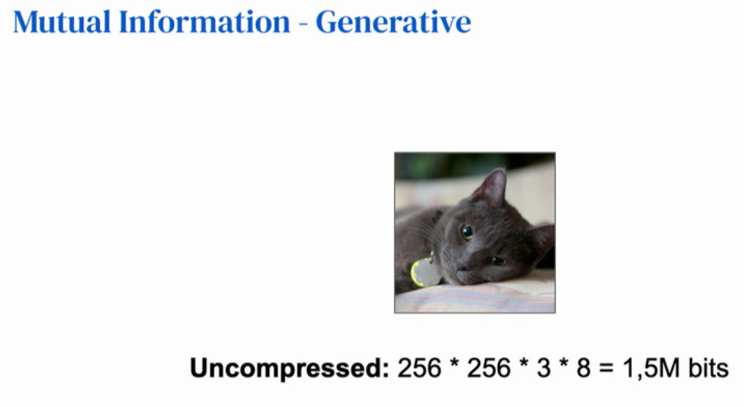

Slide 5
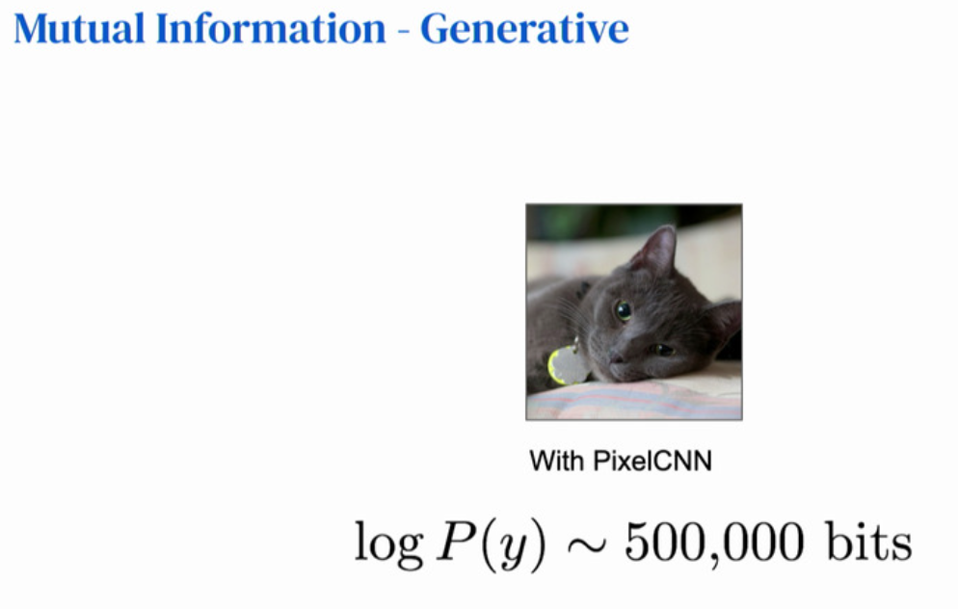

Slide 6
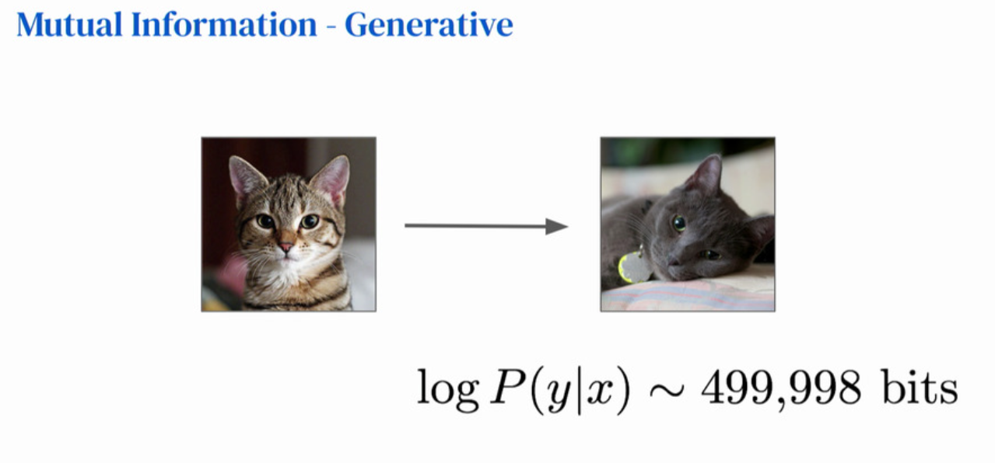

Slide 7
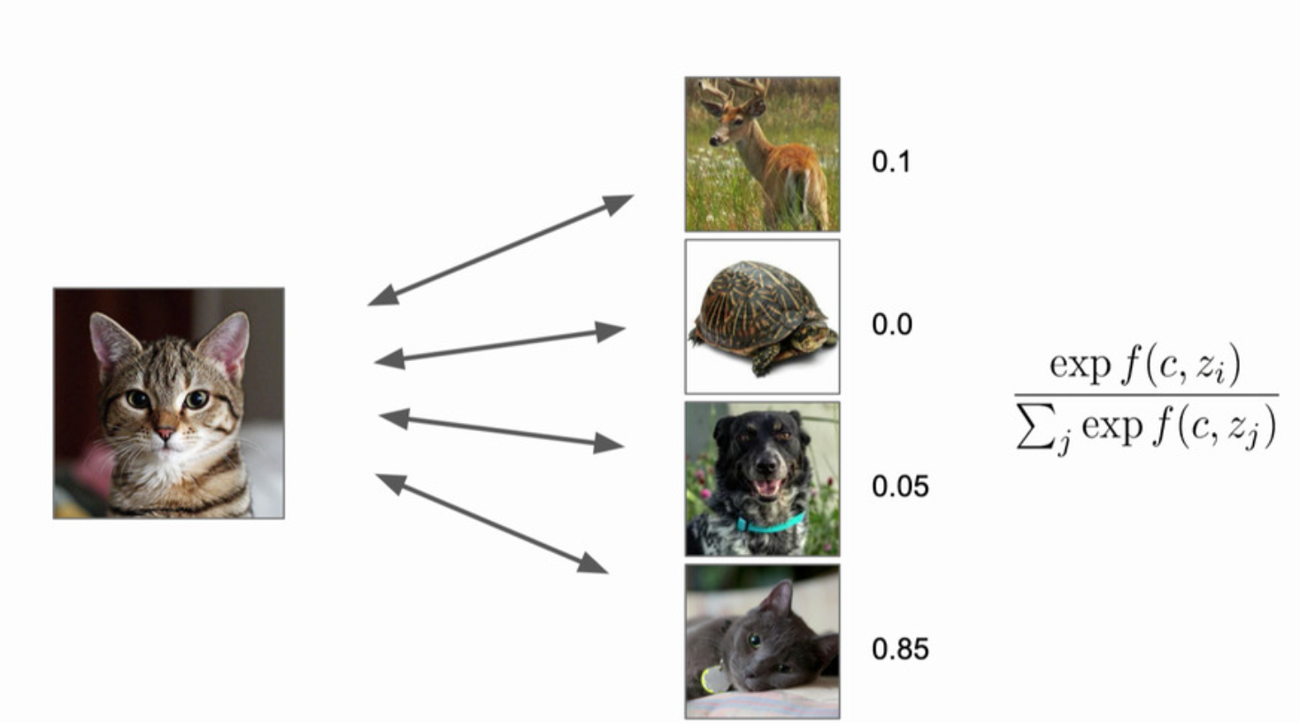
Mutual Information - Contrastive
f: critic function

Slide 8
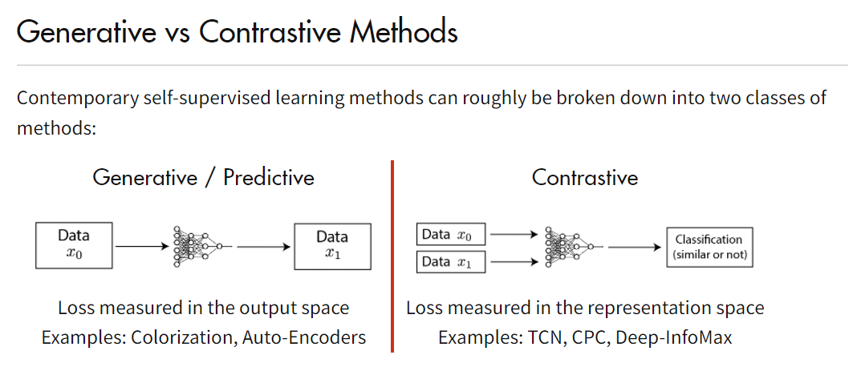

Slide 9
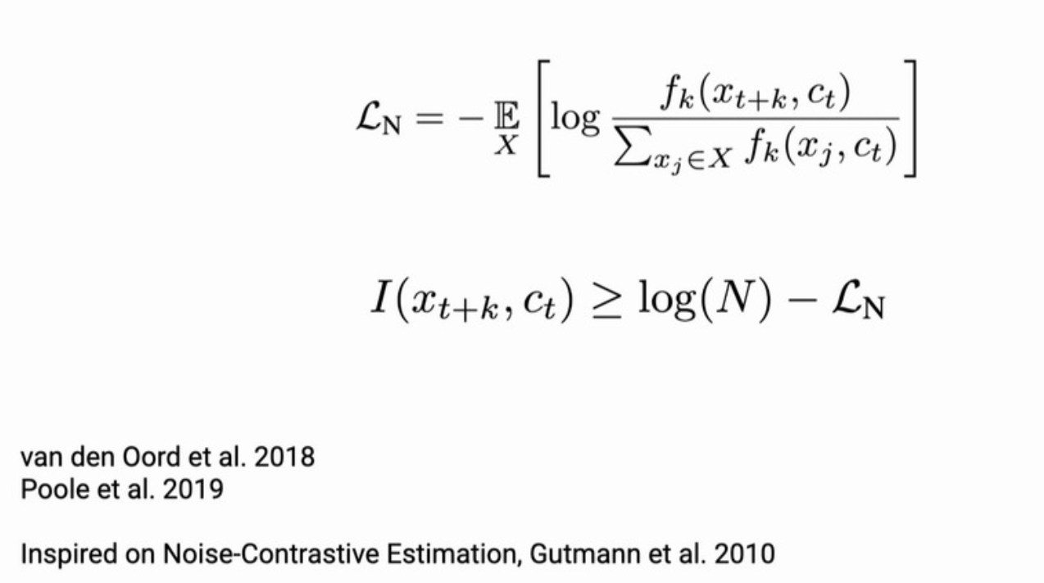
InfoNCE and Mutual Information

Slide 10
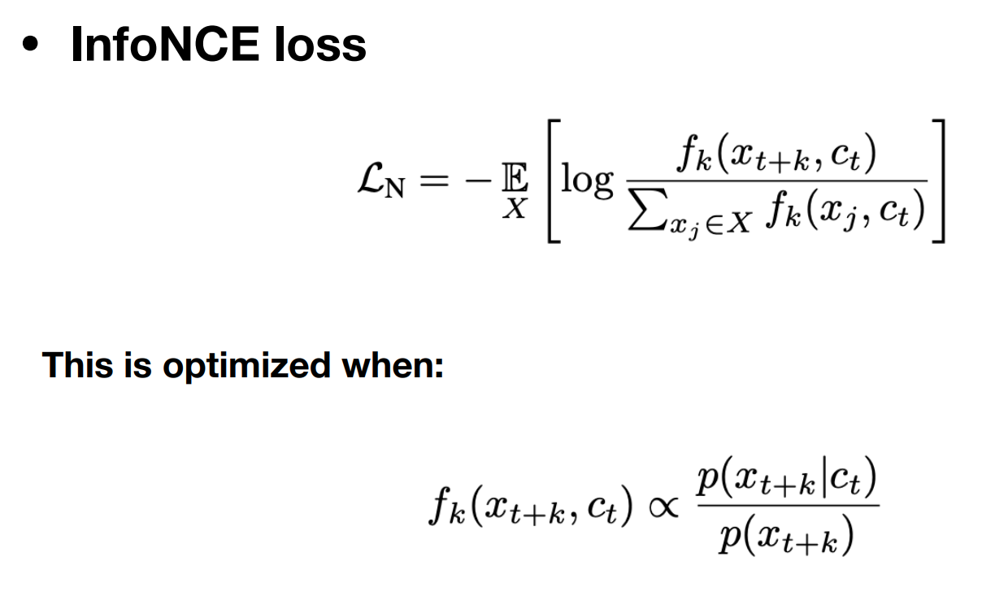
More about the InfoNCE

Slide 11
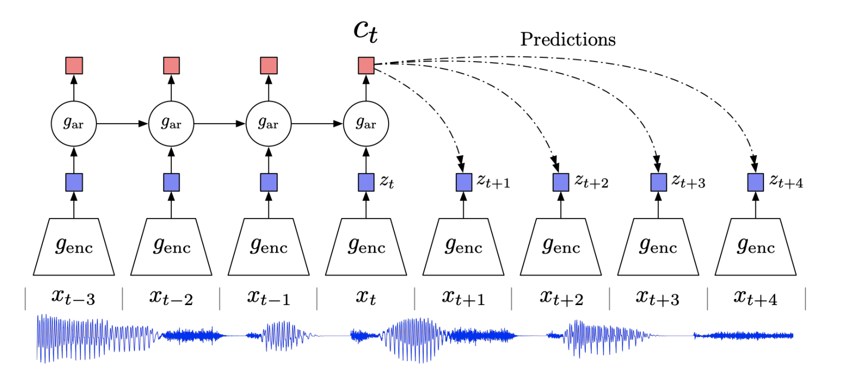
Contrastive Predictive Coding

Slide 12
Non-linear encoder
Non-linear encoder maps the input sequence of observations to a sequence of latent representations. Standard architecture such as strided convolutional layers with resnet blocks.

Slide 13
Autoregressive Model
An autoregressive model summarizes all past latent representations potentially with a lower temporal resolution. GRUs.

Slide 14

Mutual Information
Maximize the mutual information between context and future target via InfoNCE with a simple log-bilinear model:

Slide 15
Experimental Results
Experiments with speech, text, image and reinforcement learning.
Here, I will only present results on speech data.
Corpus: 100-hour subset of LibriSpeech.

Slide 16
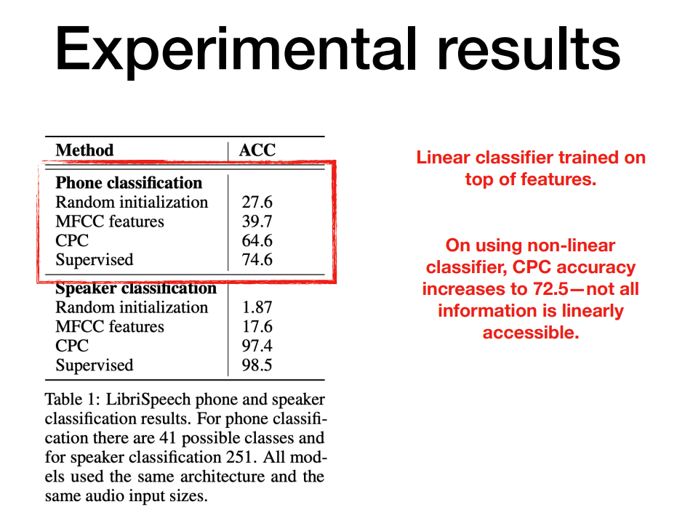

Slide 17
