Slide 1
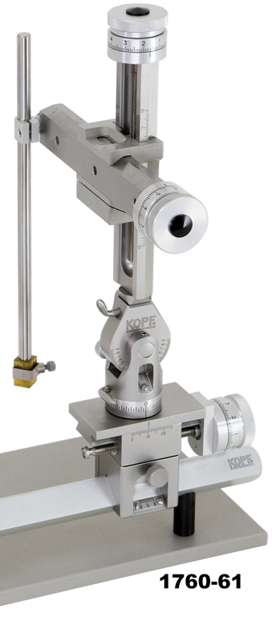
Connector clamp
Connector
8”
Sensor rod
Sensor

