Slide 1
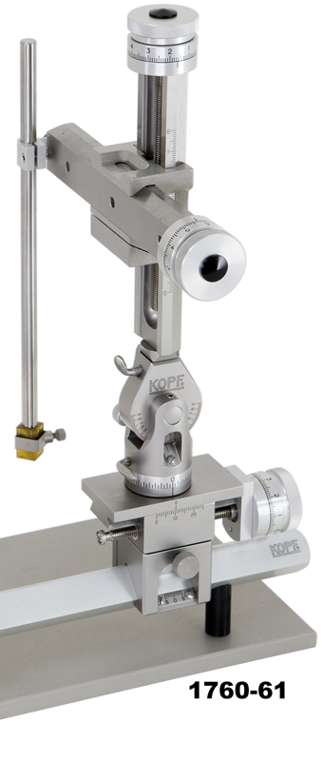
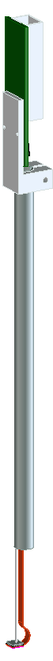
Connector
8”
Sensor rod
Sensor

Slide 2
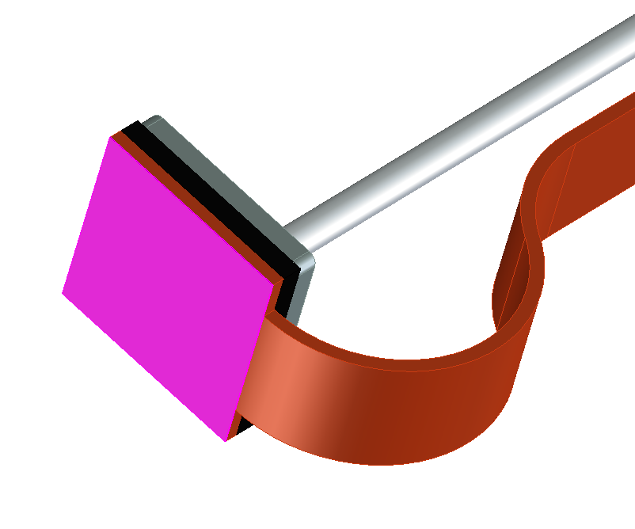
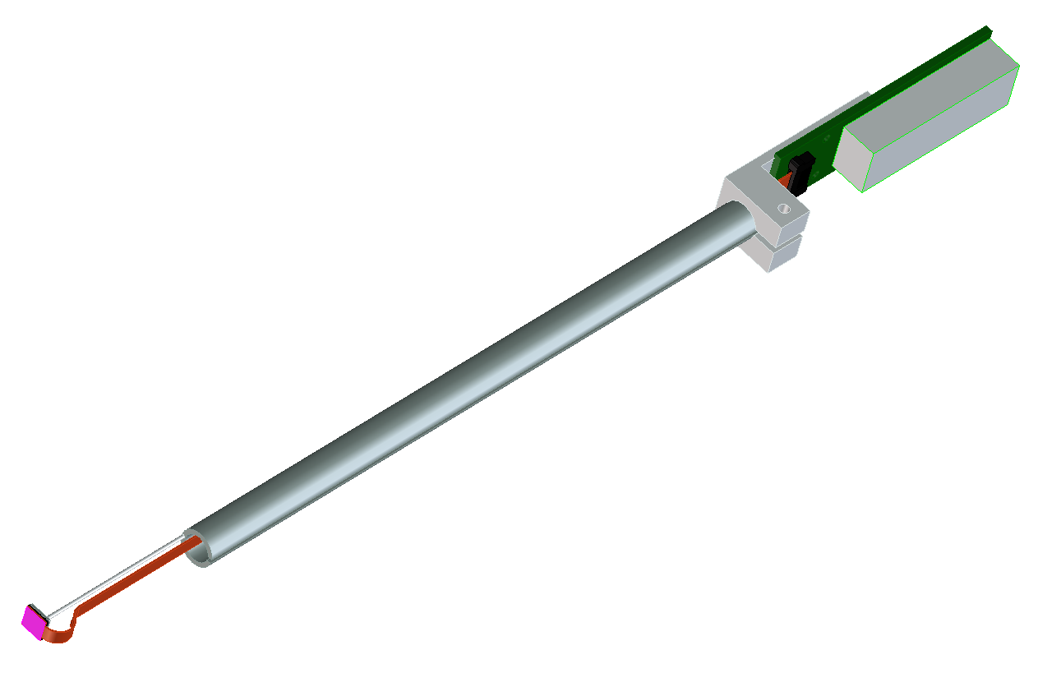
I/O electrical connector
Ribbon connector
Stainless backing
Sensor
Flex-circuit
Foam backing

