Slide 1
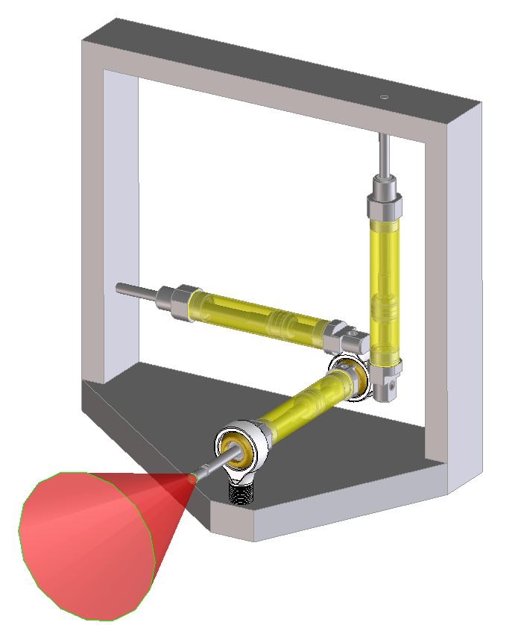
~6”
Pneumatic cylinder
Zone of handle motion
Ball joint

