Slide 1
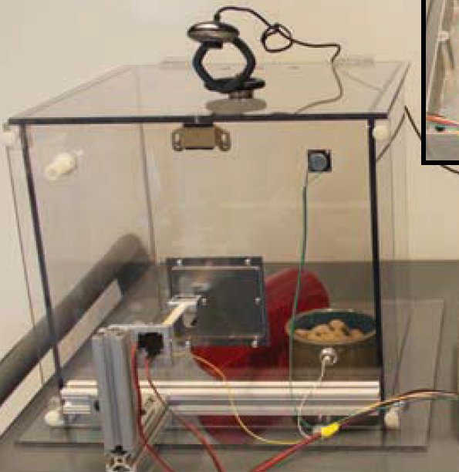
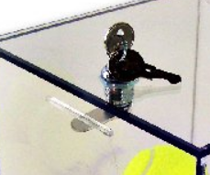
Lid is wider and hinged at back (removable hinges – use screws)
Front panel is wider and removable via L-brackets and screws
20”
12”
Base is 1” wider all around
12”
Keyed Cam-lock

