Slide 1
Ray Tracing
TI1806 Computer Graphics Project 2016
Boudewijn van Groos 4229843
Jeroen Kloppenburg 4477960
Martijn Straatman 4442504
Jurriaan den Toonder 4431324
Tim de Groot 4383052
Vincent van Heertum 4319303
Alessandro Ariës 4470346

Slide 2
Competition Image

Slide 3
Work Distribution
Who did what?
In our final version:
RayIntersection: Martijn, Boudewijn, Alessandro, Tim
Shading: Jurriaan, Alessandro
Datastructure for Acceleration: Boudewijn, Jurriaan, Jeroen
Recursive Raytracing: Vincent, Martijn, Jeroen
Moving Sun: Boudewijn, Jurriaan
Not in our final version:
SphereRayIntersect – Alessandro, Tim
Refraction: Jeroen

Slide 4
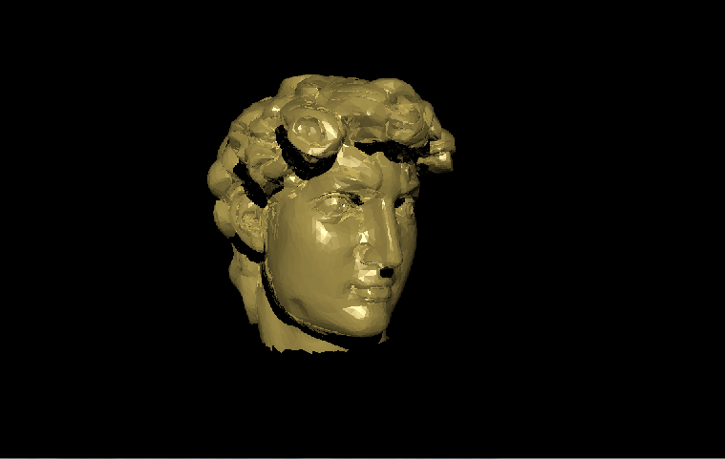
Techniques
Feature list for our ray tracer
Blinn-phong diffuse and specular shading
Reflection
Kd-tree

Slide 5
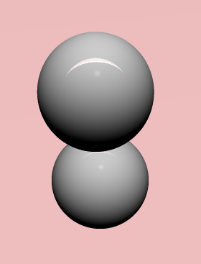
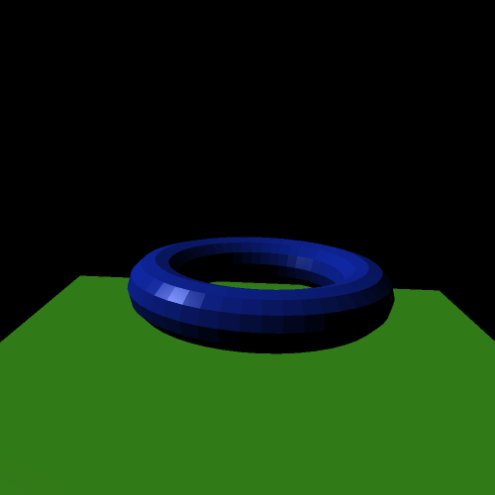
Blinn-Phong Shading

Slide 6
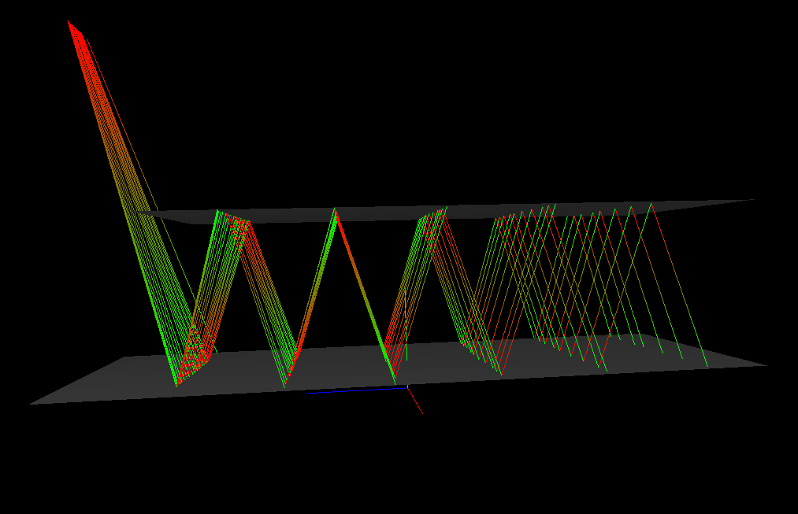
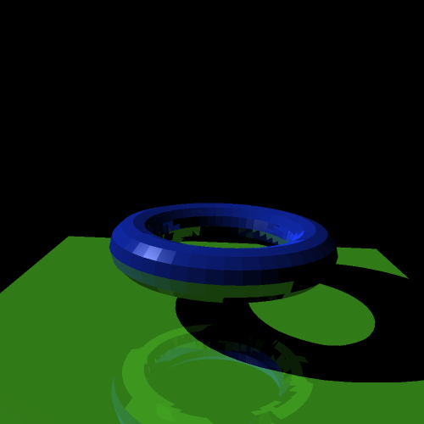
Reflection

Slide 7
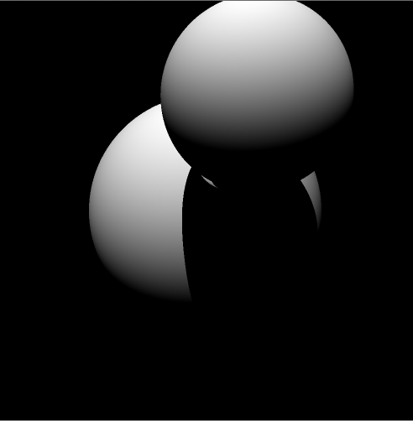
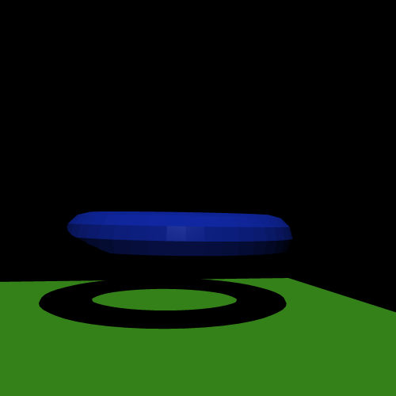
Shadow

Slide 8
Improvements
Things we couldn’t complete in time
Soft shadows
Texture mapping
Refraction

