Slide 1
Which Azure Storage Option Should I Choose?
Anne Bougie
Senior Software Developer, Concurrency Inc.
@bougiefever
https://bougiefever.com

Slide 2
Ways to Store Data in Azure
(Non-Inclusive)
Azure SQL
DocumentDb
Table Storage
Redis Cache
Hbase
Neo4j
SQL
NoSQL

Slide 3
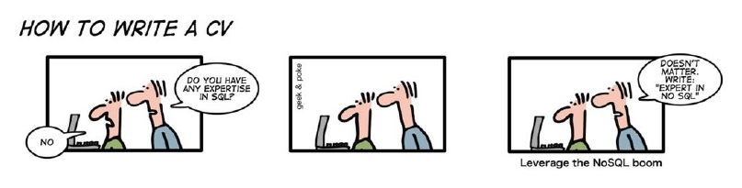
Sql vs NoSql vs Excel Spreadsheets

Slide 4

SQL
NoSQL
Relational
Schema-less
Persistent
Limited Transactional Support
Supports Transactions
Highly Scalable
Strong Schema
Highly Available
Data Integrity
Fast
Notes:
NoSQL is hard to define because it covers a broad range of products – Expect terminology to change in the future

Slide 5



SQL
NoSQL
Querying Data
Transactions
Scalability
Configuration/Management
Schema
Speed
Notes:
Queries (S)
Transactions (S)
Consistency (S)
Scalability (N)
Configuration/Management (N)
Schema (N)
Speed(N)

Slide 6

SQL
NoSQL
Notes:
SQL
Scaling up has limits – costs a lot
Sharding – “Unnatural Acts”
NoSql

Slide 7
Key-Value
Document
Azure Table Storage
DocumentDb
DocumentDb
Azure Table Storage
Azure Redis Cache
Azure Hbase
Neo4j
Azure Redis Cache
Graph
Neo4j
Column Family
Azure Hbase
Notes:
Document: DocumentDb/MongoDb/CouchDb
Json – Complex hierarchical structures – can pull out parts of document
------
KeyValue: Azure Table Storage/SimpleDb/DynamoDb/Riak
Simpleist – Glorified Dictionary/Hashmap
Redis Cache/Redis/Memcached
ColumnFamily: Azure Hbase/Apache Hbase/Cassandra (Apache)/BigTable
Graph: Neo4J/OrientDb

Slide 8

Impedence Mismatch
Order
Order
Order Id: 1234
Player: Mojo Jojo
Player Assets
In-App Purchase
1 | Gems | 250 | $5
2 | Potions | 10 | $10
Line Items
Financial
Credit Card: 4012888888881881
Expiration: 5/2020
Credit Card
Notes:
When object-oriented program is persisted to a RDBMS (relational database management system)
A cohesive set of data in your program gets persisted to several different tables
ORMs created to handle this problem
Order – we think of an order as one thing, but Order/LineItem – when we save it, we need to split it out

Slide 9
{
orderId: 1234,
player: ‘Mojo Jojo’,
inAppPurchase {
date: 1/1/2017,
items: [
  {
  objectType: ‘Gem’,
  quantity: 200,
  priceEach: 0.02
  },
  {
  objectType: ‘Potion’,
  quantity: 10,
  priceEarch: 1.00
  }
]
}
…
Order
Order Id: 1234
Player: Mojo Jojo
In-App Purchase
1 | Gems | 250 | $5
2 | Potions | 10 | $10
Financial
Credit Card: 4012888888881881
Expiration: 5/2020

Slide 10

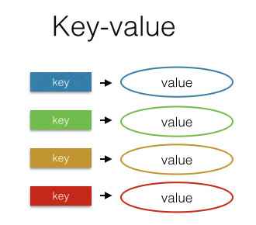

Key Value
Notes:
No set schema – need structure – Implicit Schema to get info out and to deserialize

Slide 11
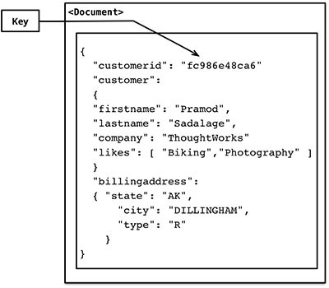
Document
Notes:
No set schema – need structure – Implicit Schema to get info out and to deserialize

Slide 12
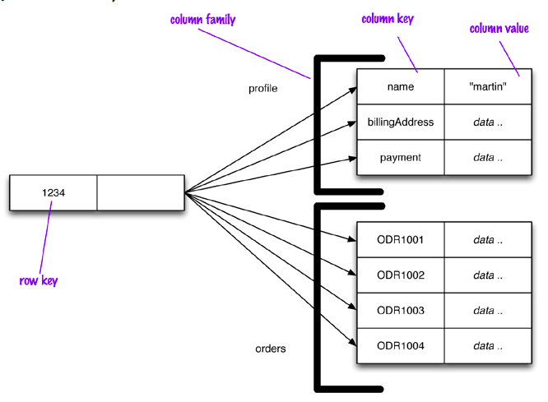
Column Family
Notes:
More complicated
Row key – can store multiple column families – columns that fit together
Retrieve by row key and column family name

Slide 13
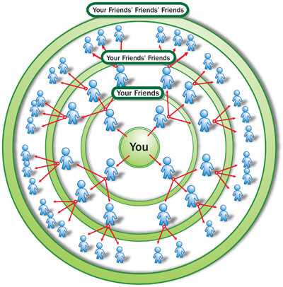
Graph

Slide 14
Document
Key Value
Document
Key Value
Column Family
Column Family
Graph
Graph

Slide 15
So How Do I Choose?

Slide 16

CAP Theorem
Never Gonna Get It
Consistency
DocumentDb
Azure Storage
Hbase
SQL
Partition Tolerance
Availability
Hbase
Azure Storage
DocumentDb
Azure Redis Cache
Notes:
Strong consistency is only guaranteed within a geo region, across geo regions the consistency guarantees are weaker. So the CAP statement theorem is only overcome within a certain geographic scope.

Slide 18
Issues To Consider
How many relationships
How much data
Data access performance requirements
Entity complexity
Programmer skill level
Notes:
Relationships: Data that has a lot of relationships don’t do as well in relational – Graph can get data with lots of connections faster than lots of joining
Scaling needs: FB – Column family database
Complexity – DocumentDb with json especially if you are going to serialize to json anyway
ORM has helped a lot – performance is often a problem

Slide 19
NoSQL Guidelines
Key Value
Column Family
Document
Graph
Lots of data
Simple data structure
Quickly perform small read and write operations
Inexpensive, fairly simple
Need to add data items willy nilly
Lots of data
Insanely huge amounts of data
Need high performance
Need to add data items willy nilly
No joins
Lots of data
Need high performance
More complex data structure
Need to add data items willy nilly
Lots of data
Lots of connections between entities
Quickly changing relationships between entities (change relationships willy nilly)
Notes:
CFDB is what happens when you take a database, strip everything away that make it hard to run in on a cluster and see what happens. (Ayende)

Slide 20
Why Choose Only One?
Problem
Solution
Lots of data
Fairly simple data structure
Lots of small reads and writes
Need high performance
Need high availability
Need fast searching
Use Azure Storage
Augment with Redis Cache for searching

Slide 21
Why Choose Only One?
Problem
Solution
Really need high consistency
Highly structured data
Current data is not really large
Historical data is huge
And we need to report on historical data
Use Azure Sql
Archive to DocumentDb

Slide 22
Resources
Anne Bougie
anne.bougie@gmail.com
@bougiefever
http://www.bougiefever.com
https://github.com/Bougiefever
A Newbie Guide to Databases https://blog.appdynamics.com/engineering/a-newbie-guide-to-databases/
That NoSQL Thing: Column (Family) Databases https://ayende.com/blog/4500/that-no-sql-thing-column-family-databases
NoSQL Distilled: A Brief Guide to the Emerging World of Polyglot Persistence http://a.co/1YwtJ47
On Sharding Graph Databases http://jimwebber.org/2011/02/on-sharding-graph-databases/

Slide 23


