Slide 1
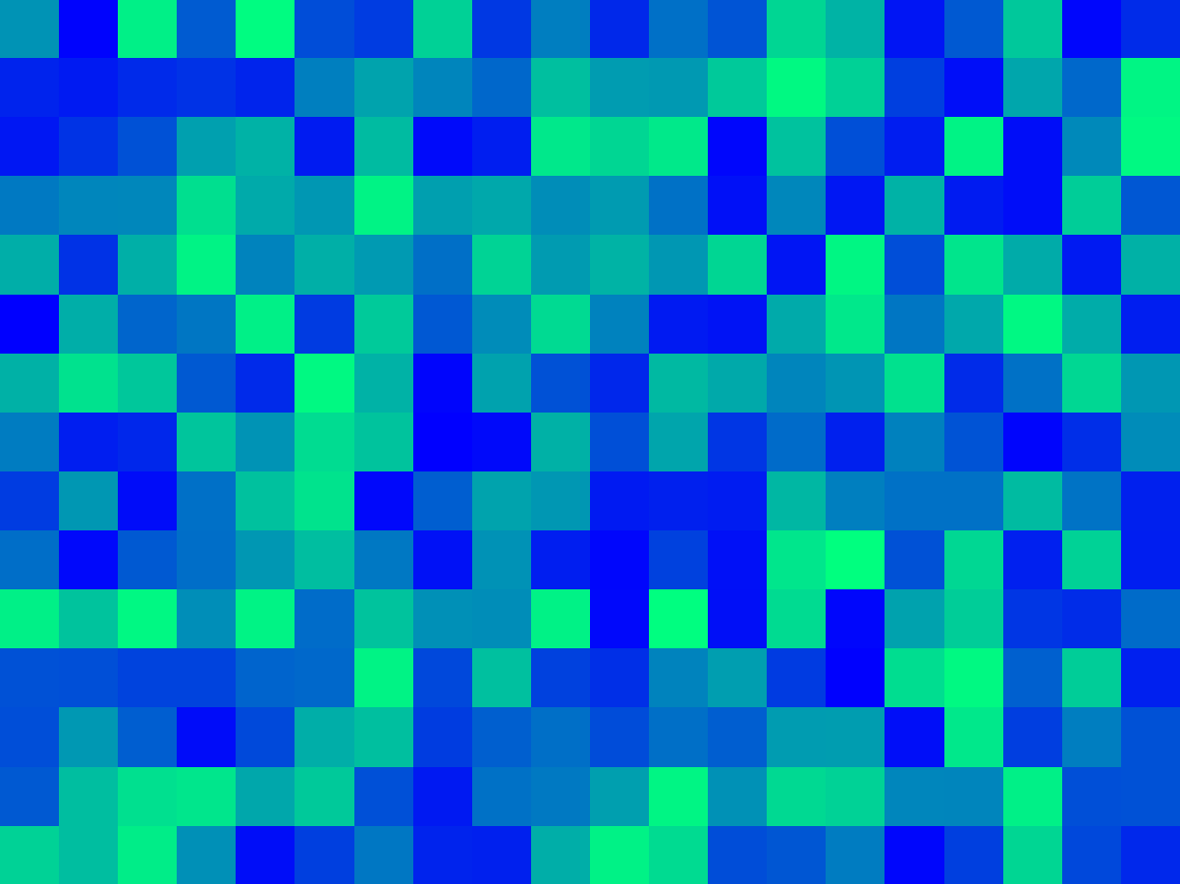

















$$1m$$
variance ($γ$)
z($u_{α1}$)
z($u_{α1}+1m$)
sill ($σ^{2}$)
$$1m$$
$$1m$$
1$m$
nugget ($c_{0}$)
z($u_{α4}$)
z($u_{α4}+1m$)
z($u_{α2}$)
z($u_{α2}+1m$)
$$1m$$
range ($a$)
z($u_{α3}$)
z($u_{α3}+1m$)
lag distance (h)

Slide 2
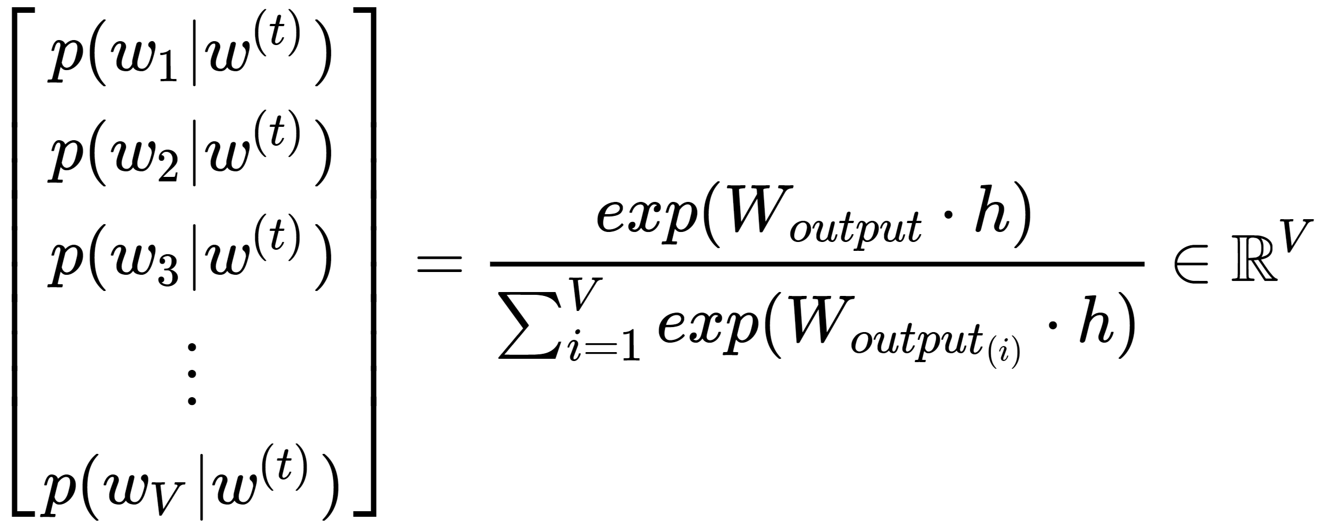
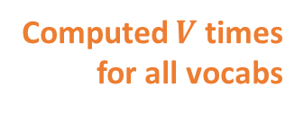
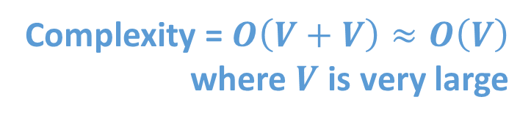
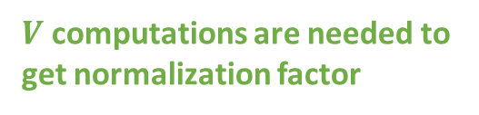
Complexity = $O\left(V+V\right)≈O\left(V\right)$
where $V$ is very large
Computed $V$ times
for all vocabs
$V$ computations are needed to get normalization factor

Slide 3
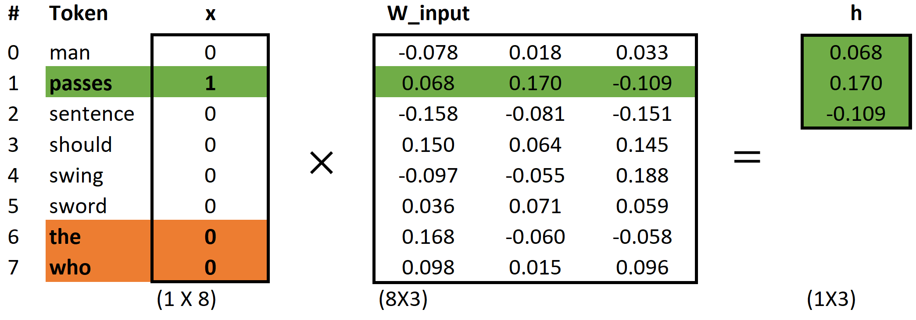
aegis4048.github.io

Slide 4
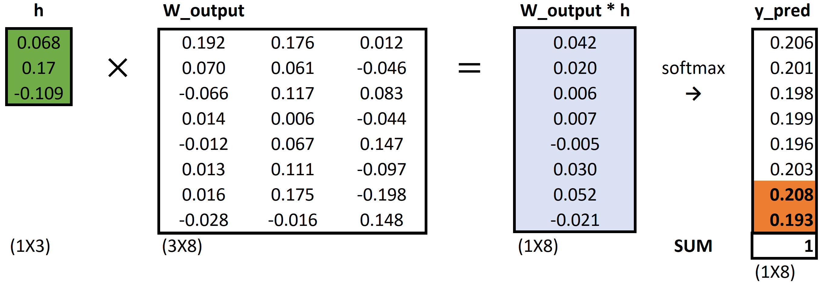
aegis4048.github.io

Slide 5
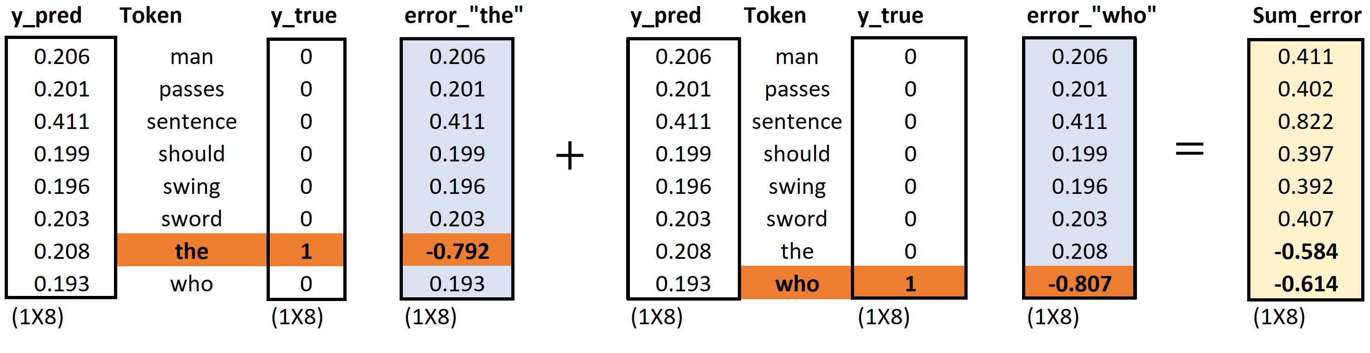
aegis4048.github.io
aegis4048.github.io
aegis4048.github.io

Slide 6
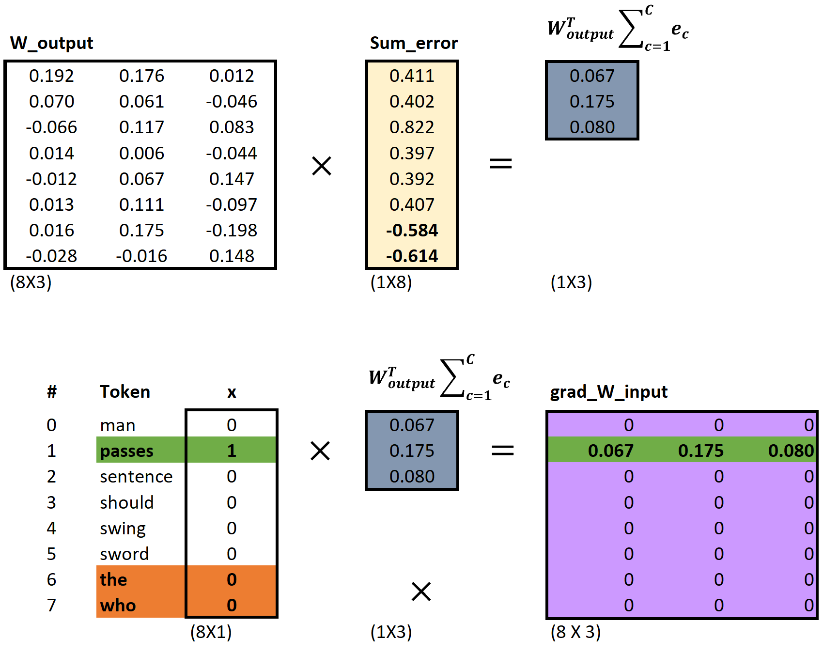
aegis4048.github.io
aegis4048.github.io
aegis4048.github.io

Slide 7
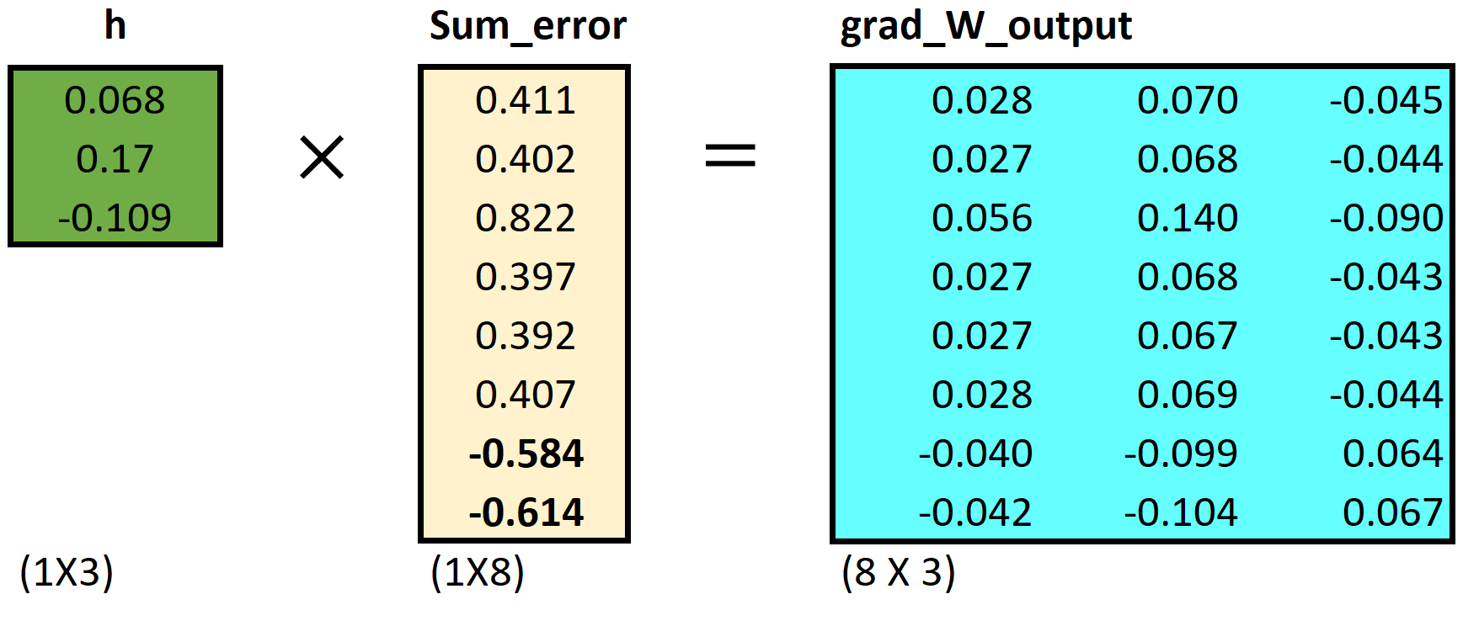
aegis4048.github.io

Slide 8
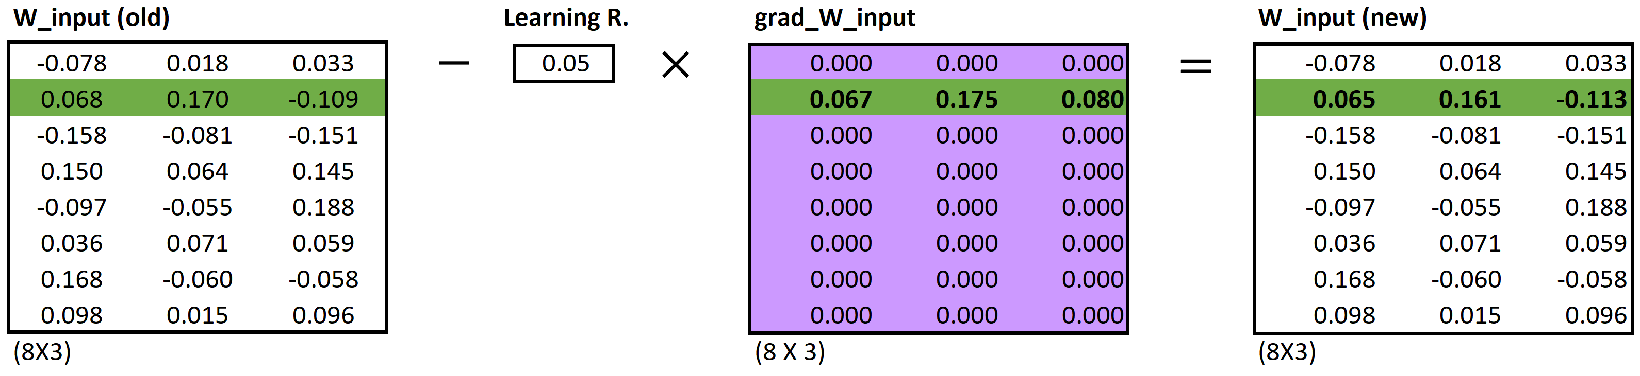
aegis4048.github.io
aegis4048.github.io
aegis4048.github.io

Slide 9
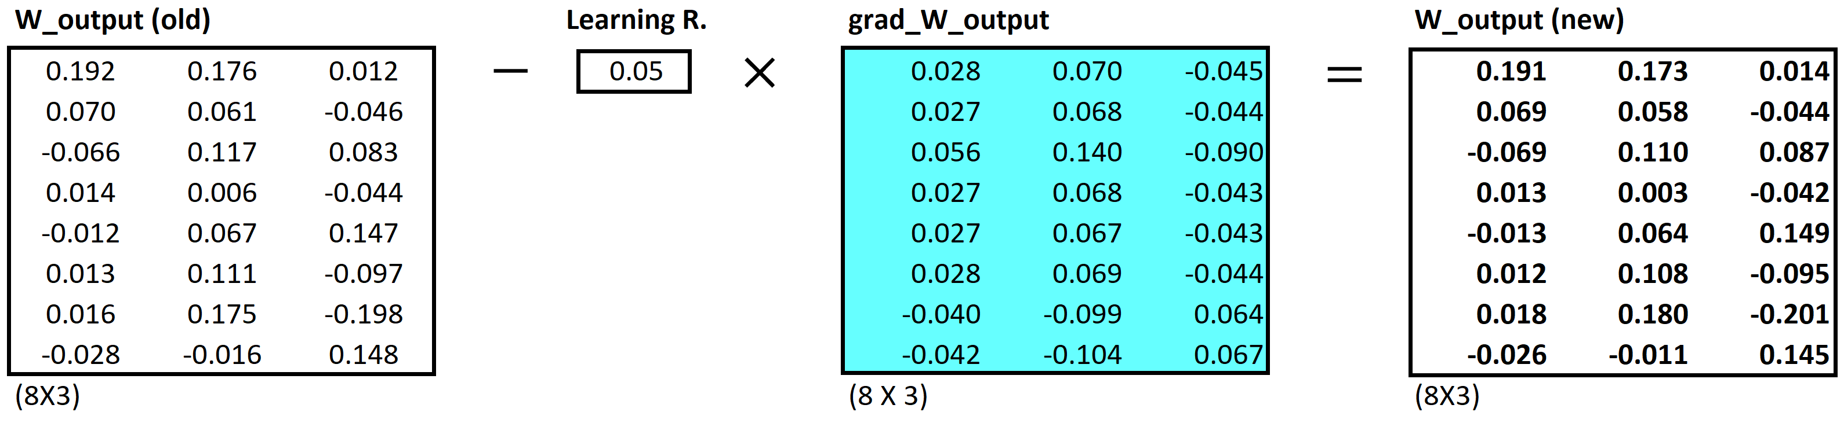
aegis4048.github.io
aegis4048.github.io
aegis4048.github.io

Slide 12


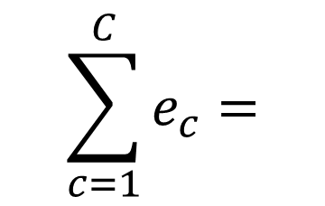



$$c=1$$
$$c=2$$
0.12
0.21
0.10
0.06
-0.87
0.09
0.12
0.21
0.10
0.06
0.13
-0.91
0.24
0.42
0.20
0.12
-0.74
-0.82
man
passes
$$\sum_{c=1}^{C}{e_{c}}=$$
sentence
$$+$$
$$=$$
should
aegis4048.github.io
the
who

Slide 13

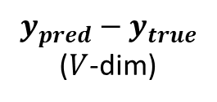

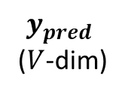
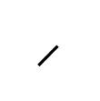
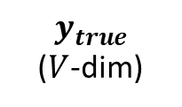
$$y_{true}$$
($V$-dim)
$$y_{pred}−y_{true}$$
($V$-dim)
0
0
0
0
1
0
0.12
0.21
0.10
0.06
-0.87
0.09
man
$$y_{pred}$$
($V$-dim)
passes
sentence
$$=$$
should
0.12
0.21
0.10
0.06
0.13
0.09
$$−$$
c = 1
the
who
aegis4048.github.io
0
0
0
0
0
1
0.12
0.21
0.10
0.06
0.13
-0.91
man
$$−$$
passes
sentence
$$=$$
should
c = 2
the
who

Slide 14
Dimension 3
0.11
0.34
0.54
Achieve
Achieve
Success
0.51
0.91
0.65
Success
Dimension 1
Vector distance
Dimension 2

Slide 15
Training Samples
Source Text
The
man
who
passes
the
sentence
should
swing
the
sword.
(passes, who)
(passes, the)

Slide 16
Dimension 3
should
passes
0.1 0.2 0.7
passes
aegis4048.github.io
should
-2 0.2 0.8
aegis4048.github.io
Dimension 1
Dimension 2

Slide 17





Makes it positive
$$W_{output}∙h$$
Softmax ($W_{output}∙h$)
$$y_{pred}$$
-1.23
0.33
0.18
-5.12
-8.79
-2.01
2.56
4.31
0.12
0.08
0.02
0.13
0.23
0.15
0.11
0.16
$$p\left(y_{i}\right)=\frac{e^{y_{i}^{}}}{\sum_{j}{e^{y_{j}}}}$$
aegis4048.github.io
Normalizes to range [0, 1]
Sum($y_{pred})$ = 1

Slide 18
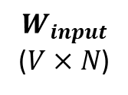
$$W_{input}$$
($V×N$)
man
2 0.5 4
0.1 0.2 0.7
0.3 -2 0.2
-2 0.2 0.8
1 0.7 3
3 5 0.2
passes
sentence
should
aegis4048.github.io
the
who

Slide 19
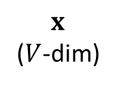
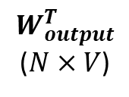
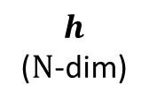
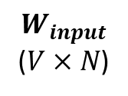
$$y_{true}$$
($V$-dim)
$$y_{pred}−y_{true}$$
($V$-dim)
0
0
0
0
1
0
0.12
0.21
0.10
0.06
-0.87
0.09
man
$$x$$
($V$-dim)
$$W_{input}$$
($V×N$)
$$h$$
($N$-dim)
$$W_{output}^{T}$$
($N×V$)
$$y_{pred}$$
($V$-dim)
passes
sentence
$$=$$
should
man
0
1
0
0
0
0
2 0.5 4
0.1 0.2 0.7
0.3 -2 0.2
-2 0.2 0.8
1 0.7 3
3 5 0.2
0.12
0.21
0.10
0.06
0.13
0.09
$$−$$
c = 1
passes
the
sentence
0.1
0.2
0.7
0.3 0.1 0.4 -0.4
0.1 0.3 -1.1 0.3
0.1 0.2 0.4 0.1
who
should
aegis4048.github.io
aegis4048.github.io
0
0
0
0
0
1
0.12
0.21
0.10
0.06
0.13
-0.91
man
the
$$−$$
passes
who
sentence
$$=$$
should
c = 2
Input Layer one-hot encoded vector
Word-Embedding matrix – a.k.a “Lookup table”
Hidden (Projection)
Layer for center word (passes)
Word-Embedding matrix for context words (the, who)
Softmax Output
Layer of range
[0, 1]
Sum = 1
the
who
Prediction Error – a.k.a function loss

Slide 20

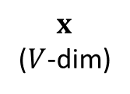

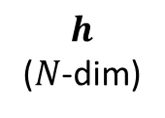
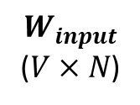
$$x$$
($V$-dim)
$$W_{input}$$
($V×N$)
$$h$$
($N$-dim)
man
0
1
0
0
0
0
2 0.5 4
0.1 0.2 0.7
0.3 -2 0.2
-2 0.2 0.8
1 0.7 3
3 5 0.2
passes
sentence
0.1
0.2
0.7
Projection of word vector for “passes” from the embedding matrix
should
$$×$$
$$=$$
aegis4048.github.io
the
who

Slide 21


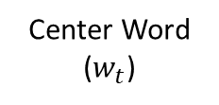

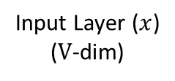


Input Layer ($x$)
($V$-dim)
Assuming Stochastic Gradient Descent…
Center Word
($w_{t}$)
v=0
v=1
v=2
v=3
v=4
v=5
v=6
v=7
man passes sentence should swing sword the who
t=0
The
0 0 0 0 0 0 1 0
t=0
$$θ_{new}=θ_{old}−η∙∇_{θ}J_{0}(θ;w^{(0)})$$
t=1
man
1 0 0 0 0 0 0 0
$$θ_{new}=θ_{old}−η∙∇_{θ}J_{1}(θ;w^{(1)})$$
t=2
who
0 0 0 0 0 0 0 1
$$θ_{new}=θ_{old}−η∙∇_{θ}J_{2}(θ;w^{(2)})$$
aegis4048.github.io
aegis4048.github.io
t=9
sword
0 0 0 0 0 1 0 0
$$θ_{new}=θ_{old}−η∙∇_{θ}J_{9}(θ;w^{(9)})$$

Slide 22
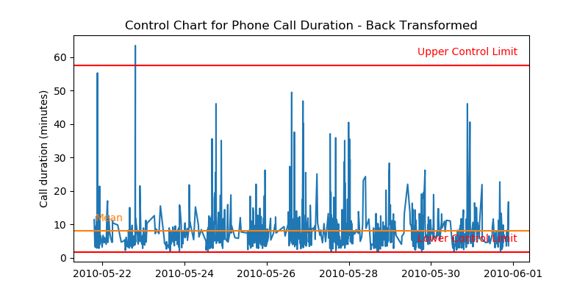
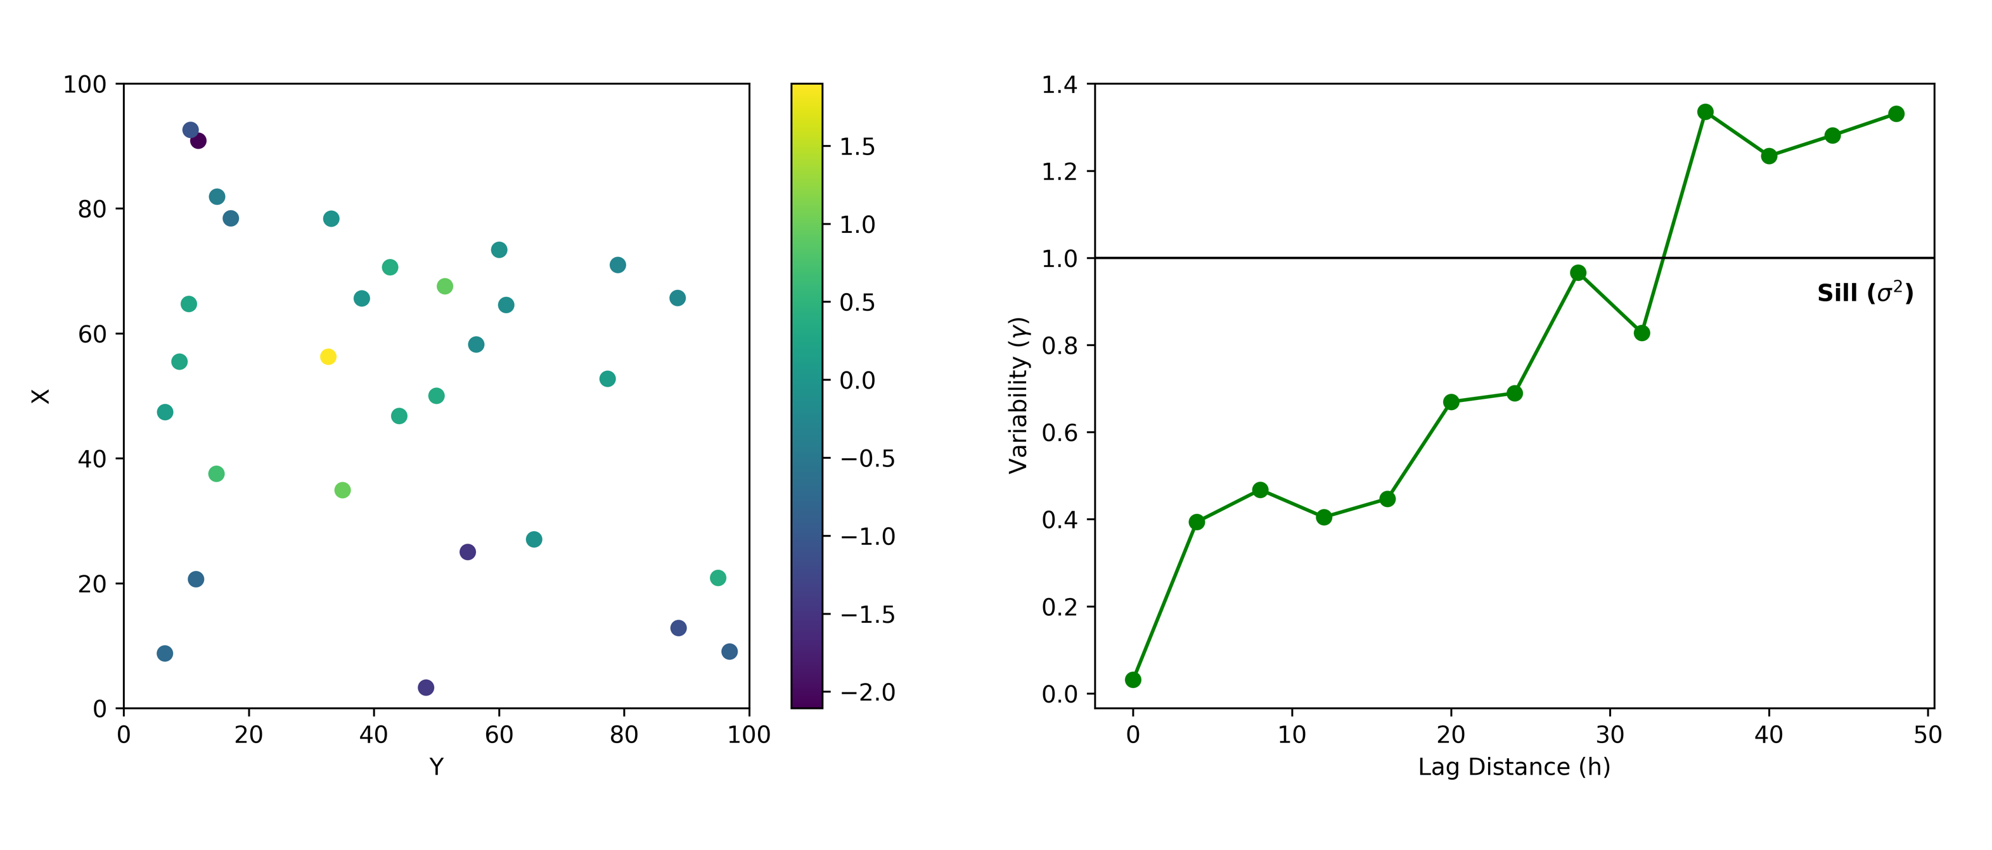

Slide 23
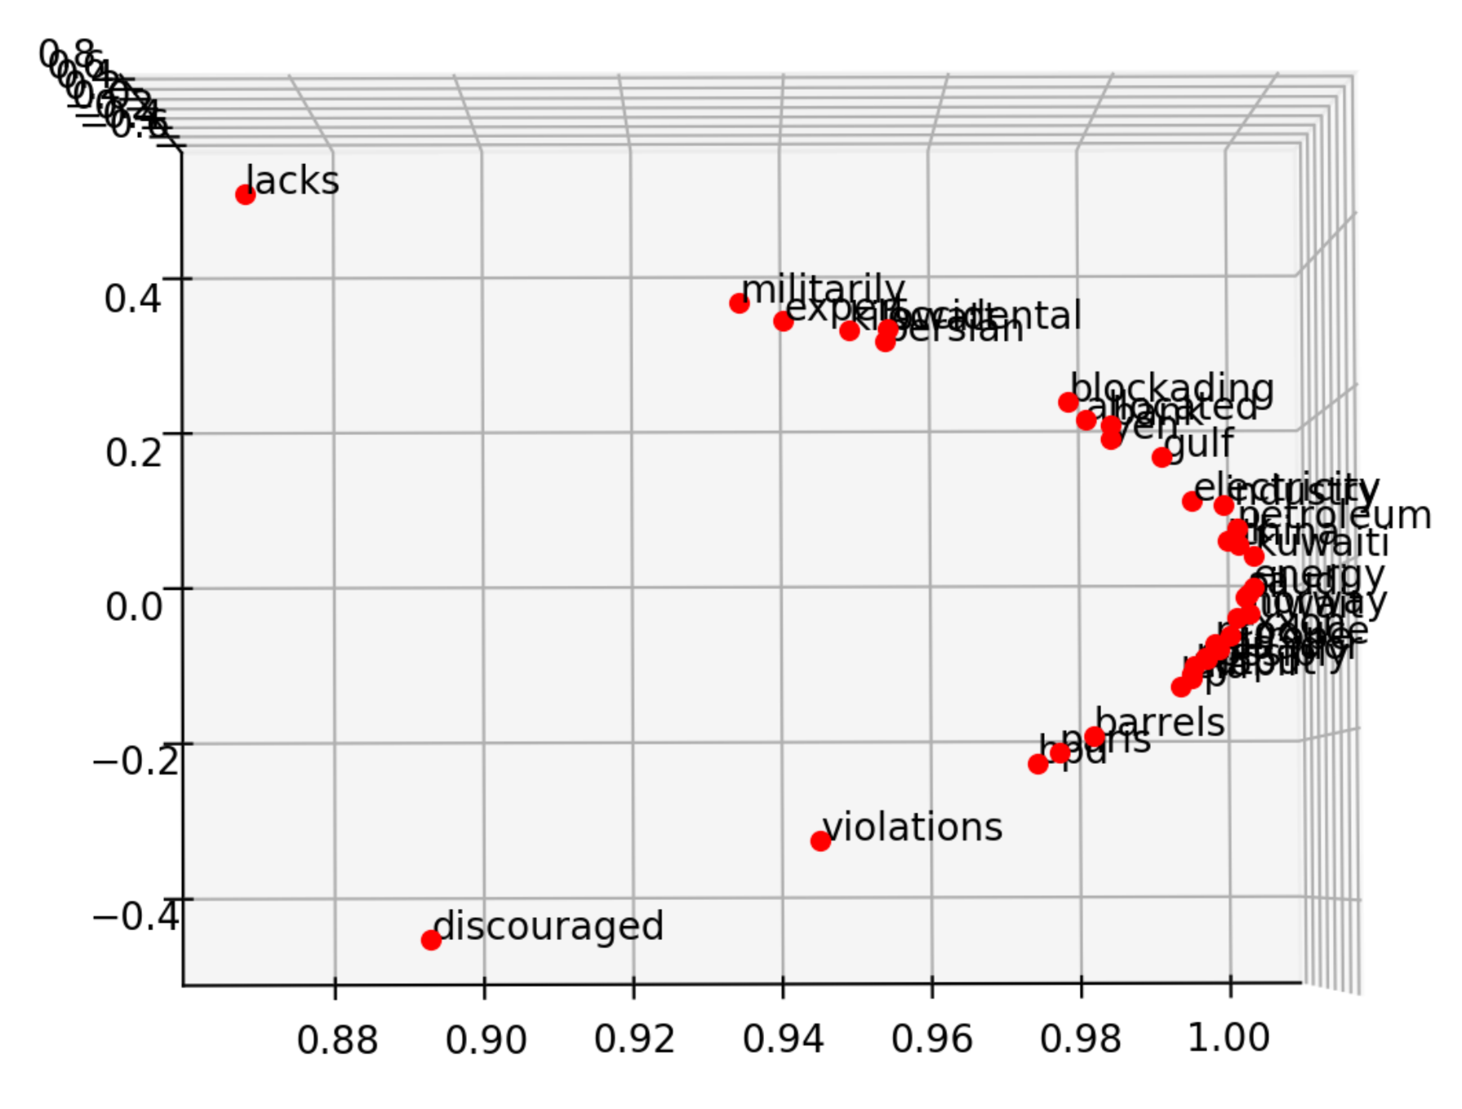
killowatt
electricity
aegis4048.github.io
Oil Producers
Barrels + bpd

Slide 24
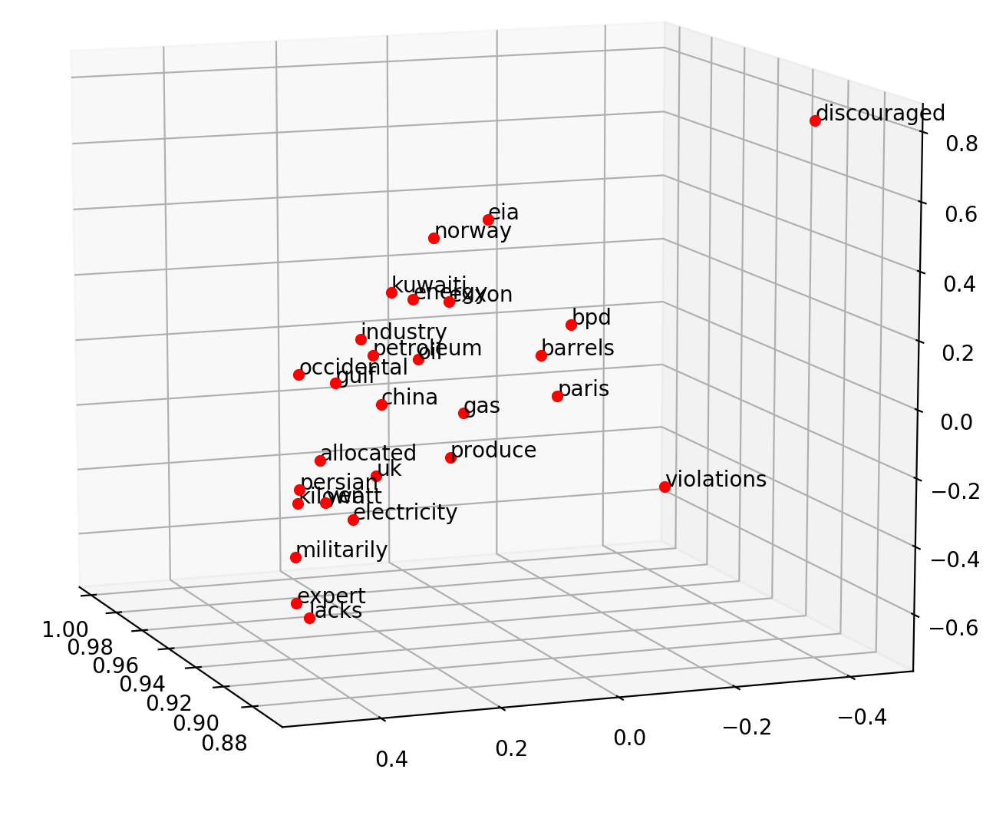
Oil Producers
Barrels + bpd
killowatt
electricity
aegis4048.github.io

Slide 25
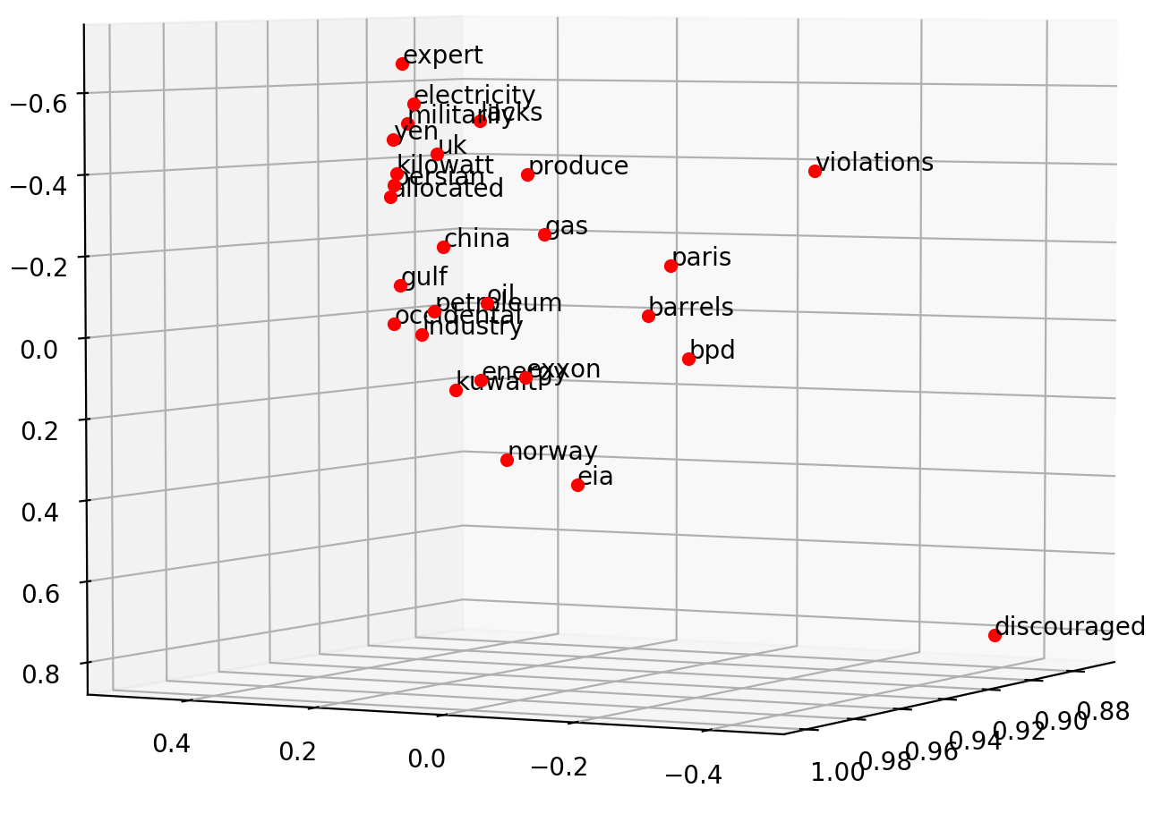
electricity
killowatt
Barrels + bpd
Oil Producers
aegis4048.github.io

Slide 26
0
0
0.32
0.79
0
0.05
0.10
0
0
0.91
Achieve
0
0
0.34
0.75
0
0.10
0
0
0
0.87
Success

Slide 27
Dimension 3
0.11
0.34
0.54
Achieve
Achieve
Success
0.51
0.91
0.65
Success
Dimension 1
Dimension 2

Slide 28
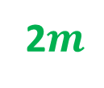












2$m$
variance ($γ$)
sill ($σ^{2}$)
z($u_{α1}$)
z($u_{α1}+2m$)
2$m$
2$m$
2$m$
z($u_{α4}$)
z($u_{α4}+2m$)
nugget ($c_{0}$)
z($u_{α2}$)
z($u_{α2}+2m$)
2$m$
range ($a$)
range
z($u_{α3}$)
z($u_{α3}+2m$)
lag distance (h)

Slide 29





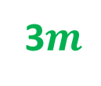



3$m$
variance ($γ$)
sill ($σ^{2}$)
z($u_{α1}$)
z($u_{α1}+3m$)
3$m$
3$m$
z($u_{α3}$)
z($u_{α3}+3m$)
nugget ($c_{0}$)
range ($a$)
3$m$
range
z($u_{α2}$)
z($u_{α2}+3m$)
lag distance (h)

Slide 30




variance ($γ$)
sill ($σ^{2}$)
nugget ($c_{0}$)
range ($a$)
lag distance (h)

Slide 31
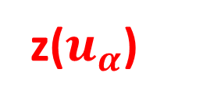
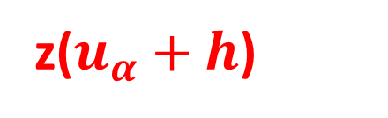
z($u_{α}$)
h
z($u_{α}+h$)

Slide 32
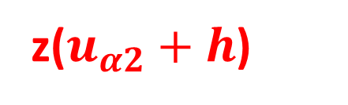
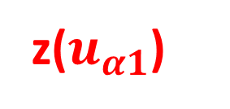
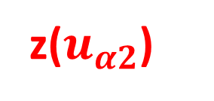
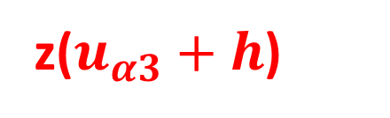

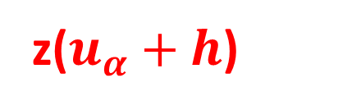
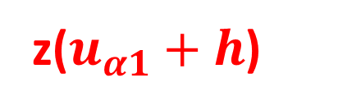

h
z($u_{α1}$)
z($u_{α1}+h$)
h
h
z($u_{α2}$)
z($u_{α2}+h$)
z($u_{α1}$)
z($u_{α}+h$)
h
z($u_{α3}$)
z($u_{α3}+h$)

Slide 34
Y axis (North)
Lag Tolerance
Lag 3
Azimuth
Lag 2
Bandwidth
Lag 1
Azimuth Tolerance
X axis (East)

Slide 35

Z axis (vertical)
Horizontal Major
Horizontal Major
Azimuth
Horizontal Minor
Horizontal Minor
Horizontal Minor
$$θ$$
X axis (East)
Y axis (North)

Slide 36
Y axis (North)
Lag 3
Lag 2
Lag 1
X axis (East)

Slide 37
