Slide 1




Phase 1
Phase 2
Phase 3
Study 1
Study 2
Study 3
Study 4
Study 5
Goals
System development
Passive social interaction detection from smartwatches and smartphones
Pre/during/post anxiety periods behavioral analysis
Investigate biomarkers predictive of peaks in anxiety
Build an initial generalized RL policy for just-in-time intervention
Optimize the effectiveness of CBM through adapting the content of interventions to participants context
Build personalized RL policies and compare their performance with traditional intervention methods
Smartphone app
Smartwatch app
Cloud infrastructure
Biomarkers for SAD
Physical context
Social context
Physiological Context
Cohort
30 engineering
students and faculty
30 socially anxious students
30 socially anxious students
500 socially anxious adults
120 socially anxious students
Study period
1 week
3 days
3 weeks
____
5 weeks

Slide 2
Phase 1
Phase 2
Phase 3
Study 1
Study 2
Study 3
Study 4
Study 5
Goals
System development
Biomarkers for SAD
Passive social interaction detection from smartwatches and smartphones
Pre/during/post anxiety periods behavioral analysis
Investigate biomarkers predictive of peaks in anxiety
Build an initial generalized RL policy for just-in-time intervention
Optimize the effectiveness of CBM through adapting the content of interventions to participants context
Build personalized RL policies and compare their performance with traditional intervention methods
Smartphone app
Smartwatch app
Cloud infrastructure
Physical context
Social context
Physiological Context
Cohort
30 engineering
students and faculty
30 socially anxious students
30 socially anxious students
500 socially anxious adults
120 socially anxious students
Study period
1 week
3 days
3 weeks
____
5 weeks

Slide 3


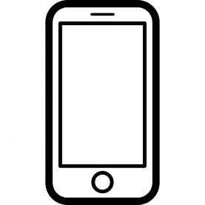



JITAI
Biomarkers extraction for SAD
Agent
State
Reward
Action
SAD
State
JIT policy
$$S_{t}$$
$$R_{t}$$
$$A_{t}$$
$$R_{t+1}$$
Context
$$S_{t+1}$$
RL Model
HIPAA Compliant Cloud
Lack of activity
Arousal in physiology
State Anxiety
Shaky hands in social interactions
Social avoidance
Symptoms
Biomarkers extraction for SAD
…
Update policy periodically
Physical context
Social context
Physiological context
Zoom in
Semantic location
(e.g., home, work, hospital)
Activity type
(e.g., walk, run, drive)
Movement intensity
Face-to-face social interaction
Phone usage
In-phone social activity
linguistic and paralinguistic features
Cardiovascular reactivity (HR, HRV, respiration rate)
…
Biomarkers
Sensing
Acceleration
Communication patterns
GPS
Audio
Physiological data
Bluetooth
Light
EMAs
Participant in daily life
PPG
GPS
Gyroscope, accelerometer
Microphone
Ambient light
Bluetooth WIFI
MicroEMA
Phone apps
Phone screen
(On/off)
In-phone communication
(e.g., calls, SMS)
EMA
Sensors
…
Sensus
Swear
Smartwatch
Smartphone

Slide 4
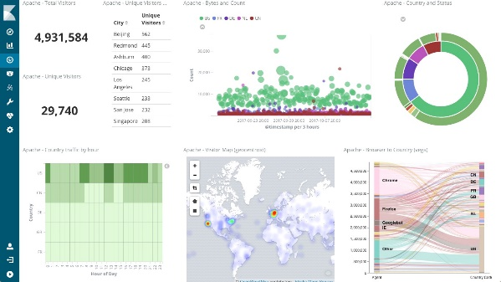

ES Medication Corpus
Sync corpus
Monitoring using Kibana
DrFirst Team
Current DrFirst Database
Script
ElasticSearch Service
Rest API
User

