Slide 1

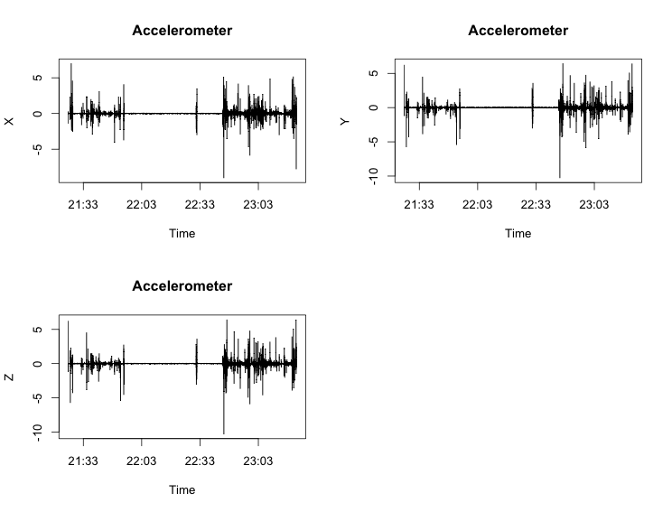
Polling probe request
(e.g., Location)
Protocol
Probes
Location
Speed
Text messages
Phone calls
…
Data request
Local Data Store
File
RAM
Polled data
(e.g., GPS location)
Probed data
Listening event
(e.g., incoming call)
Local data
Data request
Remote Data Store
Microsoft Azure
Amazon S3
SensusR
Data ingest
Visualization
Modeling
Cloud Services
Microsoft Azure
Amazon S3

