Slide 1
CS 214: System Programming (Sec 07)
Shijie Geng
09/12/2017
Email: sg1309@rutgers.edu
Office Hours: Monday 10.30-11.30am at Hill 408

Slide 2
Context of today’s recitation (55min)
Go over some knowledge points of C language (20min)
Solving some example programming questions (20min)
Do the homework for this week (15min)

Slide 3
Go over some knowledge points
Basic C syntax
Header files
Loops/conditionals
GCC compilation

Slide 4
Basic C syntax
Variables
Constant
Preprocessor definitions
Operators
Basic I/O command

Slide 5
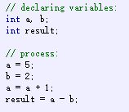
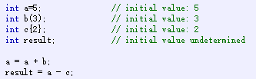
1 Variables
Declaration of variables
Initialization of variables
type identifier = initial_value;
A C identifier is a name used to identify a variable, function, or any other user-defined item. An identifier starts with a letter A to Z, a to z, or an underscore '_' followed by zero or more letters, underscores, and digits (0 to 9).

Slide 6
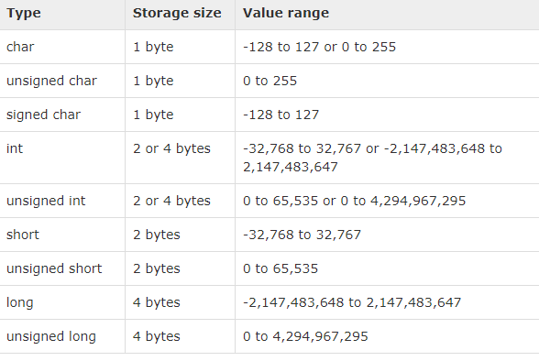
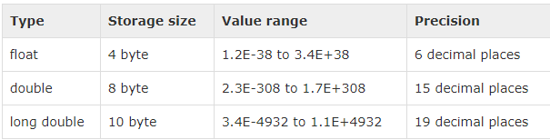
1 Variables
Types: basic type - integer and floating-point

Slide 7
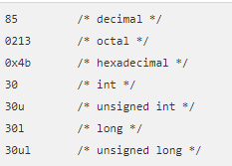
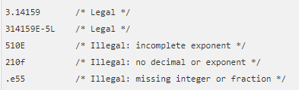


2 Constant
Constants refer to fixed values that the program may not alter during its execution. These fixed values are also called literals.

Slide 8
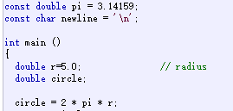
2 Constant
Typed constant expressions
printf("circle is: %c%f",newline,circle);

Slide 9

2 Constant
Typed constant expressions
printf("circle is: %c%f",newline,circle);

Slide 10
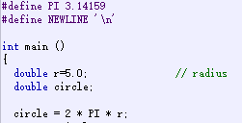
3 Preprocessor definitions
Preprocessor definitions – don’t need to specify the type
printf("circle is: %c%f",newline,circle);

Slide 11
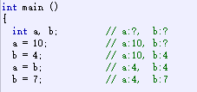
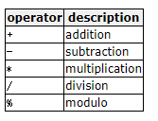
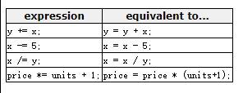
4 Operators
Assignment Operator
Arithmetic Operator
Compound Assignment

Slide 12

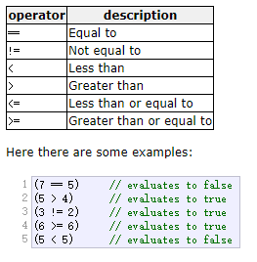

4 Operators
Increment and Decrement
Relational and Comparison Operator
Conditional Ternary Operator

Slide 13
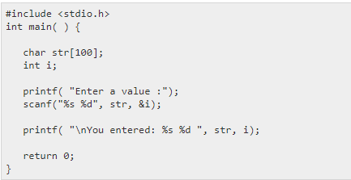
5 Basic I/O command
The format can be a simple constant string, but you can specify %s, %d, %c, %f, etc., to print or read strings, integer, character or float respectively

Slide 14
Header files
#include <stdio.h>
#include <xx.h> & #include “xx.h”
Notes:
在C程序中包含文件有以下两种方法： (1)用符号“<”和“>”将要包含的文件的文件名括起来。这种方法指示预处理程序到预定义的缺省路径下寻找文件。预定义的缺省路径通常是在INCLUDE环境变量中指定的，请看下例： INCLUDE=C:\COMPILER\INCLUDE；S:\SOURCE\HEADERS； 对于上述INCLUDE环境变量，如果用#include<file>语句包含文件，编译程序将首先到C:\COMPILER\INCLUDE目录下寻找文件；如果未找到，则到S:\SOURCE\HEADERS目录下继续寻找；如果还未找到，则到当前目录下继续寻找。 (2)用双引号将要包含的文件的文件名括起来。这种方法指示预处理程序先到当前目录下寻找文件，再到预定义的缺省路径下寻找文件。 对于上例中的INCLUDE环境变量，如果用#include“file”语句包含文件，编译程序将首先到当前目录下寻找文件；如果未找到，则到C:\COMPILER\INCLUDE目录下继续寻找；如果还未找到，则到S:\SOURCE\HEADERS目录下继续寻找。 #include<file>语句一般用来包含标准头文件(例如stdio.h或stdlib.h)，因为这些头文件极少被修改，并且它们总是存放在编译程序的标准包含文件目录下。#include“file”语句一般用来包含非标准头文件，因为这些头文件一般存放在当前目录下，你可以经常修改它们，并且要求编译程序总是使用这些头文件的最新版本。

Slide 15

Loops/conditionals
for loop

Slide 16
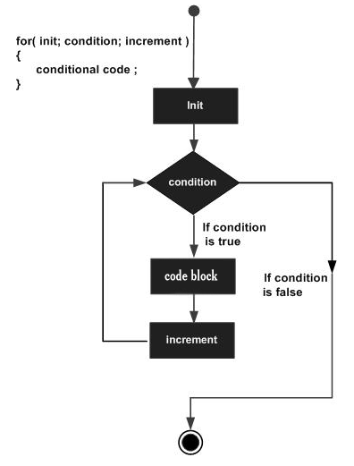
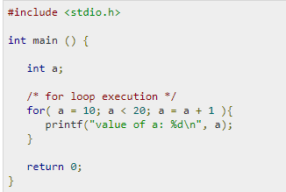
Loops/conditionals
for loop

Slide 17
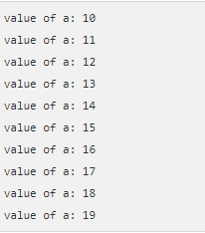
Loops/conditionals
for loop

Slide 18
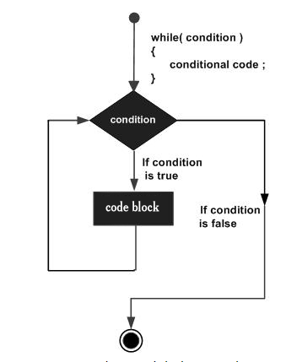
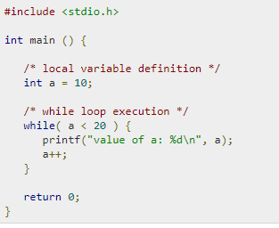
Loops/conditionals
while loop

Slide 19
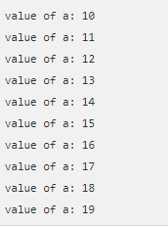
Loops/conditionals
while loop

Slide 20
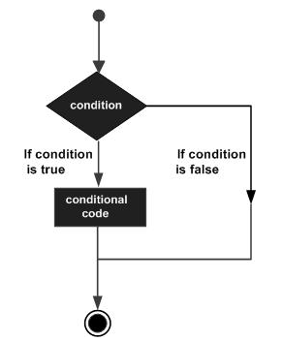
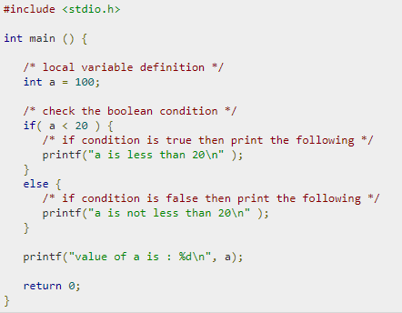
Loops/conditionals
if and else condition

Slide 21

Loops/conditionals
if and else condition

Slide 22
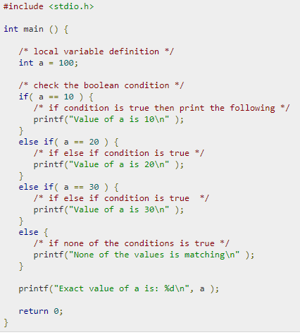

Loops/conditionals
if and else condition – more elses

Slide 23
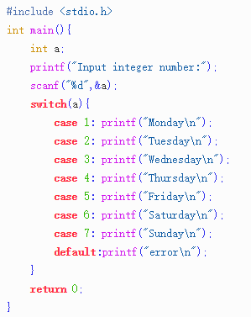
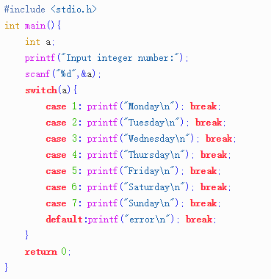
Loops/conditionals
switch condition

Slide 24
GCC compilation
4 steps: preprocessing – compilation – assembly – linking
preprocessing : from xx.c to xx.i -> gcc –E xx.c –o xx.i
gcc –E xx.c (on screen)
compilation : from xx.i to xx.s -> gcc –S xx.i –o xx.s
gcc –S xx.i (the same)

Slide 25
GCC compilation
4 steps: preprocessing – compilation – assembly – linking
assembly : from xx.s to xx.o -> gcc –c xx.s –o xx.o
gcc –c xx.s (the same)
linking : from xx.o to xx.exe or xx -> gcc xx.o –o xx (linux)
gcc xx.o –o xx.exe (windows)

Slide 26
GCC compilation
4 steps in one command: gcc –o xx.exe xx.c (in windows)
gcc –o xx xx.c (in linux)
Execute the binary file : use ./xx.exe or ./xx

Slide 27
Example Question 1
Print all the narcissistic number
A narcissistic number is 3-digit number which equals to the sum of the cube of its each digit.
For example, 153 is a narcissistic number, because 153=1^3+5^3+3^3
Hint: Use loops/conditionals to solve this question

Slide 28
Example Question 2
Calculate the value of 1!+2!+3!+...+20! (! represents factorial)
Hint: Use double loops to solve this question

Slide 29
Example Question 3
Use gcc to compile the source codes to the two questions
Execute the binary code and show the answers

Slide 30
Homework Instructions
There are two questions for this week
The homework will not be collected, but you can solve it and practice yourself

Slide 31
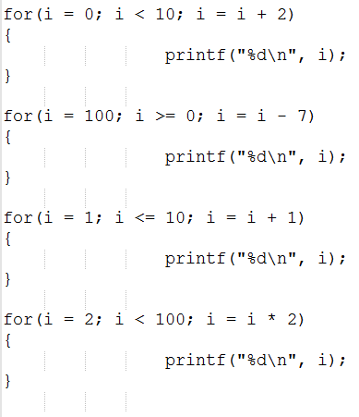
Homework 1 - Q1
What do these loops print? Determine what they print first, then run them

Slide 32
Homework 1 - Q2
Don't use ten printf statements; use two nested loops instead. You'll have to use braces around the body of the outer loop if it contains multiple statements:
for(i = 1; i <= 10; i = i + 1)
{
/* multiple statements */
/* can go in here */
}
Change your loops to be while loops
Write a program to print this triangle:
*
**
***
****
*****
******
*******
********
*********
**********

