Slide 1

Final Project Spark near real-time sentiment analysis
CN Chen, Mohan K. Patnam, Bruno Janota
CSCI E-63 Big Data Analytics
Harvard University Extension School
Prof. Zoran B. Djordjević

Slide 2
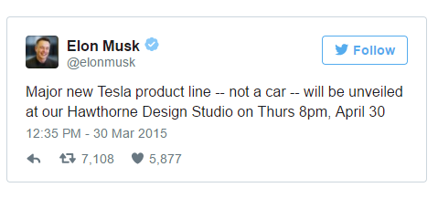
Introduction
Elon Musk made nearly 1B $$ on this single tweet!! http://www.telegraph.co.uk/news/worldnews/northamerica/usa/11505566/Elon-Musks-1bn-tweet-news-of-secret-product-line-sees-Tesla-shares-soar.html

Slide 3
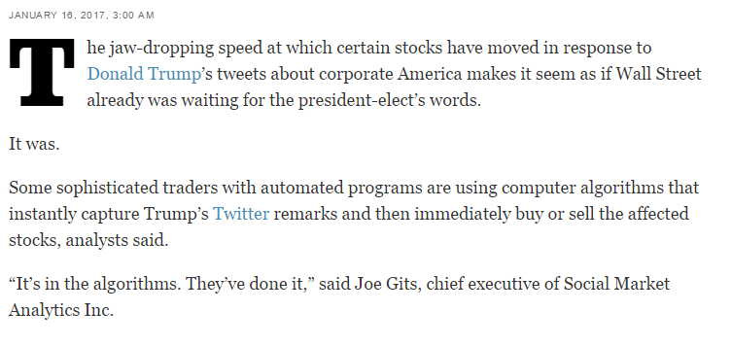
Introduction
When Trump tweets, Wall Street trades - instantly!! http://www.latimes.com/business/la-fi-agenda-trump-tweets-stocks-20170116-story.html

Slide 4
What affects Stock Prices?
Fundamental Factors:
Balance sheet - Assets vs Liabilities
Earnings, Growth etc.
Technical Factors:
Economy, Recession, Inflation
Geo-Political factors etc.
Social Sentiment:
How about Tweets?

Slide 5
Social Sentiment
Does Social Sentiment matter?
Overall user sentiment matters in every industry!
Is Social Media an electronic word of mouth?
Be aware of noise, fake-news, re-tweets and day-to-day gyrations.
Is it a leading indicator of stock prices?
May be or may be not depending on specific person tweeting!
How good is the Noise-to-Signal ratio in tweets?
Machine learning and natural language processing comes to the rescue!

Slide 6
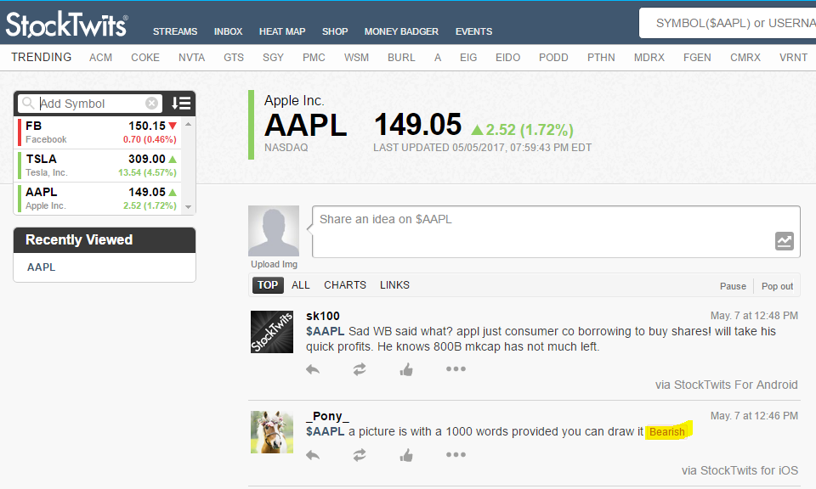
Stock Tweets

Slide 7
Project Statement
Sense the market pulse or social sentiment (bullish vs bearish) using near real-time stream of tweets.
(Data Source: www.StockTwits.com)
A case study of 3 stocks: AAPL, FB, and TSLA.
A methodology to build sentiment scores using Bag-Of-Words approach and Naive-Bayes-Classifier.
Regression analysis to predict stock volatility using sentiment scores.

Slide 8
Project Phases
Automatic Data Download and Wrangling
Output CSV files of raw tweets with optional sentiment.
Sentiment Analysis-1: Bag-of-Words approach
Calculate sentiment score using various standard dictionaries.
Sentiment Analysis-2: Naive-Bayes Classifier
Predict sentiment score and present confusion matrix.
Regression Analysis: Sentiment Score to Predict Stock Price
Present accuracy and loss function.
Spark Streaming of Tweets

Slide 9
Data Download and Wrangling
Data Sources
Tweets from StockTwits - Eg: AAPL tweets in JSON https://api.stocktwits.com/api/2/streams/symbol/AAPL.json
Historical stock prices from Yahoo! Finance - Eg: AAPL historical prices https://finance.yahoo.com/quote/AAPL/history?period1=1488344400&period2=1493524800&interval=1d&filter=history&frequency=1d
Bloomberg intraday prices
Automatic Data Download and Wrangling
StockTwits API: https://stocktwits.com/developers/docs
RESTful API providing JSON responses
Output: CSV files

Slide 10
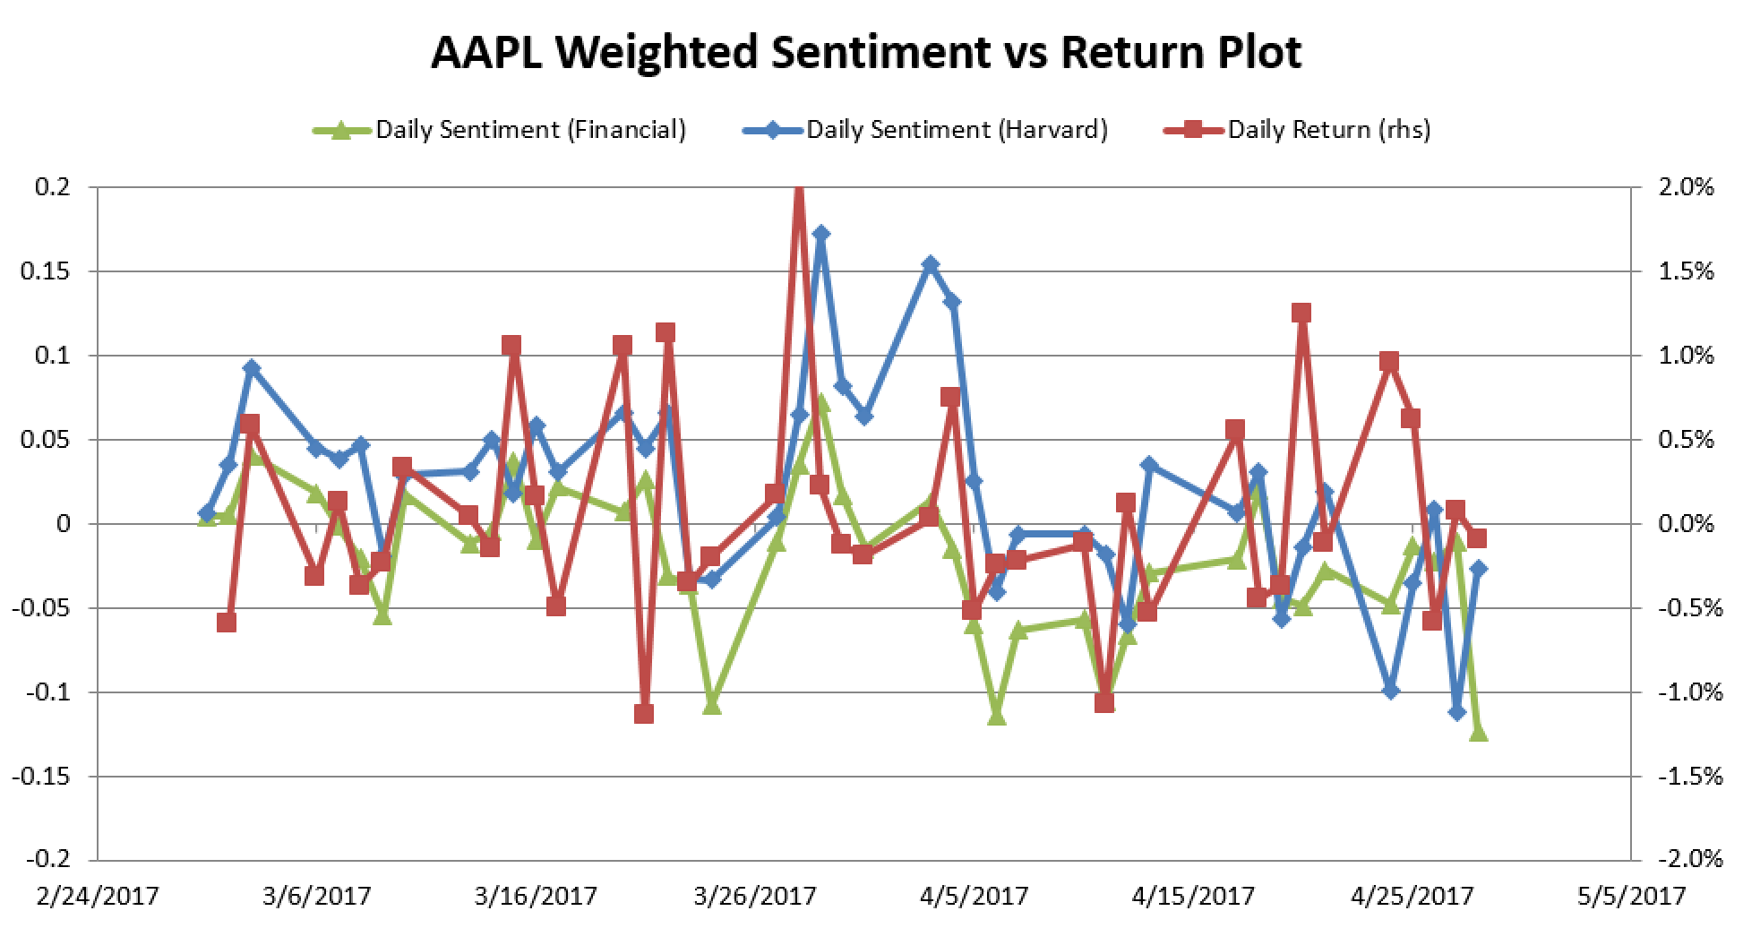
Bag-of-Words Sentiment Analysis
Dictionary Sources
LoughranMcDonald Financial Dictionary (354 pos words / 2,355 neg words)
Harvard IV-4 Dictionary (1,637 pos words / 2,006 neg words)

Slide 11
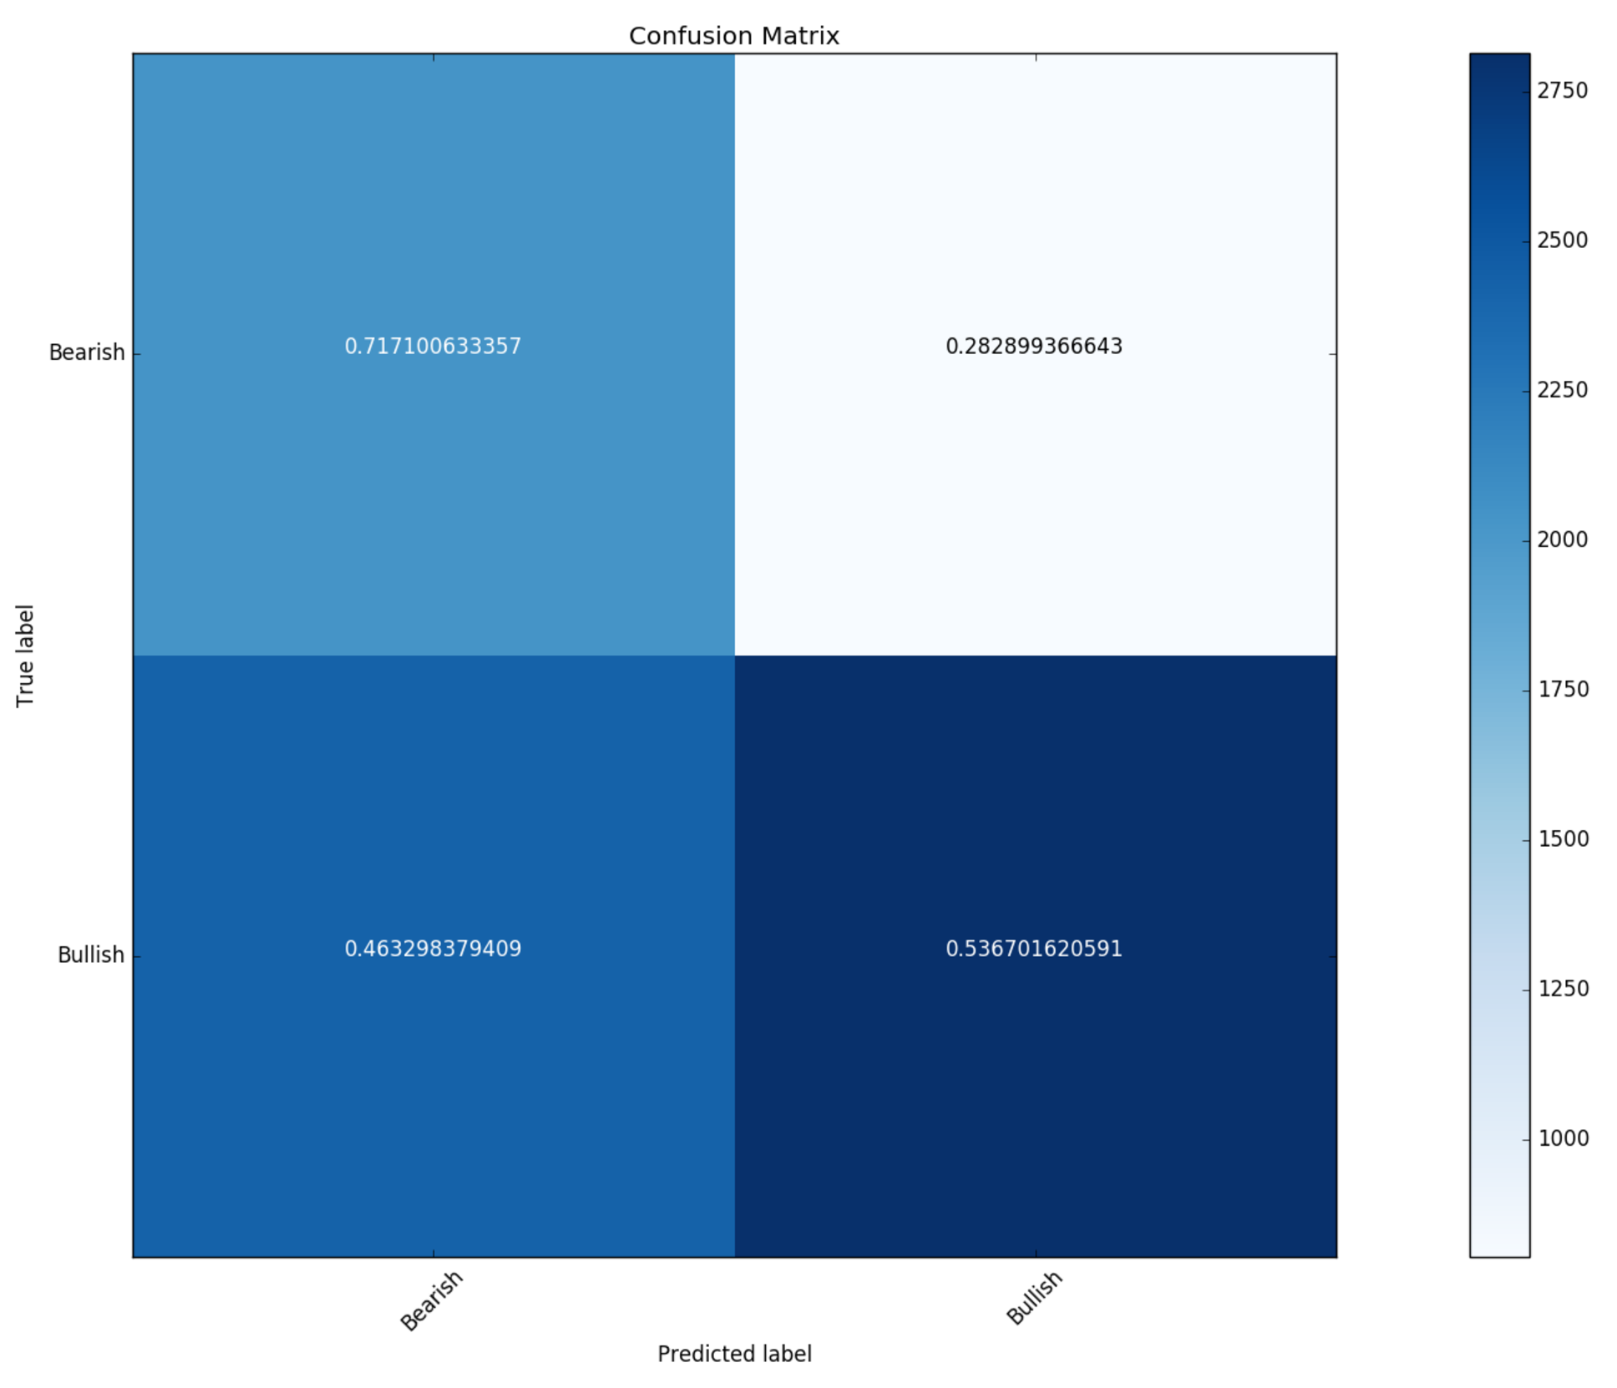
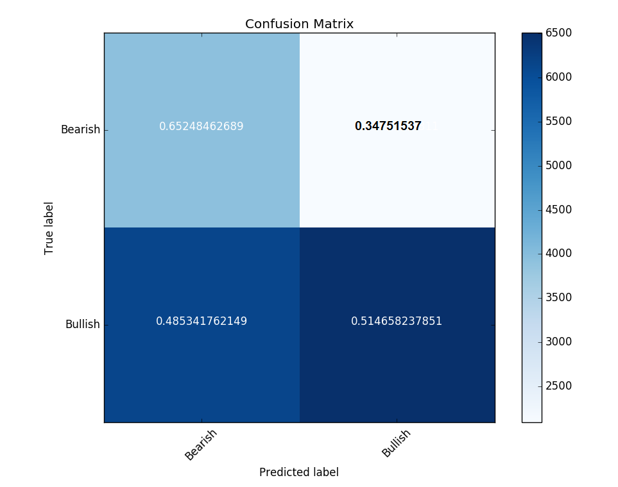
Confusion Matrices
Financial Dictionary
Harvard Dictionary

Slide 12
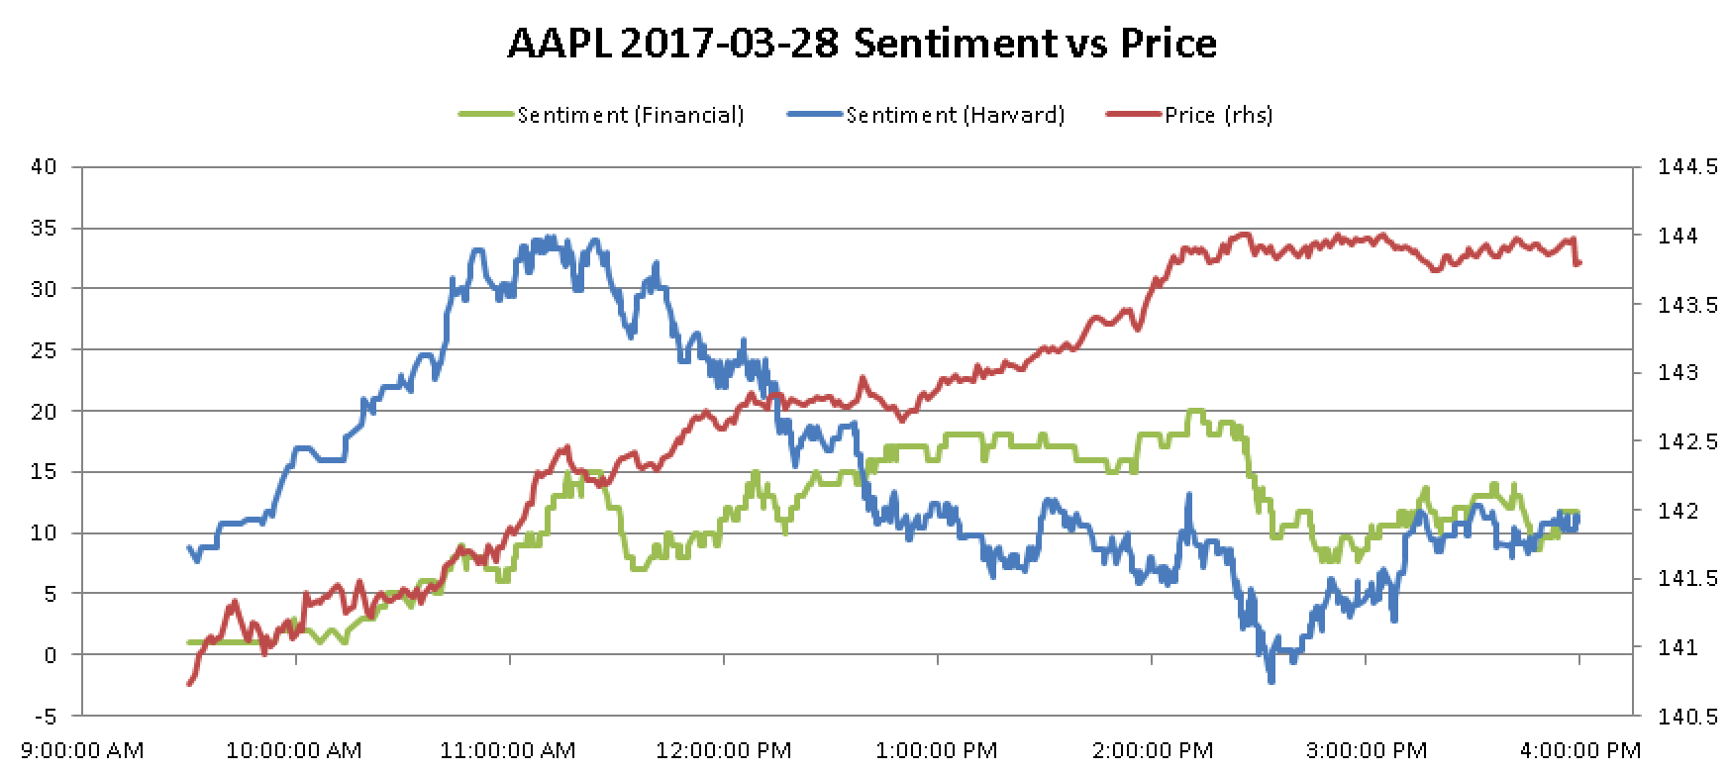
Intraday Sentiment vs Price

Slide 13
Naive-Bayes Classifier
Used Spark 1.6.0 MLlib library multinomial Naive Bayes model
Prior to training the model, several preprocessing steps were executed:
Remove Stop words
Remove other non-essential words (hyperlinks, @mentions, punctuation)
Tag remaining words for part-of-speech
Lemmatize remaining words
Drop duplicates

Slide 14
Preprocessing (1 of 4) - Remove Stop Words
Example Tweet:
$TSLA The volume today is insane! Shorts are covering and Bulls are buying! This is a sign of good things to come! http://markets.businessinsider.com/news/stocks/teslas-market-cap-passes-gm-2017-4-1001895672
Removing stop words (nltk corpus):
$TSLA The volume today insane! Shorts covering Bulls buying! This sign good things come! http://markets.businessinsider.com/news/stocks/teslas-market-cap-passes-gm-2017-4-1001895672

Slide 15
Preprocessing (2 of 4) - Non-Essential Words
Before:
$TSLA The volume today insane! Shorts covering Bulls buying! This sign good things come! http://markets.businessinsider.com/news/stocks/teslas-market-cap-passes-gm-2017-4-1001895672
Removing other non-essential words:
tsla the volume today insane shorts covering bulls buying this sign good things come news stocks teslas market cap passes

Slide 16
Preprocessing (3 of 4) - POS Tagging
Before:
tsla the volume today insane shorts covering bulls buying this sign good things come news stocks teslas market cap passes
After POS tagging and only keeping nouns, verbs, and adjectives (nltk PerceptronTagger):
tsla volume today insane shorts covering bulls buying sign good things come news stocks teslas market cap passes

Slide 17
Preprocessing (4 of 4) - Lemmatization
Before:
tsla volume today insane shorts covering bulls buying sign good things come news stocks teslas market cap passes
After lemmatization of remaining words to reduce dimensionality (nltk WordNetLemmatizer):
tsla volume today insane short cover bull buy sign good thing come news stock teslas market cap pass

Slide 18
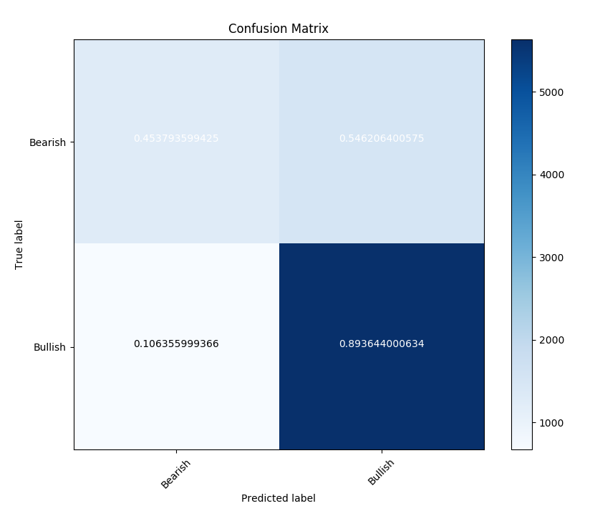
Confusion Matrix
Data used to evaluate the Naive Bayes model:
Two months of labeled StockTwits tweets for AAPL, FB, and TSLA

Slide 19
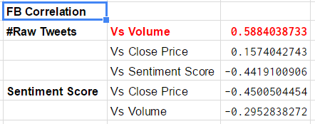
Regression Analysis
Measure correlation between
Volume of Tweets vs Volume Traded
Volume of Tweets vs change in Stock Price
Sentiment Score vs change in Stock Price
Sentiment Score vs Volume Traded
Regression analysis
Sentiment Score vs Close Price

Slide 20
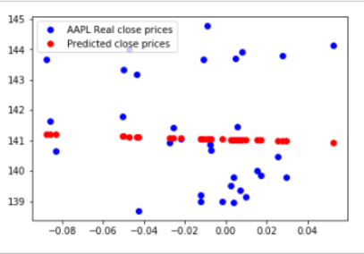
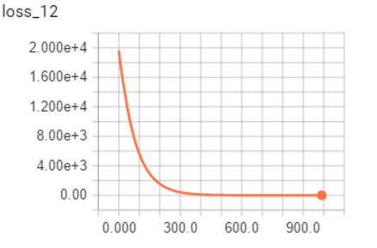
Regression Analysis
Sentiment Score as a predictor of stock price. It is rather a poor fit!

Slide 21
Pros ‘n Cons
Benefits
Provides a simple means to gauge the social sentiment of tweets and its effect on stock prices.
Technology is built using Python with its ease of use and seamless integration with web downloads (RESTful API), text analysis (NLTK), streaming (Spark) and machine learning (tensorflow) packages.
The system has the capability to parallel process the analysis using spark concurrency by simultaneously running on multiple stocks.
Drawbacks
Challenges
StockTwits RESTful API limitation of 200 requests per hour. Each request returns 30 tweets only for a chosen stock. Running batch jobs continuously helped.
Signal-to-noise ratio is often more. Tweets are often very unstructured mentioned in an informal language. Needs more sophisticated natural language techniques to derive the intention of the tweet. Otherwise, this has implication on accuracy of models.

Slide 22
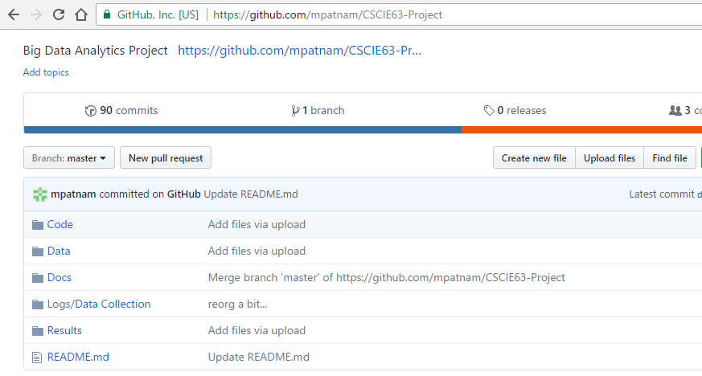
Project Documentation
Data, code, logs and docs available as a github repository:
https://github.com/mpatnam/CSCIE63-Project

Slide 23
YouTube URLs, Last Page
Two minute (short):
15 minutes (long):

Slide 24
References
Investopedia - Most followed stocks in stocktwits.com
StockTwits API - https://stocktwits.com/developers/docs
Yahoo! Finance for historical stock prices - AAPL Historical Prices
Bloomberg API for intraday prices
LoughranMcDonald Financial Dictionary - http://www3.nd.edu/~mcdonald/World_Lists.html
Harvard IV-4 Dictionary - http://www.wjh.harvard.edu/~inquirer/spreadsheet_guide.htm
Naive Bayes Classifier
Tensorflow API - https://www.tensorflow.org/api_docs/python/

