Slide 1

Big Data Infrastructure
CS 489/698 Big Data Infrastructure (Winter 2016)
Week 6: Analyzing Relational Data (1/3)
February 11, 2016
Jimmy Lin
David R. Cheriton School of Computer Science
University of Waterloo
These slides are available at http://lintool.github.io/bigdata-2016w/
This work is licensed under a Creative Commons Attribution-Noncommercial-Share Alike 3.0 United States See http://creativecommons.org/licenses/by-nc-sa/3.0/us/ for details

Slide 2
Structure of the Course
Analyzing Text
Analyzing Relational Data
Analyzing Graphs
Data Mining
“Core” framework features and algorithm design

Slide 3
Business Intelligence
An organization should retain data that result from carrying out its mission and exploit those data to generate insights that benefit the organization, for example, market analysis, strategic planning, decision making, etc.
Duh!?

Slide 4
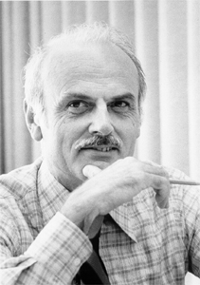
Source: Wikipedia

Slide 5
Database Workloads
OLTP (online transaction processing)
Typical applications: e-commerce, banking, airline reservations
User facing: real-time, low latency, highly-concurrent
Tasks: relatively small set of “standard” transactional queries
Data access pattern: random reads, updates, writes (involving relatively small amounts of data)
OLAP (online analytical processing)
Typical applications: business intelligence, data mining
Back-end processing: batch workloads, less concurrency
Tasks: complex analytical queries, often ad hoc
Data access pattern: table scans, large amounts of data per query
An organization should retain data that result from carrying out its mission and exploit those data to generate insights that benefit the organization, for example, market analysis, strategic planning, decision making, etc.

Slide 6
One Database or Two?
Downsides of co-existing OLTP and OLAP workloads
Poor memory management
Conflicting data access patterns
Variable latency
Solution: separate databases
User-facing OLTP database for high-volume transactions
Data warehouse for OLAP workloads
How do we connect the two?

Slide 7
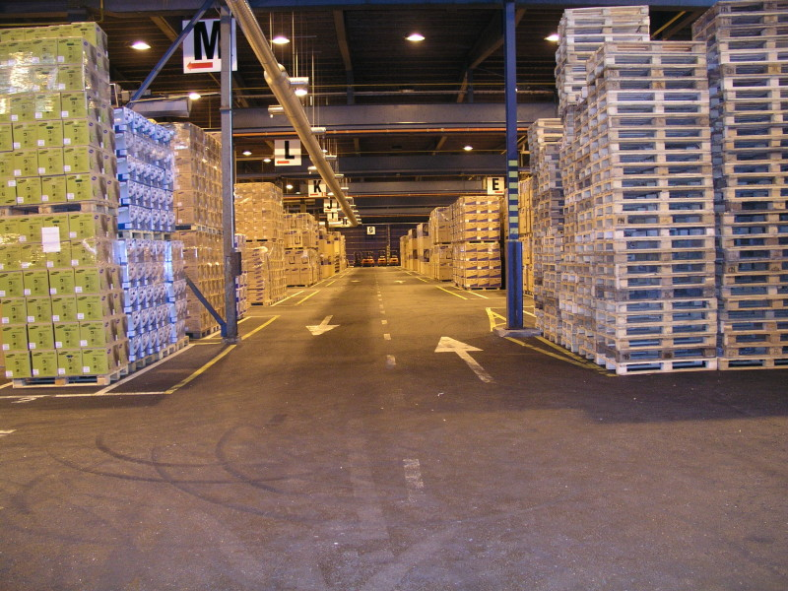
Data Warehousing
Source: Wikipedia (Warehouse)

Slide 8
OLTP/OLAP Integration
OLTP database for user-facing transactions
Extract-Transform-Load (ETL)
OLAP database for data warehousing

Slide 9
OLTP/OLAP Architecture
OLTP
OLAP
ETL (Extract, Transform, and Load)
A simple example to illustrate…

Slide 10
A Simple OLTP Schema
Customer
Billing
Inventory
Order
OrderLine

Slide 11
A Simple OLAP Schema
Dim_Customer
Dim_Date
Dim_Product
Fact_Sales
Stars and snowflakes, oh my!
Dim_Store

Slide 12
ELT
Extract
Transform
Data cleaning and integrity checking
Schema conversion
Field transformations
Load
When does ELT happen?

Slide 13
What do you actually do?
Report generation
Dashboards
Ad hoc analyses

Slide 14
OLAP Cubes
time
Common operations
slice and dice
roll up/drill down
pivot
product
store

Slide 15
OLAP Cubes: Challenges
Fundamentally, lots of joins, group-bys and aggregations
How to take advantage of schema structure to avoid repeated work?
Cube materialization
Realistic to materialize the entire cube?
If not, how/when/what to materialize?

Slide 16
Fast forward…

Slide 17

Jeff Hammerbacher, Information Platforms and the Rise of the Data Scientist. In, Beautiful Data, O’Reilly, 2009.
“On the first day of logging the Facebook clickstream, more than 400 gigabytes of data was collected. The load, index, and aggregation processes for this data set really taxed the Oracle data warehouse. Even after significant tuning, we were unable to aggregate a day of clickstream data in less than 24 hours.”

Slide 18
OLTP/OLAP Architecture
OLTP
OLAP
ETL (Extract, Transform, and Load)

Slide 19
Facebook Context
“OLTP”
“OLAP”
ETL (Extract, Transform, and Load)
Adding friends
Updating profiles
Likes, comments
…
Feed ranking
Friend recommendation
Demographic analysis
…

Slide 20
Facebook Technology
“OLTP”
PHP/MySQL

Slide 21
Facebook’s Datawarehouse
“OLTP”
Hadoop
ETL (Extract, Transform, and Load)
ETL or ELT?
PHP/MySQL

Slide 22
What’s changed?
Dropping cost of disks
Cheaper to store everything than to figure out what to throw away

Slide 23
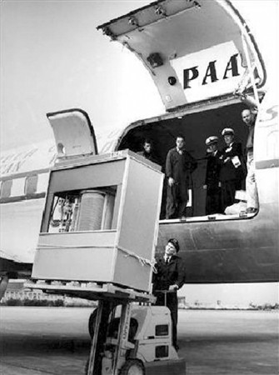
What’s changed?
Dropping cost of disks
Cheaper to store everything than to figure out what to throw away
5 MB hard drive in 1956

Slide 24
What’s changed?
Dropping cost of disks
Cheaper to store everything than to figure out what to throw away
Types of data collected
From data that’s obviously valuable to data whose value is less apparent
Rise of social media and user-generated content
Large increase in data volume
Growing maturity of data mining techniques
Demonstrates value of data analytics

Slide 25
Virtuous Product Cycle
a useful service
$ (hopefully)
transform insights into action
analyze user behavior to extract insights
Google.
Facebook.
Twitter.
Amazon.
Uber.

Slide 26
What do you actually do?
Dashboards
Report generation
Ad hoc analyses
“Descriptive”
“Predictive”
Data products

Slide 27
Virtuous Product Cycle
a useful service
$ (hopefully)
transform insights into action
analyze user behavior to extract insights
data products
data science

Slide 28
Jeff Hammerbacher, Information Platforms and the Rise of the Data Scientist. In, Beautiful Data, O’Reilly, 2009.
“On the first day of logging the Facebook clickstream, more than 400 gigabytes of data was collected. The load, index, and aggregation processes for this data set really taxed the Oracle data warehouse. Even after significant tuning, we were unable to aggregate a day of clickstream data in less than 24 hours.”

Slide 29

The Irony…
SQL
“OLTP”
Hadoop
ELT
map
map
map
…
map
map
…
map
map
map
…
map
reduce
reduce
reduce
map
map
…
map
…
reduce
reduce
…
reduce
reduce
reduce
…
reduce
reduce
reduce
…
reduce
PHP/MySQL
Wait, so why not use a database to begin with?

Slide 30
Why not just use a database?
SQL is awesome
Scalability.
Cost.

Slide 31
Databases are great…
If your data has structure (and you know what the structure is)
If your data is reasonably clean
If you know what queries you’re going to run ahead of time
Databases are not so great…
If your data has little structure (or you don’t know the structure)
If your data is messy and noisy
If you don’t know what you’re looking for

Slide 32

“there are known knowns; there are things we know we know. We also know there are known unknowns; that is to say we know there are some things we do not know. But there are unknown unknowns – the ones we don't know we don't know…” – Donald Rumsfeld
Source: Wikipedia

Slide 33
Databases are great…
If your data has structure (and you know what the structure is)
If your data is reasonably clean
If you know what queries you’re going to run ahead of time
Known unknowns!
Databases are not so great…
If your data has little structure (or you don’t know the structure)
If your data is messy and noisy
If you don’t know what you’re looking for
Unknown unknowns!

Slide 34
Advantages of Hadoop dataflow languages
Don’t need to know the schema ahead of time
Raw scans are the most common operations
Many analyses are better formulated imperatively
Also compare: data ingestion rate

Slide 35
What do you actually do?
Dashboards
Report generation
Ad hoc analyses
“Descriptive”
“Predictive”
Data products
Which are known unknowns and unknown unknowns?

Slide 36
OLTP/OLAP Architecture
OLTP
OLAP
ETL (Extract, Transform, and Load)

Slide 37
Modern Datawarehouse Ecosystem
OLTP
SQL tools
other tools
OLAP
Databases
HDFS

Slide 38
Facebook’s Datawarehouse
“OLTP”
Hadoop
ELT
PHP/MySQL
How does this actually happen?

Slide 39
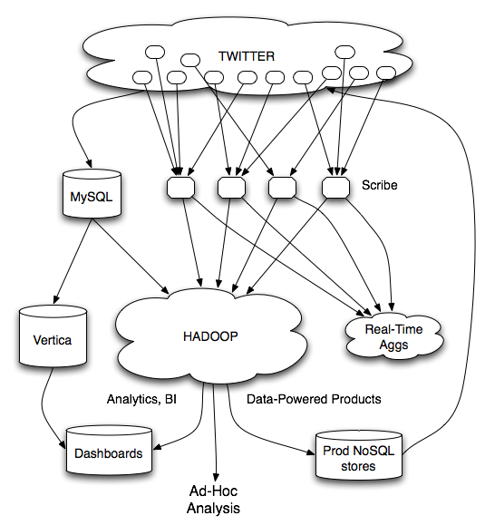
Twitter’s data warehousing architecture

Slide 40
circa ~2010
~150 people total
~60 Hadoop nodes
~6 people use analytics stack daily
circa ~2012
~1400 people total
10s of Ks of Hadoop nodes, multiple DCs
10s of PBs total Hadoop DW capacity
~100 TB ingest daily
dozens of teams use Hadoop daily
10s of Ks of Hadoop jobs daily

Slide 41
Twitter’s data warehousing architecture

Slide 42
Importing Log Data
Main Datacenter
Scribe Aggregators
HDFS
Main Hadoop DW
Staging Hadoop Cluster
Datacenter
Scribe Daemons (Production Hosts)
Datacenter
Scribe Aggregators
Scribe Aggregators
HDFS
HDFS
Staging Hadoop Cluster
Scribe Daemons (Production Hosts)
Staging Hadoop Cluster
Scribe Daemons (Production Hosts)

Slide 43
Importing Structured Data*
Tweets, graph, users profiles
Different periodicity (e.g., hourly, daily snapshots, etc.)
DB partitions
HDFS
select * from …
mappers
LZO-compressed protobufs
Important: Must carefully throttle resource usage…
* Out of date – for illustration only

Slide 44
Vertica Pipeline
import
aggregation
HDFS
Vertica
MySQL
Birdbrain
Interactive browsing tools
Why?
Vertica provides orders of magnitude faster aggregations!
“Basically, we use Vertica as a cache for HDFS data.”
@squarecog
* Out of date – for illustration only

Slide 45
Vertica Pipeline
import
aggregation
HDFS
Vertica
MySQL
Birdbrain
Interactive browsing tools
The catch…
Performance must be balanced against integration costs
Vertica integration is non-trivial
* Out of date – for illustration only

Slide 46
Vertica Pipeline
import
aggregation
HDFS
Vertica
MySQL
Birdbrain
Let’s just run this in reverse!
DB partitions
Interactive browsing tools
HDFS
select * from …
mappers
LZO-compressed protobufs
* Out of date – for illustration only

Slide 47

Vertica Pig Storage
HDFS
reducers
Vertica guarantees that each of these batch inserts are atomic
Vertica partitions
So what’s the challenge?
Did you remember to turn off speculative execution?
What happens when a task dies?
* Out of date – for illustration only

Slide 48
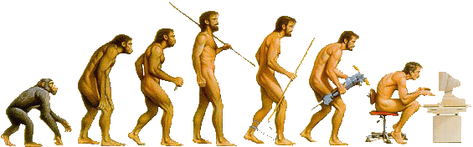
What’s Next?

Slide 49
RDBMS

Slide 50
OLTP
OLAP
ETL (Extract, Transform, and Load)

Slide 51
OLTP
Hadoop
ELT

Slide 52
OLTP
SQL tools
other tools
OLAP
Databases
HDFS

Slide 53
OLTP
OLAP
Hybrid Transactional/Analytical Processing (HTAP)
Coming back full circle?

Slide 54

Questions?
Source: Wikipedia (Japanese rock garden)

