Slide 1

Big Data Infrastructure
CS 489/698 Big Data Infrastructure (Winter 2017)
Week 6: Analyzing Relational Data (1/3)
February 7, 2017
Jimmy Lin
David R. Cheriton School of Computer Science
University of Waterloo
These slides are available at http://lintool.github.io/bigdata-2017w/
This work is licensed under a Creative Commons Attribution-Noncommercial-Share Alike 3.0 United States See http://creativecommons.org/licenses/by-nc-sa/3.0/us/ for details

Slide 2
Structure of the Course
Analyzing Text
Analyzing Relational Data
Analyzing Graphs
Data Mining
“Core” framework features and algorithm design

Slide 3
Evolution of Enterprise Architectures
Next two sessions: techniques, algorithms, and
optimizations for relational processing

Slide 4
users
Monolithic
Application

Slide 5
users
Frontend
Backend

Slide 6
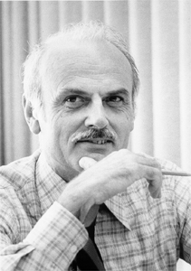
Source: Wikipedia

Slide 7
users
Frontend
Backend
database
Why is this a good idea?

Slide 8
Business Intelligence
An organization should retain data that result from carrying out its mission and exploit those data to generate insights that benefit the organization, for example, market analysis, strategic planning, decision making, etc.
Duh!?

Slide 9
users
Frontend
Backend
database
BI tools
analysts

Slide 10

users
Frontend
Why is my application so slow?
Backend
database
Why does my analysis take so long?
BI tools
analysts

Slide 11
Database Workloads
OLTP (online transaction processing)
Typical applications: e-commerce, banking, airline reservations
User facing: real-time, low latency, highly-concurrent
Tasks: relatively small set of “standard” transactional queries
Data access pattern: random reads, updates, writes (small amounts of data)
OLAP (online analytical processing)
Typical applications: business intelligence, data mining
Back-end processing: batch workloads, less concurrency
Tasks: complex analytical queries, often ad hoc
Data access pattern: table scans, large amounts of data per query

Slide 12
OLTP and OLAP Together?
Downsides of co-existing OLTP and OLAP workloads
Poor memory management
Conflicting data access patterns
Variable latency
users and analysts
Solution?

Slide 13
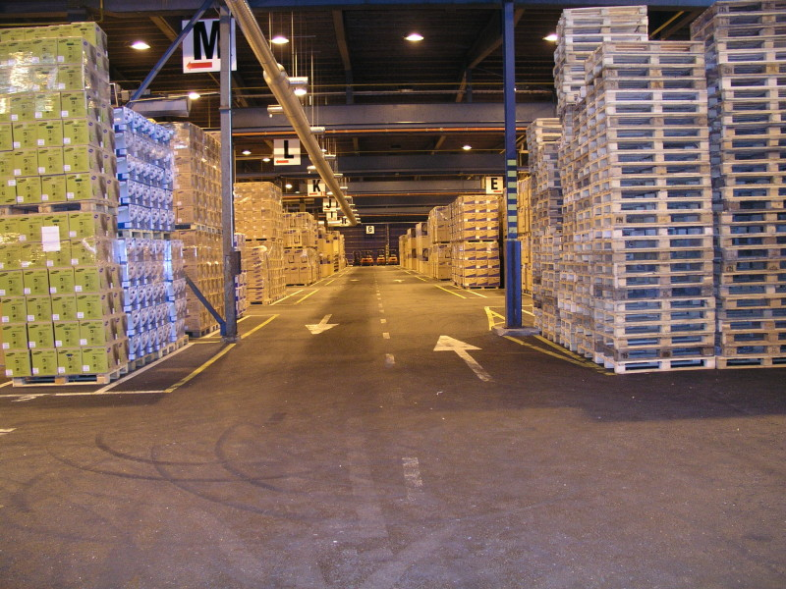
Build a data warehouse!
Source: Wikipedia (Warehouse)

Slide 14

users
Frontend
Backend
OLTP database for user-facing transactions
OLTP database
ETL (Extract, Transform, and Load)
OLAP database for data warehousing
Data Warehouse
BI tools
What’s special about OLTP vs. OLAP?
analysts

Slide 15
A Simple OLTP Schema
Customer
Billing
Inventory
Order
OrderLine

Slide 16
A Simple OLAP Schema
Dim_Customer
Dim_Date
Dim_Product
Fact_Sales
Stars and snowflakes, oh my!
Dim_Store

Slide 17
ETL
Extract
Transform
Data cleaning and integrity checking
Schema conversion
Field transformations
Load
When does ETL happen?

Slide 18
users
Frontend
Backend
OLTP database
ETL (Extract, Transform, and Load)
Data Warehouse
My data is a
day old…
BI tools
Meh.
analysts

Slide 19
external APIs
users
users
Frontend
Frontend
Frontend
Backend
Backend
Backend
OLTP database
OLTP database
OLTP database
ETL (Extract, Transform, and Load)
Data Warehouse
BI tools
analysts

Slide 20
What do you actually do?
Report generation
Dashboards
Ad hoc analyses

Slide 21
OLAP Cubes
time
Common operations
slice and dice
roll up/drill down
pivot
product
store

Slide 22
OLAP Cubes: Challenges
Fundamentally, lots of joins, group-bys and aggregations
How to take advantage of schema structure to avoid repeated work?
Cube materialization
Realistic to materialize the entire cube?
If not, how/when/what to materialize?

Slide 23
external APIs
users
users
Frontend
Frontend
Frontend
Backend
Backend
Backend
OLTP database
OLTP database
OLTP database
ETL (Extract, Transform, and Load)
Data Warehouse
BI tools
analysts

Slide 24
Fast forward…

Slide 25

Jeff Hammerbacher, Information Platforms and the Rise of the Data Scientist. In, Beautiful Data, O’Reilly, 2009.
“On the first day of logging the Facebook clickstream, more than 400 gigabytes of data was collected. The load, index, and aggregation processes for this data set really taxed the Oracle data warehouse. Even after significant tuning, we were unable to aggregate a day of clickstream data in less than 24 hours.”

Slide 26
users
Frontend
Backend
OLTP database
Facebook context?
ETL (Extract, Transform, and Load)
Data Warehouse
BI tools
analysts

Slide 27
users
Frontend
Backend
Adding friends
Updating profiles
Likes, comments
…
“OLTP”
ETL (Extract, Transform, and Load)
Data Warehouse
Feed ranking
Friend recommendation
Demographic analysis
…
BI tools
analysts

Slide 28
users
Frontend
Backend
“OLTP”
PHP/MySQL
ETL (Extract, Transform, and Load)
or ELT?
Hadoop
✗
analysts
data scientists

Slide 29
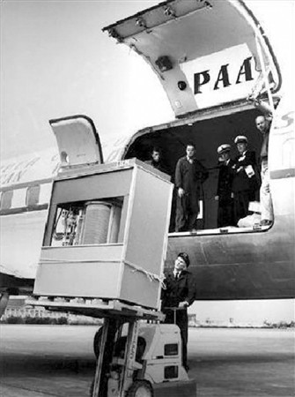
What’s changed?
Dropping cost of disks
Cheaper to store everything than to figure out what to throw away
5 MB hard drive in 1956

Slide 30
What’s changed?
Dropping cost of disks
Cheaper to store everything than to figure out what to throw away
Types of data collected
From data that’s obviously valuable to data whose value is less apparent
Rise of social media and user-generated content
Large increase in data volume
Growing maturity of data mining techniques
Demonstrates value of data analytics

Slide 31
Virtuous Product Cycle
a useful service
$ (hopefully)
transform insights into action
analyze user behavior to extract insights
Google.
Facebook.
Twitter.
Amazon.
Uber.

Slide 32
What do you actually do?
Report generation
Dashboards
Ad hoc analyses
“Descriptive”
“Predictive”
Data products

Slide 33
Virtuous Product Cycle
a useful service
$ (hopefully)
transform insights into action
analyze user behavior to extract insights
Google.
Facebook.
Twitter.
Amazon.
Uber.
data products
data science

Slide 34
Jeff Hammerbacher, Information Platforms and the Rise of the Data Scientist. In, Beautiful Data, O’Reilly, 2009.
“On the first day of logging the Facebook clickstream, more than 400 gigabytes of data was collected. The load, index, and aggregation processes for this data set really taxed the Oracle data warehouse. Even after significant tuning, we were unable to aggregate a day of clickstream data in less than 24 hours.”

Slide 35
users
Frontend
Backend
“OLTP”
ETL (Extract, Transform, and Load)
Hadoop
data scientists

Slide 36

users
The Irony…
Frontend
Backend
“OLTP”
ETL (Extract, Transform, and Load)
Hadoop
map
map
map
…
map
map
…
map
map
map
…
map
reduce
reduce
reduce
map
map
…
map
…
reduce
reduce
…
reduce
reduce
reduce
…
reduce
reduce
reduce
…
reduce
data scientists
Wait, so why not use a database to begin with?

Slide 37
Why not just use a database?
SQL is awesome
Scalability.
Cost.

Slide 38
Databases are great…
If your data has structure (and you know what the structure is)
If your data is reasonably clean
If you know what queries you’re going to run ahead of time
Databases are not so great…
If your data has little structure (or you don’t know the structure)
If your data is messy and noisy
If you don’t know what you’re looking for

Slide 39

“there are known knowns; there are things we know we know. We also know there are known unknowns; that is to say we know there are some things we do not know. But there are unknown unknowns – the ones we don't know we don't know…” – Donald Rumsfeld
Source: Wikipedia

Slide 40
Databases are great…
If your data has structure (and you know what the structure is)
If your data is reasonably clean
If you know what queries you’re going to run ahead of time
Known unknowns!
Databases are not so great…
If your data has little structure (or you don’t know the structure)
If your data is messy and noisy
If you don’t know what you’re looking for
Unknown unknowns!

Slide 41
Advantages of Hadoop dataflow languages
Don’t need to know the schema ahead of time
Raw scans are the most common operations
Many analyses are better formulated imperatively
Much faster data ingest rate

Slide 42
What do you actually do?
Report generation
Dashboards
Ad hoc analyses
“Descriptive”
“Predictive”
Data products
Which are known unknowns and unknown unknowns?

Slide 43
external APIs
users
users
Frontend
Frontend
Frontend
Backend
Backend
Backend
OLTP database
OLTP database
OLTP database
ETL (Extract, Transform, and Load)
Data Warehouse
BI tools
analysts

Slide 44
external APIs
users
users
Frontend
Frontend
Frontend
Backend
Backend
Backend
OLTP database
OLTP database
OLTP database
ETL (Extract, Transform, and Load)
“Data Lake”
Data Warehouse
Other tools
SQL on Hadoop
“Traditional”
BI tools
data scientists

Slide 45
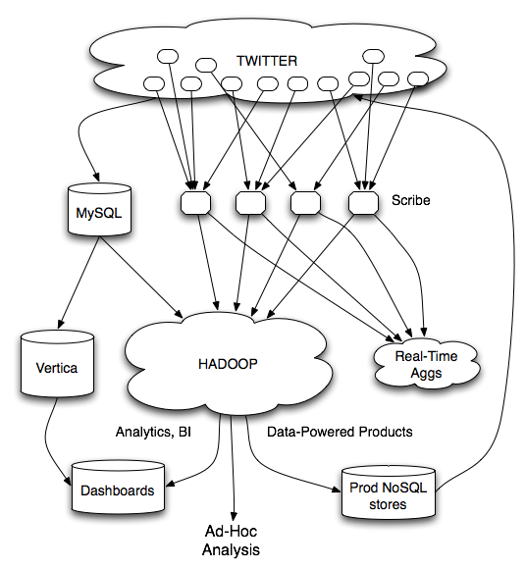
Twitter’s data warehousing architecture (circa 2012)

Slide 46
circa ~2010
~150 people total
~60 Hadoop nodes
~6 people use analytics stack daily
circa ~2012
~1400 people total
10s of Ks of Hadoop nodes, multiple DCs
10s of PBs total Hadoop DW capacity
~100 TB ingest daily
dozens of teams use Hadoop daily
10s of Ks of Hadoop jobs daily

Slide 47
How does ETL actually happen?
Twitter’s data warehousing architecture (circa 2012)

Slide 48
Importing Log Data
Main Datacenter
Scribe Aggregators
HDFS
Main Hadoop DW
Datacenter
Staging Hadoop Cluster
Scribe Daemons (Production Hosts)
Scribe Aggregators
Datacenter
Scribe Aggregators
HDFS
HDFS
Staging Hadoop Cluster
Scribe Daemons (Production Hosts)
Staging Hadoop Cluster
Scribe Daemons (Production Hosts)

Slide 49
Importing Log Data*
Tweets, graph, users profiles
Different periodicity (e.g., hourly, daily snapshots, etc.)
HDFS
DB partitions
select * from …
mappers
LZO-compressed protobufs
Important: Must carefully throttle resource usage…
* Out of date – for illustration only

Slide 50
Vertica Pipeline*
import
aggregation
HDFS
Vertica
MySQL
Birdbrain
Interactive browsing tools
Why?
Vertica provides orders of magnitude faster aggregations!
“Basically, we use Vertica as a cache for HDFS data.”
@squarecog
* Out of date – for illustration only

Slide 51
Vertica Pipeline*
import
aggregation
HDFS
Vertica
MySQL
Birdbrain
Interactive browsing tools
The catch…
Performance must be balanced against integration costs
Vertica integration is non-trivial
* Out of date – for illustration only

Slide 52
Vertica Data Ingestion
import
aggregation
HDFS
Vertica
MySQL
Birdbrain
HDFS
DB partitions
Interactive browsing tools
select * from …
mappers
LZO-compressed protobufs
Let’s just run this in reverse!
* Out of date – for illustration only

Slide 53

HDFS
Vertica Pig Storage*
reducers
Vertica guarantees that each of these batch inserts are atomic
Vertica partitions
So what’s the challenge?
Did you remember to turn off speculative execution?
What happens when a task dies?
* Out of date – for illustration only

Slide 54
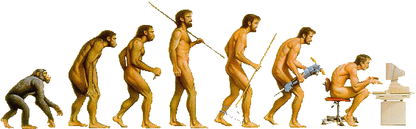
What’s Next?
Two developing trends…

Slide 55
users
Frontend
Backend
database
BI tools
analysts

Slide 56
external APIs
users
users
Frontend
Frontend
Frontend
Backend
Backend
Backend
OLTP database
OLTP database
OLTP database
ETL (Extract, Transform, and Load)
Data Warehouse
BI tools
analysts

Slide 57
external APIs
users
users
Frontend
Frontend
Frontend
Backend
Backend
Backend
OLTP database
OLTP database
OLTP database
ETL (Extract, Transform, and Load)
“Data Lake”
Data Warehouse
Other tools
SQL on Hadoop
“Traditional”
BI tools
My data is a
day old…
I refuse to accept that!
data scientists

Slide 58
ETL
OLTP
OLAP
What if you didn’t have to do this?

Slide 59
HTAP
Hybrid Transactional/Analytical Processing (HTAP)
Coming back full circle?

Slide 60
external APIs
users
users
Frontend
Frontend
Frontend
Backend
Backend
Backend
OLTP database
OLTP database
OLTP database
ETL (Extract, Transform, and Load)
“Data Lake”
Data Warehouse
Other tools
SQL on Hadoop
“Traditional”
BI tools
data scientists

Slide 61
external APIs
users
users
Frontend
Frontend
Frontend
Backend
Backend
Backend
HTAP database
HTAP database
HTAP database
Analytics
tools
Analytics
tools
data scientists
data scientists
ETL (Extract, Transform, and Load)
“Data Lake”
Data Warehouse
Other tools
SQL on Hadoop
“Traditional”
BI tools
data scientists

Slide 62
external APIs
users
users
Frontend
Frontend
Frontend
IaaS / Load balance aaS
Backend
Backend
Backend
DBaaS (e.g., RDS)
OLTP database
OLTP database
OLTP database
Everything
In the cloud!
ELT aaS
ETL (Extract, Transform, and Load)
DBaaS (e.g., RedShift)
“Data Lake”
Data Warehouse
S3
Other tools
SQL on Hadoop
“Traditional”
BI tools
“Cloudified” tools
data scientists

Slide 63

Questions?
Source: Wikipedia (Japanese rock garden)

