Slide 1

Big Data Infrastructure
CS 489/698 Big Data Infrastructure (Winter 2017)
Week 5: Analyzing Graphs (2/2)
February 2, 2017
Jimmy Lin
David R. Cheriton School of Computer Science
University of Waterloo
These slides are available at http://lintool.github.io/bigdata-2017w/
This work is licensed under a Creative Commons Attribution-Noncommercial-Share Alike 3.0 United States See http://creativecommons.org/licenses/by-nc-sa/3.0/us/ for details

Slide 2
Parallel BFS in MapReduce
Data representation:
Key: node n
Value: d (distance from start), adjacency list
Initialization: for all nodes except for start node, d = ∞
Mapper:
∀m ∈ adjacency list: emit (m, d + 1)
Remember to also emit distance to yourself
Sort/Shuffle:
Groups distances by reachable nodes
Reducer:
Selects minimum distance path for each reachable node
Additional bookkeeping needed to keep track of actual path
Remember to pass along the graph structure!

Slide 3
Implementation Practicalities
HDFS
map
reduce
Convergence?
HDFS

Slide 4
Visualizing Parallel BFS
n₇
n₀
n₁
n₃
n₂
n₆
n₅
n₄
n₈
n₉

Slide 5
Non-toy?

Slide 6

Application: Social Search
Source: Wikipedia (Crowd)

Slide 7
Social Search
When searching, how to rank friends named “John”?
Assume undirected graphs
Rank matches by distance to user
Naïve implementations:
Precompute all-pairs distances
Compute distances at query time
Can we do better?

Slide 8
All Pairs?
Floyd-Warshall Algorithm: difficult to MapReduce-ify…
Multiple-source shortest paths in MapReduce:
Run multiple parallel BFS simultaneously
Assume source nodes { s₀ , s₁ , … s_{n} }
Instead of emitting a single distance, emit an array of distances, wrt each source
Reducer selects minimum for each element in array
Does this scale?

Slide 9
Landmark Approach (aka sketches)
Select n seeds { s₀ , s₁ , … s_{n} }
Compute distances from seeds to every node:
A = [2, 1, 1]
B = [1, 1, 2]
C = [4, 3, 1]
D = [1, 2, 4]
Nodes
Distances to seeds
What can we conclude about distances?
Insight: landmarks bound the maximum path length
Run multi-source parallel BFS in MapReduce!
Lots of details:
How to more tightly bound distances
How to select landmarks (random isn’t the best…)

Slide 10
Graphs and MapReduce (and Spark)
A large class of graph algorithms involve:
Local computations at each node
Propagating results: “traversing” the graph
Generic recipe:
Represent graphs as adjacency lists
Perform local computations in mapper
Pass along partial results via outlinks, keyed by destination node
Perform aggregation in reducer on inlinks to a node
Iterate until convergence: controlled by external “driver”
Don’t forget to pass the graph structure between iterations

Slide 11

PageRank
(The original “secret sauce” for evaluating the importance of web pages)
(What’s the “Page” in PageRank?)

Slide 12
Random Walks Over the Web
Random surfer model:
User starts at a random Web page
User randomly clicks on links, surfing from page to page
PageRank
Characterizes the amount of time spent on any given page
Mathematically, a probability distribution over pages
Use in web ranking
Correspondence to human intuition?
One of thousands of features used in web search

Slide 13
PageRank: Defined
Given page x with inlinks t₁…t_{n}, where
C(t) is the out-degree of t
α is probability of random jump
N is the total number of nodes in the graph
t₁
X
t₂
…
t_{n}

Slide 14
Computing PageRank
Remember this?
A large class of graph algorithms involve:
Local computations at each node
Propagating results: “traversing” the graph
Sketch of algorithm:
Start with seed PR_{i} values
Each page distributes PR_{i} mass to all pages it links to
Each target page adds up mass from in-bound links to compute PR_{i+1}
Iterate until values converge

Slide 15
Simplified PageRank
First, tackle the simple case:
No random jump factor
No dangling nodes
Then, factor in these complexities…
Why do we need the random jump?
Where do dangling nodes come from?

Slide 16
Sample PageRank Iteration (1)
Iteration 1
n₂ (0.2)
n₂ (0.166)
n₁ (0.2)
0.1
0.1
0.1
n₁ (0.066)
0.1
0.066
0.066
0.066
n₅ (0.2)
n₃ (0.2)
n₅ (0.3)
n₃ (0.166)
0.2
0.2
n₄ (0.2)
n₄ (0.3)

Slide 17
Sample PageRank Iteration (2)
Iteration 2
n₂ (0.166)
n₂ (0.133)
n₁ (0.066)
0.033
0.083
0.083
n₁ (0.1)
0.033
0.1
0.1
0.1
n₅ (0.3)
n₃ (0.166)
n₅ (0.383)
n₃ (0.183)
0.3
0.166
n₄ (0.3)
n₄ (0.2)

Slide 18
PageRank in MapReduce
n₁ [n₂, n₄]
n₂ [n₃, n₅]
n₃ [n₄]
n₄ [n₅]
n₅ [n₁, n₂, n₃]
Map
n₂
n₄
n₃
n₅
n₄
n₅
n₁
n₂
n₃
n₁
n₂
n₂
n₃
n₃
n₄
n₄
n₅
n₅
Reduce
n₁ [n₂, n₄]
n₂ [n₃, n₅]
n₃ [n₄]
n₄ [n₅]
n₅ [n₁, n₂, n₃]

Slide 19
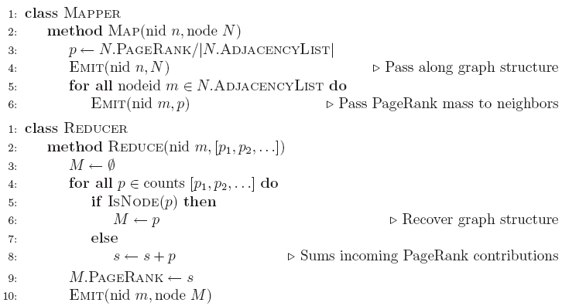
PageRank Pseudo-Code

Slide 20
PageRank vs. BFS
PageRank
BFS
Map
PR/N
d+1
Reduce
sum
min
A large class of graph algorithms involve:
Local computations at each node
Propagating results: “traversing” the graph

Slide 21
Complete PageRank
Two additional complexities
What is the proper treatment of dangling nodes?
How do we factor in the random jump factor?
Solution: second pass to redistribute “missing PageRank mass”
and account for random jumps
p is PageRank value from before, p' is updated PageRank value
N is the number of nodes in the graph
m is the missing PageRank mass
One final optimization: fold into a single MR job

Slide 22
Implementation Practicalities
HDFS
map
map
Convergence?
reduce
HDFS
HDFS
What’s the optimization?

Slide 23
PageRank Convergence
Alternative convergence criteria
Iterate until PageRank values don’t change
Iterate until PageRank rankings don’t change
Fixed number of iterations
Convergence for web graphs?
Not a straightforward question
Watch out for link spam and the perils of SEO:
Link farms
Spider traps
…

Slide 24
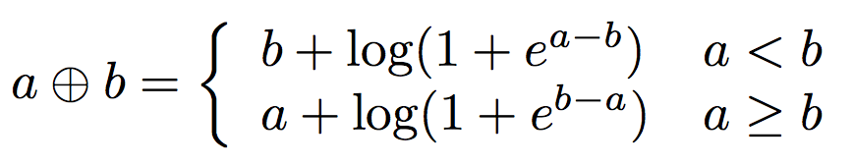
Log Probs
PageRank values are really small…
Solution?
Product of probabilities = Addition of log probs
Addition of probabilities?

Slide 25
More Implementation Practicalities
How do you even extract the webgraph?
Lots of details…

Slide 26
Beyond PageRank
Variations of PageRank
Weighted edges
Personalized PageRank
Variants on graph random walks
Hubs and authorities (HITS)
SALSA

Slide 27
Applications
Static prior for web ranking
Identification of “special nodes” in a network
Link recommendation
Additional feature in any machine learning problem

Slide 28
Implementation Practicalities
HDFS
map
map
Convergence?
reduce
HDFS
HDFS

Slide 29
MapReduce Sucks
Java verbosity
Hadoop task startup time
Stragglers
Needless graph shuffling
Checkpointing at each iteration
Spark to the rescue?

Slide 30
Let’s Spark!
HDFS
map
reduce
HDFS
map
reduce
HDFS
map
reduce
HDFS
…

Slide 31
HDFS
map
reduce
map
reduce
map
reduce
…

Slide 32
HDFS
map
Adjacency Lists
PageRank Mass
reduce
map
Adjacency Lists
PageRank Mass
reduce
map
Adjacency Lists
PageRank Mass
reduce
…

Slide 33
HDFS
map
Adjacency Lists
PageRank Mass
join
map
Adjacency Lists
PageRank Mass
join
map
Adjacency Lists
PageRank Mass
join
…

Slide 34
HDFS
HDFS
Adjacency Lists
PageRank vector
join
flatMap
reduceByKey
PageRank vector
join
flatMap
reduceByKey
PageRank vector
join
…

Slide 35
HDFS
HDFS
Adjacency Lists
PageRank vector
Cache!
join
flatMap
reduceByKey
PageRank vector
join
flatMap
reduceByKey
PageRank vector
join
…

Slide 36
MapReduce vs. Spark
Source: http://ampcamp.berkeley.edu/wp-content/uploads/2012/06/matei-zaharia-part-2-amp-camp-2012-standalone-programs.pdf

Slide 37
Spark to the rescue?
Java verbosity
Hadoop task startup time
Stragglers
Needless graph shuffling
Checkpointing at each iteration
What have we fixed?

Slide 38
HDFS
HDFS
Adjacency Lists
PageRank vector
Cache!
join
flatMap
reduceByKey
Still not particularly satisfying?
PageRank vector
join
flatMap
reduceByKey
PageRank vector
join
…

Slide 39

Stay Tuned!
Source: https://www.flickr.com/photos/smuzz/4350039327/

Slide 40

Questions?
Source: Wikipedia (Japanese rock garden)

