Slide 1

Machine Learning in Practice
Project Advice
Carolyn Penstein Rosé
Language Technologies Institute/ Human-Computer Interaction Institute

Slide 2
Yingbo et al., paper

Slide 3
What Makes a Good Paper
Argue why the problem is important, what your big result is, and what you learned about your application area
Explain prior work, where previous approaches “went wrong”, and where your approach fits
Summarize your approach
Justify your evaluation metrics, corpus, gold standard, and baselines
Present your results
Discuss your error analysis

Slide 4
What Makes a Good Paper
Argue why the problem is important, what your big result is, and what you learned about your application area
Explain prior work, where previous approaches “went wrong”, and where your approach fits
Summarize your approach
Justify your evaluation metrics, corpus, gold standard, and baselines
Present your results
Discuss your error analysis

Slide 5
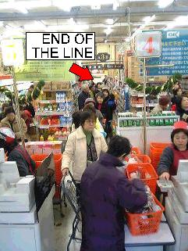
Application: Staff Assignment
Staff assignment normally performed manually
Poor assignment of human resources causes unnecessary expenses
http://www.lewrockwell.com/rogers/line.jpg

Slide 6
What Makes a Good Paper
Argue why the problem is important, what your big result is, and what you learned about your application area
Explain prior work, where previous approaches “went wrong”, and where your approach fits
Summarize your approach
Justify your evaluation metrics, corpus, gold standard, and baselines
Present your results
Discuss your error analysis

Slide 7
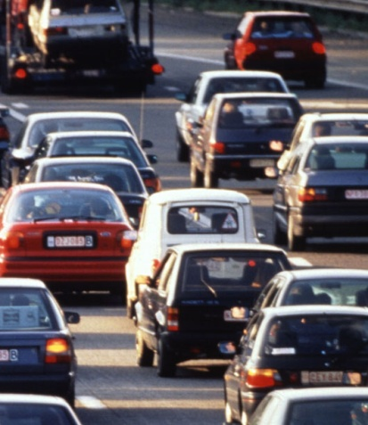

Background on Task
Workflow model: a plan that can be executed
  Composed of activities and tasks
Each activity is performed by one or more actors
An event entry records that the activity was accomplished
Event entries are recorded in an event log
One path through the plan is called a case or workflow instance
http://ec.europa.eu/enterprise
/regulation/goods/images/cars.jpg

Slide 8
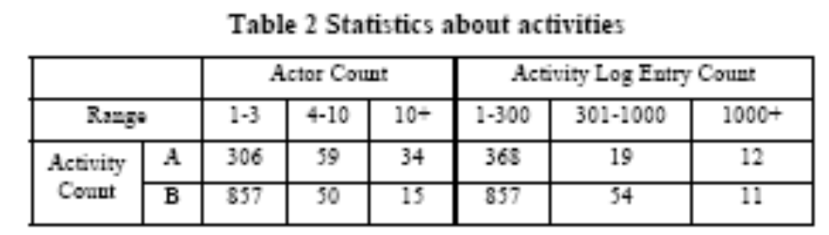
Setting Up the Problem
Raw data: an event log that shows over time who executes which activities
  Each event is an instance
  Class attribute: nominal, names of people who are potential assignees
  Features: “event entries of those completed activities in the same workflow instance”
  Representation is like a word vector where each activity is like a word
Suitable activities are ones that are executed many times and have many potential actors
  22 activities from enterprise A and 35 from B

Slide 9
More on Feature Space Design
Information in event log “actor’s identity, data contained in the workflow and structure information”
  Too vague to see what they are doing here
  Referring to documents that people access while executing the tasks
  Later they mention social network information and expertise

Slide 10
More on Feature Space Design
Did separate experiments for each workflow model
  Each instance is a vector representing the set of activities that were executed by an actor to achieve a goal as part of a case
  Ordering information must be lost (“bag of activities”)
  Basically, you are identifying difference characteristic styles of executing a plan that are associated with different actors

Slide 11
What Makes a Good Paper
Argue why the problem is important, what your big result is, and what you learned about your application area
Explain prior work, where previous approaches “went wrong”, and where your approach fits
Summarize your approach
Justify your evaluation metrics, corpus, gold standard, and baselines
Present your results
Discuss your error analysis

Slide 12
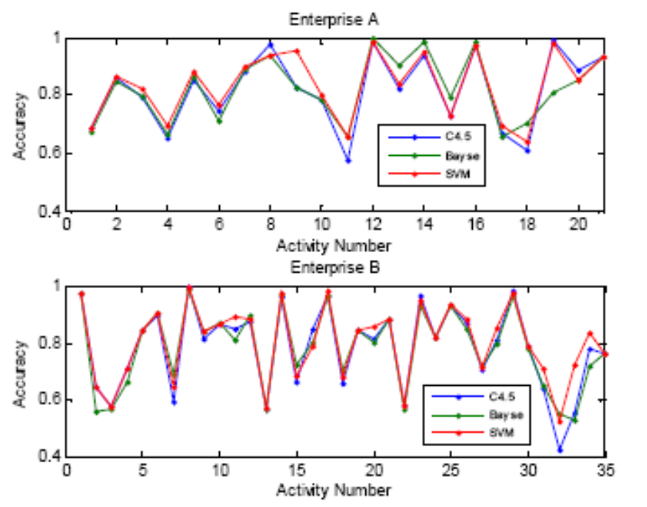

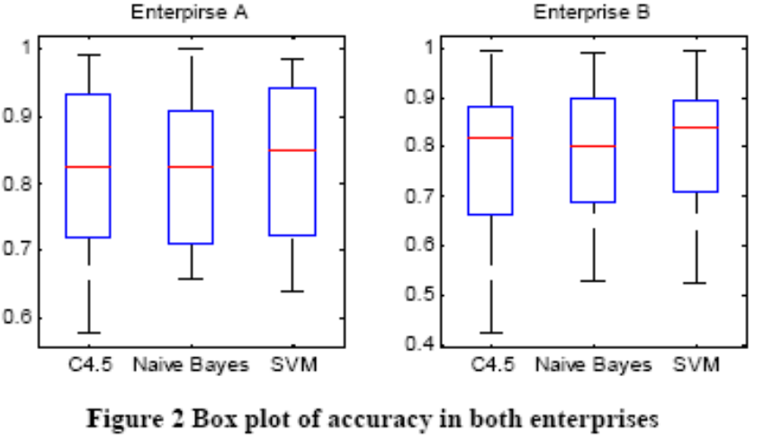
Why did they pick SVM?
No significant difference on average
Decided to go with the most consistent algorithm

Slide 13
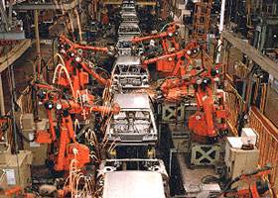
Application: Staff Assignment
Results for car manufacturing are 85.5% for one company and 80.1% for another
  But what is the kappa?
  How hard is the problem?
  What kinds of mistakes does it make?
  What does accuracy mean here?
http://www.asia-pacific-connections.com/images/
Car-manufacturing.jpg

Slide 14
What Makes a Good Paper
Argue why the problem is important, what your big result is, and what you learned about your application area
Explain prior work, where previous approaches “went wrong”, and where your approach fits
Summarize your approach
Justify your evaluation metrics, corpus, gold standard, and baselines
Present your results
Discuss your error analysis

Slide 15
Take Home Message
Positives
  Real world application of machine learning
  Evaluation on realistic dataset
  Related work discussion points out what is the unique contribution of this work
    But the latter portion of the discussion sounds like a “laundry list”
  Lots of consideration of feature space design
    Not sure feature space design makes sense for the task though – is it learning the right thing?
Negatives
  Evaluation seems weak – and no error analysis
  Writing is not clear
    You should try to explain things more clearly than this

Slide 16
How would you have approached the problem differently?

Slide 17
Stumpf et al., paper

Slide 18
What Makes a Good Paper
Argue why the problem is important, what your big result is, and what you learned about your application area
Explain prior work, where previous approaches “went wrong”, and where your approach fits
Summarize your approach
Justify your evaluation metrics, corpus, gold standard, and baselines
Present your results
Discuss your error analysis

Slide 19
What Makes a Good Paper
Argue why the problem is important, what your big result is, and what you learned about your application area
Explain prior work, where previous approaches “went wrong”, and where your approach fits
Summarize your approach
Justify your evaluation metrics, corpus, gold standard, and baselines
Present your results
Discuss your error analysis

Slide 20
Research Goals
Email classification: hard classification problem
Collaboration between machine learning and humans
  Getting advice from users
  Making machine learning transparent
  Increasing trust
User centered evaluation methodology
  Use think aloud protocols to evaluate alternative approaches to offering explanations to users
Users are able to offer “valuable” feedback
  Machine learning technology needs to be extended in order to take advantage of it

Slide 21
What Makes a Good Paper
Argue why the problem is important, what your big result is, and what you learned about your application area
Explain prior work, where previous approaches “went wrong”, and where your approach fits
Summarize your approach
Justify your evaluation metrics, corpus, gold standard, and baselines
Present your results
Discuss your error analysis

Slide 22
Related Work
Other related work on “collaborative” machine learning
  Offering explanation of predictions
  Getting feedback
  Lack of work integrating the two
Making predictions more transparent to users increases preference and trust

Slide 23
Related Work
Obtaining user feedback
  Typical: users indicate whether a prediction is right or what the correct prediction would have been
  New:
    Algorithm explains how it made its prediction
    User offers detailed feedback on how performance could be improved

Slide 24
What Makes a Good Paper
Argue why the problem is important, what your big result is, and what you learned about your application area
Explain prior work, where previous approaches “went wrong”, and where your approach fits
Summarize your approach
Justify your evaluation metrics, corpus, gold standard, and baselines
Present your results
Discuss your error analysis

Slide 25
Think Aloud Study
External validity: use real world data, but not the user’s own data
Machine learning algorithms sorted emails from the ENRON corpus into folders and “explained their reasoning”
  Three different explanation approaches: rule based, keyword based, similarity based
  Users were free to give feedback in any form
Evaluate user feedback: willingness, accuracy, demonstrated understanding of computer explanations, usability by computer algorithms

Slide 26
Procedure
Offline preparation for study:
  Classify all emails
  Generate three forms of explanation for each email
Within subject manipulation – every subject exposed to every form of explanation
  Approach selected randomly for each message
Subjects were graduate students (6 males and 7 females)
Native English speakers with computer experience but not computer science majors
Paper prototypes, so they would not give the impression of a finished system
Users could rearrange piles of “classified” email
Questionnaire data every 15 minutes and at the end to assess effort and preference

Slide 27
Explanation Generation
Used JRIP and Naïve Bayes
Popular for email classification
Decent performance, though not great
  Rule based feedback generated by highlighting the relevant JRIP rule
  Keywords from Naïve Bayes model –words with strongest positive and negative evidence
  Similarity based by finding the message that would have had the biggest impact on the prediction of the message if it was removed from the training set

Slide 28
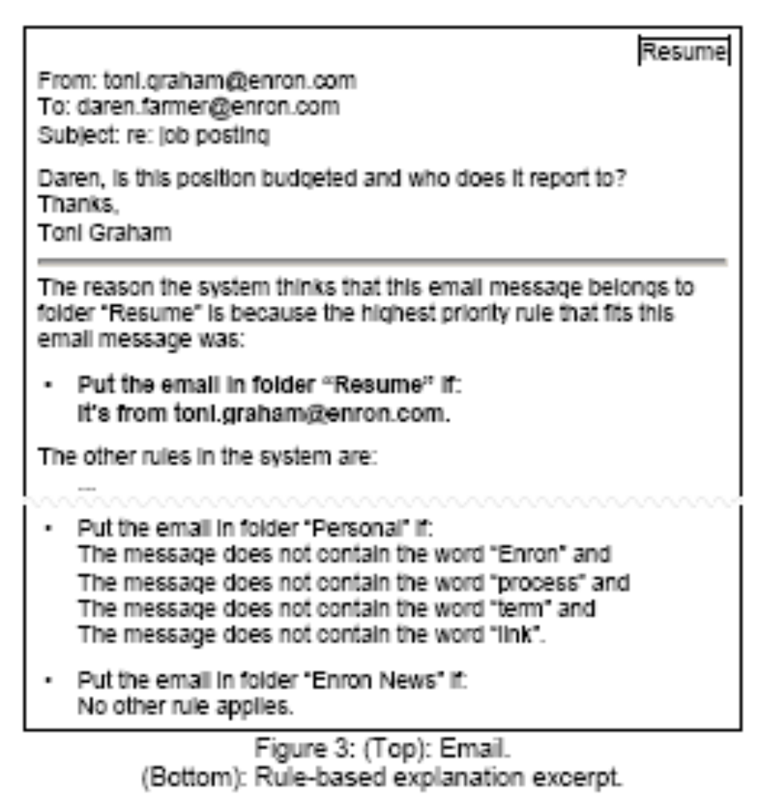
Rule Based Approach

Slide 29
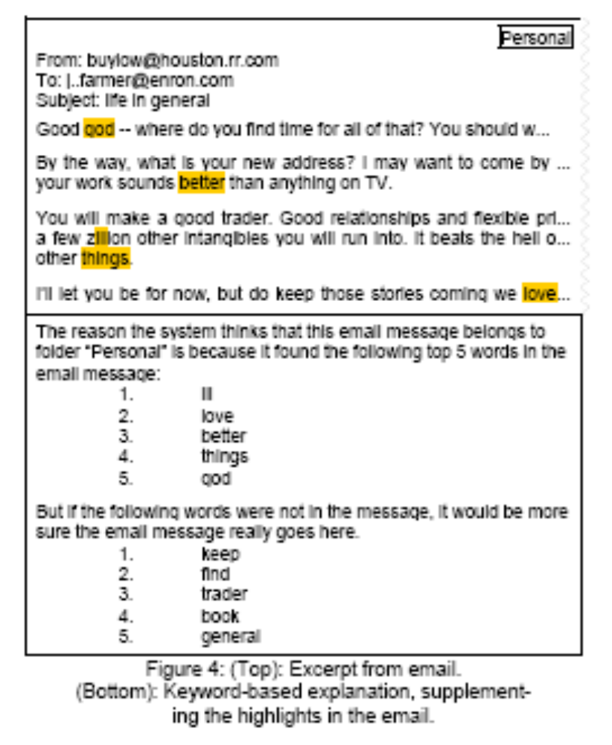
Keyword Based Approach

Slide 30
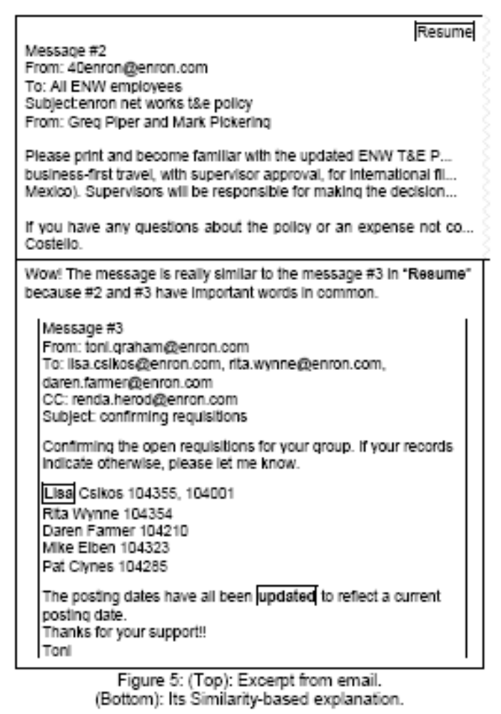
Similarity Based Approach

Slide 31
What Makes a Good Paper
Argue why the problem is important, what your big result is, and what you learned about your application area
Explain prior work, where previous approaches “went wrong”, and where your approach fits
Summarize your approach
Justify your evaluation metrics, corpus, gold standard, and baselines
Present your results
Discuss your error analysis

Slide 32
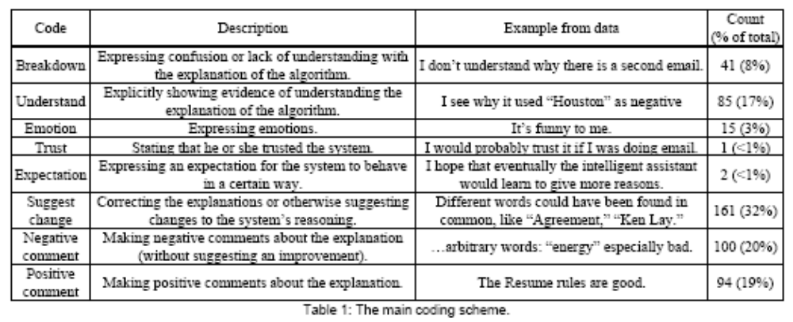
Qualitative Analysis of User Comments
Designed two coding schemes
  First identify positive and negative comments
  Then focus on finer grained distinctions in negative comments – investigating how these can be used by the algorithms
Assessed inter-rater reliability

Slide 33
What Makes a Good Paper
Argue why the problem is important, what your big result is, and what you learned about your application area
Explain prior work, where previous approaches “went wrong”, and where your approach fits
Summarize your approach
Justify your evaluation metrics, corpus, gold standard, and baselines
Present your results
Discuss your error analysis

Slide 34
Summary of Findings
Users understood and preferred the rule based approach most, based on the questionnaire data
  But enough liked the other approaches that sticking with just one does not seem advisable
  Users liked the “conversational style” of similarity based feedback
  Users expected the explanations to seem sound and reasonable
Task based explanation: User’s generate a classification based on explanation
  Most trouble with similarity based
When asked to provide an explanation, users typically used a rule based approach

Slide 35
Counterintuitive finding!
Some users were slower when the prediction was correct!
The better the accuracy, the harder it may be for users to spot the flaws
This is why it’s important to user test!!!

Slide 36
Most Common Suggestions for Keyword Based Explanations
Adjust weights
Flip polarity
Consider different words
Generalization across words
  Syntactic and semantic variants
Feature combinations
Meta data: from line, email threads
Discussion Question: How would you do this? And what effect do you think it would have?

Slide 37
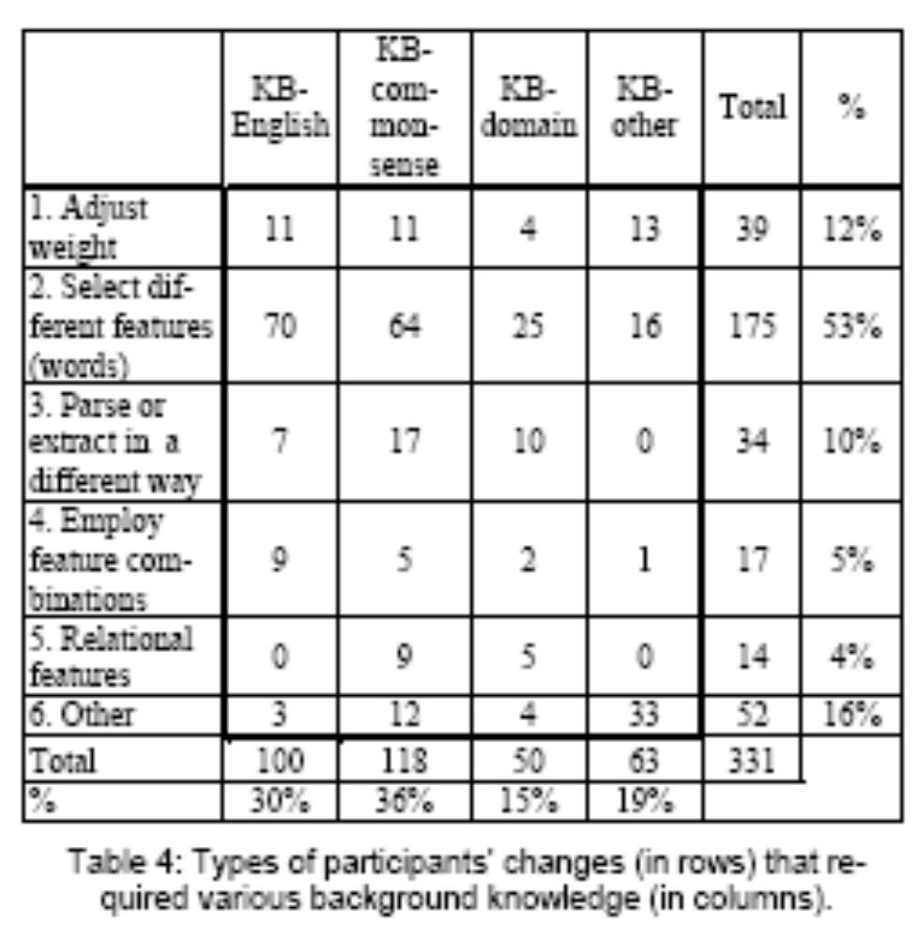
User Feedback

Slide 38
What Makes a Good Paper
Argue why the problem is important, what your big result is, and what you learned about your application area
Explain prior work, where previous approaches “went wrong”, and where your approach fits
Summarize your approach
Justify your evaluation metrics, corpus, gold standard, and baselines
Present your results
Discuss your error analysis

Slide 39

Error Analysis
?

Slide 40
What Makes a Good Paper
Argue why the problem is important, what your big result is, and what you learned about your application area
Explain prior work, where previous approaches “went wrong”, and where your approach fits
Summarize your approach
Justify your evaluation metrics, corpus, gold standard, and baselines
Present your results
Discuss your error analysis

Slide 41
Take Home Message
Interesting use of user study data in connection with machine learning
  Recent focus on how people use machine learning models and interact with machine learning algorithms
Error analysis is most commonly lacking in published work
  But I want to see that in your work!

