Slide 1
Team Ball
Neuron Finder Project
Parya Jandaghi
Jin Wang
Omid Setayeshfar

Slide 2
Pre-Processing
We examined :
Flattening each dataset to one image using summation
Flattening each dataset to one image using normalized summation
Flattening each dataset to one image using summation then applying smoothing
Thus we had :
Training and validation : 19 images with their ground truth ( Whattttt?! )
Testing 9 provided samples

Slide 3
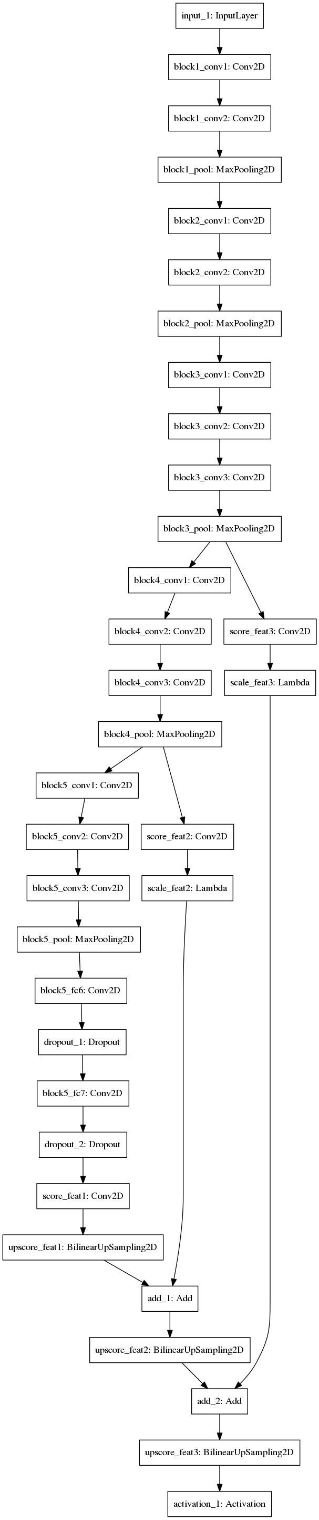
FCN based on VGG-16
https://github.com/JihongJu/keras-fcn

Slide 4
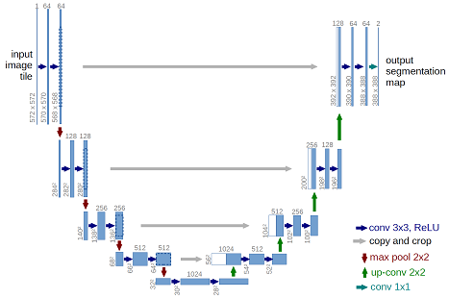
U-Net
https://arxiv.org/pdf/1505.04597.pdf

Slide 5
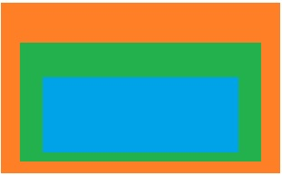
Evaluation Measure
Dice Score(%): Measuring the degree of overlap among ground truth area and algorithmic result area
Over-segmentation: Dice Score > 100%
Good segmentation: Dice Score ≈ 100%
Under-segmentation Dice Score < 100%

Slide 7
Best Results
Classifier Results :
Method | Accuracy
FCN – Trained from scratch | 0.77
FCN – Fine tuned | 0.76
U-Net | 0.94
NMF | ☹
AutoLab Results :
Score | Value | Rank
Total Score | 3.03533 | #4
Average Precision | 0.80668 | #-2
Average Recall | 0.76954 | ok
Average Inclusion | 0.66662 | #2
Average Exclusion | 0.76954 | #2

