Slide 1
Data Science Practicum
Spring 2018 Wrap-up Lecture

Slide 2
Outline
Some fun stats
Course feedback
Wrap-up

Slide 3
Commits
2,605 commits
7,347,331 additions, 2,906,254 deletions
4,441,077 new lines of code

Slide 4
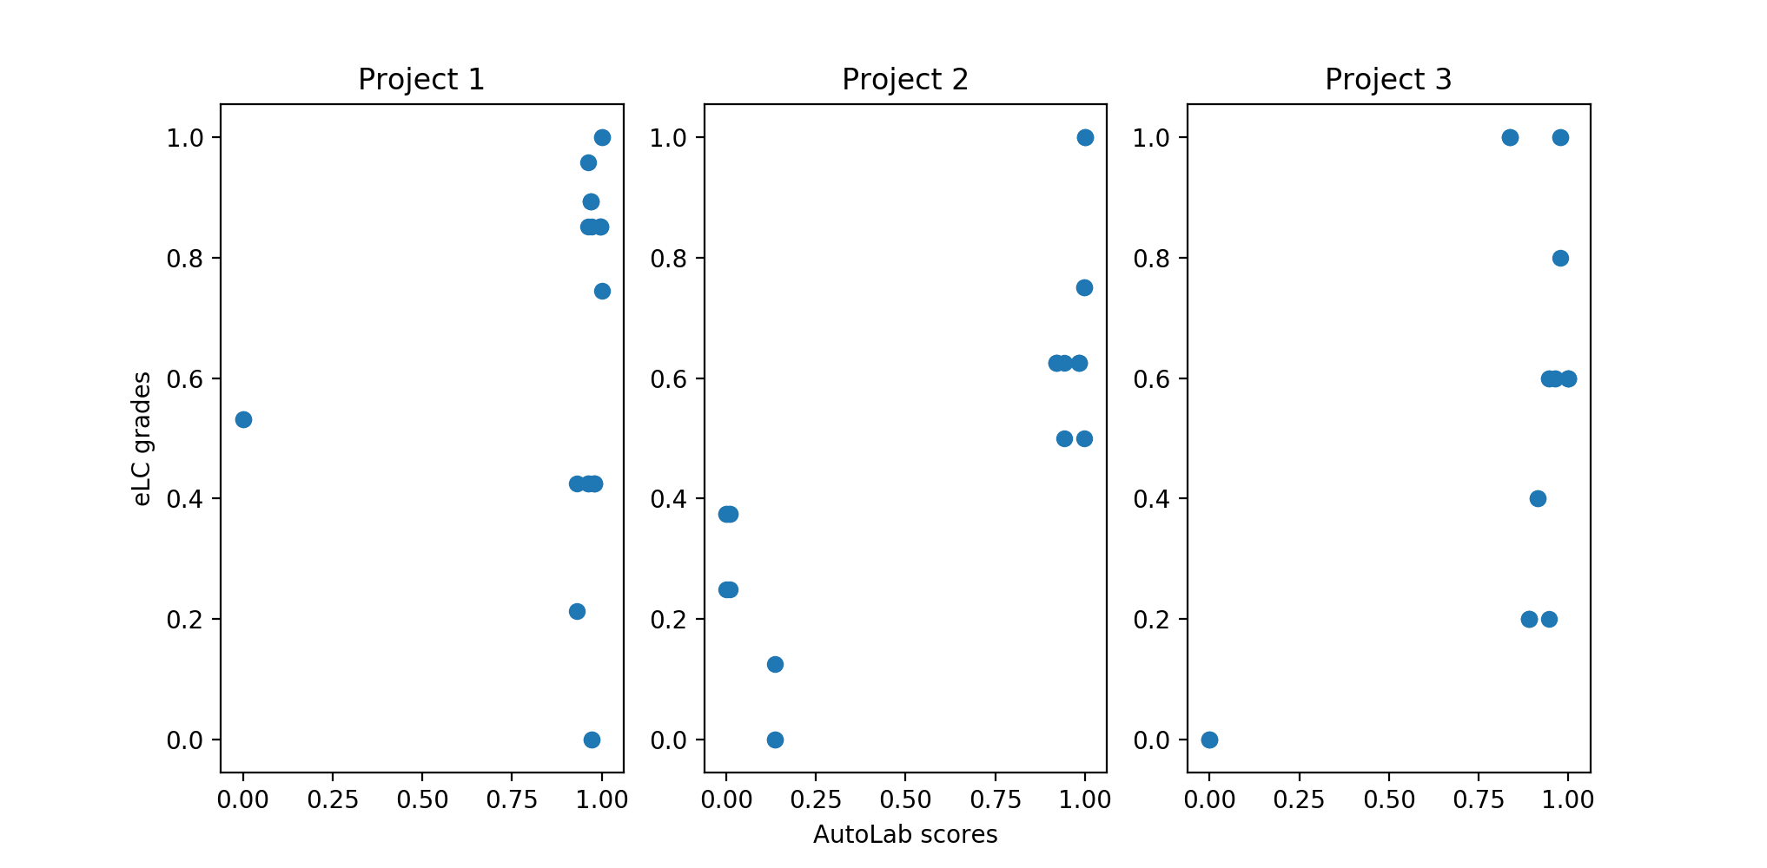
Normalized Project Performance
Takeaway:
Good AutoLab performance != High marks

Slide 5
Takeaways
Reuseability is critical in academia and industry frameworks
Documentation
READMEs
Comments
Development process (Issues, Pull Requests, Gitter/Slack/Listservs)
The real world operates in teams
Reusability + teamwork = effective communication is absolutely essential
More important than Kaggle leaderboard position (what’s the point if only you can understand it)
More important than raw coding talent (raw coding talent is dime/dozen)

Slide 6
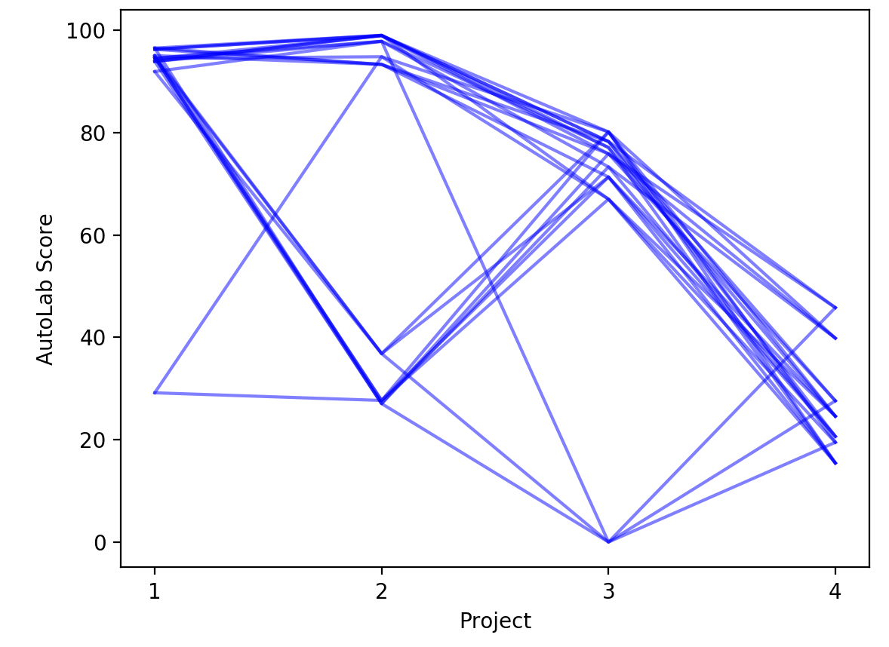
AutoLab Score Progression
Takeaway: Project difficulty increased / time availability decreased

Slide 7
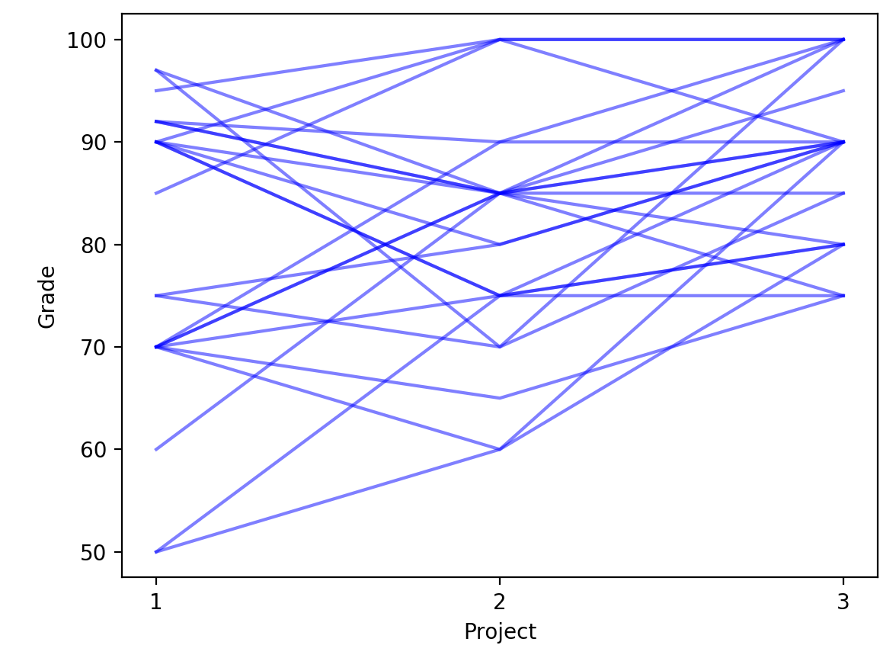
Individual Grade Progression
Takeaway:
Improvement over time!

Slide 8
Feedback
Activity time!
Three categories of feedback:
STOP: What would you remove or eliminate from the course?
START: What would you add to the course?
CONTINUE: What would you keep or retain that is already present in the course?
Individually, write down one item for each category (5 minutes)
Get in groups and develop a consensus list (10 minutes)
Notes:
Lecture to go along with Project 0 that describes all the various tools
- Flintrock!
- should probably be an individual project
- best practices & tools involved
- how to go beyond the project baseline(s)
New project ideas
- make a game AI ( “halite” )
- big data pipeline – real-time processing
- flink / spark / etc
3-week projects: yay!
2-week projects: yikes
Keep NLP projects

Slide 9
Feedback
My thoughts
Your thoughts
STOP
4 projects + Final project is too much; cut down 1 course project, extend the others, leave more room for Final project
START
New category of projects like unsupervised clustering, matrix factorization, reinforcement learning
CONTINUE
Project 0 (maybe extend in length a tad)
Notes:
I haven’t computed the distribution of commits by time, but from observing: no matter how long you have to start the project, 75% of people start in the last 1.5 weeks
- played out in each project (2-3 weeks each)
- played out in the final project (5 weeks)
Hence my hesitation to go to 3 projects vs 4

Slide 10
Other Thoughts
Teams aren’t going anywhere
Lectures will be tweaked for additional background knowledge
Also, 3360 Data Science I is proposed to become a 4000/6000 course to allow graduate enrollment
When that happens, DS1 will be a required prerequisite to 8360 (no more “toughing it out”)
Switch from Spark to dask
Submit programs to AutoLab, rather than just predictions
EXTRA CREDIT: By midnight, April 27, propose a new project idea. Needs:
A clear, unambiguous ground-truth (or evaluation metric) to put in AutoLab
An openly available dataset (or one that can be acquired, e.g., CodeNeuro or cilia)
Can achieve a reasonable solution in 2-3 weeks
Up to 5 points on your final grade
Notes:
Spark to dask would vastly simplify the projects, also give us a cutting-edge framework
- doesn’t have any deep learning attached to it (yet)
- only available in Python

Slide 11
Other thoughts
Course evaluations!
http://eval.franklin.uga.edu/

Slide 12
Final Presentations
Wednesday, April 18
Parya, Omid, Raunak
Jeremy, Ailing
Thursday, April 19
Hiten, Ankit
Ankita, Vibodh, Vyom
Nihal, Vamsi, Vinay Bingi
Tuesday, April 24
Chris, Zach
Jin
Prajay, Nick, Layton
Wednesday, April 25
Weiwen, I-Huei
Rajeswari, Maulik
Friday, April 27, 11:59pm: ALL PROJECT MATERIALS DUE

Slide 13
Final notes
Raw scores aren’t everything
…but they’re a reasonable indicator
Balance exploration (examining the data, testing multiple approaches) with exploitation (designing, testing, and documenting a complete pipeline)
Corollary: start early!!!!!!!!!!!!!!!!!!!!!!!!!!!!!!!!
Communicate. Communicate. Communicate.
Questions?

Slide 14
Thank you!

