Slide 1
Team Hastings- Cilia segmentation
- aNKIT VAGHELA
- VYOM SHRIVASTAVA
- WEIWEN XU

Slide 2
Index
Optical Flow
Unet
Tiramisu

Slide 3
Optical Flow - OPENCV DENSE OPTICAL FLOW
Scalable, runs very fast
Only able to detect moving objects (Some cilia are not moving)
Also cells are moving
Moving air bubbles

Slide 4
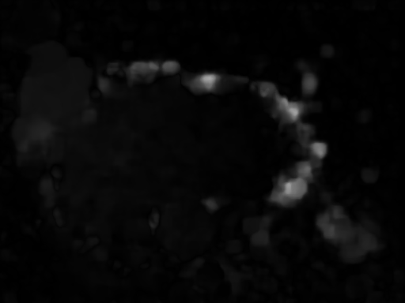
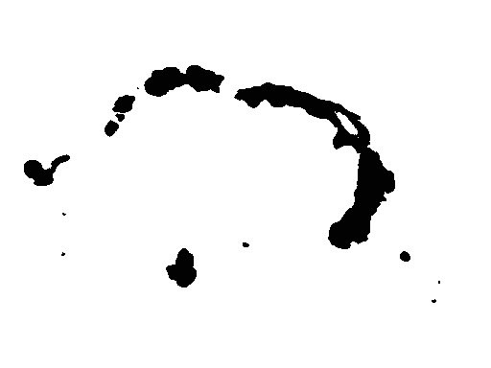
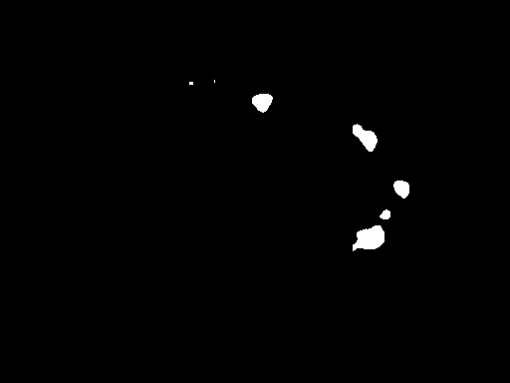

Slide 5
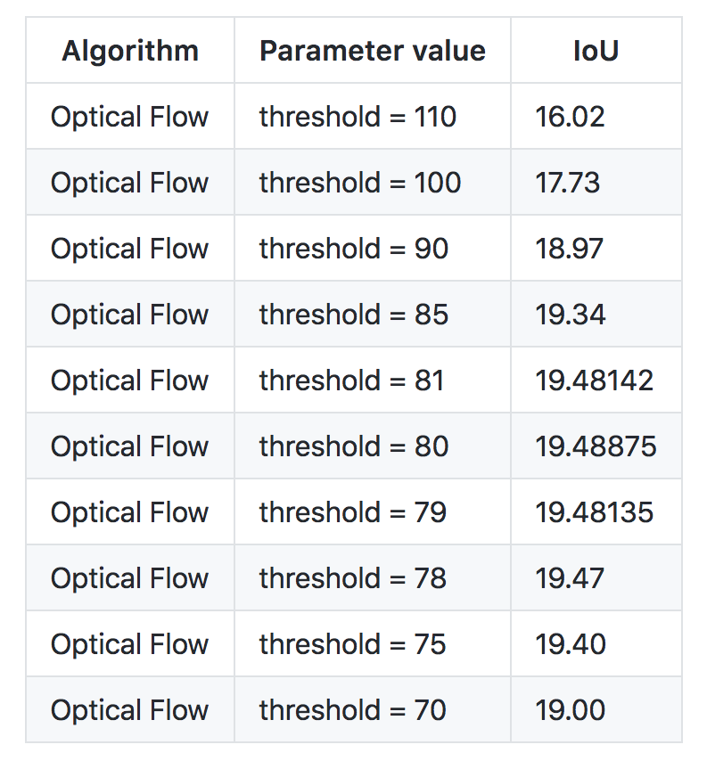

Slide 6
UNET
Minor modification to basic Unet as per the paper: https://arxiv.org/pdf/1707.06314.pdf
Added batch normalization after every convolution layer
Added dropout after every Unet block
Gave very low score.

Slide 7


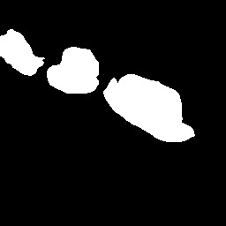
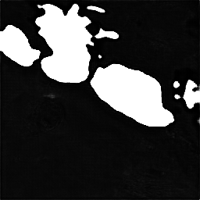
Training Mask
PREDICTED Mask

Slide 8
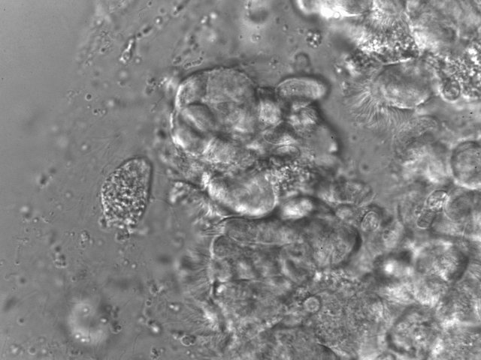
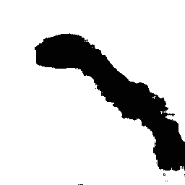
Training iMAGE
PREDICTED Mask

Slide 9
Tiramisu
We used Jeremy Howard's Tiramisu implementation with slight modification: https://github.com/fastai/courses/blob/master/deeplearning2/tiramisu-keras.ipynb
Preprocessing and post processing same as Unet
Ran on very small dataset

Slide 10
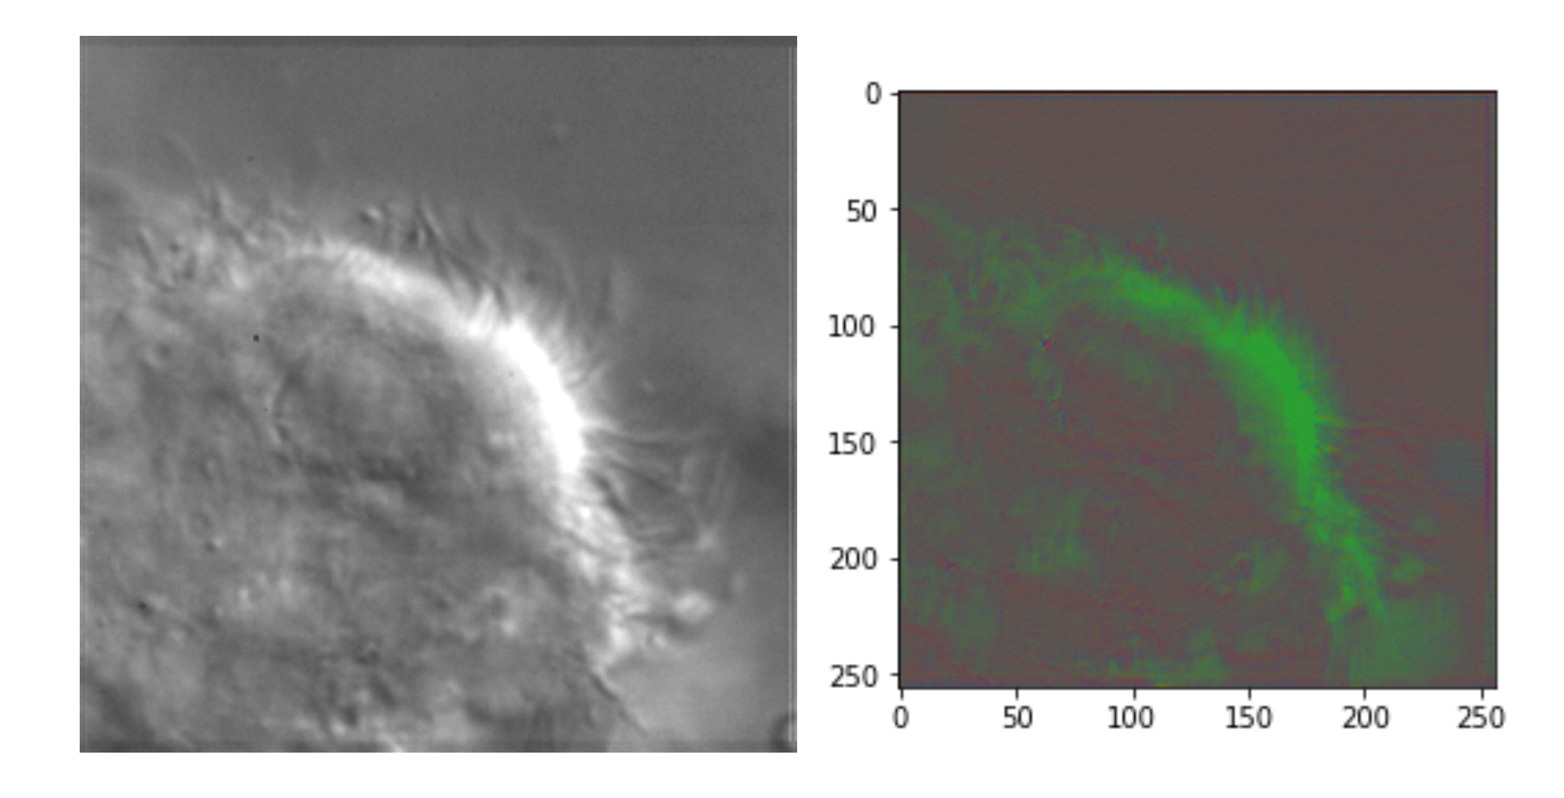

Slide 11
Questions?

