Slide 1
Data Science Practicum Project 2 Malware Classification
Teammates: Aishwarya Jagtap,
Ailing Wang,
Weiwen Xu.

Slide 2
What we did ?
Feature Engineering
Segment (frequency)
Bytes (unigram frequency, bigram frequency)
Opcodes (unigram frequency, bigram frequency, 4-gram frequency)
Combination of features
Modeling
Random Forest
Logistic Regresssion
Multilayer Perceptron Classifier
Naïve Bayes

Slide 3
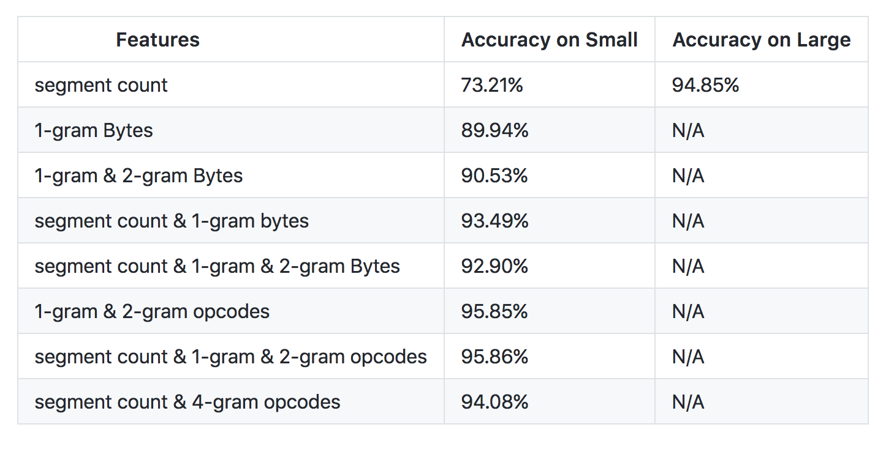
Results
Notes:
Result from using Random Forest + filtering out less frequent features

Slide 4
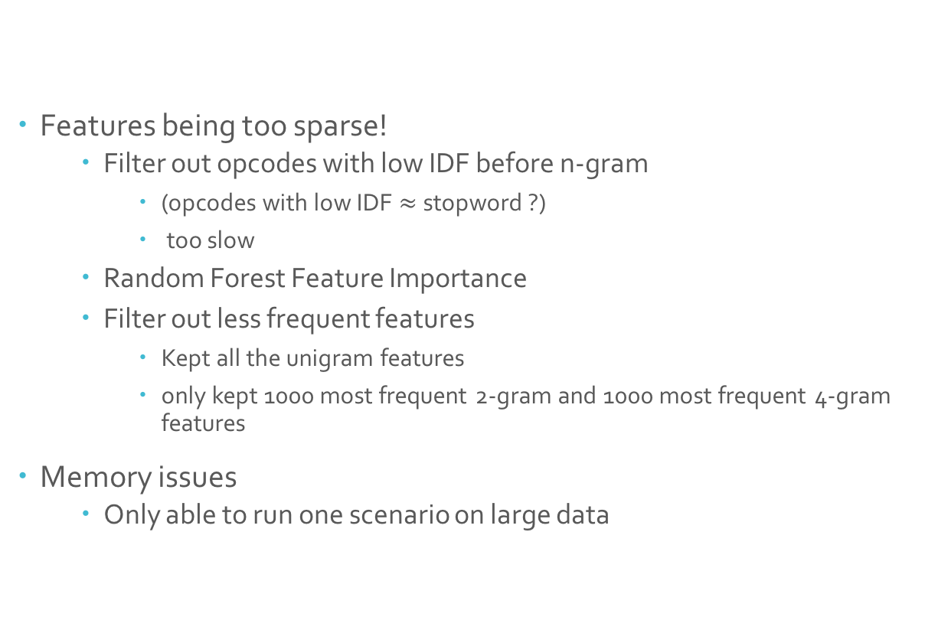
Issues
Features being too sparse!
Filter out opcodes with low IDF before n-gram
(opcodes with low IDF $≈$stopword ?)
too slow
Random Forest Feature Importance
Filter out less frequent features
Kept all the unigram features
only kept 1000 most frequent 2-gram and 1000 most frequent 4-gram features
Memory issues
Only able to run one scenario on large data

