Slide 1
Neuron Segmentation
Team Wright
Vamsi Nadella
Vinay Kumar Bingi

Slide 2
Approaches
Nonnegative Matrix Factorization
Dense Neural Networks

Slide 3
NMF
The images are read into a single large matrix V, of dimensions (R*C, N) where R is # of rows, C is # of columns, N is # of images
This matrix is factorized into W (features) and H (coefficients) matrices such that V - W*H ≈ 0
Regions of interest are extracted over feature matrix where pixels exceed an overlap threshold and are looked in k-nearest neighbors

Slide 4
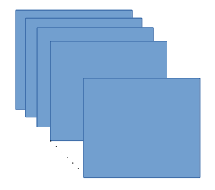
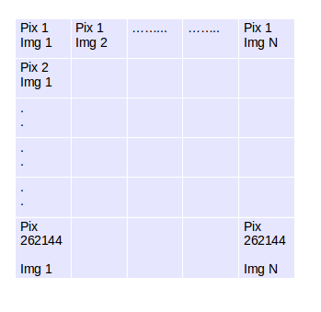
Dense Neural Network
Data Preprocessing
Three dimensional data transformed to two dimensional data.

Slide 5
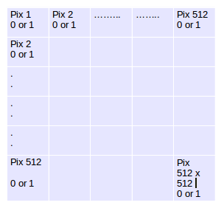
Dense Neural Network
Labels from the JSON to two dimensional matrix.
JSON

Slide 6
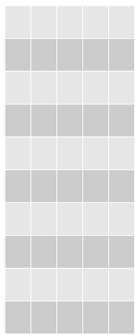

Dense Neural Network
Dense neural network for binary classification.
Predicts whether a pixel is neuron or not.
Apply Laplacian Filter to give the surroundings of the neurons.
OpenCV contours for blob detection to a list.
List to JSON
DATA
LABELS

Slide 7
Questions?
ThanQ

Slide 8
What worked well => PyCharm
What did not work well => Our code in PyCharm.

