Slide 1
Malware Classification
Catherine - Parya Jandaghi, Vibodh Fenani, I-Huei Ho

Slide 2
Flow
Feature Extraction
Random Forest Classifier
Significant Features Combination Testing

Slide 3
Feature Extraction
.bytes file
bytes file size
asm file size
bytes and asm file size ratio
unigram bytes (from bytes files)
bigram bytes (from bytes files) – Filtered top 2000 labels from each class

Slide 4
Feature Extraction
.asm files
segment (from asm files)
Detected the segments in each asm file
Recorded the counts in each document
Resulted in 257 different segments.
2-4 grams opcode (from asm files)
Detected the opcodes in each asm file
Selected those opcodes appeared only in 1/3 documents
Generated 2, 3, 4 grams opcodes by selected opcodes
Selected the important features by random forest classifier
Recorded the counts of each opcodes in each document

Slide 5
Feature Integration and Team Work
Parquet files :- For large files we choose to run our parts and save every output in parquet files which we could further ease during integration features
Maintaining both document id and hash allowed us to maintain relative order and ensure that there was no loss of data

Slide 6
Random Forest Classifier
Trees Number
Maximum Depth
Number of Features
Type of Features (Sparse/Dense)

Slide 7
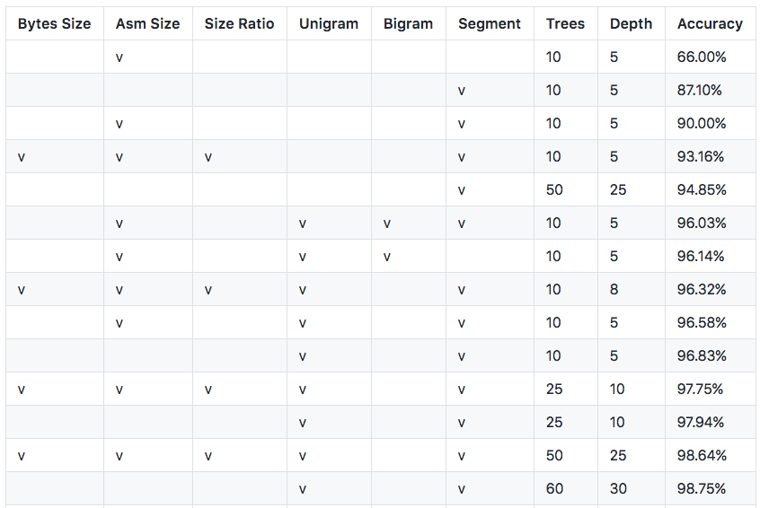
Results

