Slide 1
andromeda
Data Science Practicum, Project 1 Weiwen Xu, I-Huei Ho, Nihal Soans

Slide 2
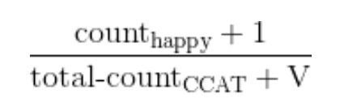
What we did:
Features: Word Count
(remove – between words
remove &quot
remove punctuation from both end
Lemmatizer
stemming (Porter, Lancaster)
remove punctuation from both end (it’s -> it’)
remove stopwords)
Modeling: Naïve Bayes
(Laplace smoothing)

Slide 3
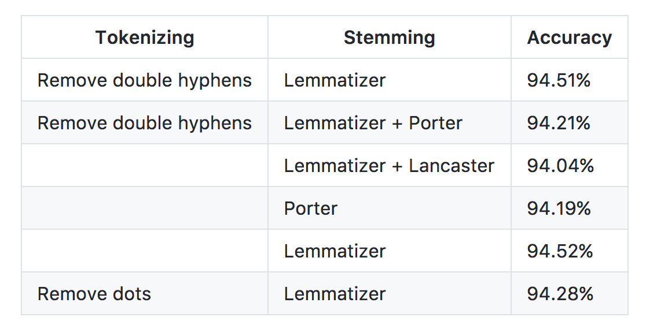

Slide 4
Issues
Using clusters NLTK data was not able to spread-out to the other worker nodes
Gutils in GCP was failing time to time
Long Running Times

Slide 5
Github
Used Kanban Board for progress on project
Issues were documented for every step with solution for the issue

