Slide 1
Scalable Document Classification
Project 1; Data Science Practicum; Fall 2018, University of Georgia
Team Pyxis

Slide 2
Who we are
Layton Hayes, Institute for Artificial Intelligence
Parya Jandaghi, Department of Computer Science
Jeremy Shi, Institute for Artificial Intelligence

Slide 3
Process
First we build a baseline Naive Bayes model.
Bag of words model
A very clear and classic tutorial here: https://nlp.stanford.edu/IR-book/html/htmledition/naive-bayes-text-classification-1.html
Additional features:
Stopwords -- we choose an aggressive (i.e. long) stop word list
Remove numbers
Word char length < 2
Tf-idf
Bi-gram
Smoothing
No “magic number” here (or anywhere, for that matter)!

Slide 4
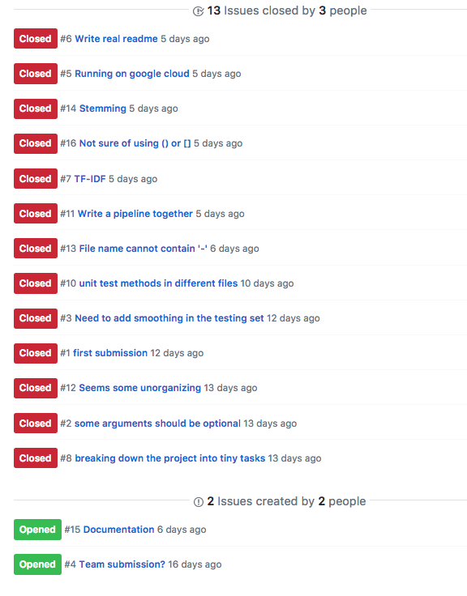
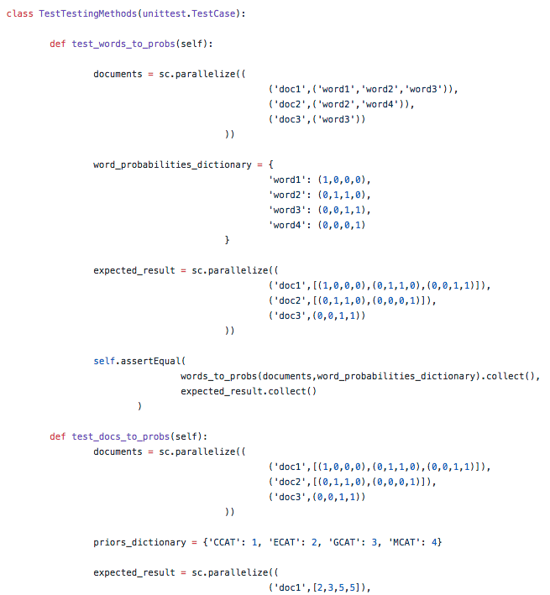
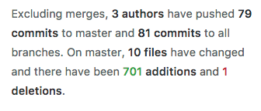
Software Engineering Practice
We use Github (branches, tickets, etc.)
We also write our unittest code!

Slide 5
THANK YOU!
Any questions?

