Slide 1
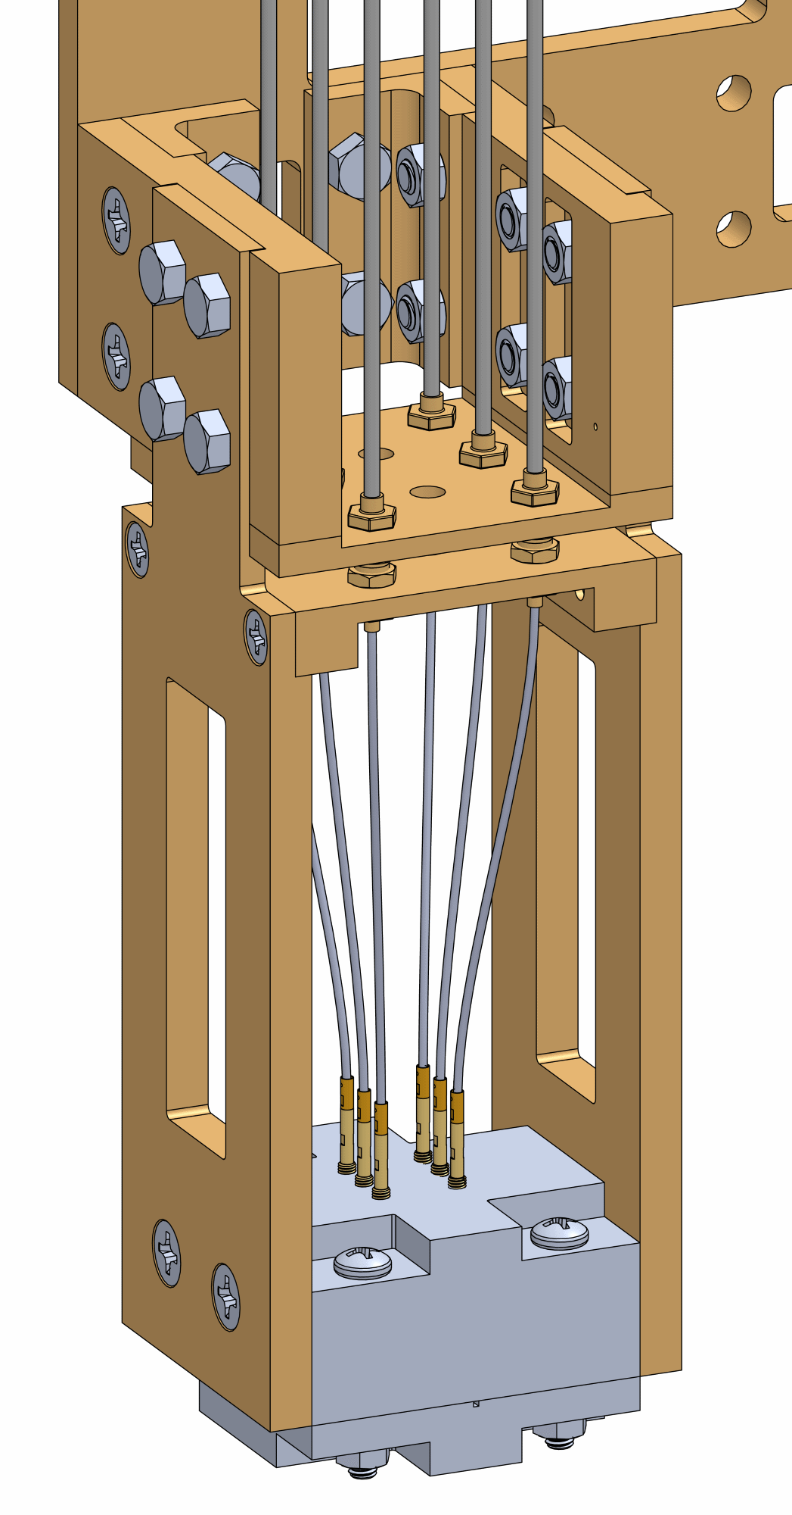
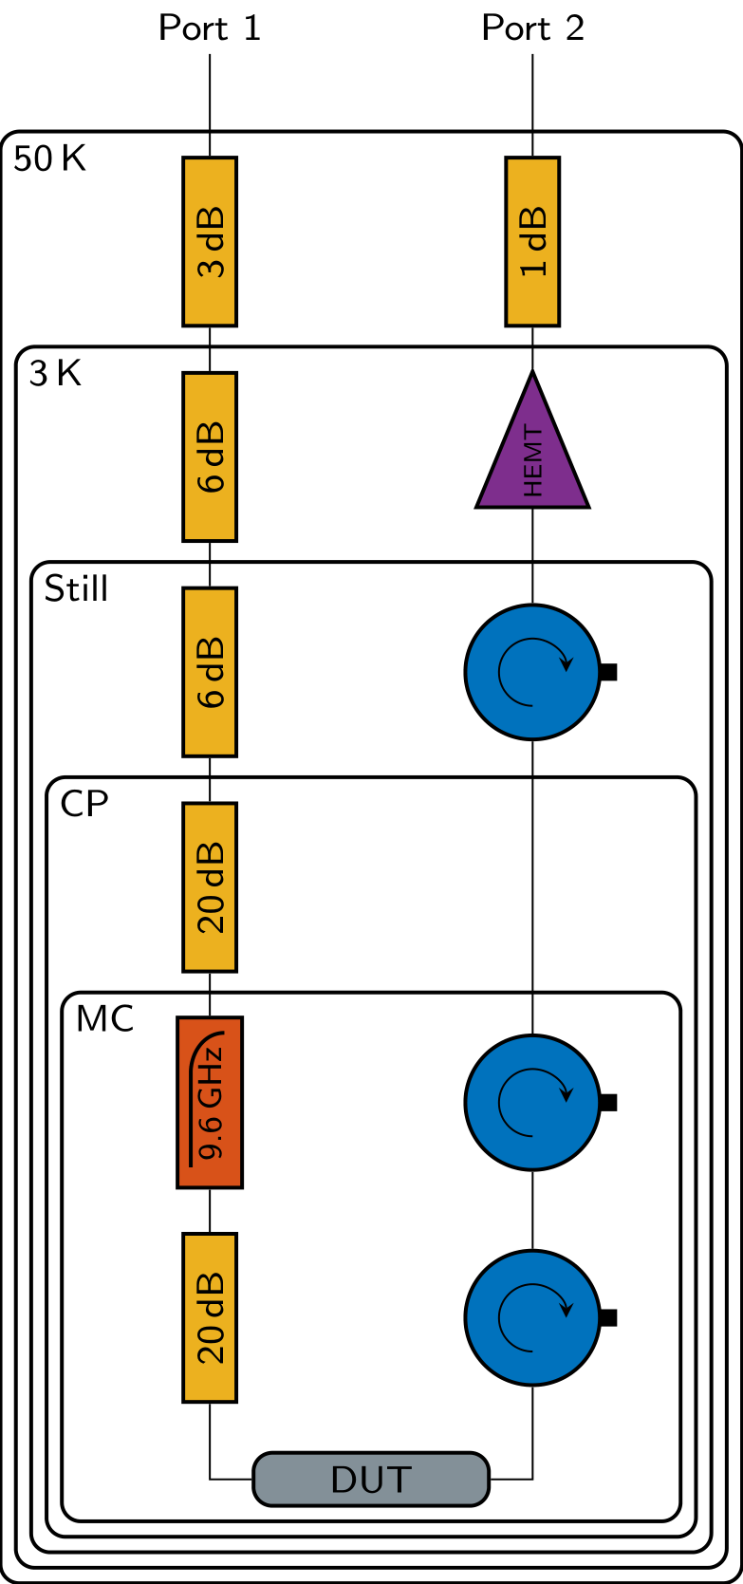
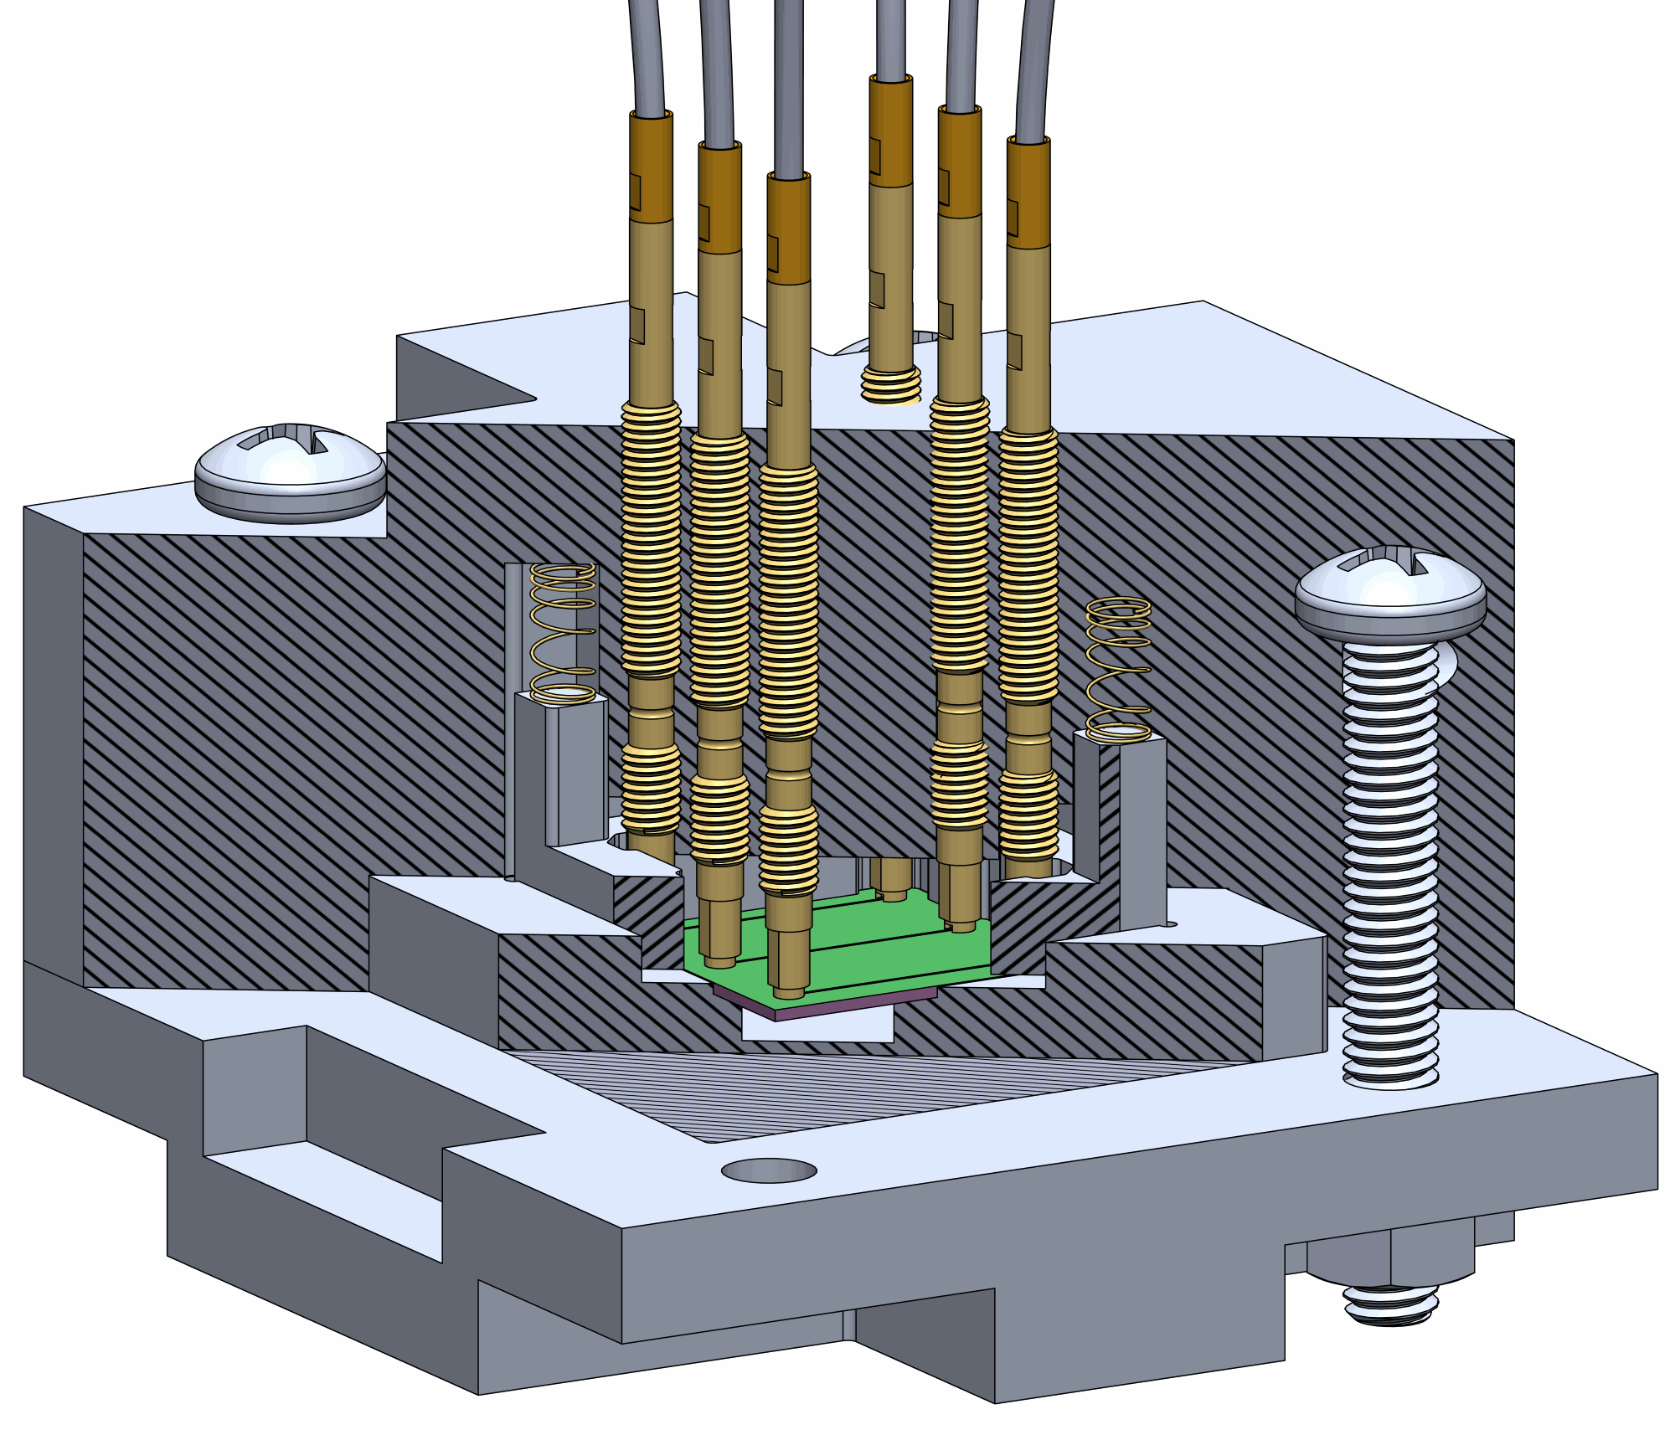
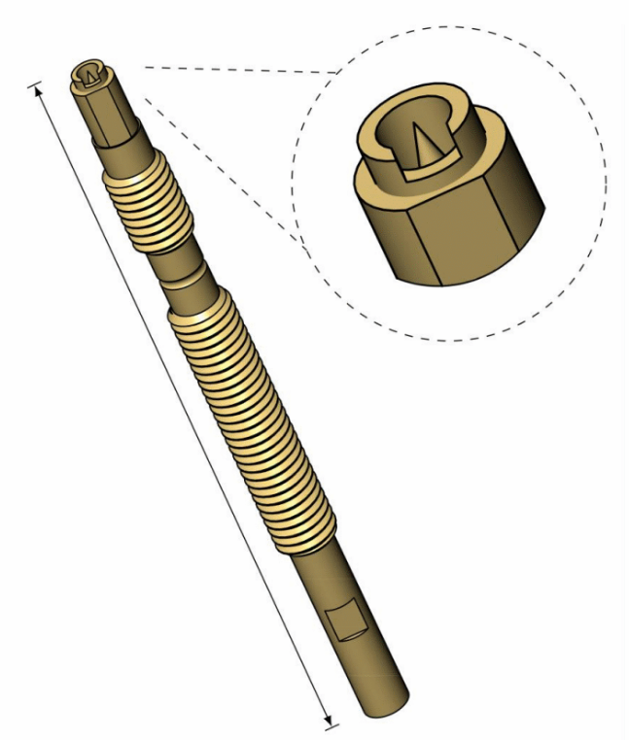
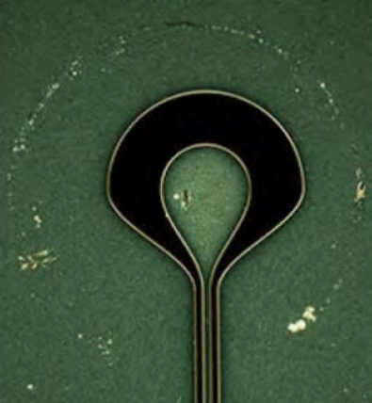
Fridge set-up and packaging
SucoFlex, flexible cables and
EZ Form SemiRigid
Semi rigid CoaxCo
SC-219/50-SS-SS
J.H. Béjanin... M. Mariantoni,
Phys. Rev. Applied 6, 044010 (2016)
Semi rigid CoaxCo
SC-219/50-SS-SS
Fully coaxial Quantum Socket (DC-8GHz)
~ 150mΩ contact resistance
~ 10Ω impedance mismatch
56dB attenuation on measurement line
Semi rigid
EZ 86-Cu-TP/M17
Semi rigid
SC-219/50-
Nb-Nb
Notes:
fridge set-up including wiring attenuation, thermalization, and sample mounting, and

Slide 2
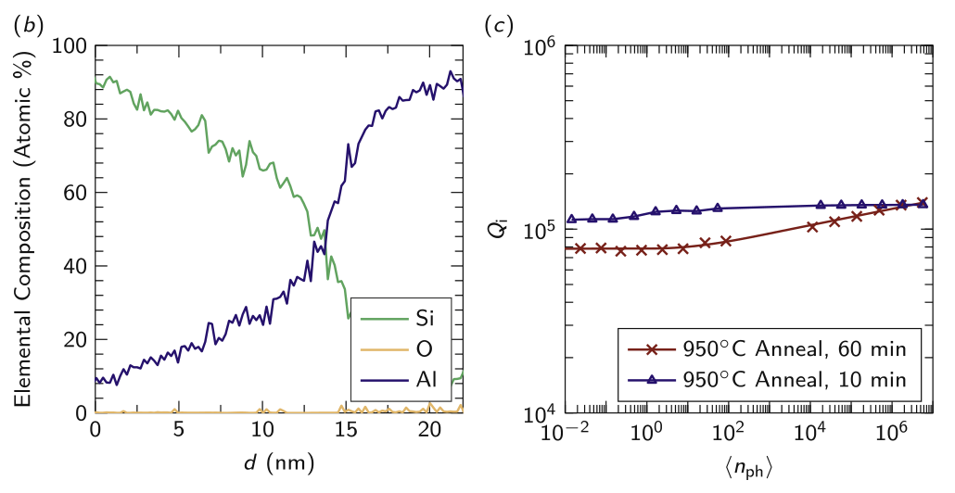
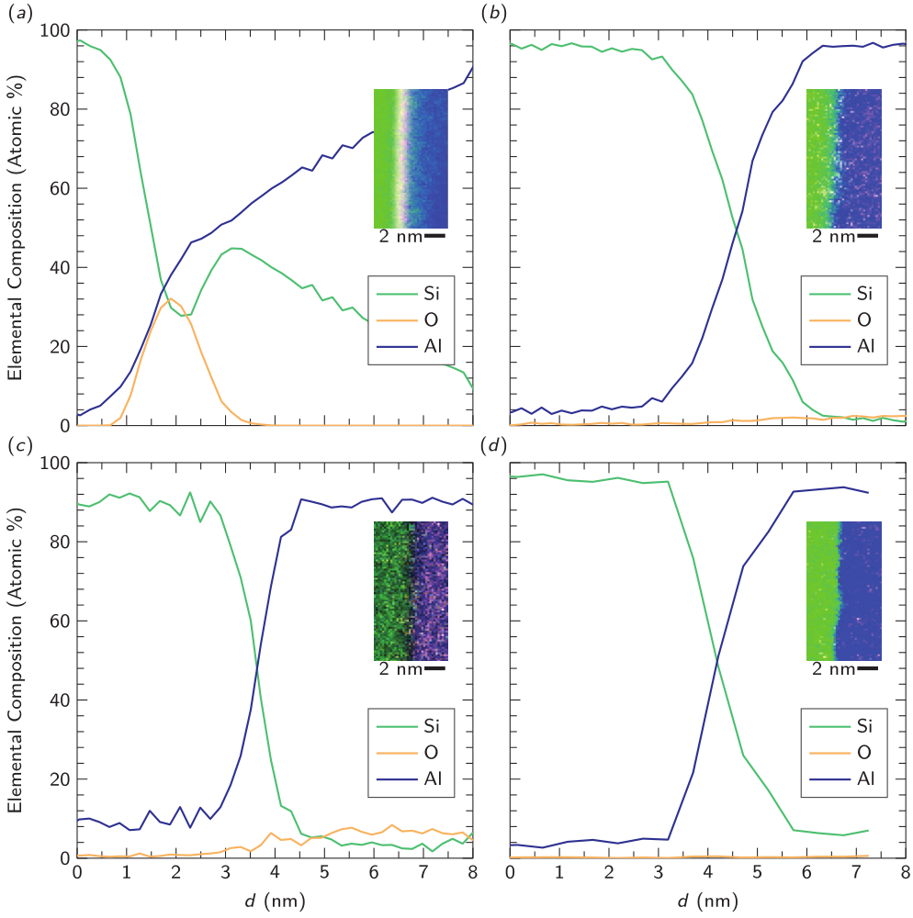
Fabrication
Alternative annealing recipes
Unprocessed
RCA1 + HF
Basic fabrication steps
Chemical clean and thermal anneal
UHV Al deposition
UV lithography
Chlorine based ICP etch
Potential issues
Annealing creates trade-off between oxide removal and surface roughness
Need to explore full recipe space more (one resonator on very rough 950C sample very good)
Resonators fabbed on chip with JJ are much worse, even if not exposed to ion mill
880C Anneal
RCA1 + HF
+ 880C Anneal
C.T. Earnest... M. Mariantoni, Supercond. Sci. Technol. 31, 125013 (2018)

Slide 3
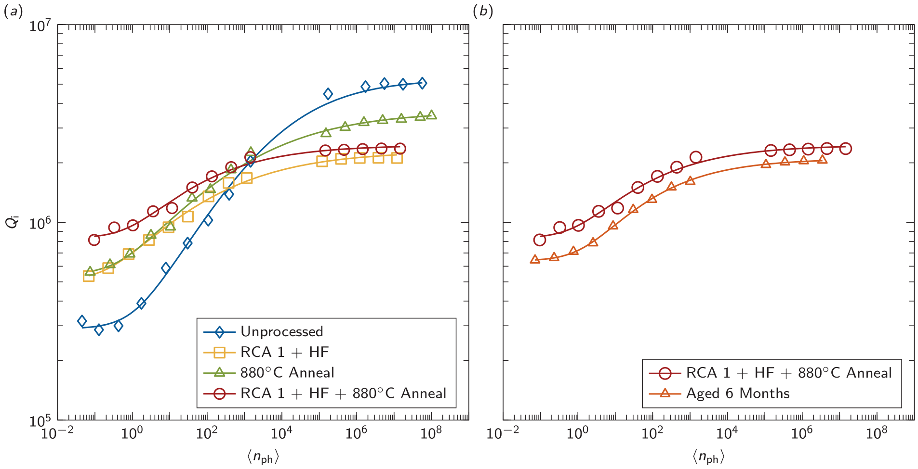
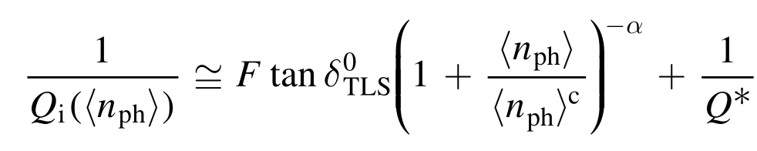
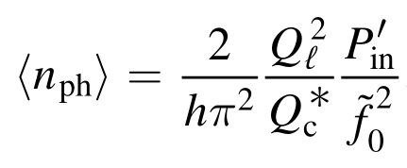
Resonator measurements
Surface Treatment | F tanδ | Qi nph ~ 1
Unprocessed | 3.27 E-6 | 320 000
RCA1 – HF | 1.53 E-6 | 530 000
880C Anneal | 1.56 E-6 | 560 000
RCA1 + HF + 880C Anneal | 0.80 E-6 | 820 000
S-curve fit obtained from modified TLS model with α between 0.24 - 0.33
High Power Quality Crossovers
Small (<5μT) field can impact 1/Qi by order of magnitude (B.Chiaro, 2016)
Cleaner Al films more susceptible than dirty films to quality loss from magnetic fields
(S Kwon, 2018)
Plotting standardization: Q or 1/Q?
Mean photon number estimated. Pin is rough and does not account for frequency
Notes:
resonator measurements, data analysis, and modelling.

Slide 4
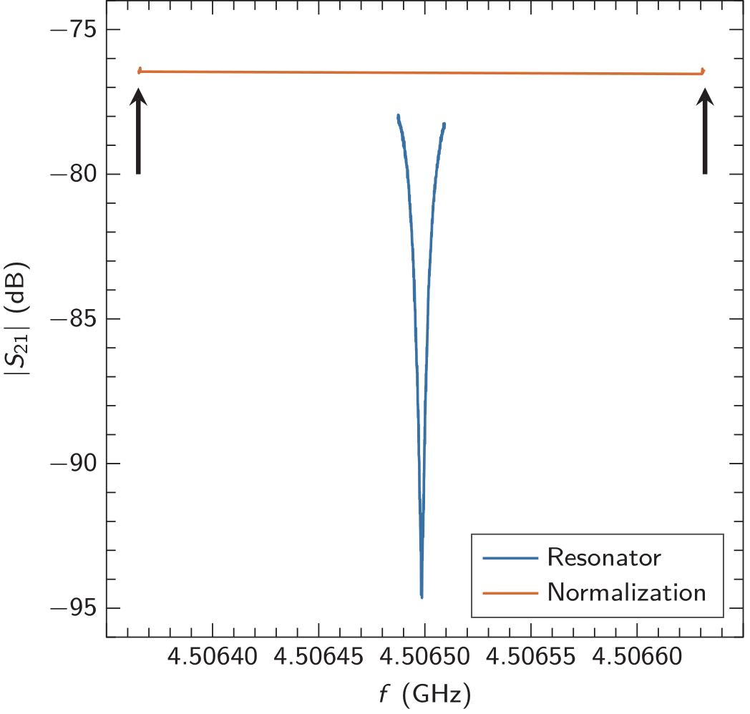
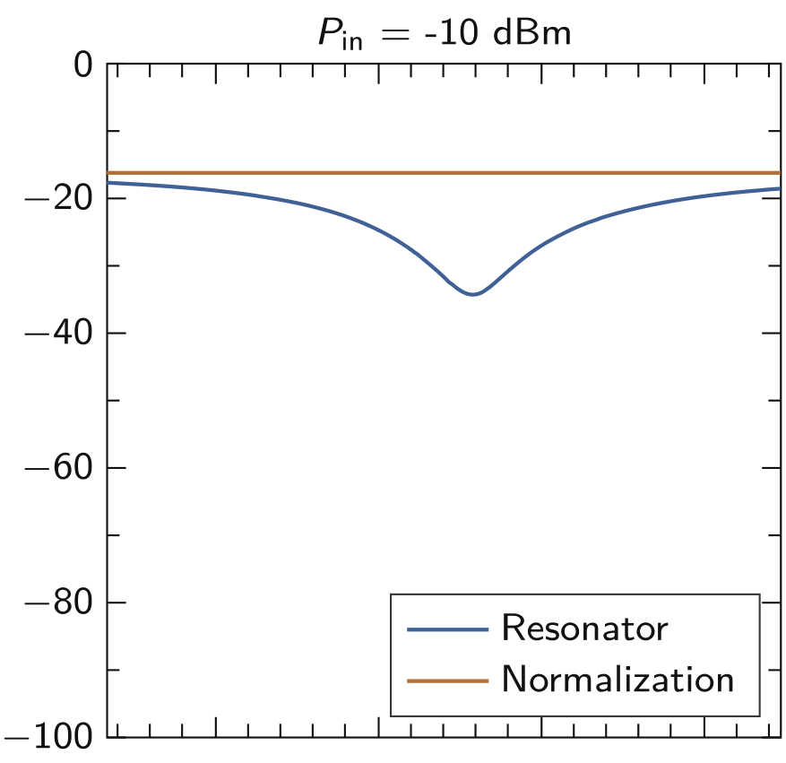
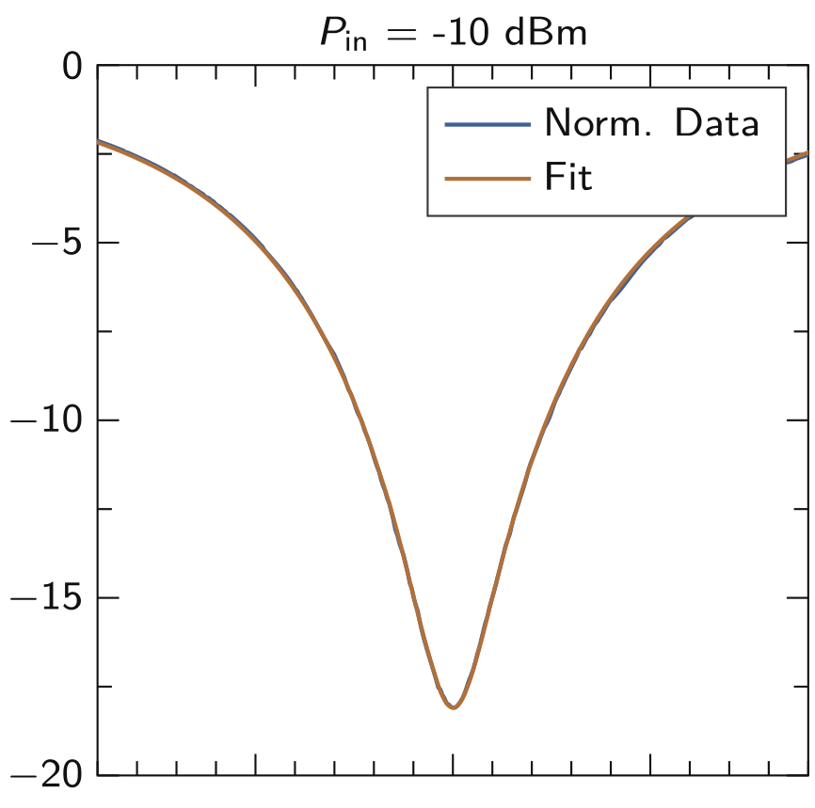
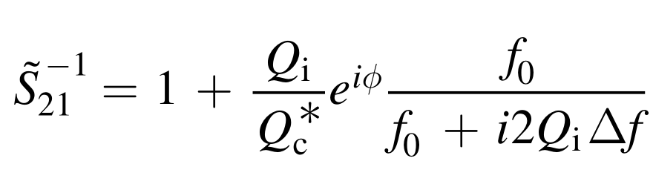

Resonator fitting
fit the normalization data in magnitude and phase separately to a line;
extrapolate the value of the magnitude and phase in the frequency range of the resonator data;
subtract the extrapolated data from the resonator data in the complex plane. This has the effect of de-embedding the measurement setup from the data.
invert the normalized resonator data;
fit the inverted normalized resonator data to (A.1) (A.Megrant, 2012) using standard nonlinear least squares techniques, starting from a reasonable initial parameters choice;
calculate the fitting errors from the covariance matrix;
obtain the fitting parameters and associated errors.
(A.1)
Notes:
Photon estimation

Slide 5
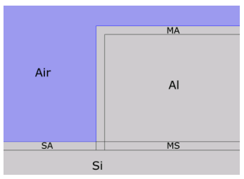


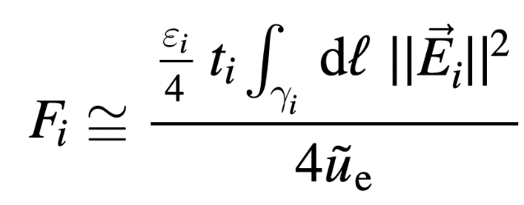
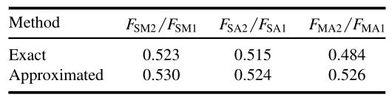
Geometry/Participation Ratios
Hard to compare Qi across publications
Determining filling factor relies on simulations: reproducible across simulation platform? At least for very simple/similar geometries
Simulations are unstable w.r.t. small reasonable parameter change: oxide thickness, conductor edge sharpness, surface roughness
STANDARDIZATION: Choose a common set of designs (lumped element and CPW)

Slide 6
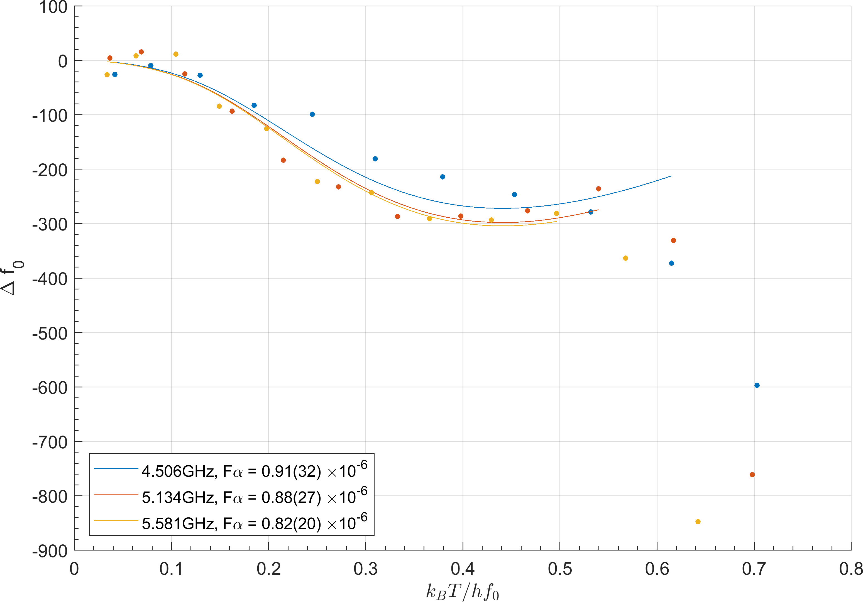
TLS Model difficulties
Fitting to TLS Model for low Tc material
Quasiparticle effects take over too quickly, can’t see temperature dependence of TLS loss
Fitting to TLS model at low power
At low power , Qi and f0 fluctuations are large, need many measurements to average but fluctuations over long times are also large
Extra fitting parameters: α
Deviates from expected value of 0.5
Notes:
Note from Chalmers

Slide 7
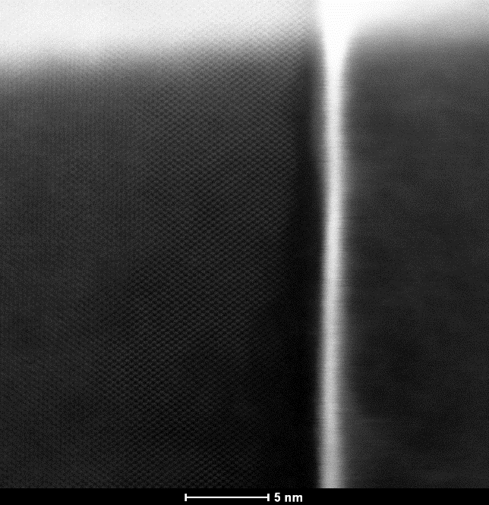
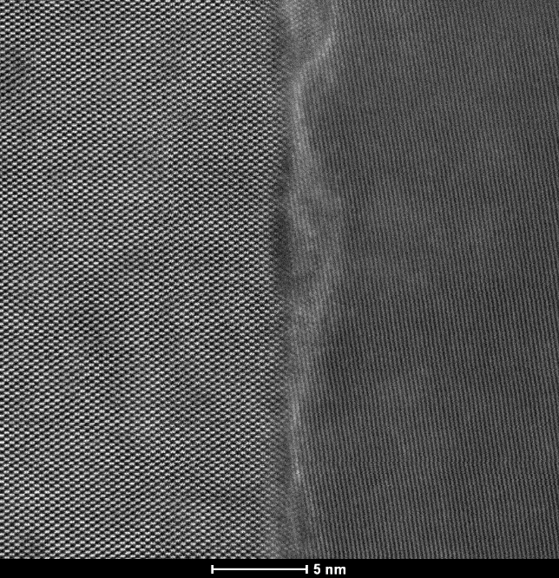
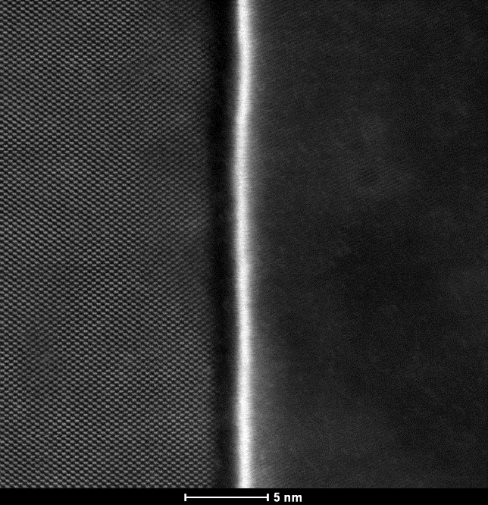
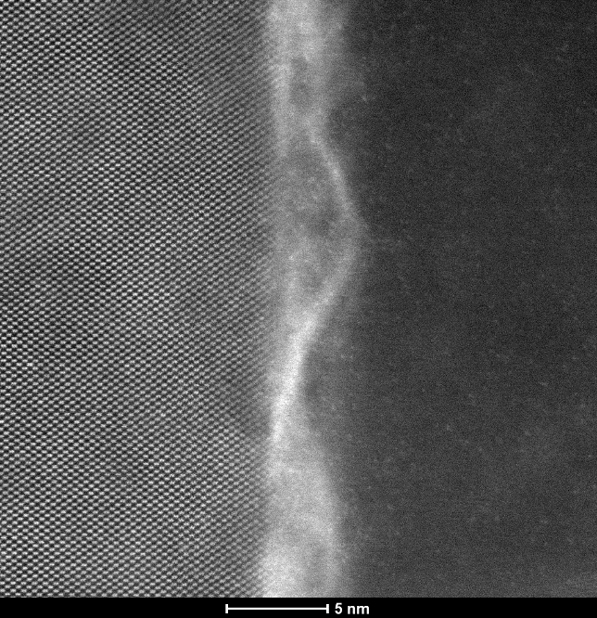
Fabrication TEM – BKP 1

Slide 8
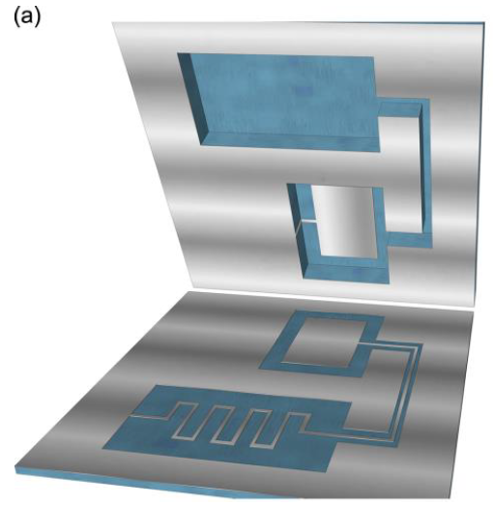
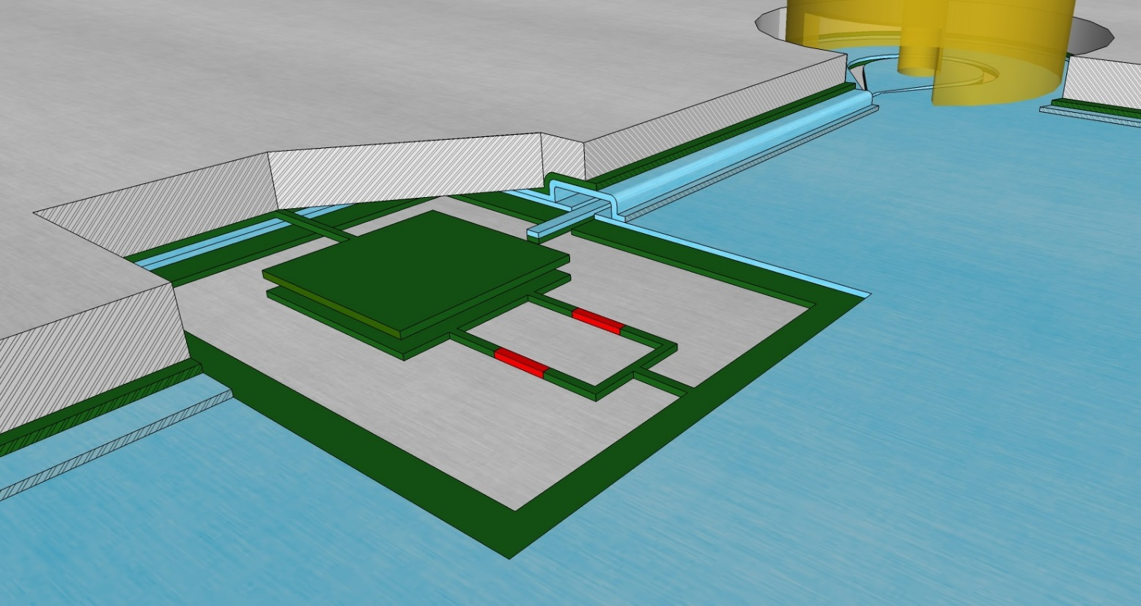
The Pocketmon Qubit – BKP2
G
Vacuum-gap capacitor
Copyright Matteo Mariantoni 2017
E.A. Peters and M. Mariantoni, in preparation

Slide 9
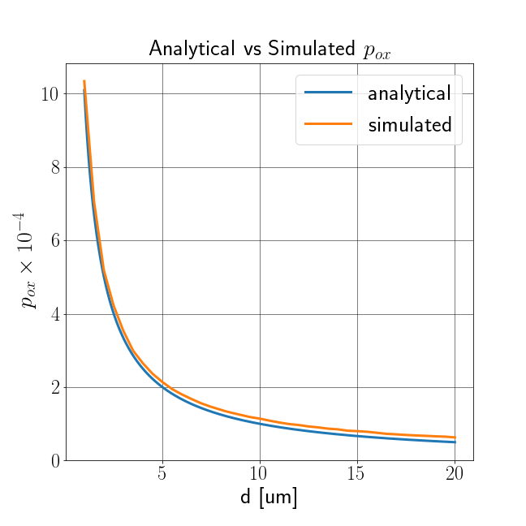
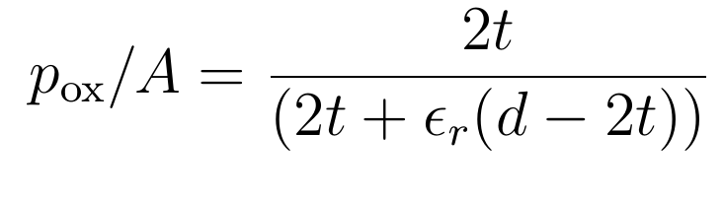
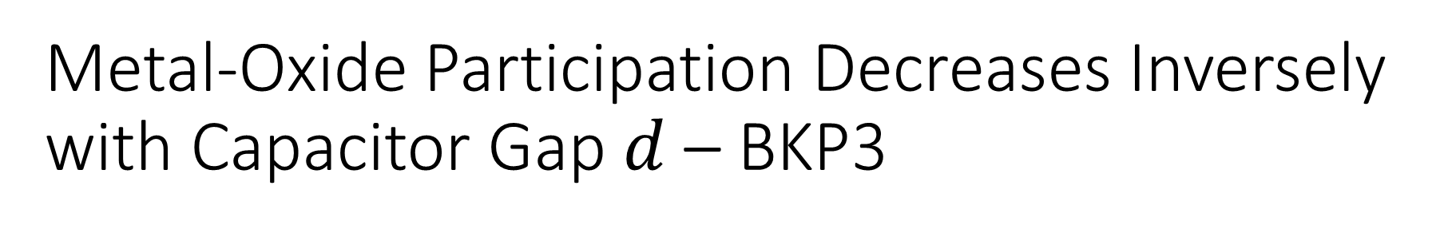
Metal-Oxide Participation Decreases Inversely with Capacitor Gap $d$ – BKP3
Metal oxide filling factor $p_{ox}$ depends on $t(=const.)$ and $d$:
$$t=5nm, ℓ=300 μm, h=100 nm$$

