Slide 1
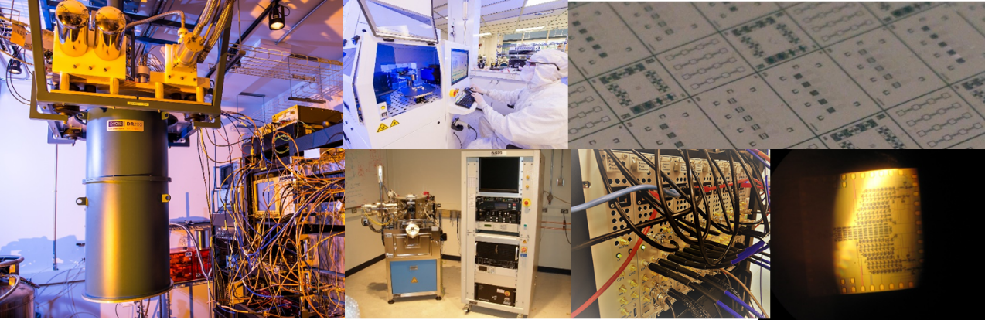

Quantum Engineering and Computing Group
This document does not contain technology or technical data controlled under either the U.S. International Traffic in Arms Regulations or the U.S. Export Administration Regulations.
Guilhem Ribeill, Leo Ranzani, and Thomas Ohki
NIST resonator workshop
Feb. 8th 2019 CU Boulder
Cambridge, Massachusetts
The project or effort depicted was or is sponsored by the Department of the Army, U.S. Army Research Office. The content of the information does not necessarily reflect the position of the policy of the federal government, and no official endorsement should be inferred.

Slide 2
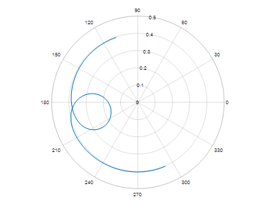
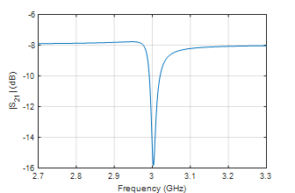
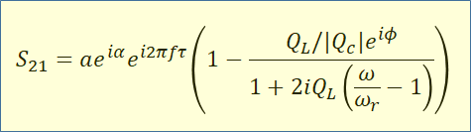
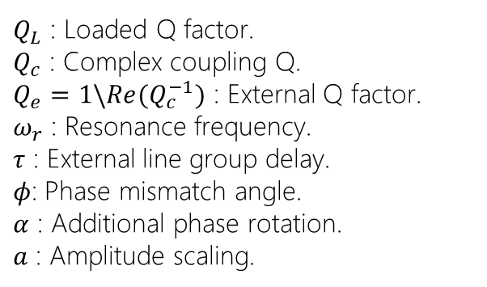
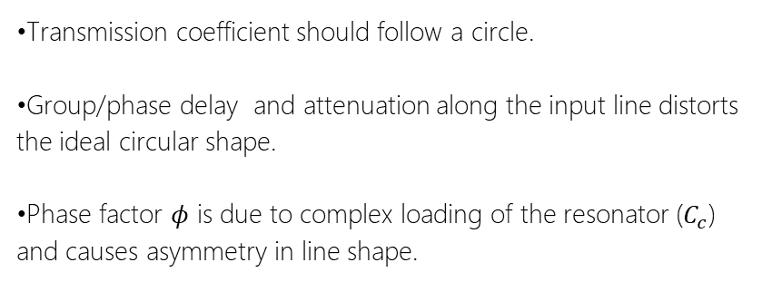
Resonator measurement calibration
$Q_{L}$ : Loaded Q factor.
$Q_{c}$ : Complex coupling Q.
$Q_{e}=1\backslash Re(Q_{c}^{−1})$ : External Q factor.
$ω_{r}$ : Resonance frequency.
$τ$ : External line group delay.
$φ$: Phase mismatch angle.
$α$ : Additional phase rotation.
$a$ : Amplitude scaling.
•Transmission coefficient should follow a circle.
•Group/phase delay and attenuation along the input line distorts the ideal circular shape.
•Phase factor $φ$ is due to complex loading of the resonator ($C_{c}$) and causes asymmetry in line shape.

Slide 3

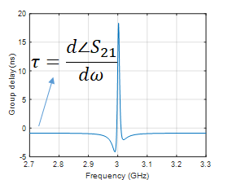
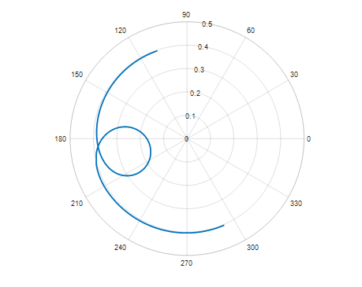
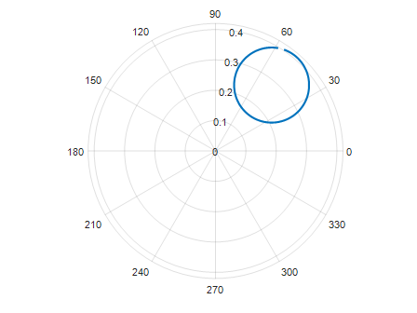

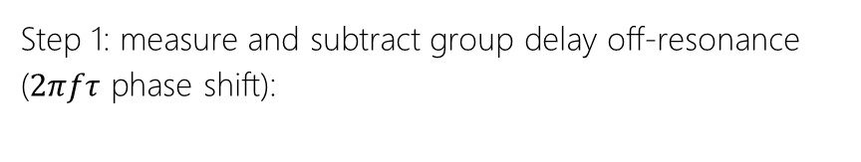
Resonator measurement calibration
Step 1: measure and subtract group delay off-resonance ($2πfτ$ phase shift):

Slide 4
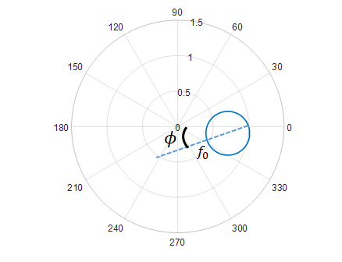

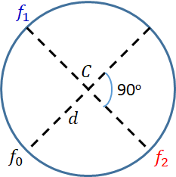




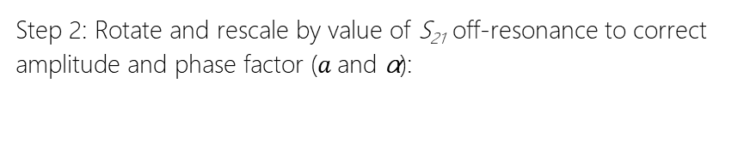
Resonator measurement calibration
Step 2: Rotate and rescale by value of S₂₁ off-resonance to correct amplitude and phase factor ($a$and α):
Note: we employ a script that automatically perform an algebraic fit of the input data to a canonical circle and extracts the resonator parameters.
Probst, S., et al. "Efficient and robust analysis of complex scattering data under noise in microwave resonators." Review of Scientific Instruments 86.2 (2015): 024706.

