Slide 1
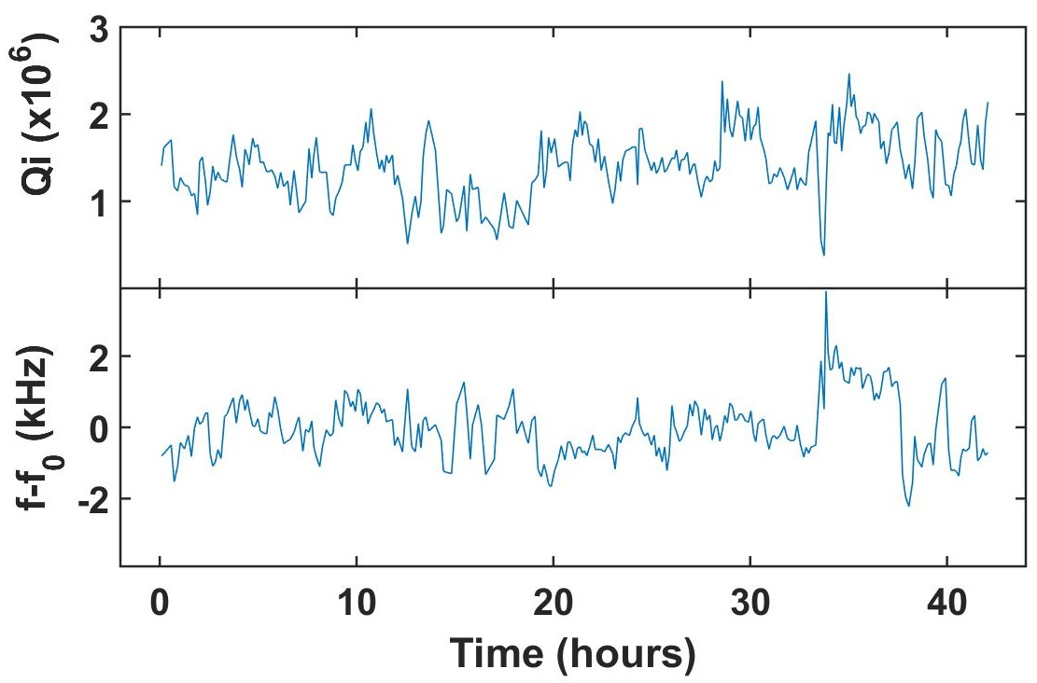
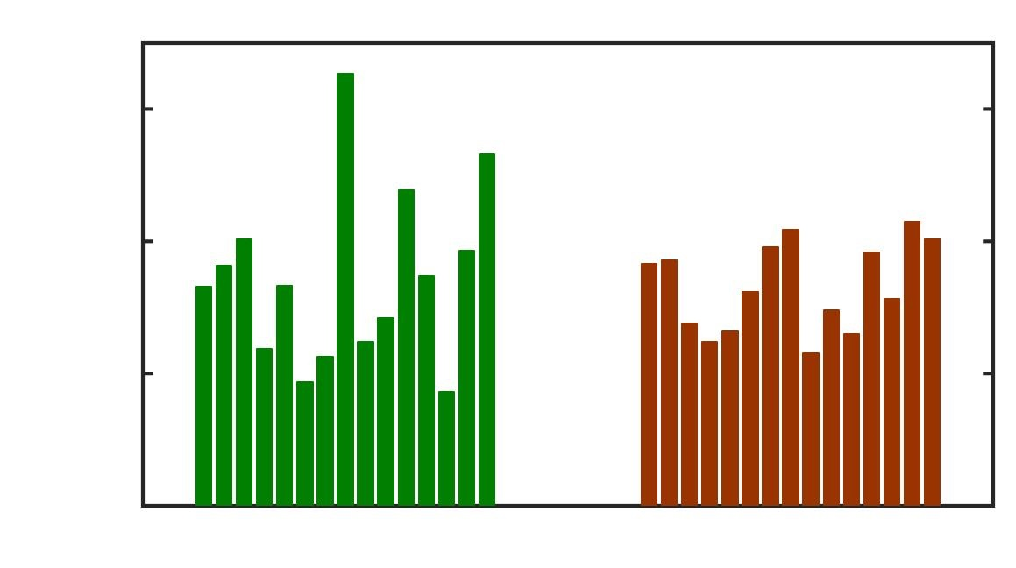
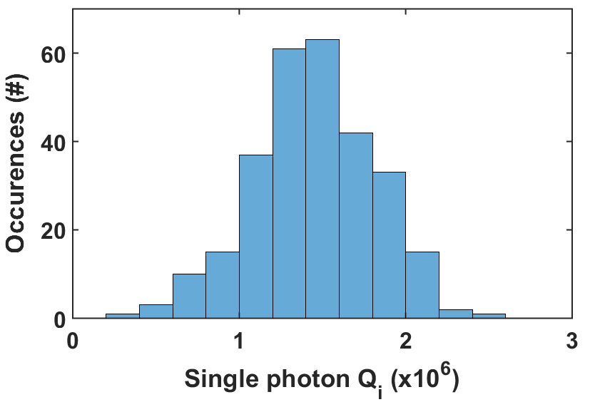
Accounting For Device-to-Device Variability Resonator Temporal Fluctuations
TiN resonator parameter fluctuations
Example: 15 TiN Resonators
Qi for Single Device
3
Mean
+ σ
Q_{i} (X10⁶)
2
1
2x reduction in σ
No averaging
Averaged
A good SNR (enabled by a TWPA) helps measure device fluctuations
Single measurements can skew estimate of device Q_{i}
Time averaging improves spread, but is it worth the effort vs. device averaging?
Notes:
One issues: at the single photon limit, the resonators fluctuate
Can use twpa for high SNR over wide bandwidth
Makes it easier for us to characterize/ see these fluctuations,
Generally follow a gaussian distribution in qi and frequency
or can use the measurement time saved to average away/avoid skew by outliers.
For example…this process

Slide 2
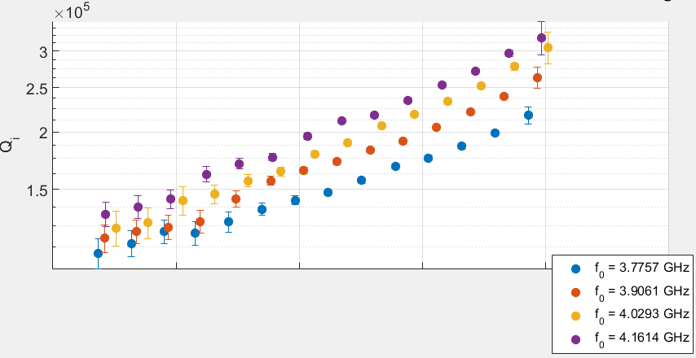
Accounting For Device-to-Device Variability Tradeoff between SNR and ‘saturation’ and time
Problem: Not all materials show same power dependence or have similar low-power saturation
Solution: always measure in low power saturation limit
…but:
SNR suffers
Low SNR → not easy to time average
Hard to assess tradeoff between averaging over devices vs. time vs. SNR
Can simulate, but what are noise properties?
Generally:
How to determine efficient measurement strategy
Why does power-dependence vary between materials(or maybe interfaces)?
Are we missing something?
Is this can of worms worth it at all?
Notes:
One issues: at the single photon limit, the resonators fluctuate
Can use twpa for high SNR over wide bandwidth
Makes it easier for us to characterize/ see these fluctuations,
Generally follow a gaussian distribution in qi and frequency
or can use the measurement time saved to average away/avoid skew by outliers.
For example…this process

