Slide 1
SwarmLoom
Watch a swarm of cursors weave it into being.

Slide 2
Why SwarmLoom
Rebuilds pages, documents, slides, sheets, code and 3D models live
Deterministic: same seed and environment, same raw frames and PCM
  Seeded randomness and a virtual clock for exports
Exports MP4/WebM with synced audio, plus silent GIF/WebP
Studio PWA, browser extensions and a CLI

Slide 3
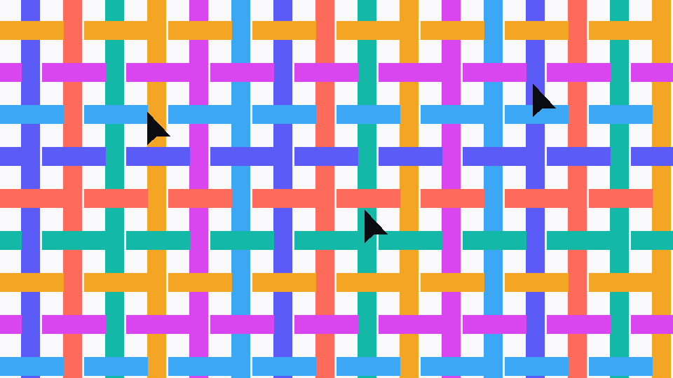
Made of layers
Every format becomes boxes, text, paths and images.
The swarm then draws, types and paints each layer in reading order.

Slide 4
Formats per release
16
13
Adapters load lazily
10
7
4
v0.1
v0.2
v0.3
v0.4
v1.0

Slide 5
Thank you
github.com/Boulea7/swarmloom · MIT licence
Platform | Start with
Browser extension | Alt+Shift+W on any page
Studio (PWA) | Drop a file
CLI | swarmloom render (in development)

