Slide 1
REST
Robin Holzwarth und Philipp Pulver

Slide 2
Gliederung
Was ist eine API?
Was ist Rest?
REST vs. CRUD
Praxis Beispiel

Slide 3
Was ist eine API?
Application Programming Interface
Schnittstelle
Modulares Arbeiten

Slide 4
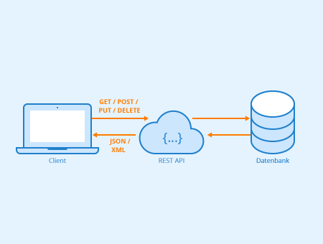
Was ist REST?
Representational State Transfer
Restful

Slide 5
Was ist REST? - Design Principles
Uniform interface
Client-server decoupling
Statelessness
Cacheability
Layered system architecture
Code on demand

Slide 6
CRUD vs. REST
CRUD
REST
CREATE
READ
UPDATE
DELETE
POST
GET
PUT
DELETE

Slide 7
Praxis Beispiel

Slide 8
Quellen
https://www.ibm.com/cloud/learn/rest-apis
https://github.com/microsoft/api-guidelines/blob/vNext/Guidelines.md
https://www.redhat.com/de/topics/api/what-is-a-rest-api
https://developer.spotify.com/documentation/web-api/
https://play.kotlinlang.org/hands-on/Creating
https://spring.io/guides/tutorials/rest/
https://github.com/s1monw1/ktor-REST-sample <- Rest Beispiel
https://www.redhat.com/de/topics/api/what-is-a-rest-api
https://www.seobility.net/de/wiki/REST-API

