Slide 1
Furuta inverted pendulum RL
Update meeting: what worked, what did not, and what needs a careful dry run next
Current honest headline
RL learned a useful swing-up/stabilization policy in simulation, but robustness and sim-to-real behavior depend strongly on reward design, actuator interface, and plant-model consistency.
Prepared from project notes and saved TD3 run artifacts
Notes:
Open naturally: this is not a victory-lap talk. The useful result is that the project moved from fragile training attempts to a controller we can actually evaluate and discuss scientifically.

Slide 2
FURUTA RL UPDATE | 2026-06-17
Where we are in the project plan
Days 1-7
Days 8-12
Days 13-16
Days 17-20
Model, signals, simulation setup, baseline context
RL training worked after moving away from the fragile curriculum path
Current phase: robustness, fixed evaluation, actuator and plant diagnostics
Meeting story, plots, demo choice, hardware dry-run preparation
Meeting framing: show the controller as useful in simulation, not solved for hardware.
Sources: meeting handoff, MathWorks-style TD3 notes, saved run CSVs
Notes:
This slide is mostly orientation. Say that the project has entered the evaluation and decision-gate phase.

Slide 3
FURUTA RL UPDATE | 2026-06-17
Before Furuta: the Water Tank project became the workflow prototype
Base example
Curriculum version
Started from MathWorks rlwatertank DDPG: compact example, single training run, random starts.
Extended it into four stages: local correction, medium transient, global robustness, precision fine-tuning.
Reward lesson
Evaluation lesson
Moved from tolerance-band success toward normalized tracking error, action effort, and action smoothness.
Saved per-stage artifacts and used fixed/deterministic evaluations so results were not dominated by random initial conditions.
Carry-over to Furuta: define the task, shape the reset distribution, log the signals, and evaluate fixed cases before believing training reward.
Sources: RL-Water-Tank README and curriculum docs; docs/chat_handoff_2026-06-09.md
Notes:
This is the bridge slide. The water tank work was valuable because it built the project discipline: staged difficulty, reward scaling, fixed evaluation, and organized results.

Slide 4
FURUTA RL UPDATE | 2026-06-17
Where the curriculum idea came from
Practical source
Control reason
Pendulum transfer
Water Tank: learn small corrections first, then widen the initial-condition distribution and reduce exploration for precision.
A nonlinear controller should not be judged only on random starts. Each stage should answer a narrower control question.
For Furuta, the natural curriculum was angle/velocity range: near-upright balance, medium recovery, large-angle recovery, full swing-up.
Important lesson: if the reward or reset distribution changes a lot, old replay/critic information can become misleading.
Sources: RL-Water-Tank curriculum docs; docs/rl_task_definition.md; docs/direct_td3_swingup_plan_2026-06-11.md
Notes:
This slide gives a natural-language explanation. The curriculum idea was not just copied blindly; it came from trying to make learning and evaluation scientifically staged.

Slide 5
FURUTA RL UPDATE | 2026-06-17
Water Tank reward: from MATLAB's band reward to control-shaped tracking
MathWorks example reward
Final project reward direction
+10 if |e| < 0.1
-1 otherwise
-100 if the tank hits unsafe height
normalized error
integral-error / PI-like terms
action effort
action-difference smoothness
unsafe-level penalty
Good for teaching the agent to enter the acceptable band. Weak for precise steady-state tracking, because 0.09 error and near-zero error can receive the same reward.
Potential shaping was used as curriculum assistance, but the base objective was kept as consistent as possible.
Lesson: reward scale is part of the controller design. A sudden reward rewrite can invalidate the critic and replay buffer.
Sources: MathWorks rlwatertank example; RL-Water-Tank README; scripts/rewardFcn.m; scripts/makeStageConfig.m
Notes:
This slide explains why the Water Tank work went beyond the MATLAB example. The key phrase: the original reward taught acceptable behavior, but not precision.

Slide 6
FURUTA RL UPDATE | 2026-06-17
Why the Water Tank was harder than it looked
One-sided actuation
Asymmetric learning problem
The agent controls inlet flow. It can add water quickly, but when the tank is too high it cannot actively pull water out. The best action is often near-zero flow plus waiting for passive drainage.
A reward that helps rising cases can punish draining cases, and a reward that keeps action smooth can make downward corrections look slow or inactive.
This is why random average reward was not enough. Raising, draining, and already-at-reference cases had to be inspected separately.
Sources: RL-Water-Tank exports and evaluation metrics
Notes:
This slide tees up the next three plots. The water tank is simple but asymmetric, which makes reward shaping surprisingly brittle.

Slide 7
FURUTA RL UPDATE | 2026-06-17
Water Tank runs: the best result depended on the slice
Run 3, stage 1
easy reset / strong shaping
excellent local and at-reference behavior
h0 = hRef = 5: Final MAE 0.0013, case cost 0.0973
Run 4, final stage
full reset / no shaping / low noise
better final-curriculum candidate
works well in many raising cases, but still weak for some draining/high-start cases
Meeting phrasing: there was no single clean 'solved' Water Tank agent. The best run depended on whether we cared about local precision, broad curriculum coverage, or asymmetric draining cases.
Sources: run 3 and run 4 allMetrics_prec4.csv
Notes:
This is the honest summary: the water tank produced useful behaviors, but the reward design never became universally satisfying.

Slide 8
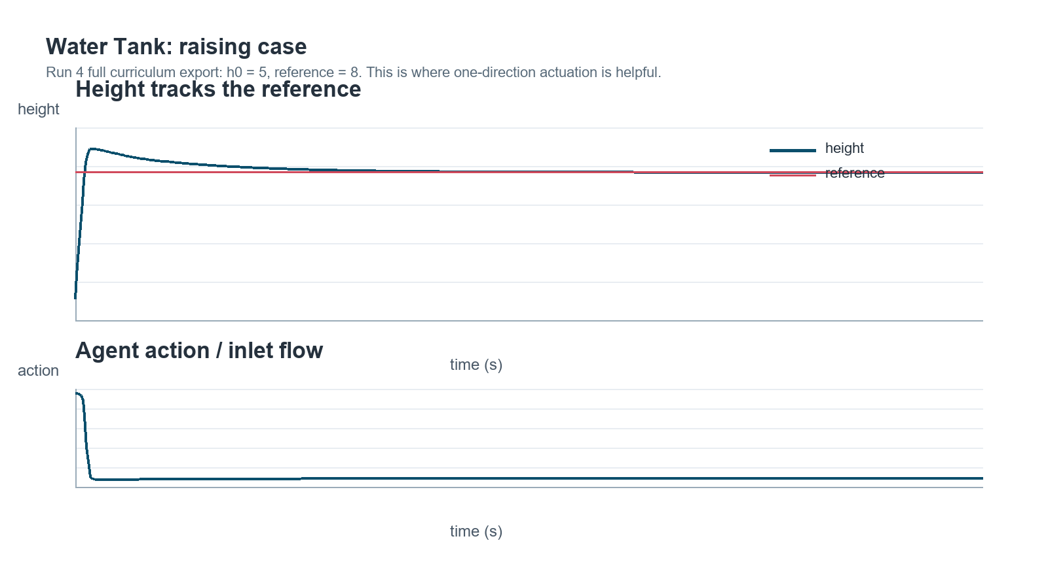
FURUTA RL UPDATE | 2026-06-17
Water Tank example: raising case
Here the one-sided actuator helps: the agent can actively add water, then back off once the height is near the reference.
Source: run 4 exported trajectory: New_Export_positive.xlsx
Notes:
The image intentionally only shows height/reference and action. This is the easy direction for the actuator.

Slide 9
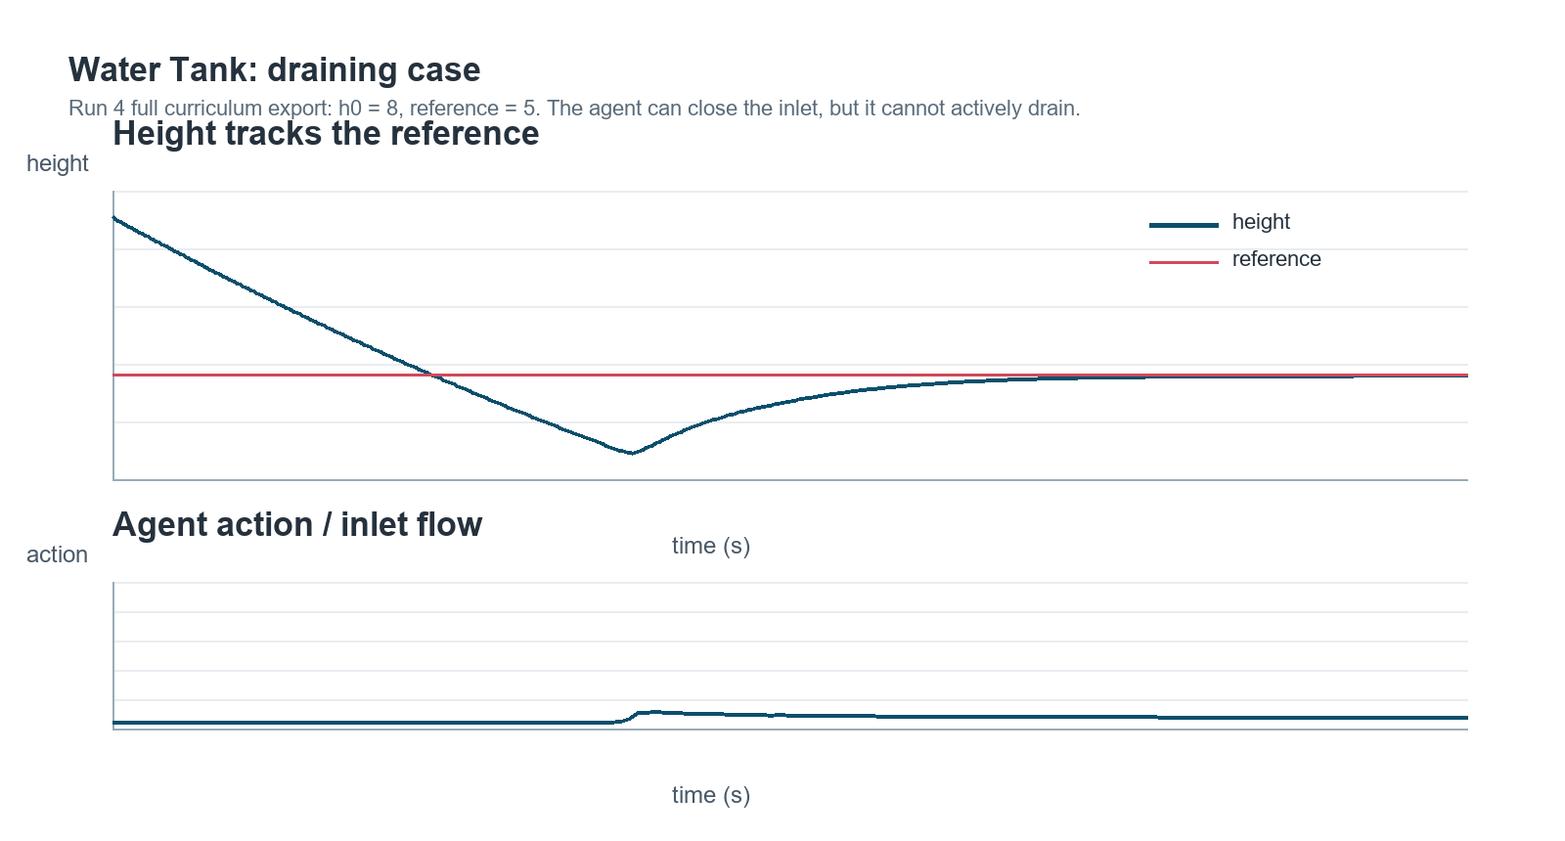
FURUTA RL UPDATE | 2026-06-17
Water Tank example: draining case
Here the agent cannot actively drain. It mostly closes the inlet and waits, so reward shaping can easily treat a physical limitation as a policy failure.
Source: run 4 exported trajectory: New_Export_negative.xlsx
Notes:
This is the contrast with the raising case. The one-direction actuator explains why reward tuning was not symmetric.

Slide 10
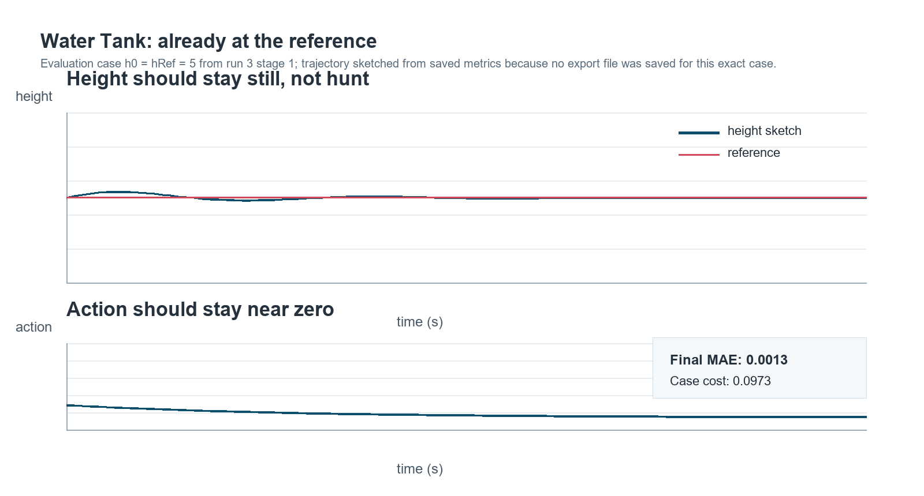
FURUTA RL UPDATE | 2026-06-17
Water Tank example: already at the reference
This case explains why precision mattered: if the tank already starts at the target, the controller should avoid unnecessary action and not create its own transient.
Source: run 3 stage 1 metrics; trajectory is a labeled sketch because this exact case was not exported
Notes:
Be explicit that the exact at-reference trajectory was not exported. The saved metrics are real; the plotted line is a simple sketch to communicate the desired behavior.

Slide 11
FURUTA RL UPDATE | 2026-06-17
Why I moved away from Water Tank
Every reward shape seemed to make one part of the grid better while making another part worse.
The one-direction actuator made the tradeoff especially visible: raising, draining, and already-at-reference behavior wanted different incentives.
The project had already served its purpose as a workflow prototype: curriculum, reset design, reward scaling, fixed evaluation, saved artifacts.
Furuta was the real target system, so the Water Tank lessons were carried forward instead of spending the whole project tuning a toy example.
Sources: RL-Water-Tank README and curriculum docs
Notes:
This should sound natural: I moved on because reward shaping started feeling like whack-a-mole across cases, not because the water tank was useless.

Slide 12
FURUTA RL UPDATE | 2026-06-17
Furuta method search: what options were on the table?
Analytical swing-up
Energy control, Lyapunov/passivity, feedback linearization, optimal control. Strong control literature; useful baseline/context.
Hybrid RL + classical
MathWorks QUBE Servo2 repo: SAC for swing-up, PPO for mode selection, feedback controller for balance.
Near-upright DDPG
First direct RL attempt: simplest continuous-action framing, but actor/critic training was fragile.
Direct TD3
Kept the same normalized action idea but added twin critics, delayed actor updates, and target smoothing.
MathWorks-style TD3
Later simplified toward the QUBE TD3 example: no curriculum, 200 Hz agent, sin/cos observations, large replay buffer.
Sources: Furuta swing-up literature note; MathWorks QUBE Servo2 refs; TD3 transition notes
Notes:
Use this to show that TD3 was a deliberate choice, not just the algorithm at hand. SAC/PPO hybrid was known, but it would have changed the architecture more radically.

Slide 13
FURUTA RL UPDATE | 2026-06-17
Early Furuta approach: good engineering, fragile learning
Started conservatively with near-upright stabilization: controller-facing errors, normalized current/torque action, explicit safety limits.
Built fixed-case post-stage evaluation, reward-diagnosis logging, signal extraction, and result organization before chasing a big demo.
DDPG did not reliably learn even local balance; TD3 was better, but fixed evaluation still showed arm-limit failures and action oscillations.
The staged direct swing-up TD3 branch showed partial learning, but reward scale and arm management were still weak.
Drawback that changed direction
Training reward could look better than fixed-case control quality.
Sources: docs/td3_transition_2026-06-10.md; docs/td3_overnight_results_2026-06-11.md; docs/direct_td3_stage1_results_2026-06-11.md
Notes:
This is a 'what I learned' slide. The early approach was not wasted: it uncovered signal, reward, timing, and evaluation problems.

Slide 14
FURUTA RL UPDATE | 2026-06-17
What changed: from fragile curriculum to MathWorks-style TD3
Earlier staged direct TD3 helped debug reward and evaluation signals, but training was slow and fragile.
The stronger path matches the MathWorks QUBE pattern more closely: no curriculum, TD3, 200 Hz agent sample time, 64-unit networks, async parallel training.
The big process improvement was fixed-case evaluation. Training reward and episode survival alone were misleading.
Reward idea
survival reward - weighted angle, velocity, action, and action-smoothing costs
Sources: docs/direct_td3_stage1_results_2026-06-11.md; docs/mathworks_style_td3_runs_2026-06-16.md
Notes:
Do not dwell too long on the formula unless asked. The important point is that the setup became stable enough to learn, then the evaluation revealed what was still weak.

Slide 15
FURUTA RL UPDATE | 2026-06-17
Evaluation matrix: 297 cases, but only four dimensions
Arm offset
Pendulum error
Arm velocity
Pendulum velocity
3 values
11 values
3 values
3 values
-45, 0, +45 deg
-180 to +180 deg
-5, 0, +5 rad/s
-10, 0, +10 rad/s
3 x 11 x 3 x 3 = 297 fixed initial-condition cases
Easy/core
theta1 = 0, small theta2, low velocities
Swing-up stress
large theta2 errors, including downward starts
Arm management
same pendulum cases with +/-45 deg arm offset
Velocity stress
same angles with arm/pendulum initial momentum
Source: full_eval_cases.csv for run_20260616_012625_td3_mathworks_style_wide
Notes:
This slide lets you avoid listing 297 cases. Say the matrix is a Cartesian product of four interpretable stress axes.

Slide 16
FURUTA RL UPDATE | 2026-06-17
Evaluation matrix is being upgraded for oscillation and energy
End theta2 behavior
End action behavior
Electrical effort
Theta2EndRMS
Theta2EndOscRMS
Theta2EndPeakToPeak
Theta2EndOscFreqHz
ActionEndRMS
ActionEndOscRMS
ActionEndPeakToPeak
ActionEndOscFreqHz
ActionDiffRMS
ElectricalAbsEnergy
MeanAbsElectricalPower
Why this matters: the old summary could say a controller survived and ended near upright, while hiding small final oscillations, action chatter, or high electrical effort.
Status: columns are now present in the PI/current analytical-active and Simscape-active rerun CSVs.
Sources: scripts/computeFurutaMetrics.m; scripts/evaluateFurutaController.m
Notes:
Use this to explain the user's newest evaluation improvement. The key is the last-second window and detrending: separate bias from oscillation amplitude.

Slide 17
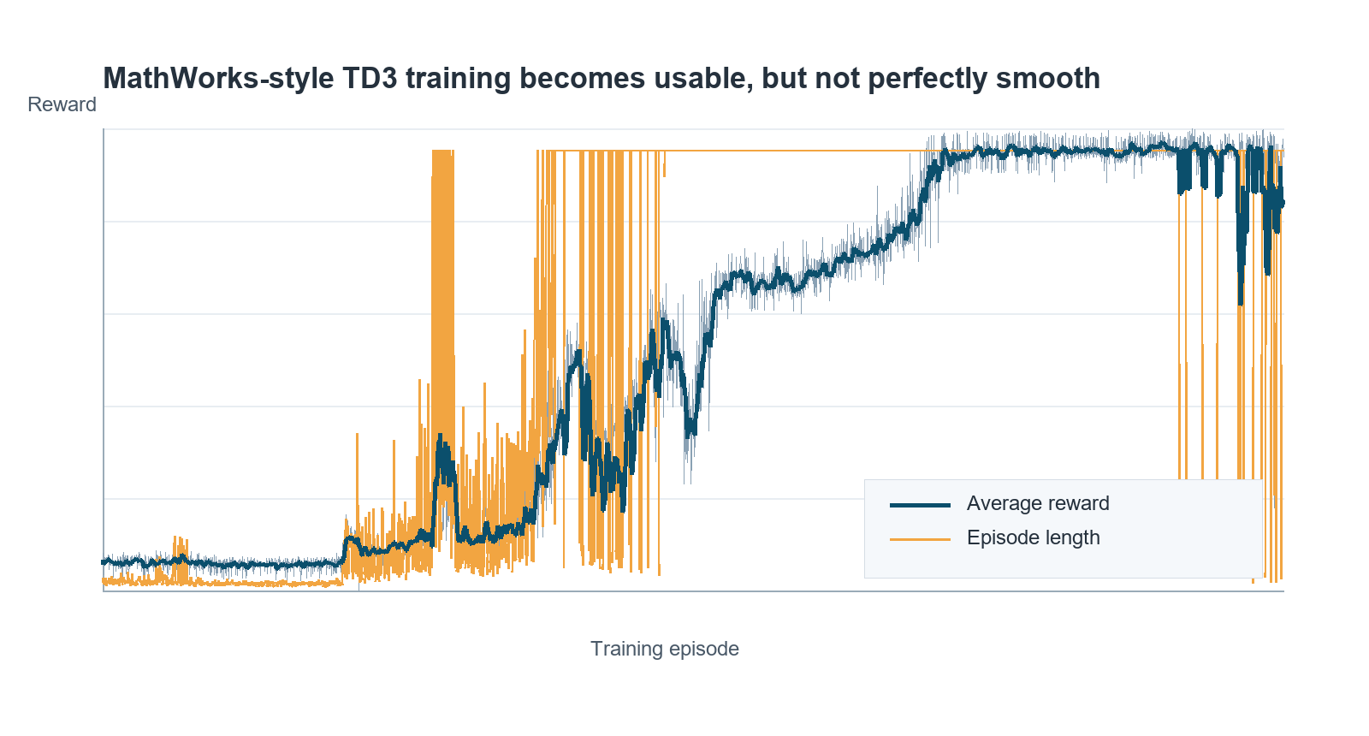
FURUTA RL UPDATE | 2026-06-17
Training result: usable, but not magic
740
43/50
3000
spiky
Final average reward
Last 50 full-length
Training episodes
Main caveat
episode 3000 snapshot
late training stability
wide randomization run
occasional collapses remain
Source: results/TD3/run_20260616_012625_td3_mathworks_style_wide/training_progress.csv
Notes:
Say: this is the first run that feels genuinely usable. But the late spikes remind us not to claim robustness just from training reward.

Slide 18
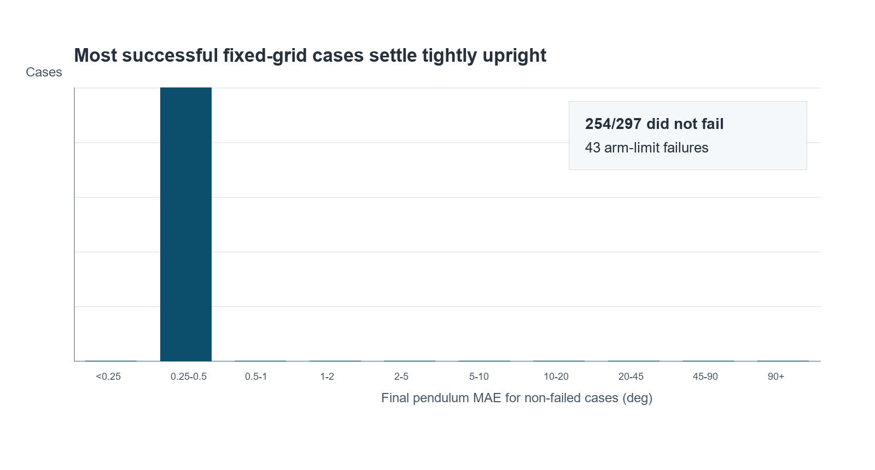
FURUTA RL UPDATE | 2026-06-17
Best current controller: PI/current path TD3
297
14.48%
0.35 deg
7.23 deg
Full fixed eval
Failure rate
Median final MAE
Mean final MAE
initial-condition cases
43/297 cases
tight when it succeeds
mean pulled by failures
Source: full_final_summary.csv and full_final_metrics.csv for run_20260616_012625_td3_mathworks_style_wide
Notes:
This is the best positive result. Make the nuance clear: successful cases are often very good, but broad robustness is incomplete.

Slide 19
FURUTA RL UPDATE | 2026-06-17
Failure mode is specific: arm management
43 failures
Exceedance margins
min 0.012 deg
median 0.312 deg
max 2.277 deg
All were arm-angle limit failures. No pendulum-limit failures. No angular-velocity-limit failures.
Interpretation: the controller can swing up and stabilize in many practical cases, but the objective still tolerates arm travel too much.
Source: meeting handoff and full_final_metrics.csv
Notes:
This is a good informal slide. It turns the failure story from vague to actionable: reward and arm constraints need attention.

Slide 20
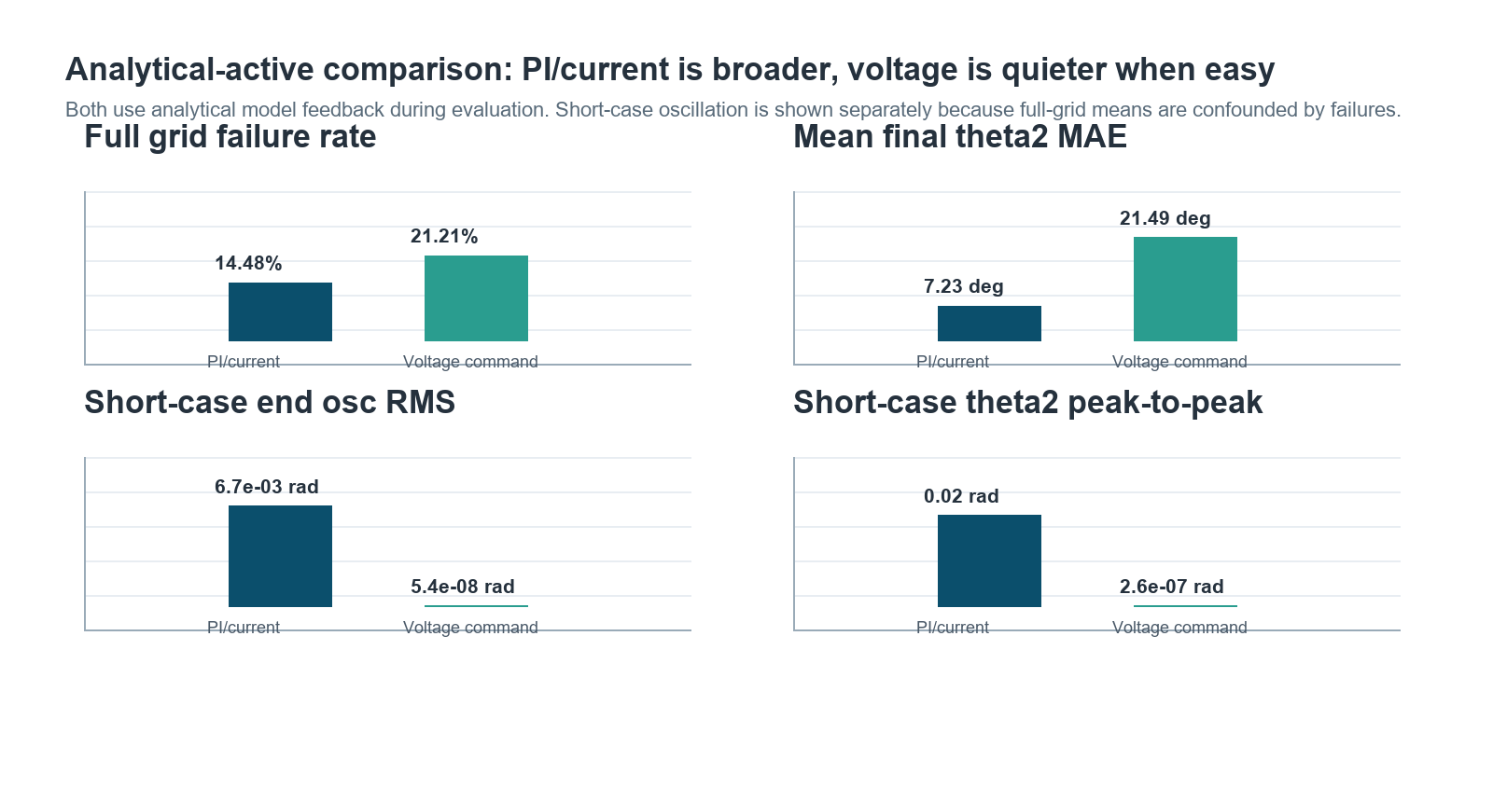
FURUTA RL UPDATE | 2026-06-17
Voltage command: quieter, but less robust on the analytical grid
Descriptive takeaway: PI/current covers more of the fixed grid. Voltage command removes almost all final theta2 oscillation in easy cases, but loses robustness on the broad analytical-active evaluation.
Sources: pi_current_analytical_active summaries; voltage_analytical_active_2 summaries
Notes:
This is the clean tradeoff slide. Say: PI/current is the safer overall policy, voltage is a useful clue about the final oscillation problem.

Slide 21
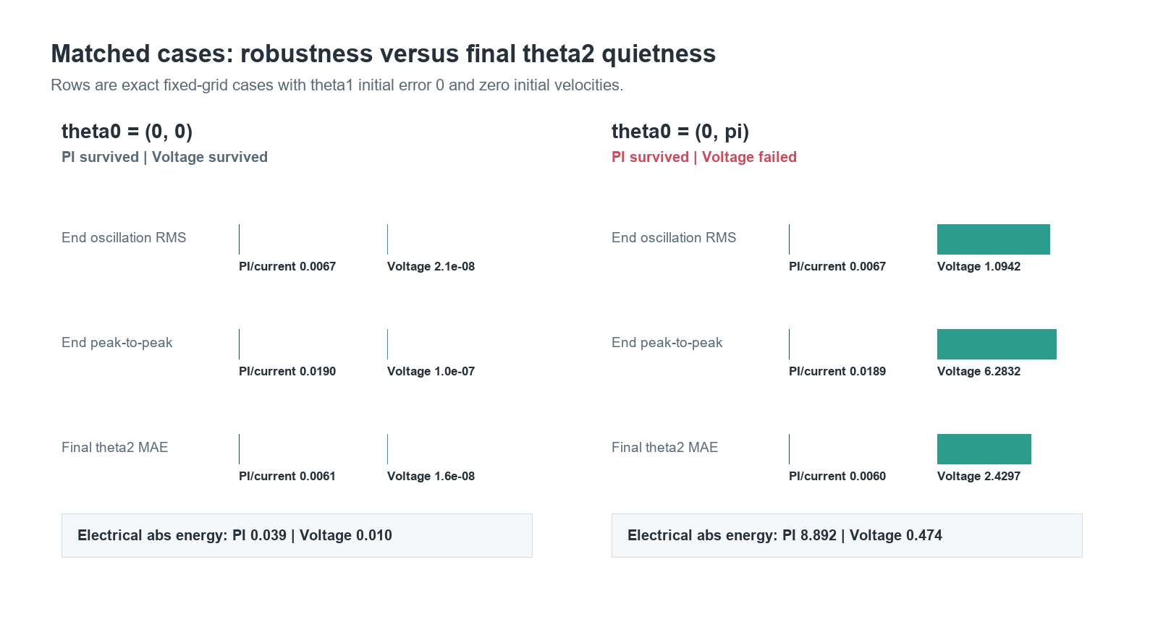
FURUTA RL UPDATE | 2026-06-17
Matched analytical cases show the tradeoff directly
theta0 = (0, 0): both survive, voltage is nearly motionless at the end. theta0 = (0, pi): PI/current survives with a small oscillation, voltage fails early.
Source: full_final_metrics.csv rows with theta1=0, theta2 in {0, pi}, omega1=omega2=0
Notes:
The per-case CSVs are metrics tables, not trajectory logs. The plot uses exact matched rows from both evaluations.

Slide 22
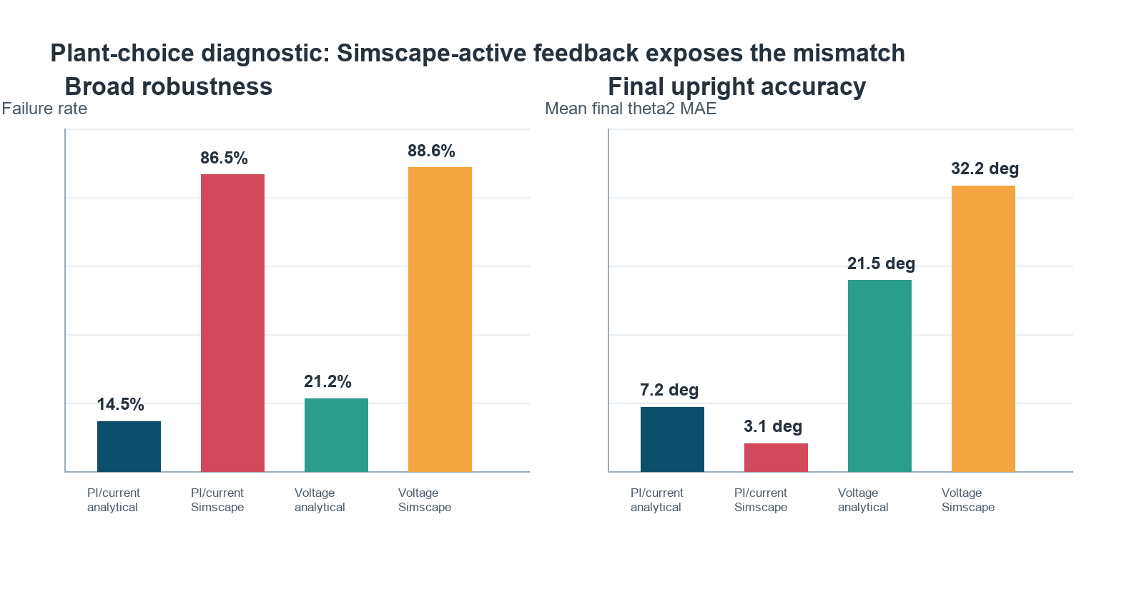
FURUTA RL UPDATE | 2026-06-17
Plant mismatch is not just a voltage-path issue
Cautious conclusion: PI/current is robust on the analytical-active plant, but Simscape-active feedback collapses broad robustness. Direct voltage is still useful diagnostically, not yet as the winner.
Sources: PI/current analytical/Simscape rerun summaries; voltage analytical/Simscape summaries
Notes:
Phrase carefully: the new PI/current rerun proves the Simscape-active problem is not only caused by the voltage command path.

Slide 23
FURUTA RL UPDATE | 2026-06-17
PI/current rerun: analytical reproduces, Simscape collapses
Feedback plant
Failure rate
Failures
Analytical-active
14.48% failure
43/297 cases
Simscape-active
86.53% failure
257/297 cases
The old PI/current result was effectively analytical-active; the explicit rerun reproduced it exactly.
The smaller Simscape mean final theta2 MAE is misleading because most hard cases fail. Lead with failure rate and breakdown.
Hardware note: this argues for plant/interface validation before hardware-oriented claims.
Sources: pi_current_analytical_active/full_final_summary.csv; pi_current_simscape_active/full_final_summary.csv
Notes:
This is the updated decision-gate slide. It replaces the pending rerun with the actual plant-mismatch result.

Slide 24
FURUTA RL UPDATE | 2026-06-17
New metrics clarify what changed and what did not
Short/easy cases
Broad/full matrix
Analytical and Simscape are very similar:
Theta2EndOscRMS about 0.0067 rad
Theta2EndPeakToPeak about 0.02 rad
Oscillation frequency about 7 Hz
Simscape-active fails much earlier/more often:
omega 5 rad/s: 66/66 failed
omega 10 rad/s: 188/198 failed
Failure rate is the headline.
Meeting phrasing: the final-second oscillation metric says easy upright behavior transfers, but the full matrix says recovery robustness does not.
Sources: PI/current analytical-active and Simscape-active rerun summaries; user-provided breakdown
Notes:
This is the clean takeaway: the new metrics did their job by separating final oscillation behavior from broad robustness.

