Slide 1
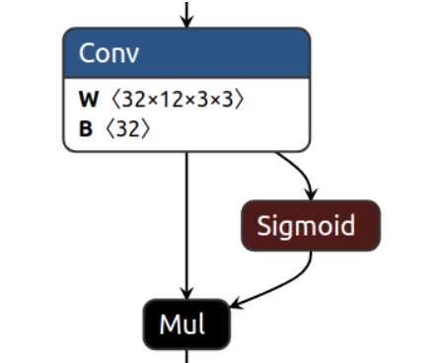
Sigmoid is
a complex
Operation
(Exponentiation
Division)
Sigmoid
Approximation is
a simple
Operation
(bit shift, …)
float input
int8 input
SiLU
QSiLUApprox
Float
operations
int8
operations
SigmoidApprox
float output
int8 output
QSiLUApprox: Quantized SIMD-Optimized SiLU Approximation vs. Standard SiLU

Slide 2
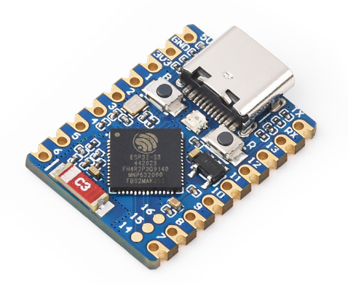
Sigmoid
Approximation is
a simple
Operation
(bit shift, …)
int8 input
QSiLUApprox
int8
operations
SigmoidApprox
int8 output
QSiLUApprox activation function
Esp32s3 mcu

