Slide 1
Sound-Radar with CNN classification

Slide 2
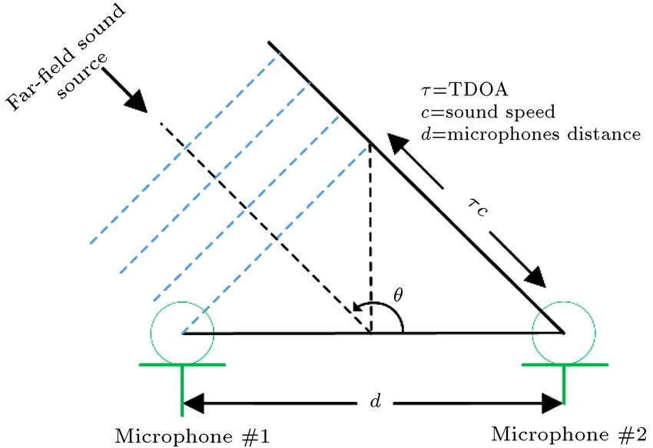
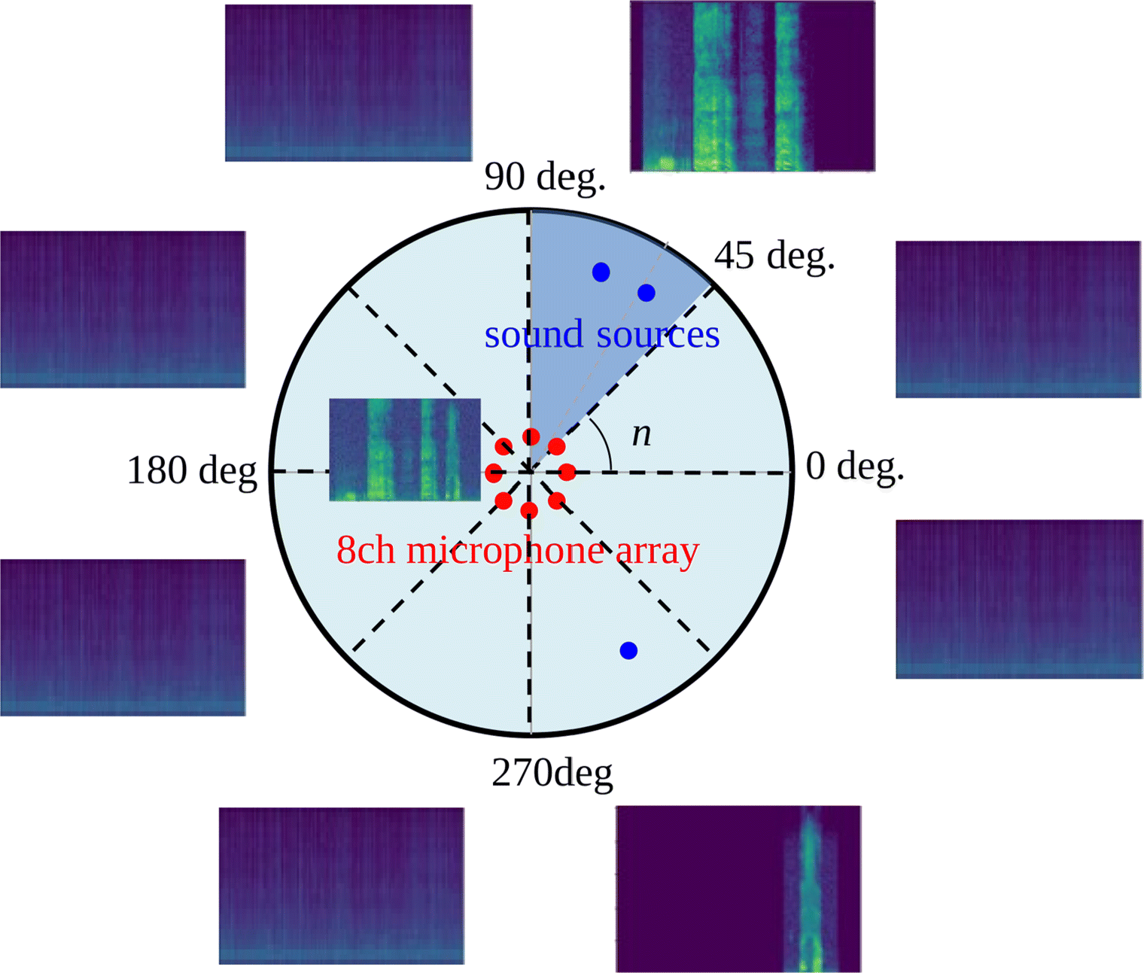
Problem
Find the direction of arrival of sound (DOA)
Give classification

Slide 3
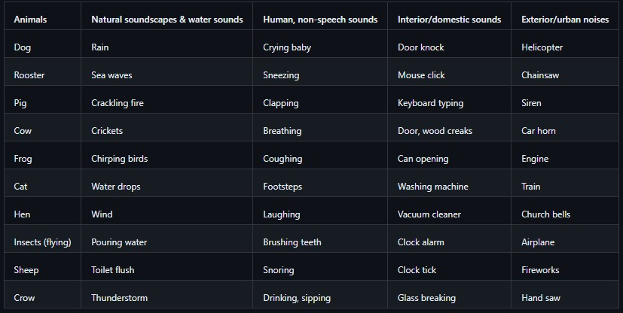
Dataset
Environmental Sound Classification 50 (ESC-50)
The dataset consists in 50 WAV files sampled at 16KHz for 50 different classes.
To each one of the classes, corresponds 40 audio sample of 5 seconds each. All of these audio files have been concatenated by class in order to have 50 wave files of 3 min. 20sec.

Slide 4
Augmentation of data
Raw audio
Audio with white noise
Augmentation
Raw audio
Mel-spectrogram
Audio with time shift
FFT
Mel scale (Human ear)
Audio with both white noise and time shift

Slide 5
Network structure
Input
Input
Input
Input
Conv2d
BatchNorm
Relu
Conv2d
BatchNorm
Relu
Conv2d
BatchNorm
Relu
Conv2d
BatchNorm
Relu
MaxPool
MaxPool
MaxPool
MaxPool
Conv2d
BatchNorm
Relu
Conv2d
BatchNorm
Relu
Conv2d
BatchNorm
Relu
Conv2d
BatchNorm
Relu
MaxPool
MaxPool
MaxPool
MaxPool
Conv2d
BatchNorm
Relu
MaxPool
Linear
Linear
Output

Slide 6
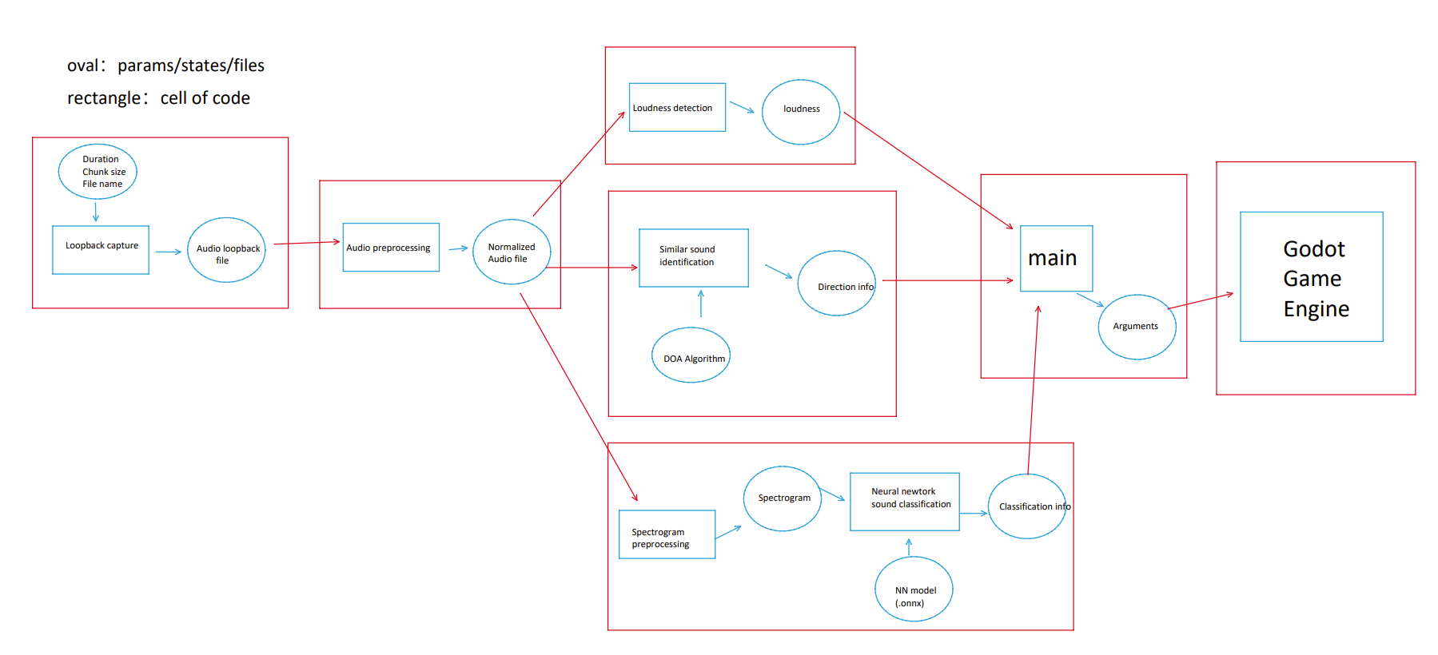
File and function structure

Slide 7
How it works?
DOA of sound
DOA of sound with type classification

