Slide 1
Interpretable sentiment analysis and detection of cognitive distortions for Chinese language
Hou Zhenghao
Notes:
The topic of my course work is <<Interpretable sentiment analysis and detection of cognitive distortions for Chinese language>>

Slide 2
Background
Interpretable sentiment analysis:
Segmentation strategy
Lexicon
Notes:
Goal of Sentiment analysis
2 steps of sentiment analysis

Slide 3
Background
Aigents sentiment analysis model:
N-grams strategy
Good performance on English and Russian text
Notes:
the unique feature of Aigents sentiment analysis
Explain the basic idea of N-grams
Narrate the previous work of aigents model with English and Russian on financial dataset

Slide 4
Background
Aigents sentiment analysis model:
N-grams strategy
Good performance on English and Russian text
What about on Chinese text?
Notes:
Tell about the difference of the logic between Chinese language and Eng/Rus, especially in segmentation

Slide 5
Segmentation Strategy
不坏的消息 不坏的 消息
Not a bad news not bad new
不 坏的 消息
not bad new
Notes:
Commom tricky phrase
Explain every single word meaning in chinese

Slide 6
Segmentation Strategy
Segmentation strategy: Jieba
不坏的消息 不坏 not bad adj.
的 aux.
消息 news noun
Notes:
What does Jieba model do to handle such trick controvercial phrase

Slide 7
Segmentation Strategy
Segmentation strategy: Jieba
不坏 not bad adj. 0.899999999
的 aux. /
消息 news noun /
Notes:
Identify the type of words and take the adj, adv, verb into account

Slide 8
Segmentation Strategy
Segmentation strategy: Jieba
不坏 not bad adj. 0.899999999
的 aux. /
消息 news noun /
Positive
Notes:
The result we got with Jieba segmentation strategy

Slide 9
Segmentation Strategy
Segmentation strategy: N-grams
N-grams=3
“不坏的” “坏的消” “的消息”
not bad bad ne- --news
(invalid) (invalid)
N-grams=2
“不坏” “坏的” “的消” “消息”
not bad bad --news news
(invalid)
N-grams=1
“不” “坏” “的” “消” “息”
not bad - other* other*
N-grams=5
“不坏的消息”
not a bad news
N-grams=4
“不坏的消” “坏的消息”
not a bad ne- bad news
(invalid)
Notes:
Let’s see how N-grams strategy handle such phrase
Be aware about the invalid combination of characters

Slide 10
Segmentation Strategy
Segmentation strategy: N-grams
N-grams=3
“不坏的” “坏的消” “的消息”
not bad bad ne- --news
(invalid) (invalid)
N-grams=2
“不坏” “坏的” “的消” “消息”
not bad bad --news news
(invalid)
N-grams=1
“不” “坏” “的” “消” “息”
not bad - other* other*
N-grams=5
“不坏的消息”
not a bad news
N-grams=4
“不坏的消” “坏的消息”
not a bad ne- bad news
(invalid)
Notes:
N-grams 5 directly matched in Lexicon

Slide 11
Improvement Needed
Segmentation strategy: N-grams
N-grams=3
“不坏的” “坏的消” “的消息”
not bad bad ne- --news
(invalid) (invalid)
N-grams=2
“不坏” “坏的” “的消” “消息”
not bad bad --news news
(invalid)
N-grams=1
“不” “坏” “的” “消” “息”
not bad - other* other*
N-grams=5
“不坏的消息”
not a bad news
N-grams=4
“不坏的消” “坏的消息”
not a bad ne- bad news
(invalid)
Positive
Notes:
We got a positve

Slide 12
Experiment
Gathered comments data from social media
Make comparison of the performance of combinations of segmentation strategies
Make comparison of the performance of Lexicon
Notes:
Three steps of experiment

Slide 13
Experiment
Comparison of segmentation strategies:
SnowNLP
Jieba
N-grams
Notes:
We control this experiment of comparison of segmentation strategies under the same Lexicon(SnowNLP)

Slide 14
Experiment
Comparison of Lexicon:
Aigents’ Lexicon
SnowNLP
Notes:
Take three segmentation strategies to check how the varying of Lexicon influence the performance of these segmentation strategies

Slide 15
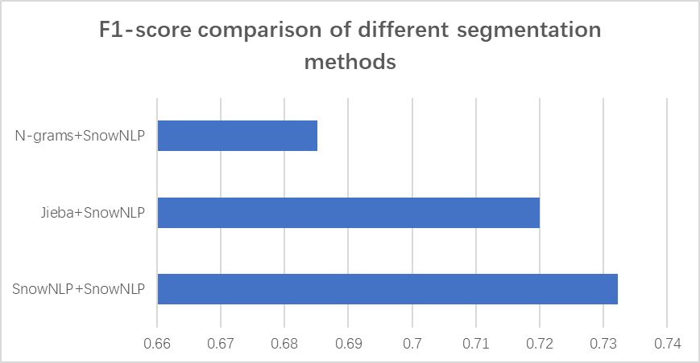
Experiment Result
Notes:
N-grams doesn’t work well with snownlp lexicon

Slide 16
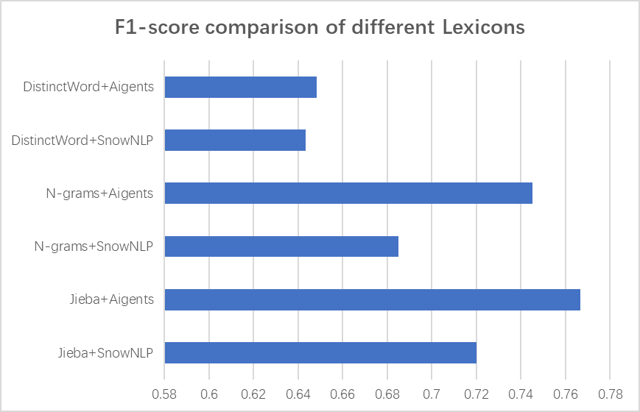
Experiment Result
Notes:
Jieba and lexicon of aigents work best

Slide 17
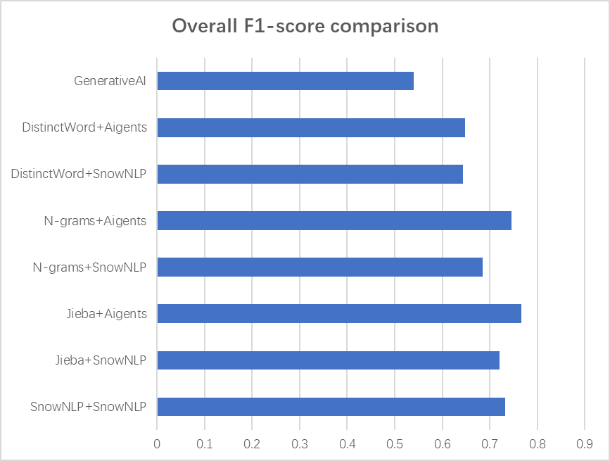
Experiment Result

Slide 18
Improvement Needed
Segmentation strategy: N-grams
N-grams=3
“不坏的” “坏的消” “的消息”
not bad bad ne- --news
(invalid) (invalid)
N-grams=2
“不坏” “坏的” “的消” “消息”
not bad bad --news news
(invalid)
N-grams=1
“不” “坏” “的” “消” “息”
not bad - other* other*
N-grams=5
“不坏的消息”
not a bad news
N-grams=4
“不坏的消” “坏的消息”
not a bad ne- bad news
(invalid)
Notes:
Roll back to page 15, why the n-grams worked bad with lexicon of snownlp

Slide 19
Improvement Needed
Segmentation strategy: N-grams
N-grams=3
“不坏的” “坏的消” “的消息”
not bad bad ne- --news
(invalid) (invalid)
N-grams=2
“不坏” “坏的” “的消” “消息”
not bad bad --news news
(invalid)
N-grams=1
“不” “坏” “的” “消” “息”
not bad - other* other*
N-grams=5
“不坏的消息”
not a bad news
N-grams=4
“不坏的消” “坏的消息”
not a bad ne- bad news
(invalid)
Notes:
The lack of rubust of n-grams require better lexicon, for this case if N-grams 5 doesn’t match, then we will got a negative result

Slide 20
Improvement Needed
Segmentation strategy: N-grams
N-grams=3
“不坏的” “坏的消” “的消息”
not bad bad ne- --news
(invalid) (invalid)
N-grams=2
“不坏” “坏的” “的消” “消息”
not bad bad --news news
(invalid)
N-grams=1
“不” “坏” “的” “消” “息”
not bad - other* other*
N-grams=5
“不坏的消息”
not a bad news
N-grams=4
“不坏的消” “坏的消息”
not a bad ne- bad news
(invalid)
Negative
Notes:
May consider the type of word to deal with Chinese text
For jieba, check only adj and adv and verb can avoid this problem in this case

