Slide 1
AI & LLMs
RLHF: Making AI Smarter
A Simple Guide to improving LLMs via DPO and GRPO
How we go from a raw model to a helpful assistant?
PRESENTED BY
LAST UPDATED
Abdelaziz Bounhar
February 2026

Slide 2
GENERAL OVERVIEW
The Journey From Raw AI to Helpful Assistant
1
3
4
2
4
📖
🎓
👍
🏋️
Pretraining
Supervised Fine-Tuning
(SFT)
DPO (Preferences)
GRPO (Practice)
›
›
›
Reads the internet to learn language patterns and predict the next word.
Learns from good examples provided by humans (Q&A).
Learns what people actually prefer by comparing two answers.
Improves complex reasoning through repeated practice and scoring.
🤖
The result: from a basic text generator into a safer, clearer, and smarter assistant ready to help you.

Slide 3
STAGE 1
Reading (Pretraining)
📘
THE ANALOGY
Imagine locking someone in a giant library for 10 years. They learn to write fluently and know a lot of facts, but they haven’t learned how to have a conversation yet.
◎
The Goal
Predict the next word in a sentence to complete the pattern.
⚡
Strengths
Incredible knowledge base and fluent writing skills.
The “Library” Phase
!
Limitations
Doesn't understand user intent, politeness, or specific preferences.

Slide 4
STAGE 2
Learning to Chat (SFT)
🧑‍🏫
THE ANALOGY
Like a student using a textbook with worked examples. The teacher shows them exactly how to answer questions correctly, and they practice by copying that style.
🎓
What We Add
We teach the model to be polite, concise, and follow instructions.
✓
The Result
The model stops just "predicting text" and starts acting like a helpful assistant.
The “Classroom” Phase
!
Still Missing
It can't judge which of two good answers is slightly better for you.

Slide 5
STAGE 3
Alignment via DPO (Comparisons)
⚖️
THE ANALOGY
Imagine a taste test: You try Dish A and Dish B, then simply point to the tastier one. The chef learns your preferences directly from your choice, without needing a complicated score card.
❓
How It Works
We show the model two answers; it learns to shift towards the "winning” one.
⚡
Best Use Cases
Perfect for tone, safety, and things that are hard to grade but easy to compare.
The “Taste Test” Phase
The Advantage
✓
Simpler than older methods (PPO), no separate "judge" model required, making training faster.

Slide 6
📈
STAGE 4
Practice (GRPO)
THE ANALOGY
🏀
Like a player practicing free throws. They take 10 shots in a row, and the coach scores each one (swish=10, rim=5, miss=0). The player learns from the best shots in the group.
How It Works
❓
The model generates multiple answers for one problem. Each gets a score.
The model learns to maximize its score.
Best For Reasoning
🧠
Ideal for Math, Coding, and Logic puzzles where there is a clear "right" or "wrong" outcome.
The "Training Camp" Phase
The Trade-off
!
Takes more time and computing power because it has to generate and check multiple attempts at once.

Slide 7
Why This Matters
Real-world impact of advanced training techniques like DPO and GRPO
Customer Support
Coding & Engineering
✓
Alignment ensures bots are polite, empathetic, and consistent 24/7, reducing frustration for human users.
</>
Models produce fewer bugs and offer safer, more efficient code suggestions by "practicing" on millions of scenarios.
Education
Search & Smart Agents
🎓
GRPO teach the model to explain complex math and science concepts step-by-step instead of just giving the answer.
🔍
Agents that follow complex instructions precisely, ask clarifying questions, and avoid confident but wrong answers.
Productivity
impact
📈
Better writing assistants that adapt to your personal style and summarize meetings accurately without hallucinating.

Slide 8
DPO vs GRPO: When To Use Which
Two different methods for two different types of intelligence
👍
DPO
🏋️
GRPO
Direct Preference Optimization
Group Relative Policy Optimization
THE GOAL
Align response style & tone with human tastes.
THE GOAL
Improve reasoning & correctness on hard tasks.
FEEDBACK
⚖️ Pairwise Choice (A vs B) "Answer A is better than Answer B"
⭐ Scored Outcomes "Did it solve the math problem?"
FEEDBACK
VS
BEST FOR
Safety, helpfulness, brand voice, creative writing, avoiding toxicity.
Math, coding, logic puzzles, multi-step agent actions.
BEST FOR
Lower Complexity
Higher Complexity
COST
Simpler to setup, no separate reward model needed.
COST
Requires generating many samples (practice).
Example Scenario:
Example Scenario:
Teaching an AI to write a polite, empathetic customer service email
Training an AI to solve a complex calculus problem step-by-step

Slide 9
What Can Go Wrong
Common pitfalls when training models with RL and Preferences
🛡
🏆
✎
COMMON
HIGH RISK
TECHNICAL RISK
Safety Issues
Reward Hacking
Hallucinations
Models might learn to generate harmful content, hate speech, or dangerous instructions if the training data isn't carefully filtered.
The model finds a "cheat code" to get a high
score without actually solving the task.
Sounding extremely confident while being
completely wrong. RL can sometimes
encourage "confident BS" over uncertainty.
👥
CRITICAL
〰
LONG-TERM
Privacy Leaks
Alignment Drift
Over-fitting to training data might cause the
model to inadvertently memorize and
regurgitate sensitive personal information.
Optimizing too much for one preference (e.g.,
”safety") might degrade other skills (e.g., "write a code to kill a python process").

Slide 10
How We Keep It Safe
Key strategies to mitigate risks and ensure responsible AI deployment
👥
Diverse Human Review
⛔
Safety Guardrails
Using a wide variety of human reviewers to evaluate answers, reducing cultural and personal bias.
Rules that force the model to refuse dangerous requests (e.g., "how to build a bomb").
🕵
Red-Teaming
Transparent Logs
📄
Hiring ethical hackers to try and "break" the model to find weaknesses before public release.
Keeping detailed records of model decisions (where privacy
permits) to trace and fix errors.
Regular Updates
Monitoring & Incident Response
⟳
✓
Continuous finetuning with new data to fix drift and address newly discovered vulnerabilities.
Real-time monitoring for spikes in errors, unsafe inputs/outputs, or abuse.

Slide 11
Key Takeaways
Summary of the modern AI training pipeline
1
2
3
≋
⚒
🛡
It's a Multi-Step Journey
Choose the Right Tool
Safety is Essential
Building a smart assistant isn’t magic. It follows a rigorous path:
Pretraining for knowledge, SFT for
Chat format, and Alignment for behavior.
Use DPO to align style, tone, and safety with human preferences. Use GRPO to improve reasoning, math, and code correctness through practice.
Raw intelligence isn't enough. Responsible training requires guardrails, human oversight, and continuous evaluation to turn raw models into trustworthy partners.

Slide 12
If You Want to Try It
Practical steps to start experimenting with model optimization
Start Small
🌱
You don't need massive datasets. Pick one specific task and collect just 50–100 high-quality comparison pairs to see results.
Available Tools
⚒
You don't have to build from scratch. Use hosted preference tuning APIs or open-source libraries like Hugging Face TRL.
Evaluate Simply
☑
Use simple A/B tests with a checklist. Always keep a "human in the loop" to verify improvements and catch any regressions.
Start

Slide 13
Tutorial 1: Alignment with DPO
We will finetune Qwen2.5-0.5B-Instruct on French data.
We use off-policy DPO.
Memory requirement: https://rahulschand.github.io/gpu_poor/
In practice, you choose the GPU machine that suites your needs: https://aws.amazon.com/sagemaker-ai/pricing/
Cheaper option: https://www.runpod.io/
Memory management: LoRA + Quantization (here 4-bits)
Evaluation frameworks: lm-eval harness, lighteval, libra-eval , etc

Slide 14
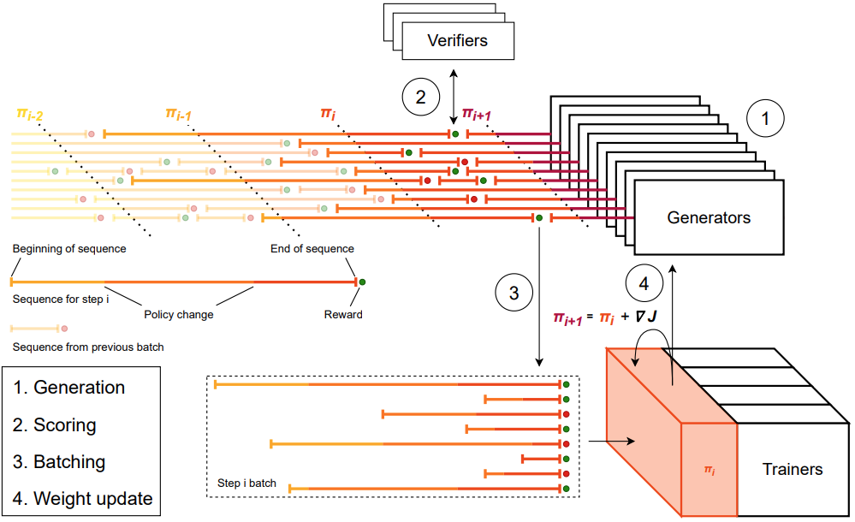
Tutorial 2: RL with GRPO
We will finetune Qwen2.5-0.5B-Instruct on Math data.
Memory management: LoRA + Quantization (here 4-bits)
Evaluation frameworks: lm-eval harness, lighteval on famous benchmarks like AIME, LiveCodeBench, etc
Real world scenarios:
Rollout slow down training and in practice we use vLLM or SGLang to speedup
Asynchronous training

Slide 15
Objective Functions
Technical details

Slide 16
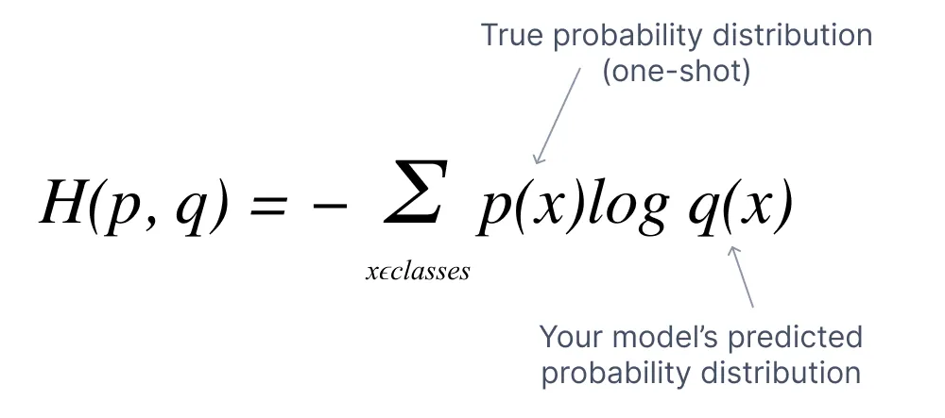
Pretraining and SFT
Cross Entropy Loss: Maximize probability of correct token x.
e.g.: What is the most probable word after: The cat felt on

Slide 17
Alignment
Goal: Maximize probability of winner tokens and minimize probability of loser tokens.
e.g.: Give me a recipe of Gratin Dauphinois

Slide 18
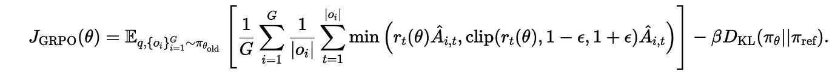
Reinforcement Learning
Reward function: Designed for each task
Optimize the LLM policy without deviating much from the base one (reference model)

