Slide 1
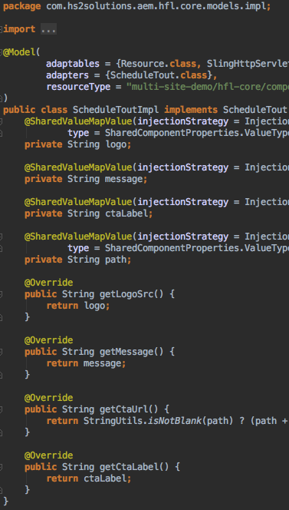


Shared Component Properties
Saying Goodbye to the Global Configs Page
Presented by: Brett Birschbach, AEM Certified Expert
Adobe IMMERSE, June 12-15, 2018

Slide 2
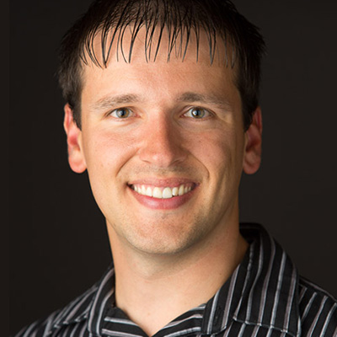

Who IS Brett Birschbach?
HS2 Solutions lead Adobe Marketing Cloud Solutions Architect, with 13 years industry experience on a wide variety of high-profile client projects.
Innovator behind several ACS AEM Commons features, including Shared Component Properties, On-Deploy Scripts, and Remote Assets (2018 AEM Rock Star Winner).
What I love about AEM: The field is wide open with opportunity for the architects and developers that choose to “own” and understand the technology.
Fun Fact: Growing up in Wisconsin, where being a Green Bay Packers fan is basically the state religion, I have a tough time relating to my clients in other parts of the country that hardly know who their football team is.
Notes for use:
Boilerplate – use as is
https://www.linkedin.com/in/brettbirschbach/

Slide 3










Who is HS2 Solutions
Our company
Our awards
Our clients
Founder led company – impassioned and visionary leadership team
225+
problem solvers and design thinkers
Big enough to deliver. Small enough to care.
Employee turnover rate of less than 5% and an average of 15 years of experience per employee
Robust Adobe Experience Cloud practice

Slide 4
Overview
What is this Shared Component Properties magic you talk about, and how does it apply to me?

Slide 5
Those Crazy Marketers…
Marketing comes to you with the following requirements…
Site-wide promotion exists on all pages of the site that use templates X or Y, totaling 50+ unique pages
Promotion content consists of:
Brand Logo
Headline Text
CTA Label
CTA URL
Must be able to change the promotion on just one page and have all other pages reflect the updates automatically
Promotion content must differ between two sites on the same AEM platform
(extra credit) It would be nice if authors could override the promotion text on one or two of the 50+ pages

Slide 6
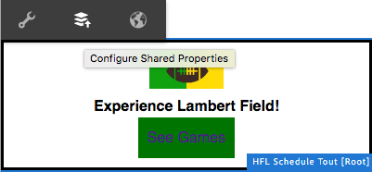
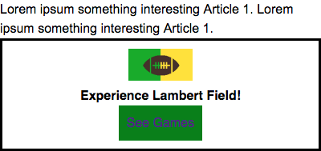
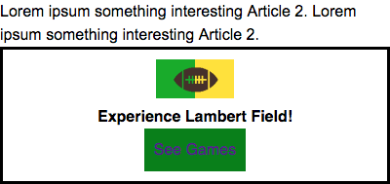
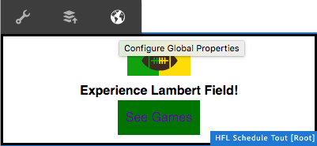

Be your Marketer’s Best Friend
Authoring options that appear OOTB
Shared content with the ability to override
Notes:
If using AEM 6.3+ might choose to use Experience Fragments - its works but is a little heavy handed for this simple use case.
Also, remember that "extra credit" ask from the previous slide? SCP is going to allow you to have instance-level overrides.

Slide 7
AEM Content Sharing
AEM has OOTB options for sharing content. Why not use those?

Slide 8
OOTB Sharing vs. Shared Component Properties?
It’s not an “either, or” proposition.
Select the right tool for the right job.

Slide 9
Content Fragments
Design and component agnostic content
Unstructured editorial content
Structured data content (e.g. store location)
Content is largely text-based, often long-form
Can be leveraged for omni-channel content, often via content APIs
Managed as a DAM Asset, outside the context of a single site
Renders via OOTB Content Fragment component

Slide 10
Experience Fragments
Composite of one or many fully configured components
Defines design and layout of content
Can be shared across multiple sites, have multiple variations within a site
Can be leveraged for omni-channel content, often as rendered via AEM’s standard HTML renderer
Managed as a experience that sits outside the context of a single site
OOTB publishing to channels such as Adobe Target, Facebook, Pinterest
Variations generally focused around channel or general context

Slide 11
Shared Component Properties
Contextual to a specific website
Contextual to a component type (sling:resourceType), or shared across all component types
Supports instance-level content overrides per field while allowing other fields to continue sharing
Practical for authoring of small text snippets such as CTA labels
Field-level granularity, with support for all field types
Can be used when extending components (including WCM Core Components)
Authoring is not conceptually separated from standard page authoring
Notes:
Demo time!

Slide 12
Reference Component?
The OOTB Reference can also be used for component-level content sharing. However, depending on your use case there can be limitations.
Reference is an ”all or nothing” deal, an exact copy of the referenced component
i.e., Cannot share a title or CTA link via the Reference component if you want the main copy to be page-specific
No ability to override shared content at an instance level
Authors must track down the single “real” version of the component to make changes
If not used carefully, Reference components can create a nasty spider web of content references across a site

Slide 13
Getting Started
Easy as 1, 2, 3

Slide 14
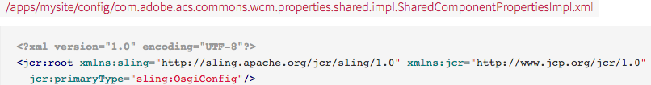
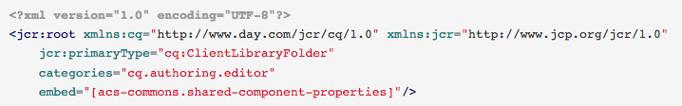
Step 1: Enable Shared Component Properties
Enable the Shared Component Properties OSGi service
Blank OSGi config
Enable the Shared Component Properties authoring clientlib
cq.authoring.editor category that embeds acs-commons.shared-component-properties
Don’t forget js.txt!

Slide 15
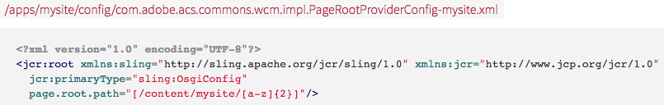
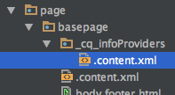
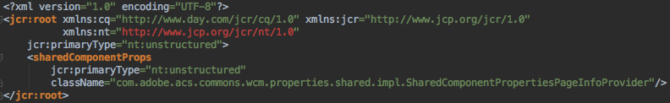
Step 2: Configure for your site
Configure an OSGi Page Root Provider service
Add Shared Component Properties page info provider

Slide 16
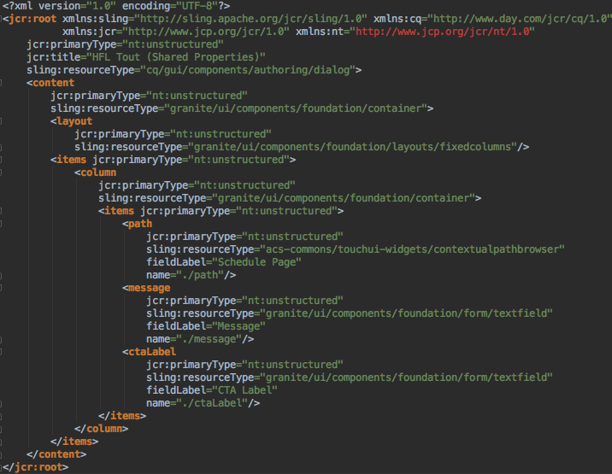
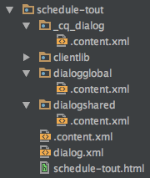
Step 3: Add Shared/Global Dialogs to Components
Shared Properties
dialogshared node, analogous to cq:dialog
Values shared within sling:resourceType
Global Properties
dialogglobal node, analogous to cq:dialog
Values shared across sling:resourceTypes
(Be careful of naming conflicts!)

Slide 17
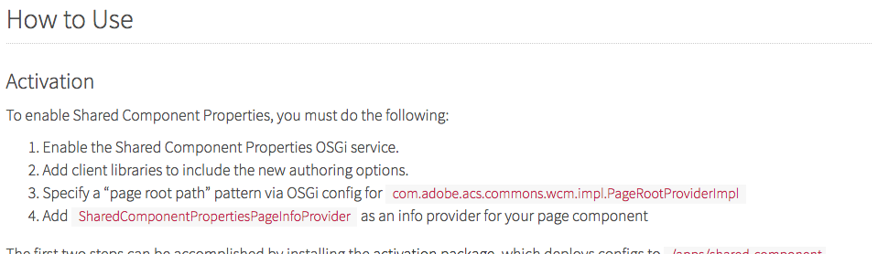
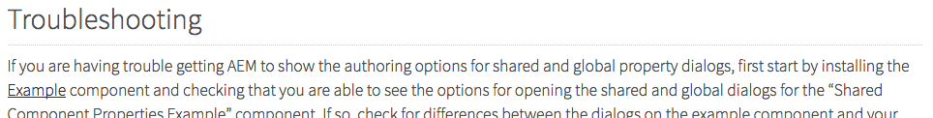
You don’t have to be a Master Builder – There’s a Manual
https://adobe-consulting-services.github.io/acs-aem-commons/features/shared-component-properties/index.html
…and of course…

Slide 18
Rendering Shared Properties
What’s the use of easy setting without easy getting?

Slide 19
Access Levels – Global, Shared, Merged
Global
Value shared across all components (agnostic of sling:resourceType)
Shared
Value shared within the sling:resourceType of the current component
Merged
Merging of all global, shared, and instance-level property values
Shared values override global values with same name
Instance-level values override shared and global values with same name
Most common access method, as it allows overrides and but still works for pure global and shared values.

Slide 20
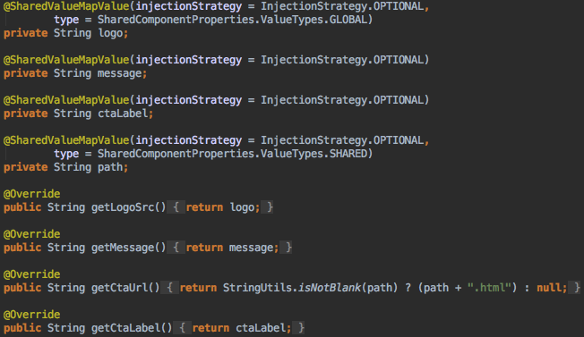
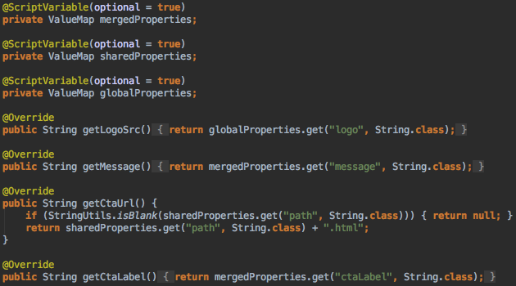
Sling Model Access
ACS Commons >= 3.17.0
@SharedValueMapValue injector
ACS Commons < 3.17.0
@ScriptVariable injector

Slide 21
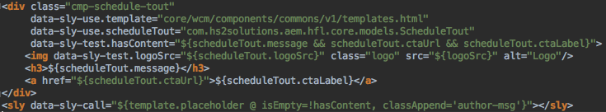
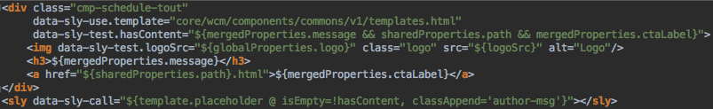
Direct HTL/JSP Access
Script variables: mergedProperties, sharedProperties, globalProperties (same as accessed in sling models)
Sling Models Access
Direct Access (no sling models)

Slide 22
Summary
The short, short version

Slide 23
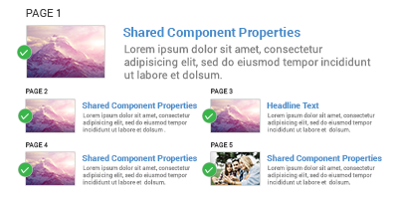
Shared Component Properties – Endless Possibilities!
Shared content across a site without an arbitrary "global configs" page or workarounds such like design dialog.
Every piece of content on the site can now be authorable, including short text snippets that are often hard-coded (form labels, CTA labels, etc.)
No need for i18n libraries – shared component properties are standard site content and can replace your hard-coded text snippets.
No need for iparsys for site header/footer (and their associated drop zones that confuse authors).
Can be used for just a portion of a component, or the entire thing.
Authors can override shared content at an instance level without breaking the overall sharing.
Say goodbye to the “global configs” page with Shared Component Properties!
Notes:
Authors set “shared” values the same exact way they set standard component values, just via clicking a different icon
There is no arbitrary separation requiring authoring on one "central" (global) page then returning to the page where the content is displayed.
I18n compliant, as opposed to leveraging design dialogs for content.
Can be used within a component (single resource type) as well as across components (multiple resource types).

Slide 24

Wrapping up
Three Key Points
Shared Component Properties leverages OOTB AEM component authoring patterns to create and maintain shared content w/o copy and paste.
SCP are extremely intuitive for authors to use, and require extremely minimal developer training to leverage.
SCP is already available to you if you have ACS AEM Commons installed.
Interested in More?
You can find the full code base I used in this presentation online at https://github.com/HS2-SOLUTIONS/hs2-aem-commons/tree/master/multi-site-demo.
Need a hand? Go to www.hs2solutions.com/contact-us and we can make time to meet!
Notes for use:
Can tailor for project

Slide 25

Thank you
Brett Birschbach
HS2 Solutions, Inc.
Phone: (773) 296-2600, x251
Email: brett.birschbach@hs2solutions.com
LinkedIn: https://www.linkedin.com/in/brettbirschbach/
Notes for use:
Tailor for project/presentation

