Slide 1
Bird Biodiversity Monitoring Through Sounds
Presented by: Ralph Diaz

Slide 2
Status Update

Slide 3
Status Update
✓
Dataset Collation
✓
Metadata Collection
✓
Building a simple CNN
✓
Experimenting with a small Dataset
✓
Build and Analyze the baseline CNN

Slide 4
Experiment

Slide 5
Dataset
Overall Dataset (Xeno-Canto)
362 Species
3,556 Overall Audio Files
Experimental Dataset
10 Species
473 Overall Audio Files
Experimental Dataset
Philippine Bulbul (60)
Balicassiao (59)
White-eared Brown Dove (57)
Luzon Hawk-Owl (51)
Philippine Coucal (45)
White-browed Shortwing (43)
Elegant Tit (42)
Long-tailed Bush Warbler (42)
White-vented Whistler (38)
Grey-backed Tailor bird (36)

Slide 6
Preprocessing
Feature: Mel Spectrogram
Target Labels: Species Identification
Additional: Audio Reduction (Spectral Gating)
Transforms
Training Data
Load Audio
Load Metadata
Resample and convert to Mono
Audio Files
Resize to fixed length
Prepare Feature and Target Labels
Audio Augmentation
Convert to Mel Spectrogram
Spectrogram Augmentation

Slide 7
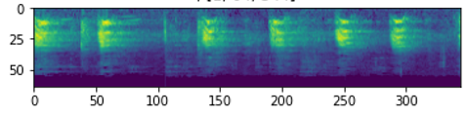
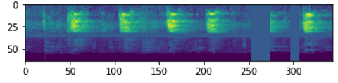
Preprocessing
Normalized Audio Specifications
Duration: 4 secs
Sample Rate: 44100
Channel: Mono

Slide 8
Data Loader
Prepare Training Data
Features (X)
Labels (Y)
Audio Files
Training Data (0.80)
Validation Data (0.20)

Slide 9
CNN Model
Since the problem is converted to a standard image classification, the CNN implemented is described by an implementation described by the MNIST database.
This will serve as the baseline so that we have clue about the dataset and CNN performance.
Data is reshaped into a format that can be inputted into the linear classifier layer, outputs predictions for 10 classes.
The model has 4 blocks of Conv2d, 2 blocks of Dropout, 1 block of AdaptiveAvgPool2d.

Slide 10
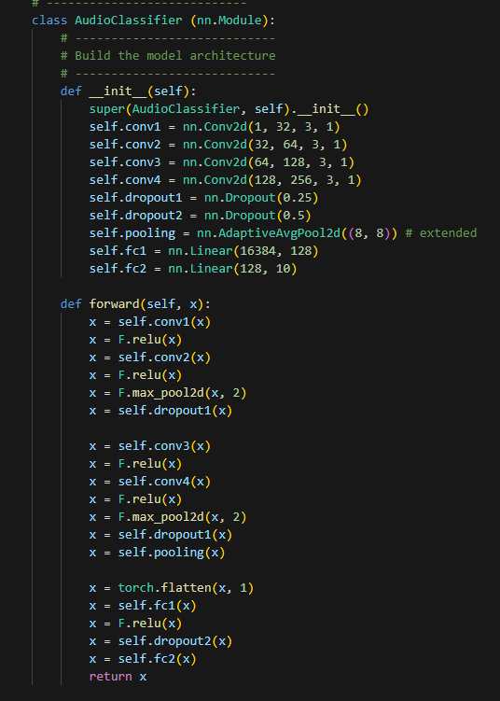

Slide 11
Mel Spectrogram

Slide 12
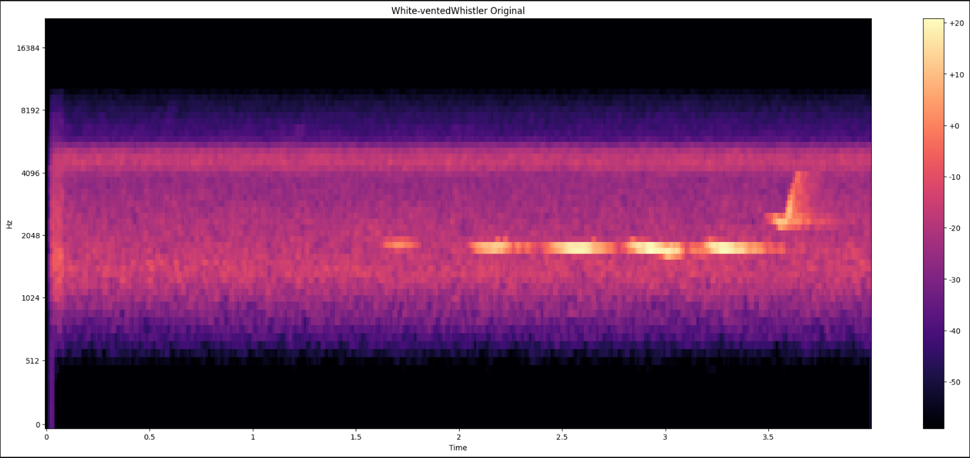
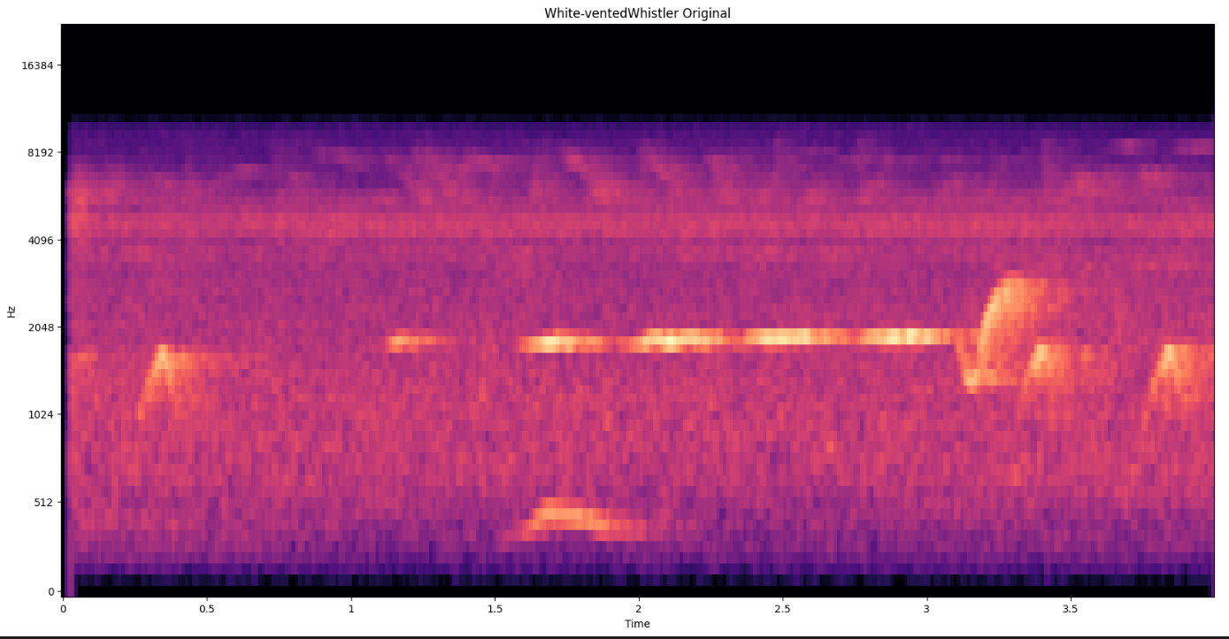
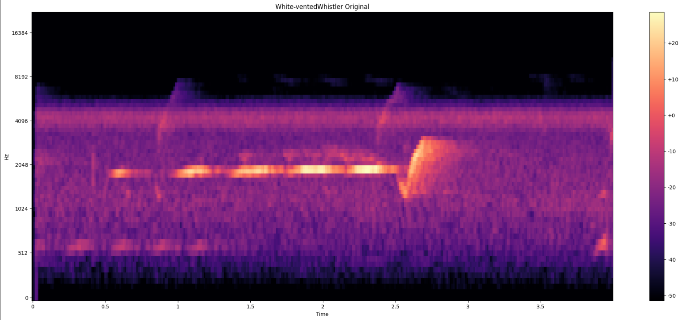
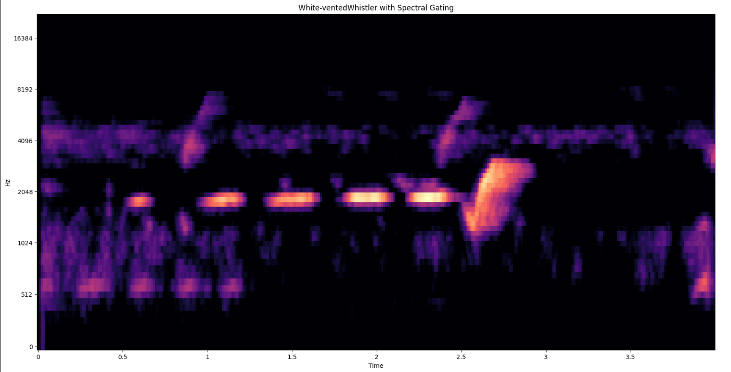
Mel Spectrograms (White-vented Whistler)

Slide 13
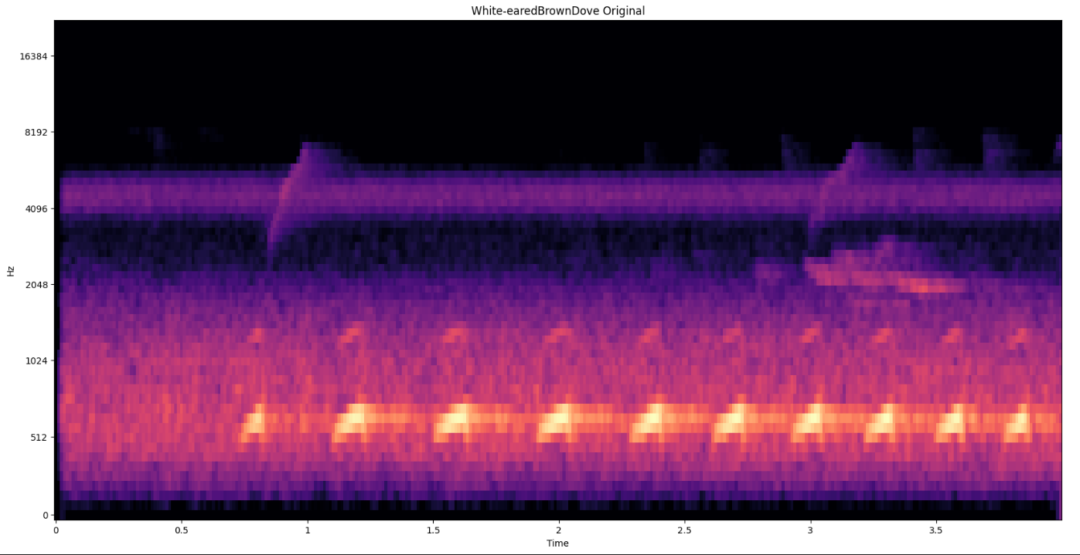
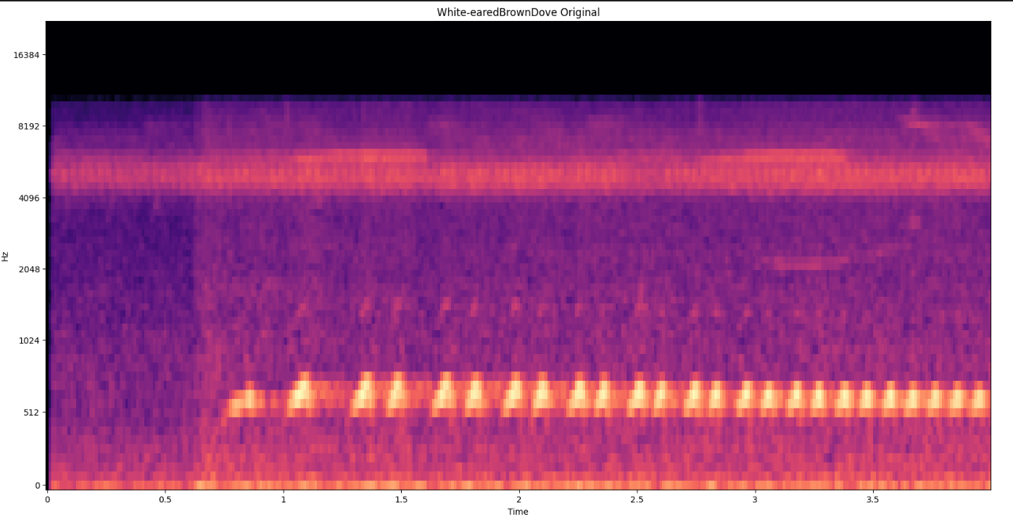
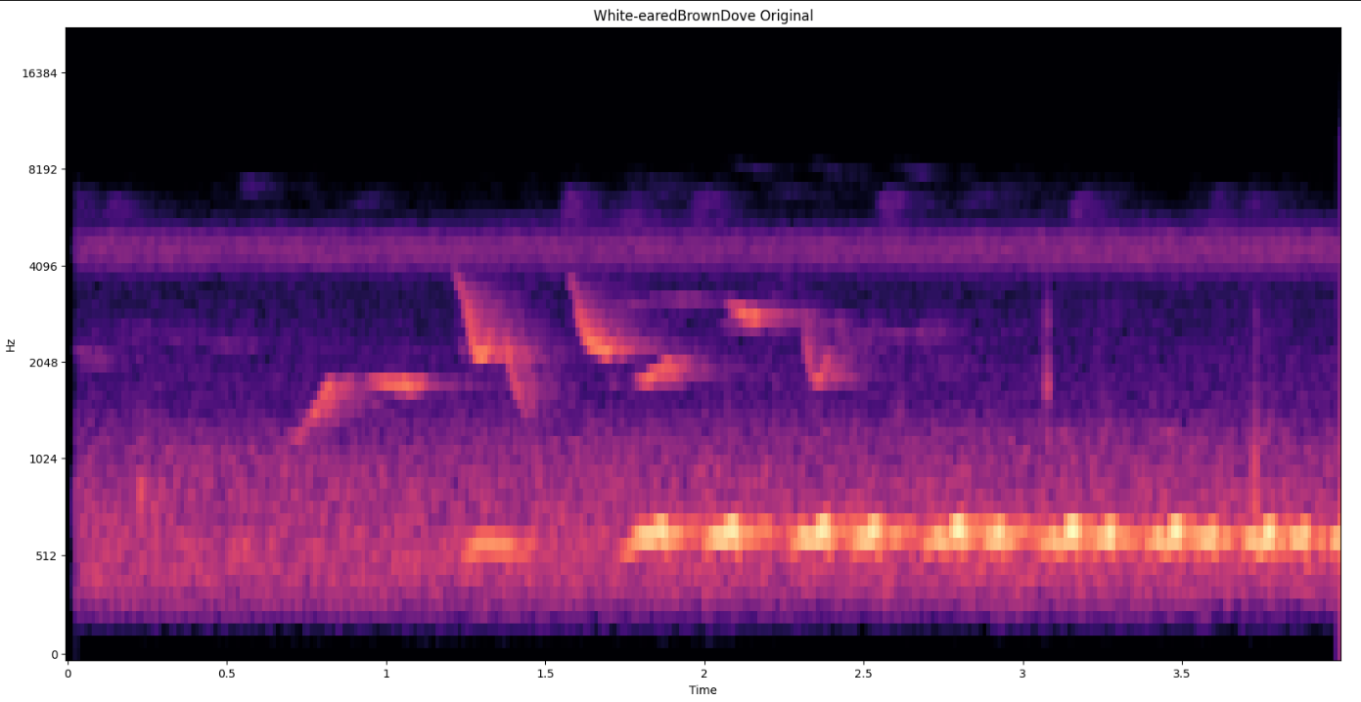
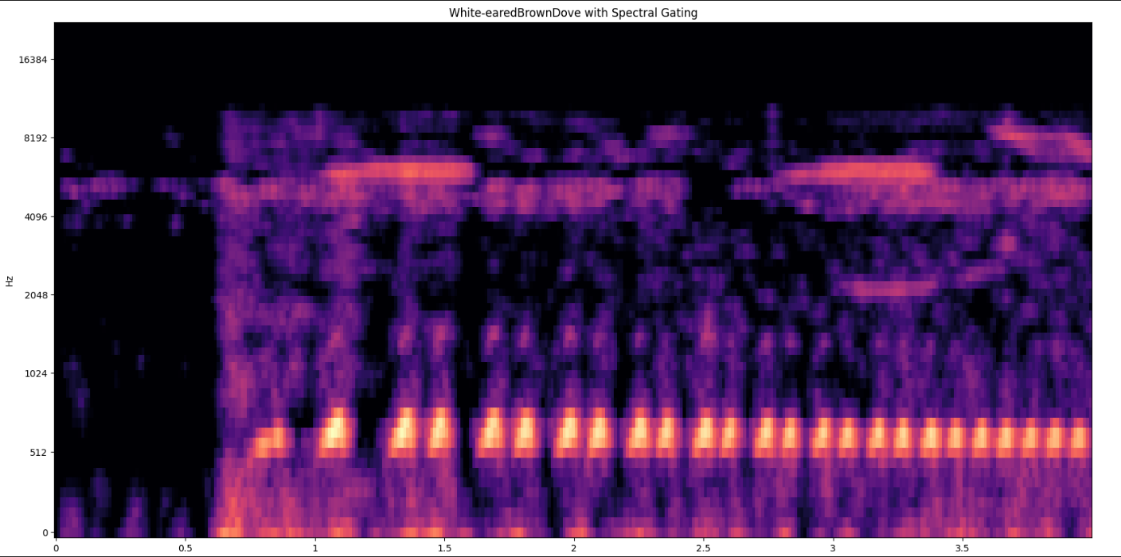
Mel Spectrograms (White-eared Brown Dove)

Slide 14
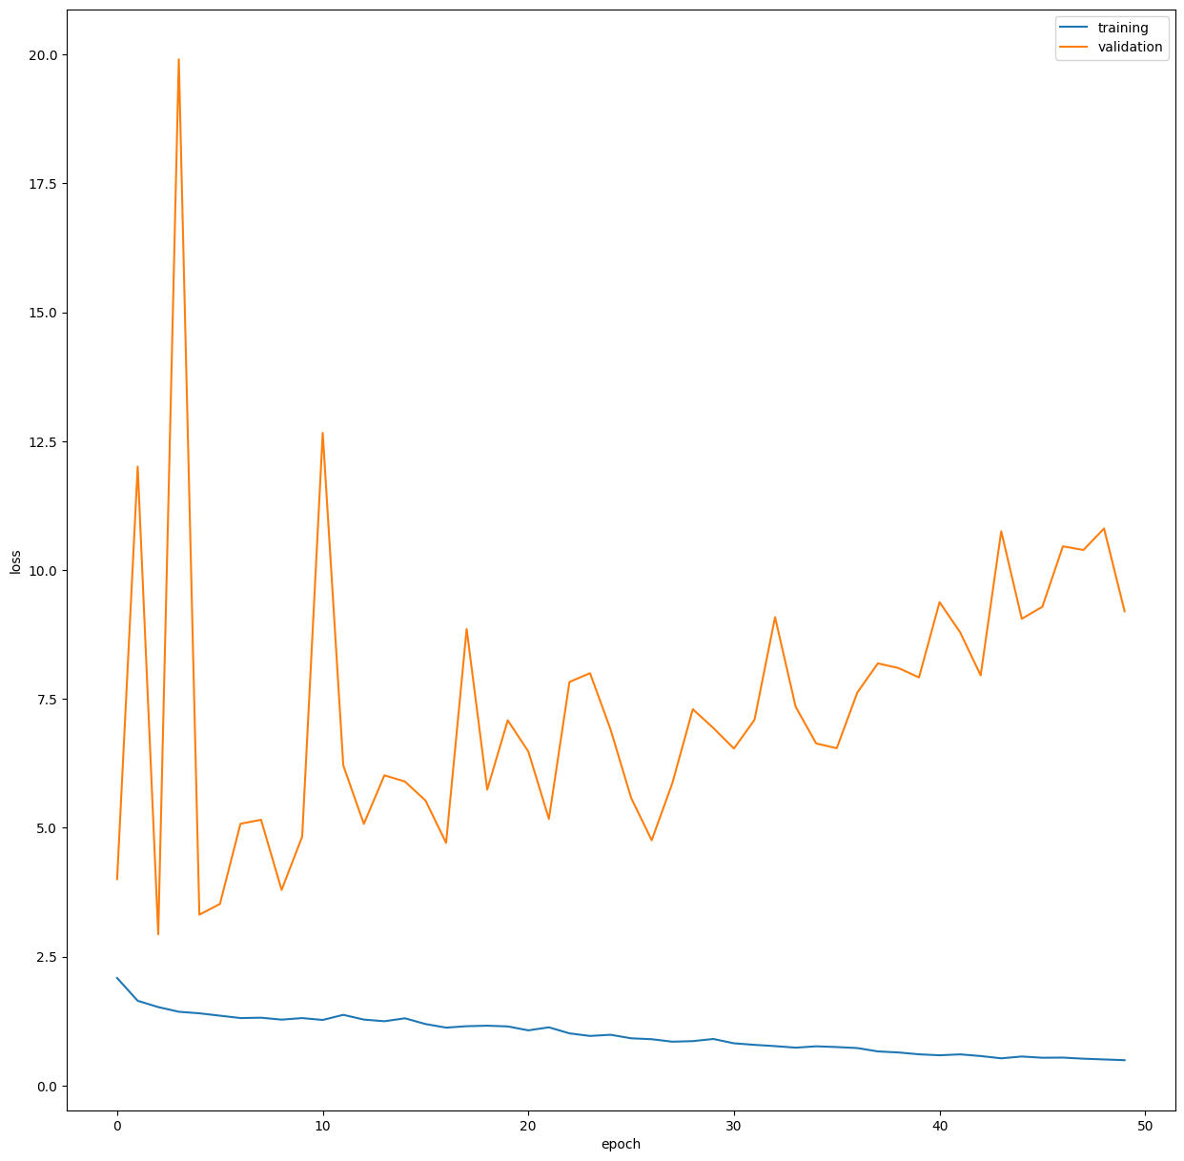
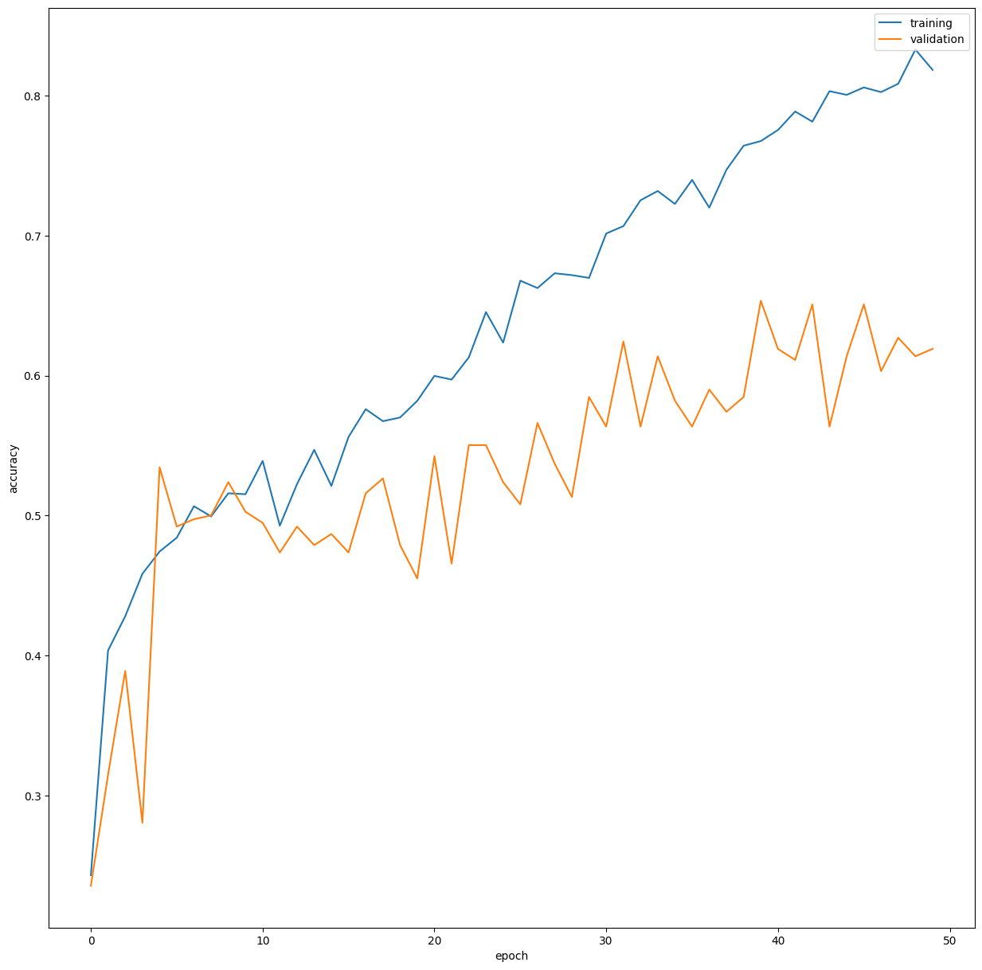
Training Results (Experiment 1)

Slide 15
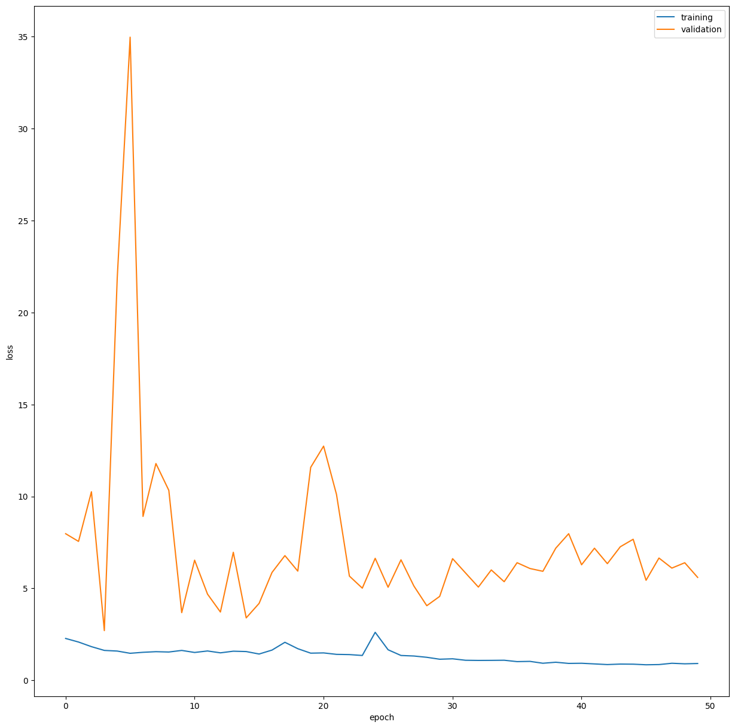
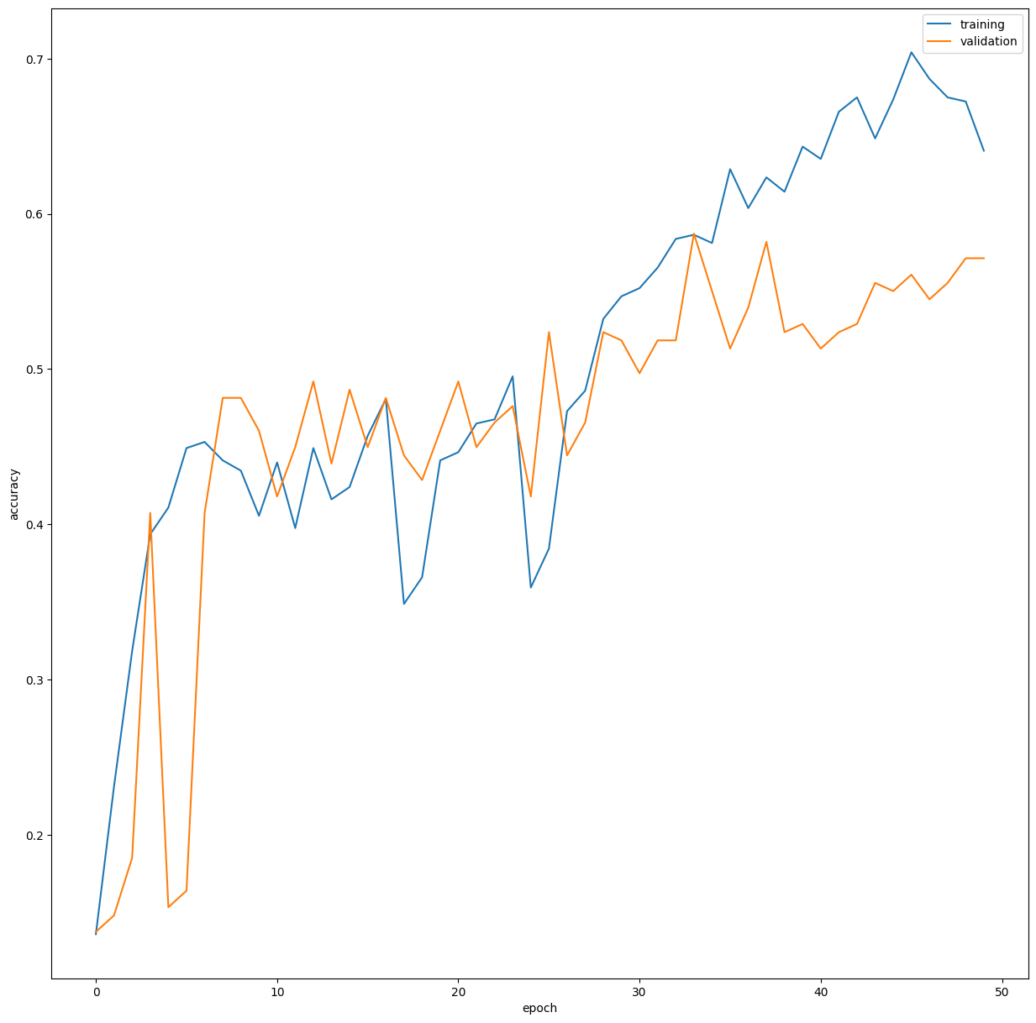
Training Results (Experiment 2)

Slide 16
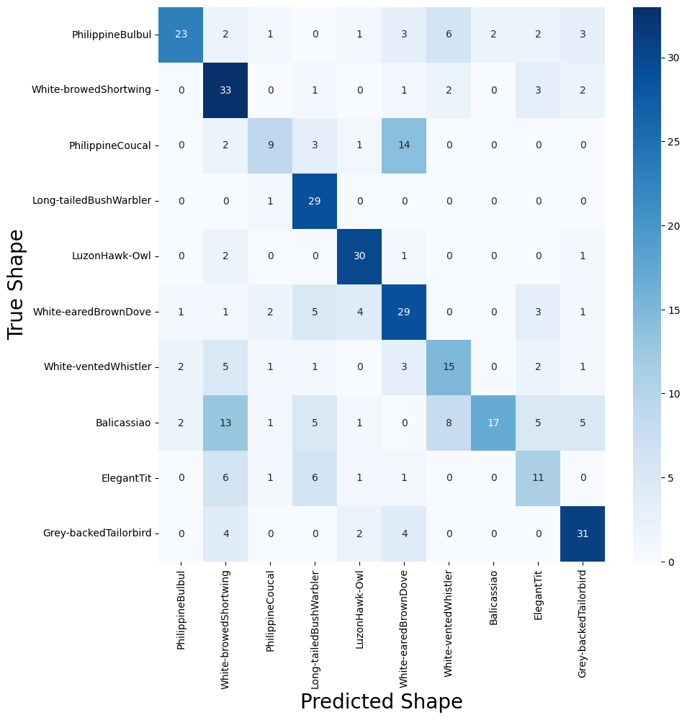
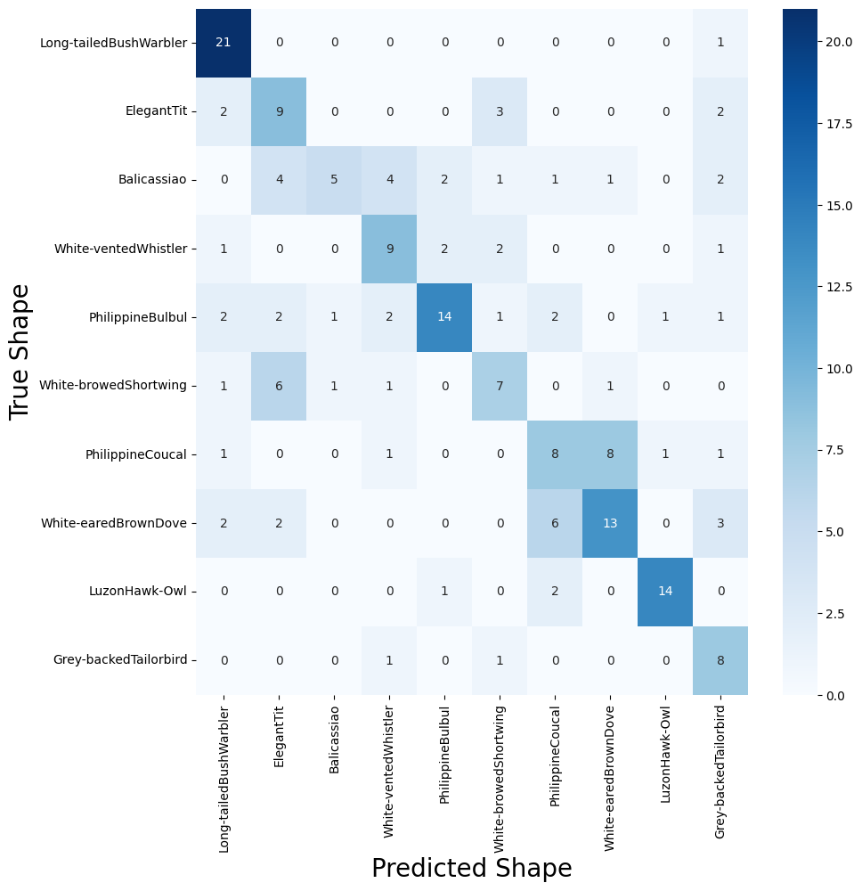
Training Results

Slide 17
Training Results
As expected, the performance of the model is not good. Based on the accuracy and validation loss, the model tends to overfit. This leads to low accuracy of the model, typically amounting to atleast 55-60%.
There is a need for improvement of the model or cleanup of the dataset.

Slide 18
References
https://www.researchgate.net/publication/367070934_Noise_Reduction_in_Audio_File_Using_Spectral_Gatting_and_FFT_by_Python_Modules
https://github.com/timsainb/noisereduce
https://www.kaggle.com/code/mauriciofigueiredo/methods-for-sound-noise-reduction#Combining-the-methods

